Slide 2
Connectivity Properties and Structure of
Random Graphs Obtained by
Vertex Percolation on
Erdős-Rényi Binomial
Random Graph
Bhaskar Ray
Dibyendu Saha
Guide: Prof. Antar Bandyopadhyay

Slide 3
Defining our graph of interest
$$𝒱_{n}≔[n]$$
1
2
$ℰ_{n}≔\{\{u,v\}|u≠v;u,v∈\left[n\right]\}$
Erdős-Rényi Random Graph
Our graph of interest
}
$Y_{e}∼Ber\left(p_{n}\right);$ $e∈ℰ_{n}$
Independent
$V(G_{ER})=𝒱_{n}$
$$Y_{\{1,5\}}∼Ber\left(p_{n}\right)$$
If $Y_{\{1,5\}}=1$, the edge
is included, else not.
6
3
$$V\left(G\right)=\{v|v∈𝒱_{n} \& X_{v}=1\}$$
$$E\left(G_{ER}\right)=\{e|e∈ℰ_{n} \& Y_{e}=1\}$$
$$E\left(G\right)=\{e=\{u,v\}|e∈ℰ_{n},$$
$$Y_{e} =1,X_{u}=1,X_{v}=1\}$$
Vertex Percolation on ER Graph
$X_{v}∼Ber\left(q_{n}\right);$ $v∈𝒱_{n}$
Denote $G∼𝒢(n,p_{n},q_{n})$
5
$$V\left(G\right)=\{v|v∈V\left(G_{ER}\right) \& X_{v}=1\}$$
4
$$E\left(G\right)=\{e=\{u,v\}|e∈E\left(G_{ER}\right),$$
$$X_{u}=1,X_{v}=1\}$$
n=6

Slide 4
Add or Remove?
Putting in vertices for which $X_{v}=1$
only
Deleting vertices for which $X_{v}=0$
from the set of n vertices
$$≡$$
Putting in each vertex with
probability $q_{n}$
Deleting each vertex with
probability ${(1−q}_{n})$
$$≡$$
Putting in edges for which $Y_{e}=1$
only
Deleting edges for which $Y_{e}=0$
from compete graph of size n
$$≡$$
Putting in each edge with
probability $p_{n}$
Deleting each edge from $K_{n}$ with
probability ${(1−p}_{n})$
$$≡$$

Slide 5
$Y_{e}∼iid Ber\left(p_{n}\right);$ $e∈ℰ_{n}$
$$X_{v}∼iid Ber\left(q_{n}\right);v∈ℰ_{n}$$
$$X_{v}^{′}s and Y_{e}^{′}s are independent$$
$$V\left(G\right)=\{v|v∈𝒱_{n} \& X_{v}=1\}$$
$$E\left(G\right)=\{e=\{u,v\}|e∈ℰ_{n},Y_{e} =1,$$
$$X_{u}=1,X_{v}=1\}$$
1
1
$$𝔼\left[\left|V\left(G\right)\right|\right]=nq_{n}$$
Result :
0
0
$\left|V\left(G\right)\right|=$ $\sum_{v∈𝒱_{n}}{1(X_{v}=1)}=\sum_{v∈𝒱_{n}}{X_{v}}$
and
$$𝔼\left(X_{v}\right)=q_{n}$$
1
1
1
1

Slide 6
$Y_{e}∼iid Ber\left(p_{n}\right);$ $e∈ℰ_{n}$
$$X_{v}∼iid Ber\left(q_{n}\right);v∈ℰ_{n}$$
$$X_{v}^{′}s and Y_{e}^{′}s are independent$$
$$V\left(G\right)=\{v|v∈𝒱_{n} \& X_{v}=1\}$$
$$E\left(G\right)=\{e=\{u,v\}|e∈ℰ_{n},Y_{v} =1,$$
$$X_{u}=1,X_{v}=1\}$$
2
$$ℙ\left(e∈E(G)\right)=q_{n}^{2}p_{n} ∀e∈ℰ_{n}$$
Result :
$$ℙ\left(e=\{u,v\}∈E(G)\right)$$
$$=ℙ\left(X_{u}=1,X_{v}=1,Y_{e}=1\right)$$
$=$ $ℙ\left(X_{u}=1)(X_{v}=1)(Y_{e}=1\right)$
$$=q_{n}.q_{n}.p_{n}$$
$$q_{n}$$
$$p_{n}$$
$$q_{n}$$

Slide 7
$Y_{e}∼iid Ber\left(p_{n}\right);$ $e∈ℰ_{n}$
$$X_{v}∼iid Ber\left(q_{n}\right);v∈ℰ_{n}$$
$$X_{e}^{′}s and Y_{v}^{′}s are independent$$
$$V\left(G\right)=\{v|v∈𝒱_{n} \& X_{v}=1\}$$
$$E\left(G\right)=\{e=\{u,v\}|e∈ℰ_{n},Y_{e} =1,$$
$$X_{u}=1,X_{v}=1\}$$
3
Result :
$$ℙ\left(e=\left\{u,v\right\}∈E(G)|X_{u}=1,X_{v}=1\right)=p_{n} ∀e∈ℰ_{n}$$
$$q_{n}$$
$$p_{n}$$
$$q_{n}$$

Slide 8
A change in perspective
It is important to observe that in each of the previous results, it didn’t matter whether we chose to remove the edges first and the vertices later or vice-versa.
$V\left(G\right)=\{v|v∈𝒱_{n} \& X_{v}=1\}$ and $E\left(G\right)=\{e=\{u,v\}|e∈ℰ_{n},Y_{e} =1,X_{u}=1,$
$$X_{v}=1\}$$
depend only on the values of $X_{v}$’s and $Y_{e}$’s
Consider an example with 5 vertices. Suppose for some $p_{n}$ and $q_{n}$, we get:
Case 1: Simulating $Y_{e}$’s first
$$X_{1}=1$$ | $$Y_{\{1,2\}}=0$$ | $$Y_{\{2,4\}}=1$$
$$X_{2}=0$$ | $$Y_{\{1,3\}}=1$$ | $$Y_{\{2,5\}}=0$$
$$X_{3}=1$$ | $$Y_{\{1,4\}}=1$$ | $$Y_{\{3,4\}}=0$$
$$X_{4}=1$$ | $$Y_{\{1,5\}}=0$$ | $$Y_{\{3,5\}}=1$$
$$X_{5}=0$$ | $$Y_{\{2,3\}}=0$$ | $$Y_{\{4,5\}}=0$$
1
5
2
4
3

Slide 9
A change in perspective
It is important to observe that in each of the previous results, it didn’t matter whether we chose to remove the edges first and the vertices later or vice-versa.
$V\left(G\right)=\{v|v∈𝒱_{n} \& X_{v}=1\}$ and $E\left(G\right)=\{e=\{u,v\}|e∈ℰ_{n},Y_{e} =1,X_{u}=1,$
$$X_{v}=1\}$$
depend only on the values of $X_{v}$’s and $Y_{e}$’s
Consider an example with 5 vertices. Suppose for some $p_{n}$ and $q_{n}$, we get:
Case 2: Simulating $X_{v}$’s first
$$X_{1}=1$$ | $$Y_{\{1,2\}}=0$$ | $$Y_{\{2,4\}}=1$$
$$X_{2}=0$$ | $$Y_{\{1,3\}}=1$$ | $$Y_{\{2,5\}}=0$$
$$X_{3}=1$$ | $$Y_{\{1,4\}}=1$$ | $$Y_{\{3,4\}}=0$$
$$X_{4}=1$$ | $$Y_{\{1,5\}}=0$$ | $$Y_{\{3,5\}}=1$$
$$X_{5}=0$$ | $$Y_{\{2,3\}}=0$$ | $$Y_{\{4,5\}}=0$$
1
5
$$p_{n}$$
2
$$p_{n}$$
$$p_{n}$$
4
3

Slide 10
$Y_{e}∼iid Ber\left(p_{n}\right);$ $e∈ℰ_{n}$
$$X_{v}∼iid Ber\left(q_{n}\right);v∈ℰ_{n}$$
$$X_{e}^{′}s and Y_{v}^{′}s are independent$$
$$V\left(G\right)=\{v|v∈𝒱_{n} \& X_{v}=1\}$$
$$E\left(G\right)=\{e=\{u,v\}|e∈ℰ_{n},Y_{e} =1,$$
$$X_{u}=1,X_{v}=1\}$$
4
Result :
$$G|{\left(X_{v}\right)}_{v∈𝒱_{n}}∼𝒢(|V\left(G\right)|,p_{n})$$

Slide 11
Not Connected
Not Connected
Connected
Simulating for n=30, qn=0.6, pn=0.14
Not Connected
Connected
Not Connected

Slide 12
Estimating the connectivity probability
For fixed values of $p_{n}$ and $q_{n}$, simulate 1000 graphs
Estimate connectivity probability, ${\hat{p}}_{con.}=\frac{Number of connected graphs}{Total number of simulaed graphs}$

Slide 13
Computational Optimization for
Simulating ‘large’ graphs
Even with the above optimization of getting rid of simulating redundant $Y_{e}$ values, the computational complexity is huge for all practical purposes as it involves:
Simulating the Bernoulli random variables
Storing the simulated graph
Performing a graph algorithm to determine connectivity.
A change in perspective brings all of it down to a single step

Slide 14
Computational Optimization for
Simulating ‘large’ graphs
Observation: Connectivity is invariant under isomorphism.
Hence, we may re-label the vertices after simulating $X_{v}$’s by re-labelling the vertices for which $X_{v}=1$ as 1, …, $|V\left(G\right)|$ and re-labelling the rest as
$\left(\left|V\left(G\right)\right|+1\right),…,n$.
Also, from Result 4, given $X_{v}$’s, $G∼𝒢(\left|V\left(G\right)\right|,p_{n})$
It is thus sufficient to know $\left|V\left(G\right)\right|=\sum_{v∈𝒱_{n}}{X_{v}}$, which follows $Bin(n,q_{n})$

Slide 15
Computational Optimization for
Simulating ‘large’ graphs
We shall devise an algorithm equivalent to (Breadth First Search) for $\left|V\left(G\right)\right|$ vertices
Choose a vertex to begin with. Label this as the active vertex and the others as unexplored.
It can have an edge with the remaining $(|V\left(G\right)|−1)$ vertices, each w.p. $p_{n}$.
Re-label to keep the connected ones first and the rest next. Hence, it is sufficient to know how many new vertices got connected from the old vertex. Label the newly connected vertices as active, and the old vertex as explored. Number of new vertices that got connected follows $Bin(\left|V\left(G\right)\right|−1,p_{n})$.

Slide 16
Computational Optimization for
Simulating ‘large’ graphs
We shall devise an algorithm equivalent to (Breadth First Search) for $\left|V\left(G\right)\right|$ vertices
Explored
Pick an active vertex and simulate for edges between it and the other vertices, excluding the explored ones.
It is redundant for the sake of connectivity to simulate for edges between two active vertices as they are already connected to the explored set.
Active
Unexplored

Slide 17
Computational Optimization for
Simulating ‘large’ graphs
We shall devise an algorithm equivalent to (Breadth First Search) for $\left|V\left(G\right)\right|$ vertices
At step $i$, let number of explored, active and unexplored vertices be $e_{i},a_{i}≠0,d_{i}≠0$ respectively. Then,
$e_{i+1}=e_{i}+1$
$a_{i+1}=a_{i}−1+A_{i}$ where $A_{i}∼Bin(d_{i},p_{n})$
$d_{i+1}=d_{i}−A_{i}$
Explored
$$e_{i}$$
Active
$$a_{i}$$
Unexplored
$$d_{i}$$
Case 1: $a_{i}=0, d_{i}≠0$
This means there are no more active vertices that can connect the unexplored to the explored. The graph is disconnected.
Case 2: $a_{i}≠0, d_{i}=0$
This means there are no more vertices left to connect. The graph is connected.

Slide 18
Connectivity in Erdős-Rényi Random Graph
Theorem (Connectivity Threshold): Let $G∼𝒢\left(n,p_{n}\right)$. Then,
$$\lim_{n→∞}{ℙ_{𝒢\left(n,p_{n}\right)}\left(G is connected\right)=\left\{\begin{aligned}0 ;\frac{p_{n}}{{log(n)}/n}→0 \\ 1 ;\frac{p_{n}}{{log(n)}/n}→1\end{aligned}\right.}$$
Theorem (Behavior around critical window):
Fix $t∈ℝ$ and $λ_{n}=log\left(n\right)+t$;
$$\lim_{n→∞}{ℙ_{𝒢\left(n,\frac{λ_{n}}{n}\right)}\left(G is connected\right)=exp\{−exp\left(−t\right)\}}$$

Slide 19
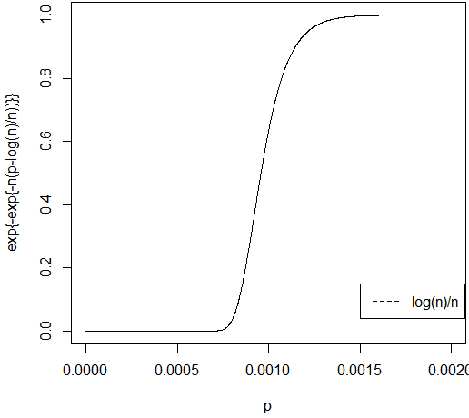
Connectivity in Erdős-Rényi Random Graph
Theorem (Alternate version of Theorem related to critical window):
Fix $p∈\left(0,1\right);$
$$ℙ\left(G is connected\right)=exp\left\{−exp\left\{−n\left(p−\frac{\log\left(n\right)}{n}\right)\right\}\right\}(1+o\left(1\right))$$

Slide 20
Connectivity in our Graph
We have, $G∼𝒢(n,p_{n},q_{n})$
However, we also know, $G|{\left(X_{v}\right)}_{v∈𝒱_{n}}∼𝒢(|V\left(G\right)|,p_{n})$
Connectivity is an increasing property for Erdős-Rényi Random Graphs, whereas it is not so for graphs obtained by vertex percolation.
So, for now, we restrict ourselves to studying connectivity properties as functions of $p_{n}$ for given values of $n$ and $q_{n}$.

Slide 21
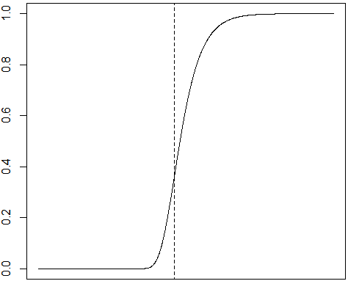
Connectivity in our Graph
We have, $G∼𝒢(n,p_{n},q_{n})$
However, we also know, $G|{\left(X_{v}\right)}_{v∈𝒱_{n}}∼𝒢(|V\left(G\right)|,p_{n})$
If we let $𝔼\left(\left|V\left(G\right)\right|\right)=nq_{n}→∞$, we may observe a behavior of the connectivity probability similar to that in case of ER graph.
$$\frac{log(nq_{n})}{nq_{n}}$$

Slide 22
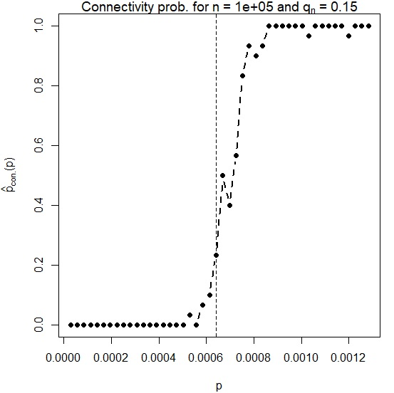
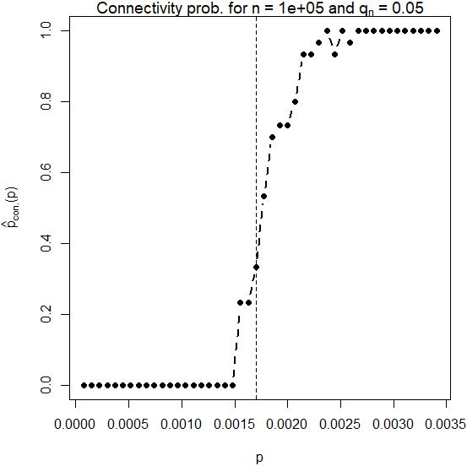
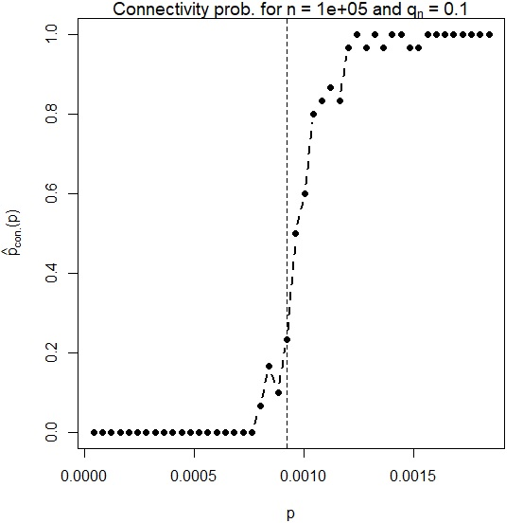
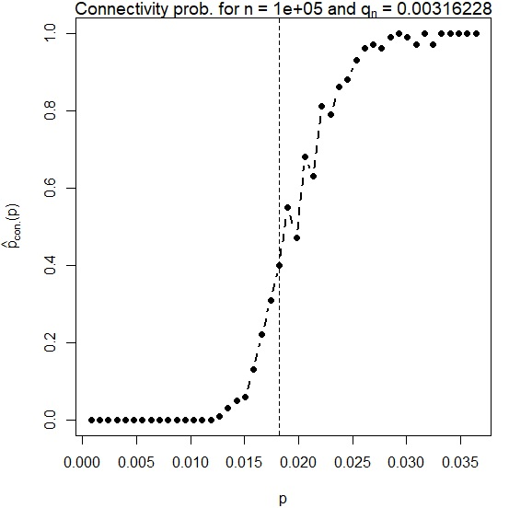
Simulation 1:
Fix a ‘large enough’ $n$.
Fix a $q_{n}∈(0,1)$
Simulate to estimate connectivity probability, ${\hat{p}}_{con.}$ for a set of values of $p∈(0,1)$
Plot ${\hat{p}}_{con.}(p)$ vs $p$.
Observations:
The connectivity probability apparently stays 0 up to a certain value of $p$ and then increases steadily to 1, for some values of $q_{n}$.
The transition of connectivity probability from 0 to 1 takes place around $\frac{log(nq_{n})}{nq_{n}}$.

Slide 23
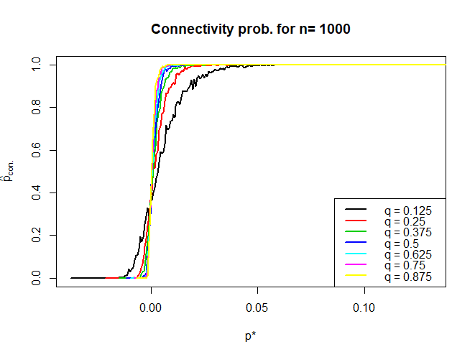
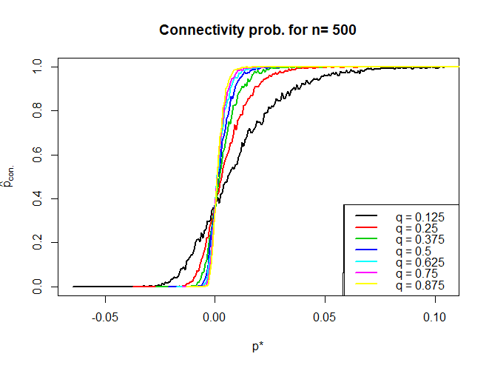
Simulation 2:
For each value of $n$, fix a set of values of $q_{n}$ to simulate.
For each $q_{n}$,
Follow Simulation 1 to obtain values of ${\hat{p}}_{con.}(p)$ vs $p$.
Fit ${\hat{p}}_{con.}\left(p\right)=exp\left\{−exp\left\{−δ_{n}(p−c_{n})\right\}\right\}$ using IRLS method to obtain estimates ${\hat{c}}_{n}$ and ${\hat{δ}}_{n}$.
Plot ${\hat{p}}_{con.}(p)$ vs $p^{∗}≔p−{\hat{c}}_{n}$ in the same plot.
Observations:
The connectivity probability stays 0 up to a certain value of $p$ and then increases steadily to 1, confirming observation from Simulation 1.
The connectivity probability behaves like it has a threshold.
For increasing value of $q_{n}$, the transition from 0 to 1 gets steeper.
$$q_{n}$$ | Multiple Correlation
0.125 | 0.9998685
0.250 | 0.9999298
0.375 | 0.9999158
0.500 | 0.9999595
0.625 | 0.9999591
0.750 | 0.9999464
0.875 | 0.9999696
$$q_{n}$$ | Multiple Correlation
0.125 | 0.9997871
0.250 | 0.9998905
0.375 | 0.9998995
0.500 | 0.9999568
0.625 | 0.9999508
0.750 | 0.9999827
0.875 | 0.9999582

Slide 24
Our guess: Since $𝔼\left(\left|V\left(G\right)\right|\right)=nq_{n}$, and based on the previous results and observations, we might guess that if $nq_{n}→∞$, for $p∈(0,1)$,
$$ℙ_{𝒢\left(n,p,q_{n}\right)}\left(G is connected\right)$$
$$→exp\left\{−exp\left\{−nq_{n}\left(p−\frac{\log\left(nq_{n}\right)}{nq_{n}}\right)\right\}\right\}$$
Simulations to follow:
Fitting a functional form to the connectivity probability.
Investigating for different functional forms of $q_{n}$.
Investigating the degree of fit and whether ${\hat{c}}_{n}$ and ${\hat{δ}}_{n}$ are in accordance with our guess

Slide 25
Conjecture 1:
Let $G$ be a random graph such that
$$V\left(G\right)≔\left\{v│v∈𝒱_{n} \& X_{v}=1\right\}$$
$$E\left(G\right)≔\{e≔\{u,v\}|e∈ℰ_{n} \& X_{u}=1,X_{v}=1,Y_{e}=1\}$$
and
$$\lim_{n→∞}{𝔼\left[\left|V\left(G\right)\right|\right]=∞}$$
i.e., $nq_{n}→∞$ as $n→∞$
Then,
$$\lim_{n→∞}{ℙ\left(G is connected\right)=\left\{\begin{aligned}0 ;\frac{p_{n}}{{log(nq_{n})}/{nq_{n}}}→0 \\ 1 ;\frac{p_{n}}{{log(nq_{n})}/{nq_{n}}}→∞\end{aligned}\right.}$$

Slide 26
Conjecture 2:
Fix $t∈ℝ$ and $λ_{n}=log\left(nq_{n}\right)+t$. Provided that $nq_{n}→∞$ as $n→∞$,
$$\lim_{n→∞}{ℙ_{𝒢\left(n,\frac{λ_{n}}{nq_{n}},q_{n}\right)}\left(G is connected\right)=}exp\{−exp\left(−t\right)\}$$

