Slide 1
Financing management of fecal sludge from onsite latrinesin Bangladesh
Soumya Balasubramanya, Barbara Evans, Ahasan Habib, Rizwan Ahmed, N.S.A. Asad, Richard Hardy, Miller Alonso Camargo Valero, Digbijoy Deb, Sharmin Ubaid
November 3, 2015
Centre for Research on the Economics of Climate, Food, Energy and Environment

Slide 2
DISCIPLINES
Economics
Environmental Engineering
Business Development
Social Entrepreneurship
Civil Engineering
Microbiology
Public Health
Chemical Engineering
WASH (practitioner)

Slide 3
Research partners: IWMI-CGIAR; University of Leeds; NGO Forum for Public Health; Bangladesh University of Engineering and Technology; BRAC; ICDDR-B; Mati Organics
Funding: Government of Netherlands
Implementation partner: BRAC
Policy partner: National Committee for Fecal Sludge Management Policy, Government of Bangladesh (Ministry of Local Government); IRC
PURPOSE:
Guide BRAC’s efforts in FSM
Guide IRC’s research agenda
Feed results into policy in Bangladesh

Slide 4
Managing sludge from rural pit toilets
How can the cost of managing sludge be shared between households and governments?
Onsite structures:
  emptied + transport
  treatment and disposal: co-composting (Local Govt./BRAC run composting businesses from MSW; expanding)
http://www.theguardian.com/global-development/gallery/2015/feb/27/bangladesh-toilet-waste-high-value-compost-in-pictures

Slide 5
Many latrines, no safe disposal
 |  |  | Rural | Urban
Sanitary with water seal |  |  | 22.9 | 48.2
Sanitary without water seal |  |  | 33.9 | 33.5
Non-Sanitary/ Kutcha |  |  | 35.1 | 16.2
Open defecation |  |  | 8.2 | 2
Census of GoB, 2011
No sewerage in rural areas
All toilets are on-site (mostly single pit)
Managed dumpsite➔ authorized dumping of raw sludge
99% of rural households’ waste dumped raw
 |  |  | Rural | Urban
Managed dumpsite |  |  | 13.4 | 47.7
Unmanaged dumpsite |  |  | 55.3 | 36.1
Bury inside pit |  |  | 30.5 | 15.8
Burn |  |  | 0.8 | 0.4
Census of GoB, 2011

Slide 6
Policy Questions
How do rural households currently dispose sludge?
What are the health risks from raw sludge?
Would households be willing to pay for scheduled emptying and collection of sludge?
What collection and transportation model works best for rural areas?
What are the costs of emptying and transporting sludge?
What subsidy is needed for managing rural fecal sludge?
At what points do subsidies need to be targeted to ensure emptying and transportation?
Can a co-compost be made from fecal sludge?
Is this co-compost safe for use in agriculture?
What are the costs of producing co-compost?
Is there a market for such a product?

Slide 7
Household study
Upazila with high number of pits/sq.km
  Bhaluka (Mymensingh)
Cross-sectional study
  1,110 households with single-pit latrines (BRAC)
  Toilets ~ 5 years old
  44 villages.
  Random sample (40% of BRAC households)
Data
  Latrine management practices (inc. payments)
  Base bid; follow-up bid
  GIS data for toilets
  Perceptions about pit emptying/sludge management

Slide 8
Summary statistics
Table 3: Summary statistics for sample of households
 |  |  |  |  |  | Mean | Std Dev
No. of family members |  |  |  |  |  | 4.56 | 1.71
% households where highest education is
 | Class 1-5 |  |  |  |  | 0.34 | 0.47
 | Class 6-10 |  |  |  |  | 0.46 | 0.5
 | Class 11-12 |  |  |  |  | 0.08 | 0.27
 | Beyond Class 12 |  |  |  |  | 0.05 | 0.22
No. of concrete liners in the pit |  |  |  |  |  | 2.36 | 1.14
Annual household income (USD) |  |  |  |  |  | 1245.61 | 1077.83
No. Women/household making toilet-management decisions |  |  |  |  |  | 1.17 | 0.66
% households with non-farming income source |  |  |  |  |  | 0.67 | 0.47
% households with brick walls |  |  |  |  |  | 0.68 | 0.47
% households with metal sheet roof |  |  |  |  |  | 0.97 | 0.17
Source: Authors' data

Slide 9
Household behaviors

Slide 10
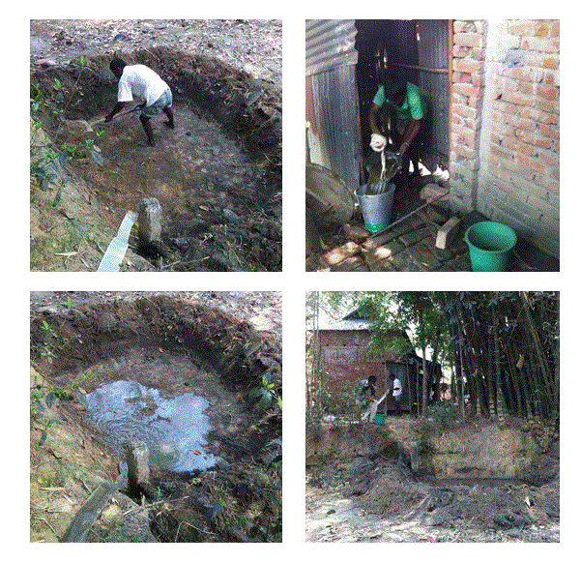
Household behaviors (2)
Table 4: Pit management of households emptying pit at least once (n=222)
 |  |  |  |  |  | Obs | Mean | Std Error
No. times pit was emptied |  |  |  |  |  | 222 | 2.07 | 0.23
% households that hired sweeper for emptying pit |  |  |  |  |  | 222 | 0.88 | 0.06
% households that paid sweeper when hired |  |  |  |  |  | 195 | 0.99 | 0.02
% households that dumped waste next to their house |  |  |  |  |  | 222 | 0.9 | 0.06
% households that reused buried waste |  |  |  |  |  | 198 | 0.03 | 0.03
Table 5: Pit management of households yet to empty their pits (n=827)
 |  |  |  |  |  | Obs | Mean | Std Error
% households planning to hire sweeper when pit fills |  |  |  |  |  | 827 | 0.91 | 0.03
% households planning to dump waste near their house |  |  |  |  |  | 827 | 0.91 | 0.03
% households that plan to build a new pit |  |  |  |  |  | 827 | 0.06 | 0.02

Slide 11
What are households paying now?
Asked pit emptiers how they charge a fee
Asked household what they had paid when emptied (n=222)
 |  |  |  |  | Effect | Std Error
Family size |  |  |  |  | 10.46 | 7.12
Highest schooling
 | Class 1-5 |  |  |  | 69.08 | 65.65
 | Class 6-10 |  |  |  | 65.10 | 61.83
 | Class 11-12 |  |  |  | 62.21 | 83.07
 | Beyond Class 12 |  |  |  | 13.48 | 95.91
No. of concrete liners in the pit |  |  |  |  |  | 9.57
Annual household income (USD) |  |  |  |  | 0.05 | 0.03
No. Women/household making toilet-management decisions |  |  |  |  | 22.01 | 21.24
Household has a non-farm source of income (Indicator) |  |  |  |  | 42.46 | 24.33
Household lives in dwelling with brick walls (Indicator) |  |  |  |  | -25.37 | 29.52
Household lives in dwelling with roof of metal sheets (indicator) |  |  |  |  | 10.78 | 68.21
Age of the pit latrine |  |  |  |  | 20.10 | 12.14
N |  |  |  |  | 185
Prob> F |  |  |  |  | 0.0004
R-squared |  |  |  |  | 0.15
Lower bound WTP |  |  |  |  | 337.28 | 48.45

Slide 12
Estimating willingness to pay
Would households pay for organized emptying and collection?
Randomly assigned bids to households in a village
Base bid | Follow-up bid | base bid accepted | Follow-up bid | base bid rejected
400 | 600 | 300
600 | 700 | 400
700 | 800 | 600
800 | 1000 | 700

Slide 13

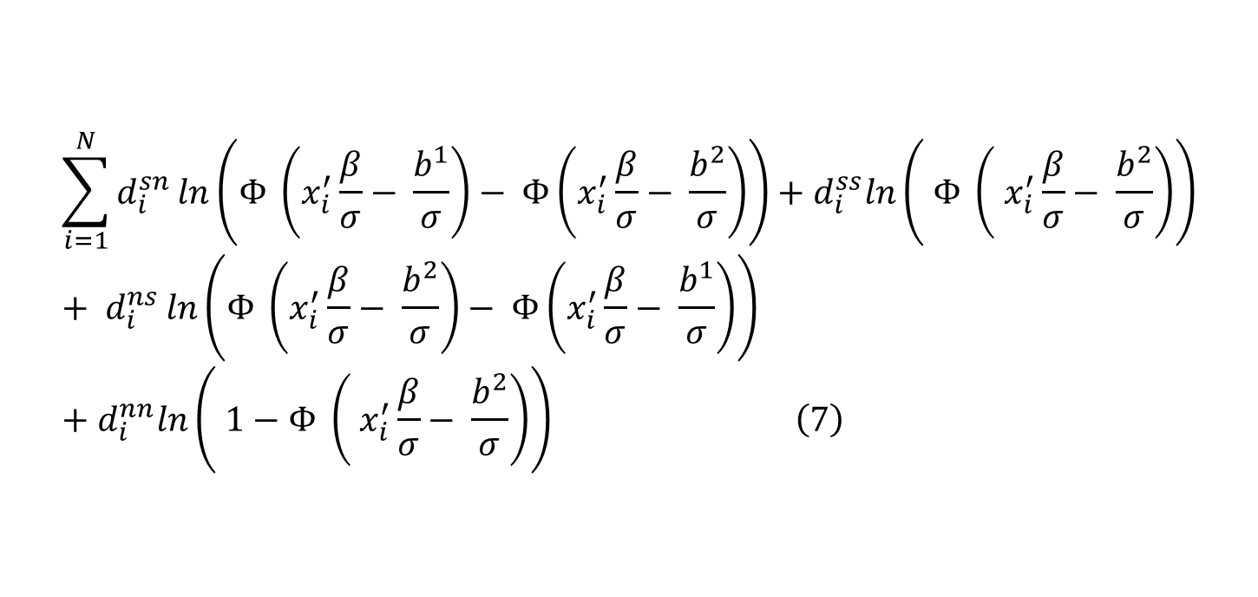
Estimating willingness to pay
$$\sum_{i=1}^{N}{d_{i}^{sn }ln\left(Φ \left(x_{i}^{′}\frac{β}{σ}− \frac{b^{1}}{σ}\right)− Φ\left(x_{i}^{′}\frac{β}{σ}− \frac{b^{2}}{σ}\right)\right)}+d_{i}^{ss}ln\left( Φ \left( x_{i}^{′}\frac{β}{σ}− \frac{b^{2}}{σ}\right)\right)+ d_{i}^{ns }ln\left(Φ \left(x_{i}^{′}\frac{β}{σ}− \frac{b^{2}}{σ}\right)− Φ\left(x_{i}^{′}\frac{β}{σ}− \frac{b^{1}}{σ}\right)\right)+d_{i}^{nn}ln\left( 1−Φ \left( x_{i}^{′}\frac{β}{σ}− \frac{b^{2}}{σ}\right)\right) \left(7\right)$$
$$\hat{WTP}= x^{′}\hat{β}$$

Slide 14
Estimating willingness to pay
Table 6: Upper bound on WTP for emptying and transportation
 |  |  |  |  | Number of samples = 100
 |  |  |  |  | Number of obs/ sample = 100
 | Observed | Boostrap |  |  | Normal-based | Bias-corrected
 | Coeff | Std Err | z | P > |z| | 95% CI | CI
WTP | 506.66 | 13.15 | 38.54 | 0.000 | 480.89-532.42 | 482.80-534.01
Simple probit using the base bids and their responses: BDT 436 (24)

Slide 15
Emptying and Transport Costs
Estimate volume of sludge generated by population a year
Identify viable emptying options
Identify viable transporting options
Four options emerge: estimate capital costs and operational costs for each (‘model’ calculates the number of pits to be emptied; equipment; labor needed..)
25 year period

Slide 16
Emptying and Transport Costs
Study Area
  Bhaluka Upazilla
  95 Villages in 11 Unions; population approx. 400,000
  Approx. 95,900 households
Data used:
    Census 2011 (population)
    Survey data (latrine practices and features)
    GPS data (distances, state of roads etc.)

Slide 17
Emptying options
Assessed mechanical methods of emptying pits
  Diaphragm pumps
  Gulpher
  Diesel
  Electric
Worked with local pit emptiers
  emptied near full and half-full pits
  Observations
  Debriefing sessions
  DWASA emptiers

Slide 18
 |  |  |  | Gulpher | Diaphragm | Diesel | Electric
Capital costs/ Purchasing costs (BDT) |  |  |  | 10-15K | 25-30K | 20-25K | 10-15K
Energy requirements |  |  |  | None | None | Diesel | Electricity
Maintenance costs (annual, BDT) |  |  |  | 1-2K | 1-2K | 3-5K | 2-3K
Ease of use in rural areas |  |  |  | Difficult | Easy | Difficult | Easy
Ease of handling |  |  |  | Difficult | Easy | Difficult | Difficult
Minimun labour requirement (per pit) |  |  |  | 2 | 1 | 2 | 1
Van needed for transporting pump |  |  |  | Yes | No | Yes | No
Ideal pit depth |  |  |  | 3-5ft | 3-10 ft | 10-15 ft | 3-10 ft
Pit emptying charges (per pit; BDT) |  |  |  | 0.5-1.5K | 0.5-1.5K | 1.5-2K | 1.5-2K
Spillage during emptying |  |  |  | Yes | No | Yes | Yes
Probability of damaging latrine during use |  |  |  | High | Low | Med | Low
Preparation time (minutes) |  |  |  | 15-20 | 10-15 | 20-30 | 15-20
Pit emptying time (minutes) |  |  |  | 20-30 | 15-20 | 5-10 | 101-5
Hand emptying vs diaphragm pump

Slide 19
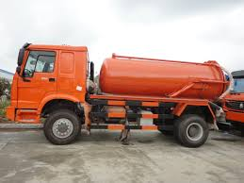
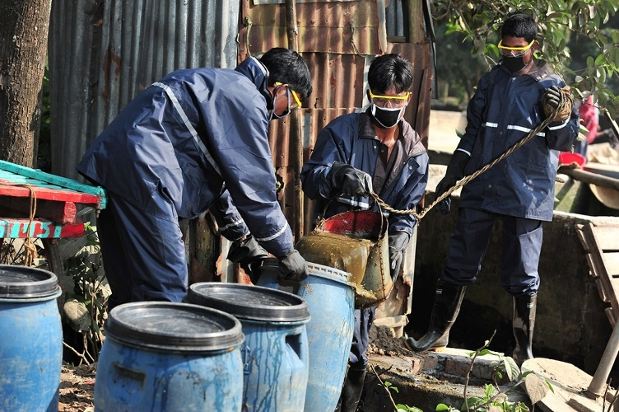
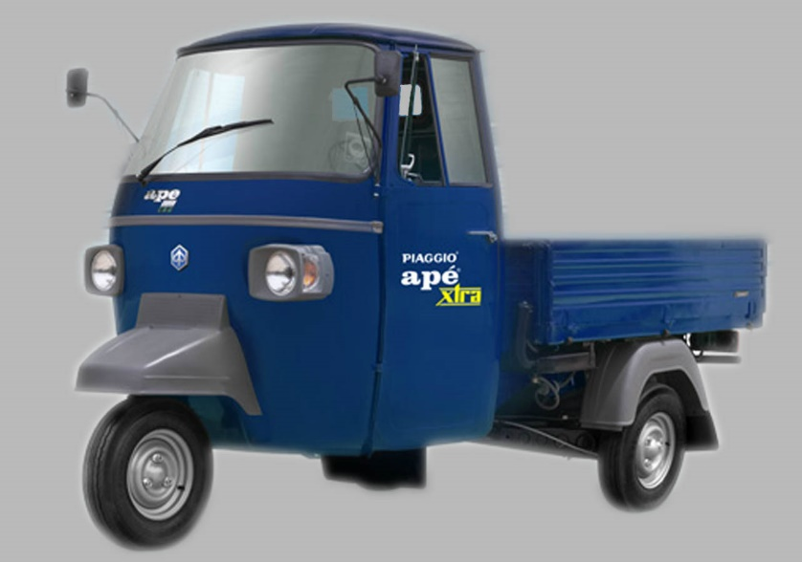
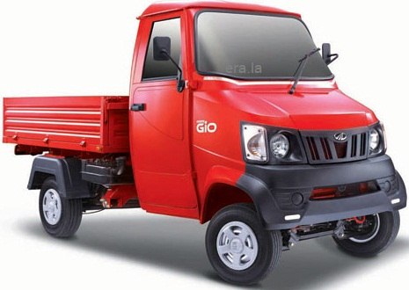
Transportation options
Treatment site has to be located at upazila HQ: 2 options
Small trucks carry 6 plastic containers of 20 liters from village to upazila HQ OR
Transfer point at Union Parishad; small trucks, then large trucks

Slide 20
Emptying and Transportation
Assessed four methods for emptying and transportation for managing the amount of fecal sludge produced in a year.
Lower cost method
  Diaphragm pumps for emptying
  Combined transportation method using smaller trucks (from villages to Union) and larger tankers (from Union to Upazila)

Slide 21

Costs and subsidy (tentative)
Volume of fecal sludge produced a year : 6,641 $m^{3}$
Need 59 small trucks and 1 large truck (120 people); need 18 pumps (18 emptiers)
Annual operating costs BDT 4.56 million (USD 58,461)
  Avg. cost of empting/$m^{3}$ = BDT 687
From community can raise: BDT 1.6 million - BDT 2.1 million (USD 20,306 to USD 26,331)
  Avg. WTP/ $m^{3}$ = BDT 238-309
Gap: BDT 3 million to 2.2 million (~67% to 57% of OC)
Annualized capital costs: BDT 3 million (USD 37,764 )

Slide 22
Next steps
Check our numbers…
Where to target subsidies?
How to monitor?
How to subsidize?
Co-composing: costs?
Markets for compost
……

Slide 23
Thank you

