Slide 1
Kerosene Consumption in India
Welfare and Environmental Issues
K.S. Kavi Kumar & Brinda Viswanathan
MSE, Chennai
ISI Workshop, New Delhi
2-3 November 2015

Slide 2
Context & Main Argument
Based on primary fuel consumption data, NSSO (2015) highlights that incidence of kerosene as primary fuel (in urban areas) has declined by 74% between 1999-2000 and 2011-12
The Economic Survey (2014-15) observes that only a smaller fraction of poorer households (46%) use kerosene for cooking needs
Further there is growing concern about increasing leakages and diversion of kerosene and need to contain increasing fiscal burden on account of kerosene subsidy

Slide 3
Context & Main Argument (contd.)
While all of this is factual, we argue here based on regional analysis that unless LPG penetration increases dramatically – both in rural and urban areas, drop in kerosene supply and consumption leads to increase in indoor air pollution and undermines efforts to reduce health burden
  The Southern, Western and Northern states which have better penetration of LPG in urban areas do show significant decline in indoor air pollution
  The urban areas of Eastern states and the rural areas of Southern states also show decline in indoor air pollution due to better functioning PDS and hence greater use of kerosene in supplementing their cooking energy needs away from coke/coal and firewood, respectively
  In the absence of these options, the rural areas of Eastern, Central and Northern states move towards other dirty fuels (dung and crop residue)

Slide 4
Context & Main Argument (contd.)
Apart from the reduction of indoor air pollution, the kerosene subsidy continues to provide implicit income transfer to socially and economically weaker sections and such transfers are ‘progressive’
Related literature – Datta, 2010; Rao, 2012; Anand et al., 2013; Basole and Basu, 2015
Notes:
Anand et al – look at kerosne and LPG together and argue that these subsidies are not progressive and need better targeting; combining kerosene story with LPG may not be appropriate
Basole and Basu – link increase in cooking fuel expenditure to food budget squeeze and calorie reduction

Slide 5
Objectives
This study focuses on kerosene used by the households and explores the following issues:
  Primary fuel choice vs energy mix in cooking fuels
    Market vs PDS kerosene consumption – spatial issues
  Indoor air pollution – spatial and temporal trends
  Role of kerosene in determining indoor air pollution
  Changes in progressivity of income transfers

Slide 6
Data
The study uses unit record data from two NSS rounds – 66th (2009-10) and 68th (2011-12)
In particular the study uses consumption data reported by the households for cooking and lighting purposes
Analysis is mostly at geographic zones and expenditure deciles in rural and urban areas
  North: J&K, Haryana, Punjab, HP, and Delhi
  Central: MP, Chattisgarh, UP, and Uttaranchal
  West: Rajsthan, Gujarat, Maharashtra, and Goa
  East: Assam, Bihar, Orissa, WB, and NE
  South: AP, Karnataka, Kerala and TN

Slide 7
The present work is extension of our earlier works in this area including
  Analysis of trends in fuel use patterns across India (Viswanathan and Kumar, 2005);
  Analysis of indoor air pollution patterns (Kumar and Viswanthan, 2007);
  Analysis of patterns and projections of household level pollution (local and global components) in India (Kumar and Viswanathan, 2013);
  Analysis of implicit income transfers and functioning and non-functioning states with respect to PDS kerosene (Kumar and Viswanathan, 2015)

Slide 8
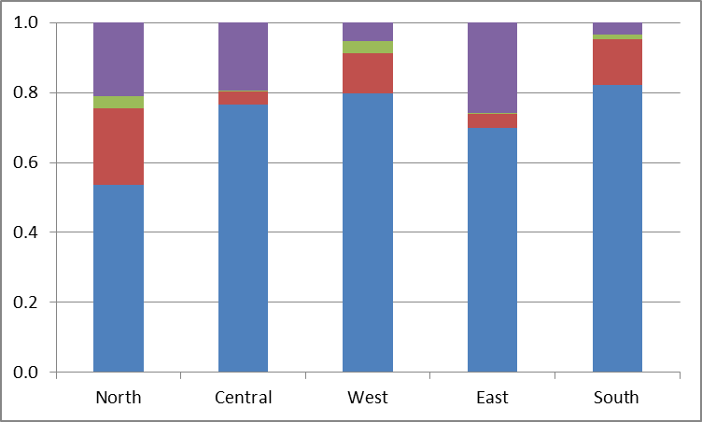
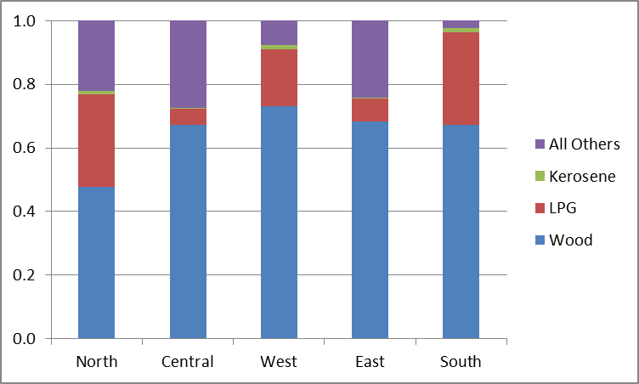
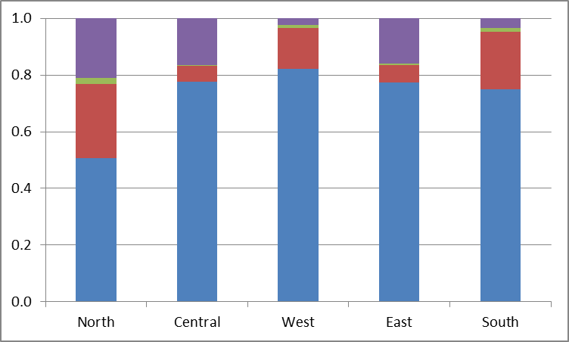
Primary Cooking Fuel: Rural
2004-05
2009-10
2011-12
Use of others as pry fuel increased – Central and East
Kerosene as pry fuel declined in all zones

Slide 9
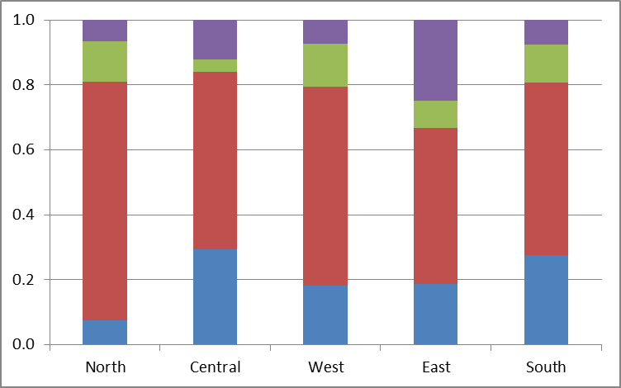
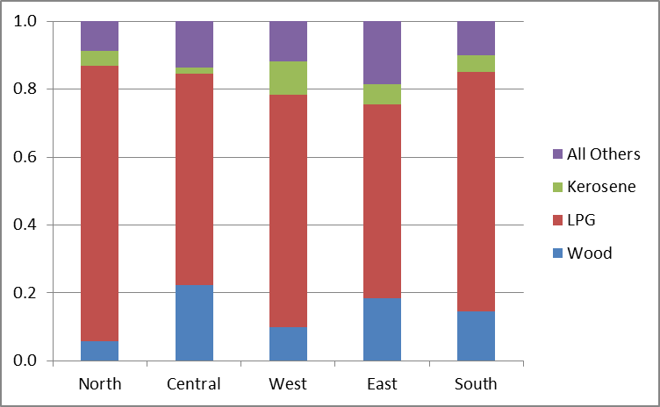
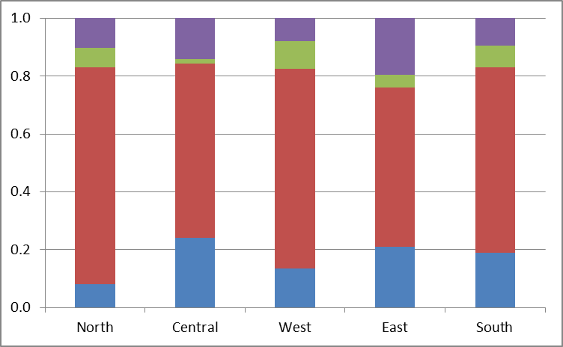
Primary Cooking Fuel: Urban
2004-05
2009-10
2011-12
Greater LPG penetration – more so in North and South – led to decline in firewood as well as kerosene

Slide 10
Cooking Energy Estimation
Cooking energy at household level is estimated based on energy content and thermal efficiency reported in Smith et al. (2000), Venkataraman et al. (2010), and Mestl and Eskeland (2009)
Total consumption of kerosene is allocated between cooking and lighting needs based on the household’s choice of cooking and lighting primary fuels
Dung and other cooking fuels (e.g., crop residue) should be accounted though the quantity data is missing in the NSS database
Households with no cooking arrangement are excluded

Slide 11
Accounting for Other Cooking Fuels
Estimate the mean energy at decile level in each zone for a particular sector from the fuels with quantity data
For household which report positive expenditure on dung and other energy, the energy from these fuels is attributed as the residual of mean cooking energy and their own total energy from the fuels with quantity data
This correction may not still accurately capture the energy from other fuels and hence would underestimate the indoor pollution that we discuss later

Slide 12
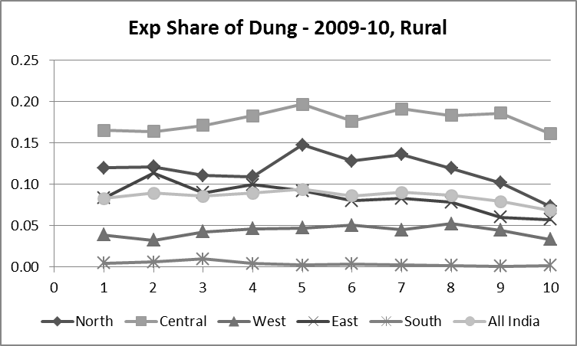
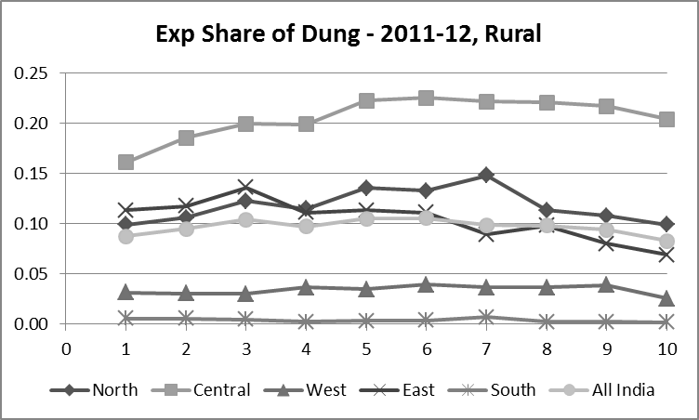
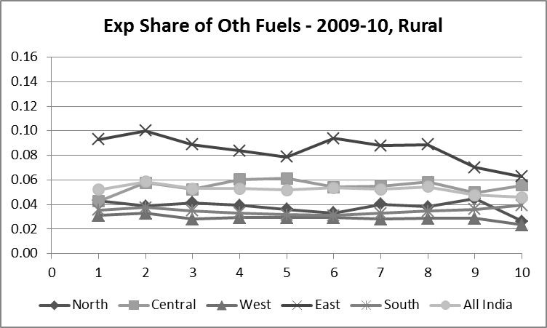
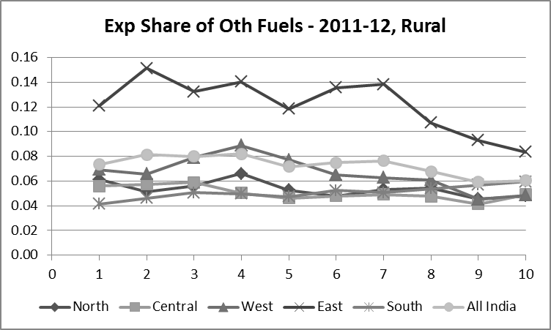
Expenditure share of dung and other fuels is showing increasing trend across zones and for most deciles over time

Slide 13
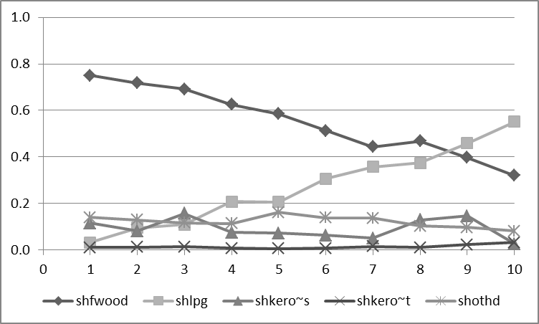
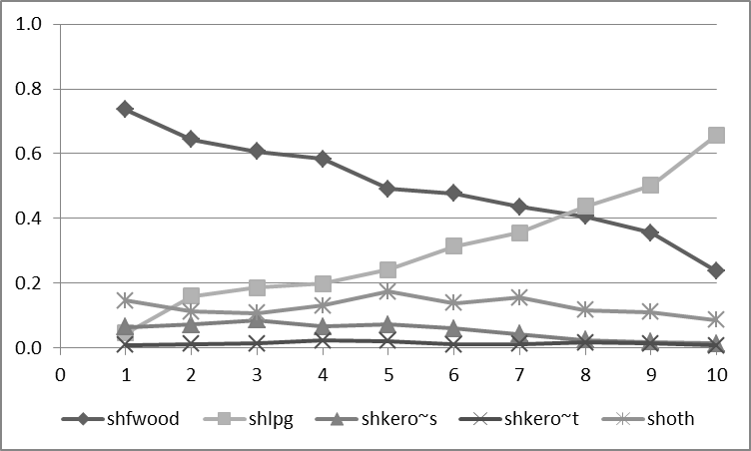
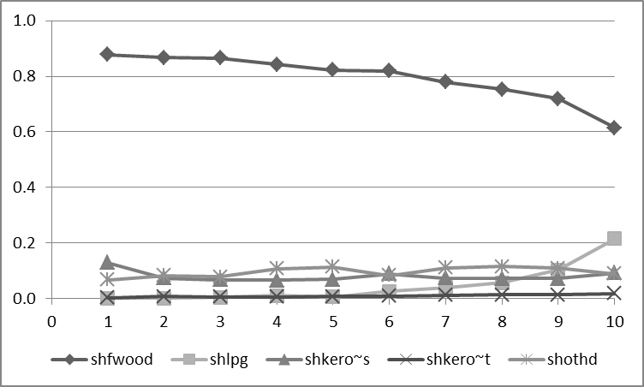
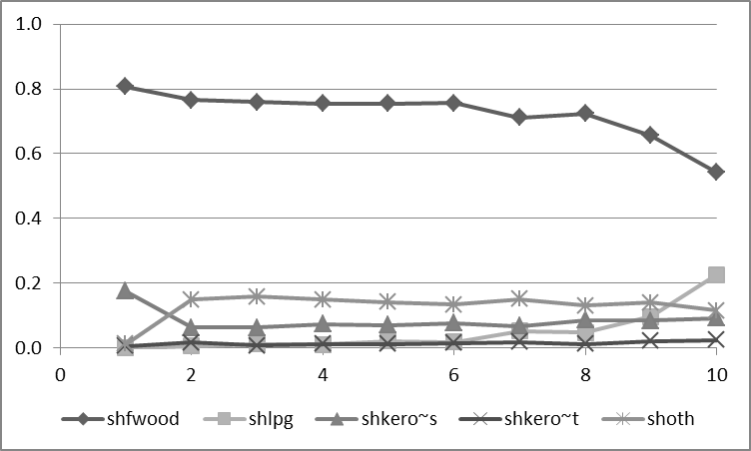
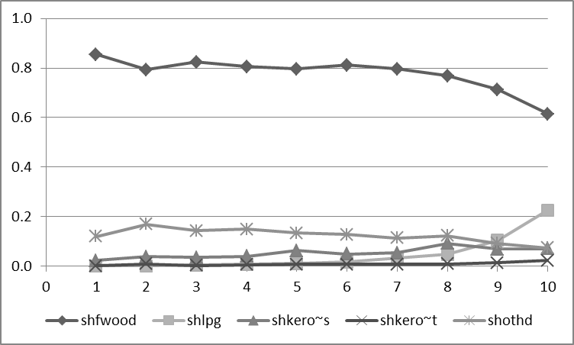
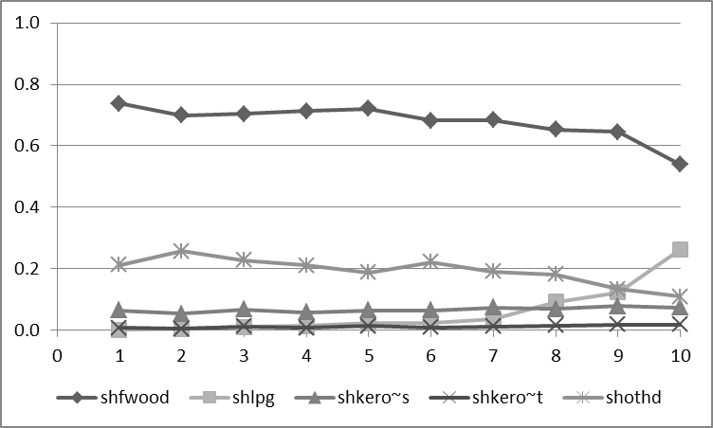
2009-10, Rural North
2011-12, Rural North
Share of fuels in Household Energy-mix
2009-10, Rural Central
2011-12, Rural Central
2009-10, Rural East
2011-12, Rural East

Slide 14
2009-10, Rural North
2011-12, Rural North
Other fuels have significant share in the household’s cooking energy mix
In North, Central and East, share of Kerosene – both PDS and Market – is low (compared to West and South) and is declining over time
2009-10, Rural Central
2011-12, Rural Central
2009-10, Rural East
2011-12, Rural East

Slide 15
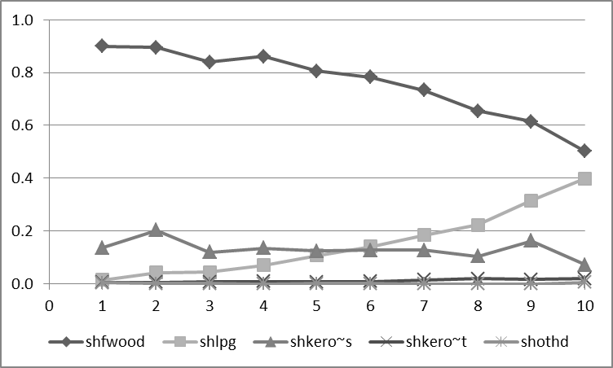
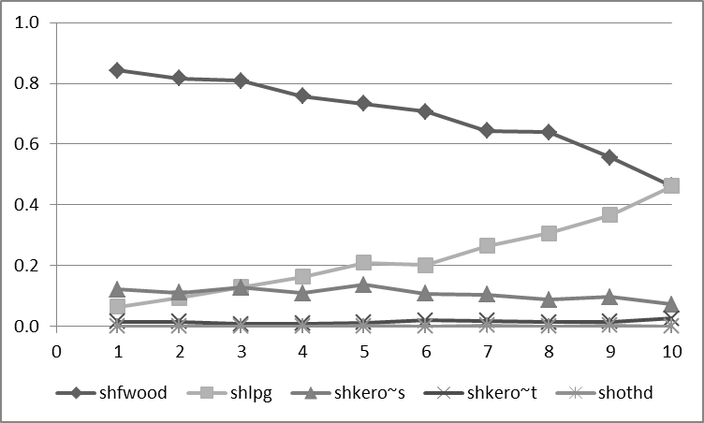
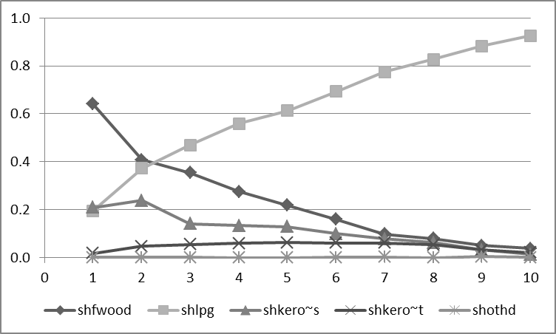
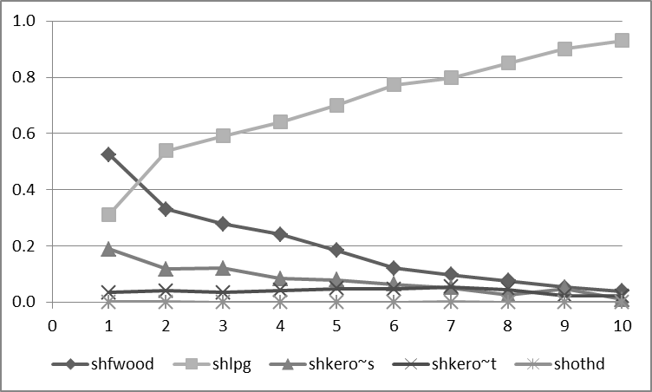
2009-10, Rural South
2011-12, Rural South
Urban to rural ‘diversion’ of PDS kerosene for cooking – facilitating drop in indoor pollution
Similar pattern in West with regard to kerosene consumption in rural areas
2009-10, Urban South
2011-12, Urban South
Notes:
As per norms, kerosene should not be allocated in rural areas if the household reports electricity as primary fuel for lighting.
In South despite better electrification, the states are still managing to allocate kerosene in rural areas through PDS – which of course is having beneficial effects in reducing dependence on firewood

Slide 16
Indoor Air Pollution Estimation
Using emission coefficients reported in the literature (Smith et al., 2000; Venkataraman et al., 2010), along with the fuel consumption quantities and the attributed cooking energy from other fuels, household level particulate matter emissions are estimated
  The emission estimates are approximate as no information is available on stove efficiency, kitchen characteristics and missing quantitative data on other fuels
Spatial and temporal patterns of the estimated PM emissions are analysed
Role of household’s consumption of kerosene in explaining the variation in PM emissions is explored using econometric specification

Slide 17
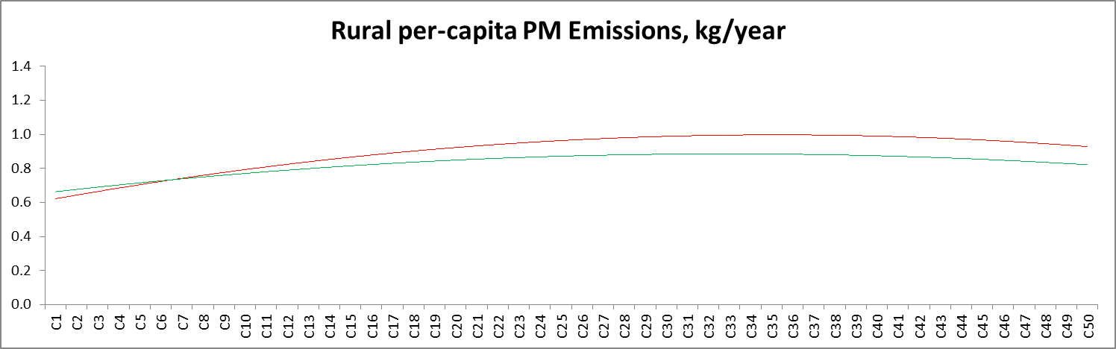
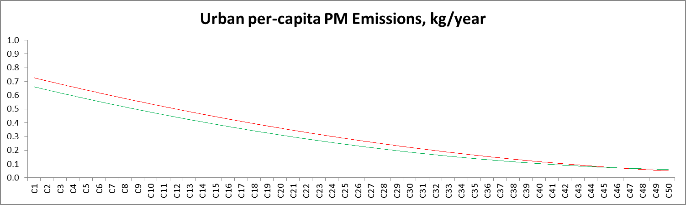
Particulate Matter Emissions
2009-10
2011-12
2009-10
2011-12

Slide 18
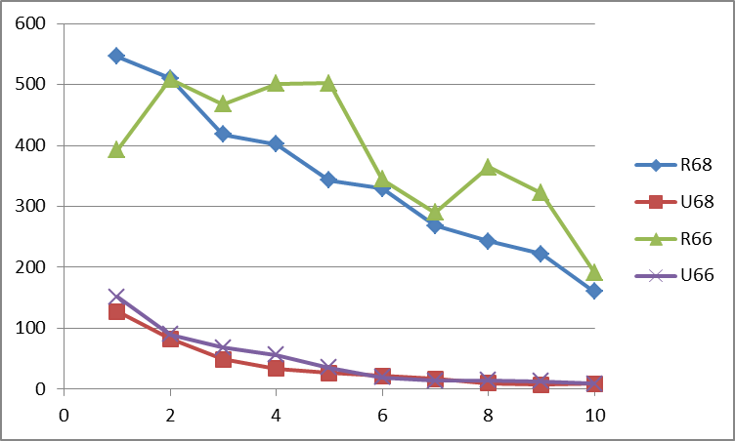
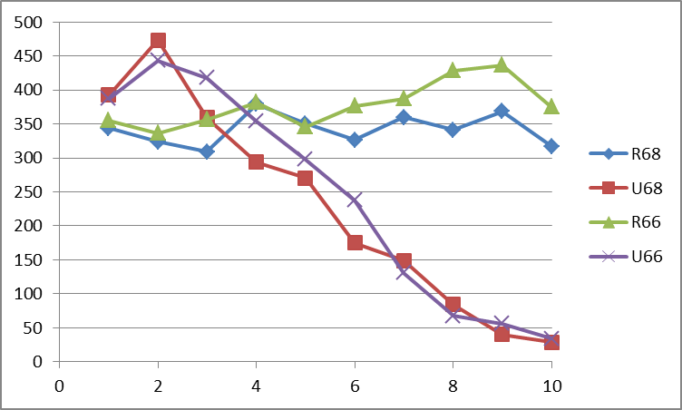
Particulate Matter Emissions
North:
2009-10 & 2011-12
Higher emissions in 2011-12 in the lower expenditure decile in rural areas
Similar patterns in Central and Western Zones
Lower emissions in the lower expenditure deciles of rural areas than those in urban areas
  Improper accounting of energy from other fuels?
  Energy poverty?
East:
2009-10 & 2011-12

Slide 19
Rural Indoor Air Pollution: Role of Kerosene
Dependent variable: log per capita particulate emissions
Prmfwd, prmlpg – firewood and LPG as pry fuels (dummy)
Shkeropds, shkeromkt – share of kerosene (from PDS and Mkt) in the household energy mix
Includes relevant control variables like demographic and social characteristics
Notes:
Better specification of the model to avoid endogeniety problem – with regard to use of prmfwd and prmlpg – is needed; work in progress

Slide 20
Rural Indoor Air Pollution:
Role of Kerosene
Indoor pollution broadly declines over time in rural areas driven largely by LPG penetration
This obscures the role played by the reduction in supply and consumption of kerosene on indoor pollution
Regression results clearly highlight the role of kerosene (in the fuel mix) in decreasing the indoor pollution, with an increasing magnitude over time
Kerosene sourced from market has played relatively more significant role than the PDS kerosene in reducing indoor pollution

Slide 21
Is Kerosene Reaching the Needy?
The implicit income transfers to the household due to purchase of PDS kerosene are estimated as
Income Transfer = Q_{PDS}*(P^{K}_{Market} – P^{K}_{PDS})
The income transfers are expressed as percentage of total expenditure and analysed across zones, decile groups and social groups
These income transfers are first order approximations as actual transfers will depend on substitution possibilities between kerosene and other fuels captured through the relevant elasticities and accessibility

Slide 22
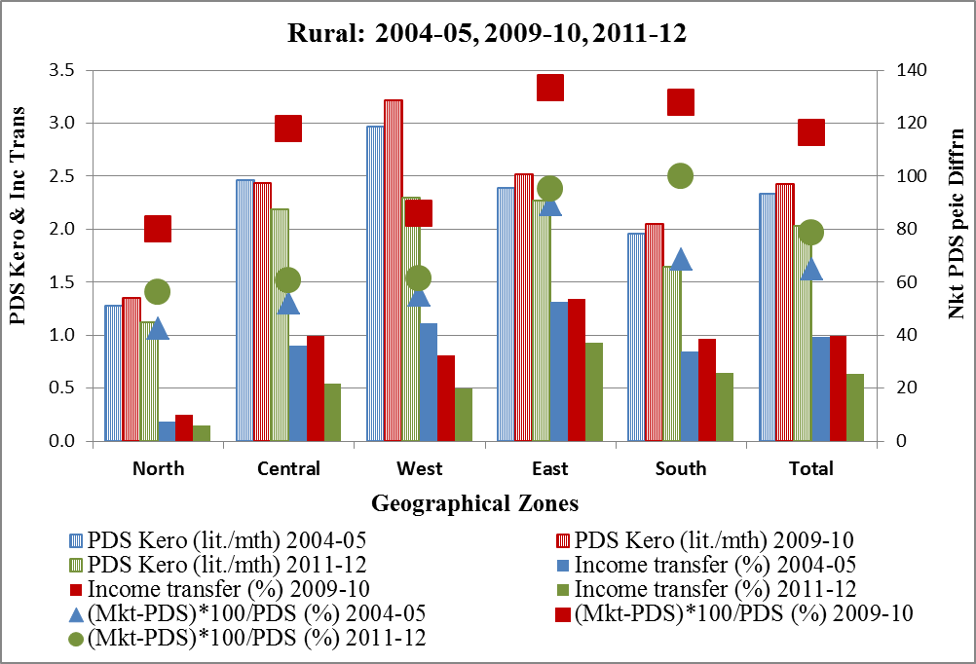
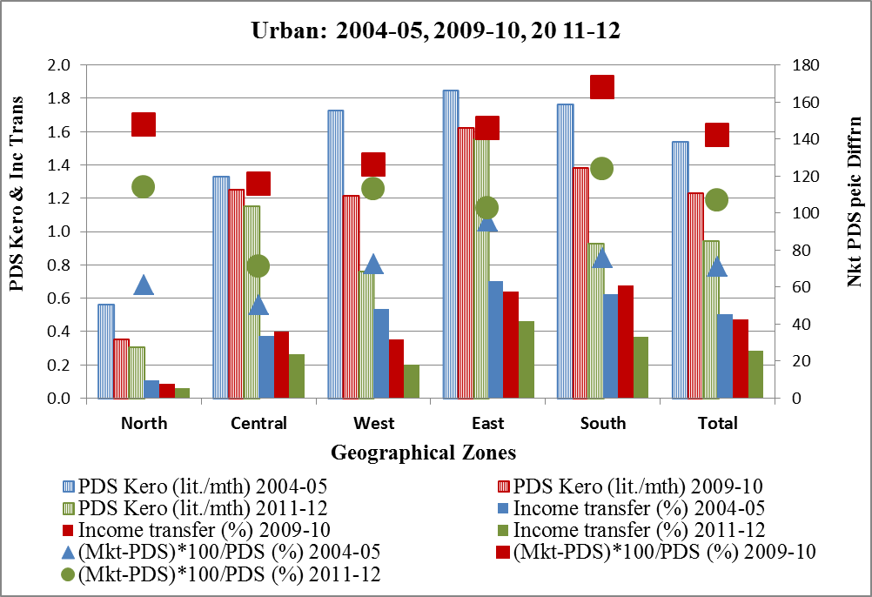

Slide 23
Over the period 2004-2012, PDS kerosene consumption has increased and then decreased in rural, whereas it uniformly decreased in urban areas
Share of income transfer in total household expenditure is uniformly higher in rural (poorer regions) than in urban
Eastern region which has relatively more poor population, shows higher share of income transfer
Income transfers in Southern and Western zones become comparable with those of Central (where poor population is higher again) perhaps due to better targeting and functioning of PDS

Slide 24
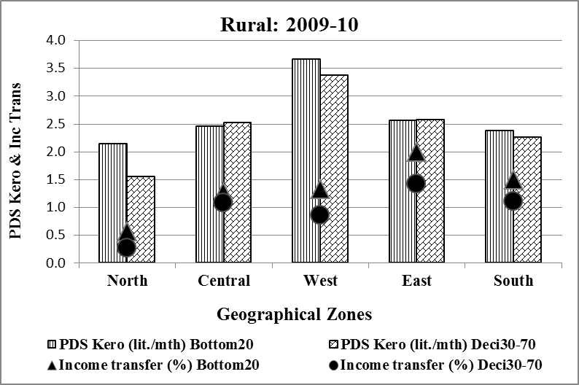
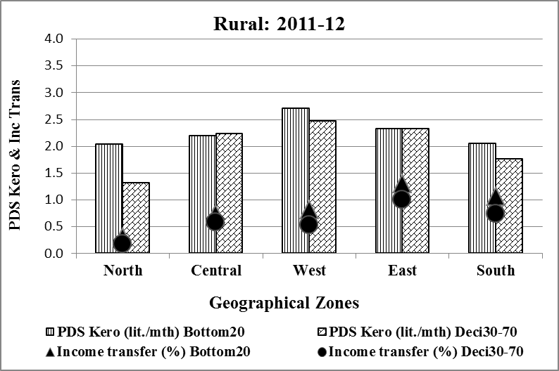
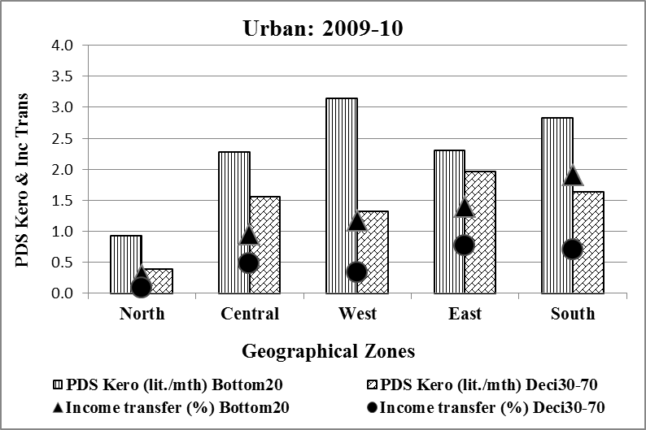
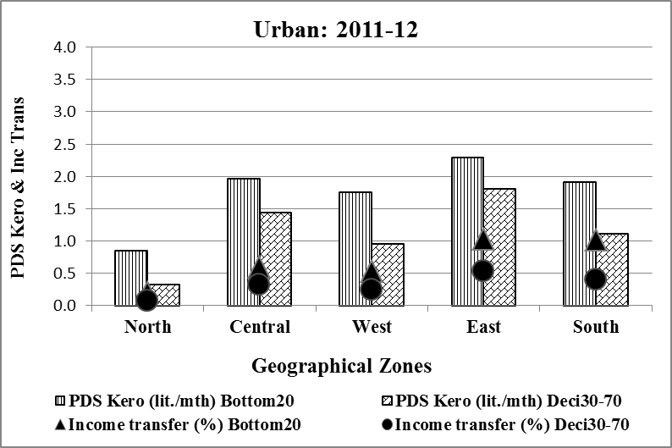
Bottom 20% of population benefit more than middle 30-70%
Urban benefit more due to higher kerosene consumption than rural population
Rural Central and East report uniform benefits for both groups due to inadequate penetration of LPG

Slide 25
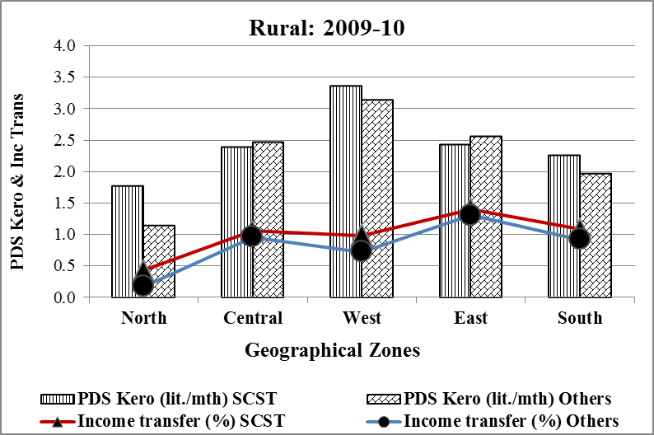
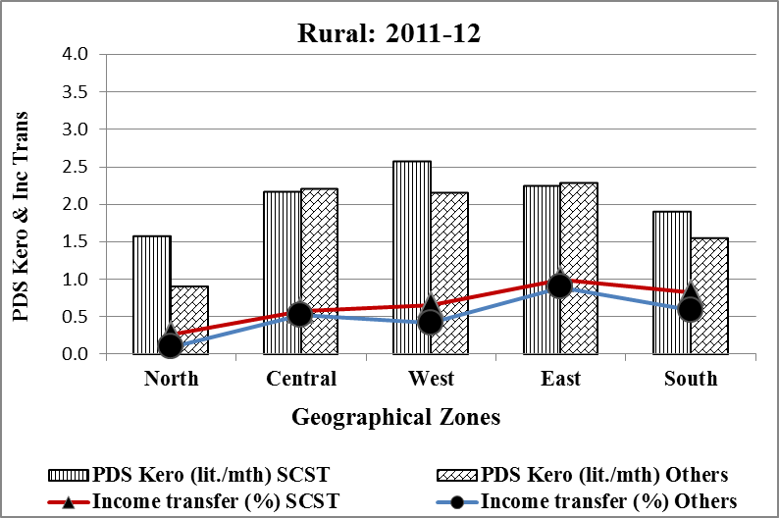
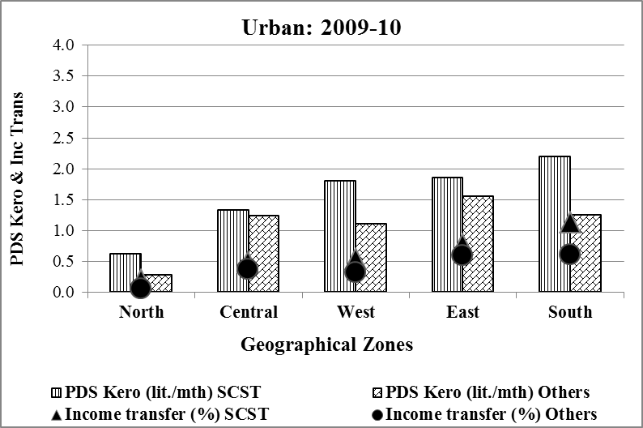
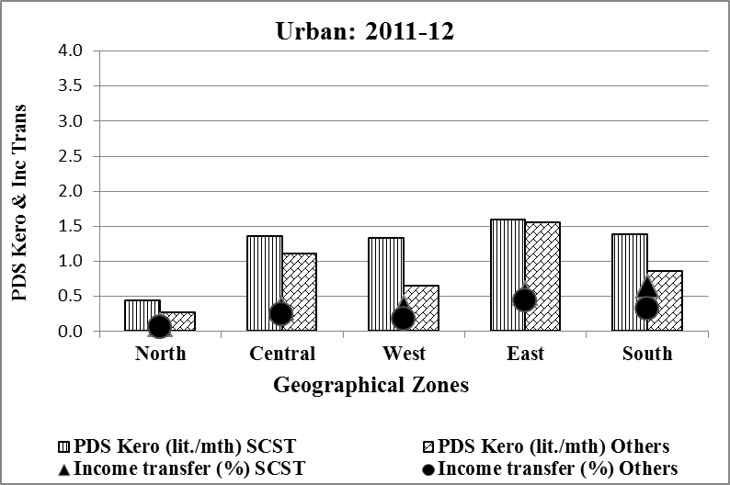
SC/ST population benefit more than ‘others’ throughout except in Central and Eastern zones – where inadequate penetration of LPG is perhaps leading to the ‘diversion’

Slide 26
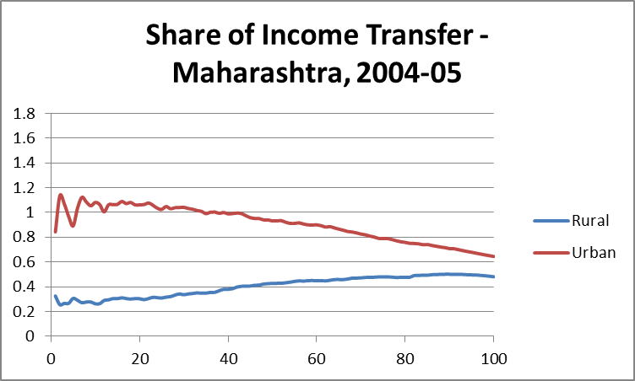
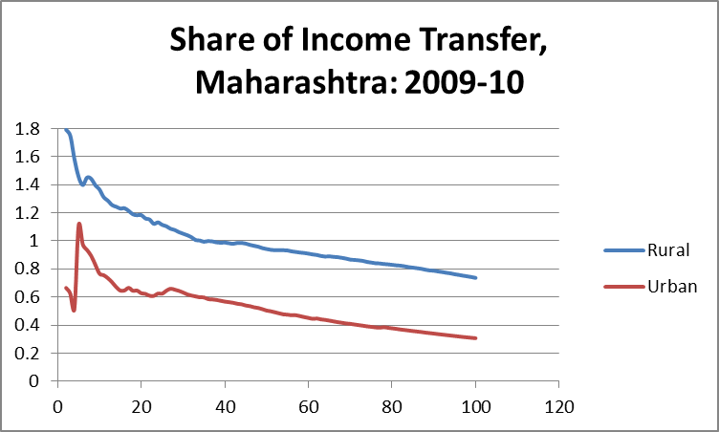
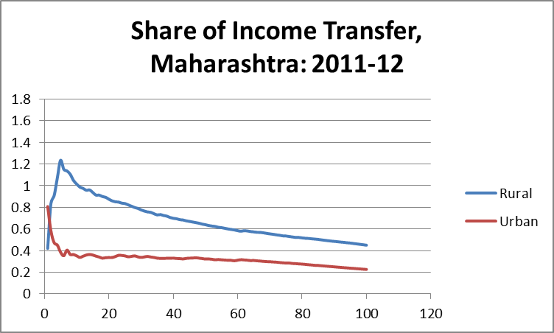
Progressivity/Regressivity – Kerosene Subsidy
Based on 2004-05 data, Rao (2012) argued that the kerosene subsidy benefits are regressive in rural Maharashtra, and that they are progressive in the urban areas
Evidence from subsequent years – 2009-10 & 2011-12 – suggests progressivity in both rural and urban Maharashtra
Notes:
Cummulative average shares

Slide 27
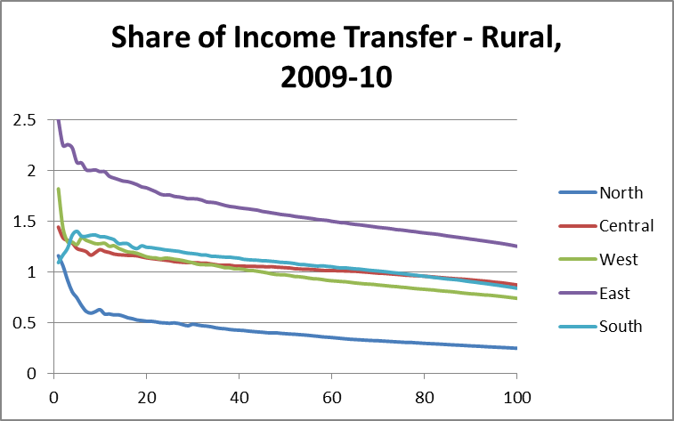
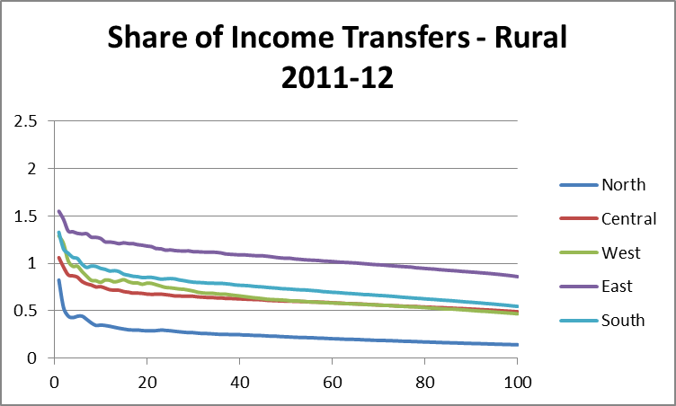
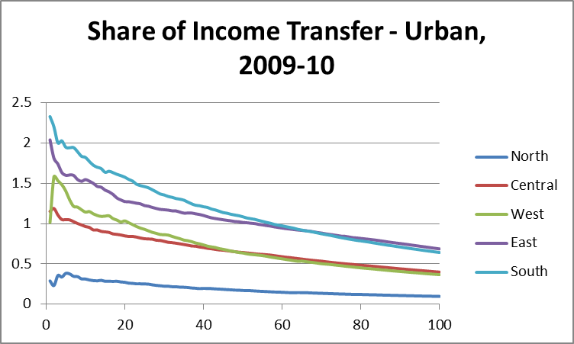
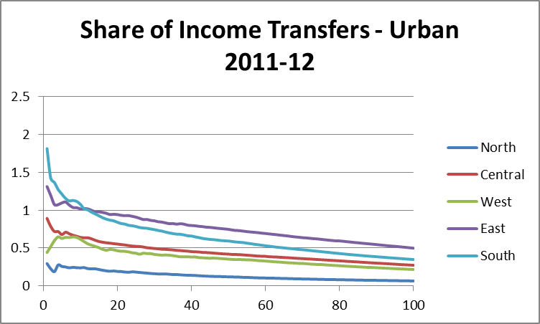
Progressivity/Regressivity – Kerosene Subsidy

Slide 28
Diversion of Kerosene – Status and Trends
Kerosene is allocated on the basis of two household characteristics – number of LPG cylinders and household size
Since lower income households tend to have fewer LPG cylinders and larger family size, the kerosene subsidy does have the potential to serve as a redistributive instrument
Kerosene allotted to a state through PDS finds its way to two other markets – black market where the households can purchase kerosene for household purposes and to other markets for adulteration purposes
The significant diversion has often been cited as reason for doing away with kerosene subsidy
Diversion in a state is estimated as percentage of aggregate household level consumption of kerosene in a given year to the offtake of that state in the same year

Slide 29
Eastern zone shows sharpest increase, followed by the Southern zone
Northern and Western zones continue to have high diversion rates
Less diversion than all India
More diversion than all India

Slide 30
Concluding Remarks
Significant diversion of kerosene to ‘other markets’ continues
  Provides ground for phasing out kerosene subsidy
  However, targeting has improved over years and the subsidy benefits are by and large progressive across zones and sectors
  Allocation and offtake of kerosene have declined in recent years; also reflected in considerable reduction in household level consumption across zones and sectors in 2011-12
Declining consumption of kerosene can have adverse welfare and environmental effects
  Poorer states, rural areas, lower income groups, and disadvantaged social groups are likely to lose out more
  Reduction in kerosene supply is pushing households to supplement their cooking energy needs through use of cheaper and dirty fuels such as dung and crop residue

Slide 31
Concluding Remarks
Need for providing effective alternatives to minimize the adverse implications
  In case of cooking – in addition to increasing penetration of LPG, efforts should be made to increase use of improved cook stoves, which could provide ‘win-win’ option of reducing both local and global pollution
  In case of lighting – in addition to increasing electrification, efforts should also be made to explore the solar options

Slide 32
Thanks for you attention!

