Slide 1

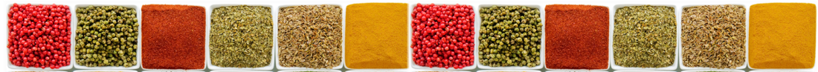
CECFEE Workshop
ISI, Delhi | 02-03 Nov 2015
Energy-Irrigation Nexus in India
Is Solar going to be the ‘game changer’?
Tushaar Shah, Shilp Verma, Neha Durga

Slide 2
Outline
IWMI-Tata Program
Energy-Irrigation Nexus
Solar Irrigation as Game Changer
SPaRC, SPICE, SolarISPs

Slide 3
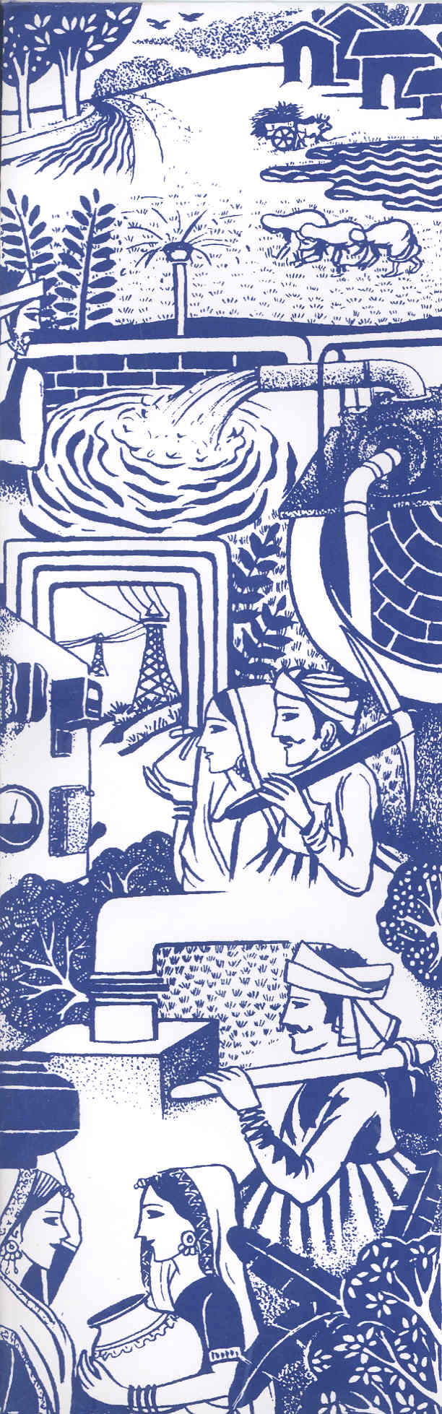
IWMI-Tata Water Policy Research Program (ITP)
Co-equal partnership between IWMI and Tata Trusts
Mandate
  Policy research with a bias for action
  Problem-solving, managerial approach
  “Converting science into policy action”
  Agriculture-Livelihoods-Water-Energy-Environment
  Partnerships, Capacity Building

Slide 4
ITP’s Positioning…
ICAR System
[Production Functions/
Micro-Models]
CSE
[Journalistic
/Activist?]
Roorkee/IIT
[Engineering/
Modeling]
IWMI-Tata Program
[Problem-Solving Approach;
Working from Action-end to Science;
Intelligent Processing of Ideas]
MIDS/GIDR
[Rich, Nuanced
Descriptions/
Analyses]
TERI/ORG/AFC
[Techno-Economic
Consulting]

Slide 5
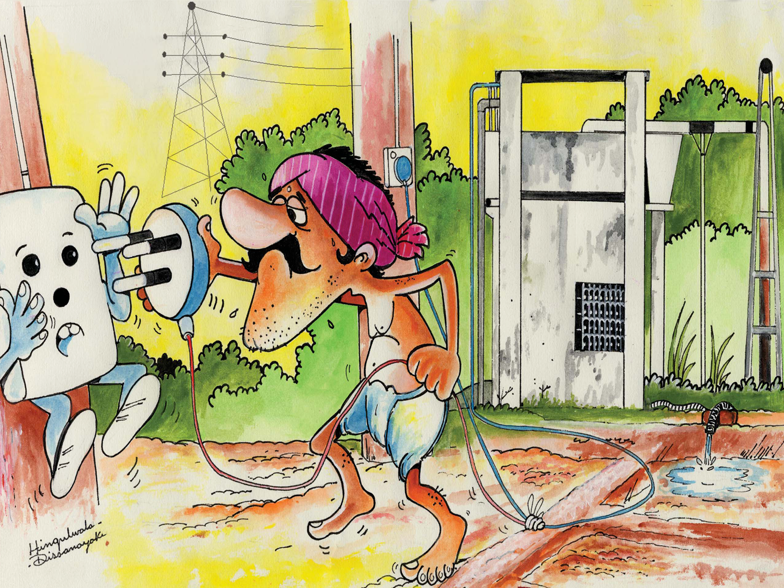
Energy-Irrigation Nexus

Slide 6
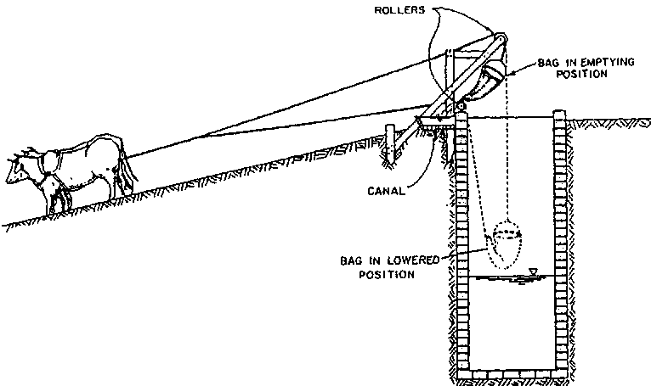
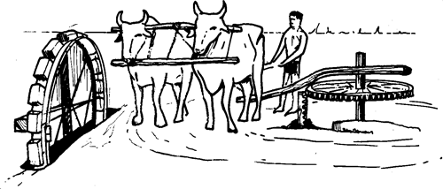
Evolution of E-I Nexus (Pre-British)
Well Irrigation Early History
  3rd Century mention in Arthashastra
  16th Century, Abu-al-Fazl: “most of the province of Lahore is cultivated with well irrigation”
~1800, 2 mHa well irrigated
Early EI Nexus
  Charasa vs. Persian Wheel

Slide 7
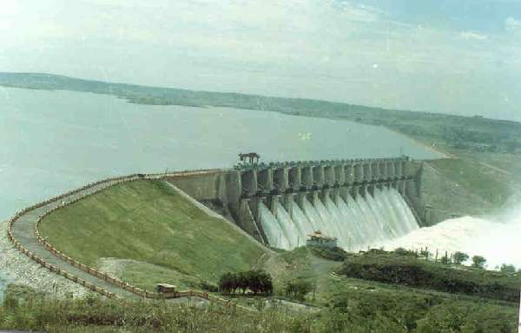
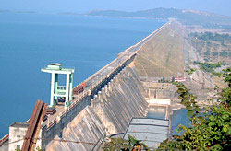
Evolution of E-I Nexus (Dams)
British Irrigation
  Cotton-Cautley Era
Colonial Hangover
  Temples of Modern India

Slide 8
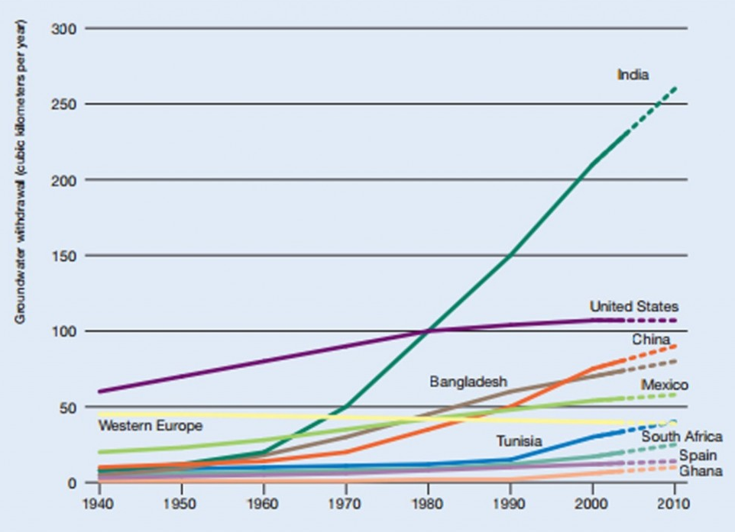
Evolution of E-I Nexus (1970-90)
WB Rural Electrification started in 1950’s
  Public Tubewell Programs
  Poorly managed, unreliable, politicized BUT
  Convinced farmers about Groundwater
Mechanized Pumps
  1960: 200,000
  1994: 14 million
Metered vs. Flat Tariffs
  Tyranny of Meter Readers
  Transaction Costs
  Equity and Access to GW
Wells and Welfare…

Slide 9
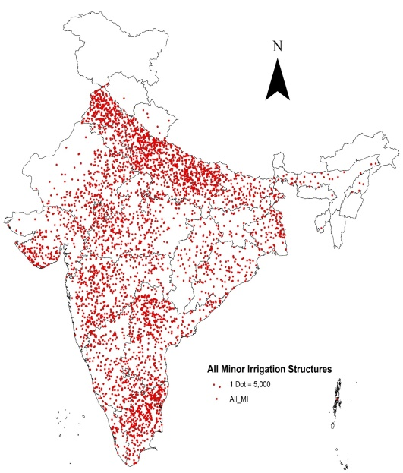
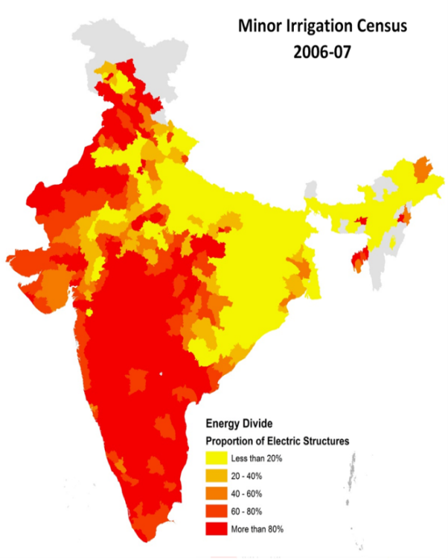
Evolution of E-I Nexus (1990-2010)
Wells and Ill-fare
  Rising power subsidies
  GW over exploitation; pockets of mining
Energy Divide
  De-electrified Eastern India
  Water-scarce Western and Peninsular India
Rationing Power to Ag
  DISCOM inefficiencies shown as Ag power consumption
  Phase-splitters, auto-switches
  Deteriorating Rural Power Ss’Env.

Slide 10

4th MIC
2006-07

Slide 11

India’s Energy Divide, 2006-07
Map prepared by IWMI based on
Minor Irrigation Census 2006-07

Slide 12
Energy cost and pumping behavior

Slide 13
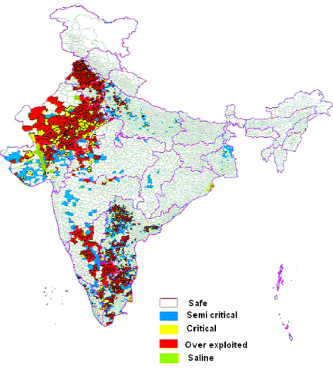
Planning Commission of India, 20007
http://cdn.iopscience.com/images/1748-9326/4/3/035005/Full/9925403.jpg

Slide 14
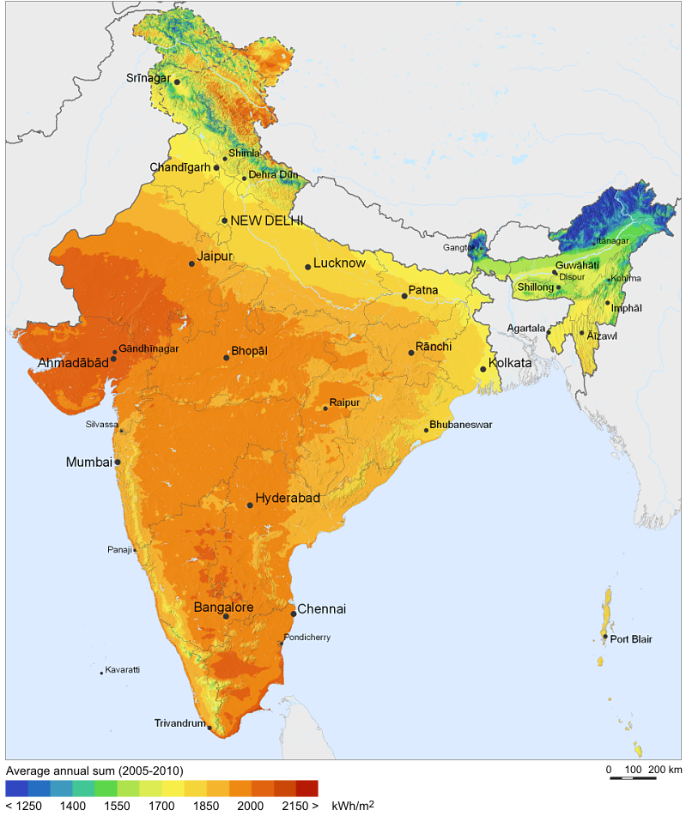
"Solar Resource Map of India" by SolarGIS
© 2011 GeoModel Solar s.r.o. - http://solargis.info/doc/71

Slide 15
India’s Solar Mission:
Target 100 GW by 2022
1. Who will install, own and operate 100 GW of solar capacity that India creates over coming 7 years?
2. From the overall national viewpoint, what is the best architecture for our emerging solar economy?

Slide 16
Who will install, own and operate 100 GW of solar capacity over the coming 7 years?
 | Utility scale | Rooftop PV | SPIS
Jawaharlal Nehru National Solar Mission | ~80 | ~20 | <1
Bridge-to-India Indo-German Collab. | ~85 | ~15 | <1
IWMI-Tata Program | ~10 | ~10 | >80

Slide 17
SPaRC
Solar Power as Remunerative Crop

Slide 18
Alternative Models of Solar Powered Irrigation System (SPIS) Promotion Policy
Current Solar Pump Strategy
SPaRC Strategy
SIPs are promoted by capital cost subsidy of 80-90%
Capital cost subsidy on SIP’s should be around Rs 40,000/kW
SIP owners have no power purchase guarantee or FiT
SIP owners should be grid connected, have power purchase guarantee at Rs 5-7/kWh
Solar power complements grid power
Surrender of grid connection is a pre-condition; so SIP replaces grid connection
Farmer remains net buyer of grid power
Farmer becomes net seller of power to the grid

Slide 19
Benefit 1: Shot-in-the-arm to farm incomes
10 million SIPs of 10 kW=100 GW of solar
At 4 kWh/kWp/d, these can generate 130 billion units of solar power worth Rs. 100,000 crore today
Indian farmers can earn more net income by selling half this power than from growing rice on 45 million ha
An average 10 kW SIP can give a farmer 6-8 hectares of irrigation and Rs. 40,000-50,000/year of income from sale of solar power
SPaRC income is free of risk from droughts, floods, pests and diseases; needs no fertiliser nor pesticides; ideal ‘farm income insurance’

Slide 20
Benefit 2: No need for land acquisition
100 GW solar through MW-scale projects would need acquiring 300,000 ha of land.
10 million 10 kW SIPs would need no land acquisition
SIPs have no land footprint; Land under solar panels can be used to grow high value vegetable and medicinal crops

Slide 21
Benefit 3: Fixing the perverse electricity-groundwater nexus
11 million electric tubewells use 117 billion kWh of “free” or subsidized grid power to deplete western and peninsular India’s aquifers
Farm power subsidy burden: Rs. 60,000 crore/year; many DISCOMs nearly bankrupt
Solarizing these can turn around the finances of DISCOMs
Paying farmers for solar power will discourage over-pumping of aquifers and encourage groundwater and energy conservation

Slide 22
Benefit 4: Releasing grid capacity
Biggest challenge of 100 GW solar is how to expand grid capacity;
11 million electric tube-wells take up nearly 1/3rd of the grid capacity; taking tubewells off the grid will release this capacity
SIPs will not need new T&D infrastructure as remote MW-scale plants do
Replacing grid power by locally generated solar power for tubewells will also save approx. 20 billion kWh of T&D losses

Slide 23
Benefit 5: Cutting the Carbon Footprint of Tubewell Irrigation
11 million electric tubewells and 9 million diesel tubewells emit 130 mmt of CO₂/year, 6-10% of India’s total
Solarizing grid-connected and diesel tubewells can reduce carbon footprint of Indian irrigation

Slide 24
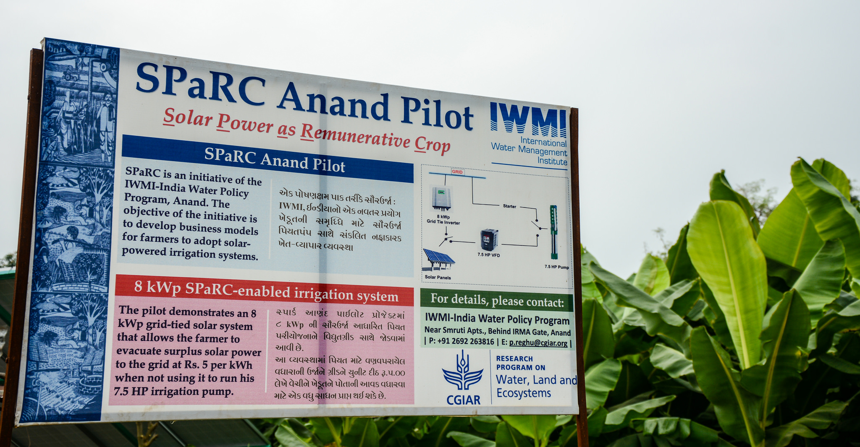
IWMI-WLE SPaRC Pilot in Anand

Slide 25
National Solar Mission
MW/GW scale concentrated solar power plants: 100 GW
Gains
Solar Jobs
Reduced Carbon Footprint
100 GW Solar Capacity
Ecosystem
Economic
Groundwater Depletion
30-40% energy waste due to nightly supply, uncertainty and zero marginal cost
Capital Cost to Society
Land Acquisition
Rs. 7-13/kWh
Losses

Slide 26
Additional farm income of Rs 30-50 k/year/SIP from solar power sales
Improved Working of Canal Irrigation Systems
Gains
Improved Health of Aquifers
Improved Finances of Electricity Utilities
(Reduced Power Subsidies)
Reduced Carbon Footprint
of Groundwater Irrigation
Solar Jobs
(Distributed Generation)
Technical Losses Saved
120 GW Solar
Capacity by 2020
Thermal Energy Saved
in Groundwater Pumping
120-130 billion kWh of solar power for irrigation or sale at Rs 5-7/kWh
Ecosystem
Economic
Groundwater Depletion
Loss of ecosystem resilience of aquifer systems in western corridor due to sustained groundwater depletion
Cost to Society (Economies of Scale and Scope)
Incentive to waste power and water replaced by incentive to conserve
Near-zero Land Footprint
The SPaRC Proposal
Upto 12 million 10kWp Solar
Irrigation Pumps (total: 120 GW)
Losses

Slide 27
Key Barriers to SPaRC Uptake
Unfamiliarity
Coordination costs for solar PV companies
Intricacies of grid-tying and net-metering and of power evacuation from dispersed small generators
Opposition from DISCOMs
Transaction costs of power purchase from millions of small distributed generators

Slide 28
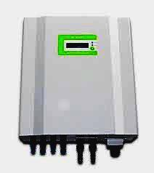
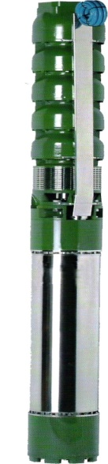
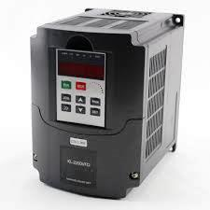
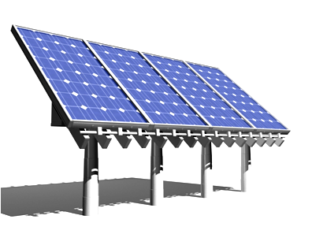
SPaRC Enabled
IRRIGATION
GRID
FiT
Rs 5 /kWh
Free to Rs. 0.5 /kWh
Starter
8 kWp
Grid Tie Inverter
7.5 HP VFD
7.5 HP Pump
Solar Panels

Slide 29
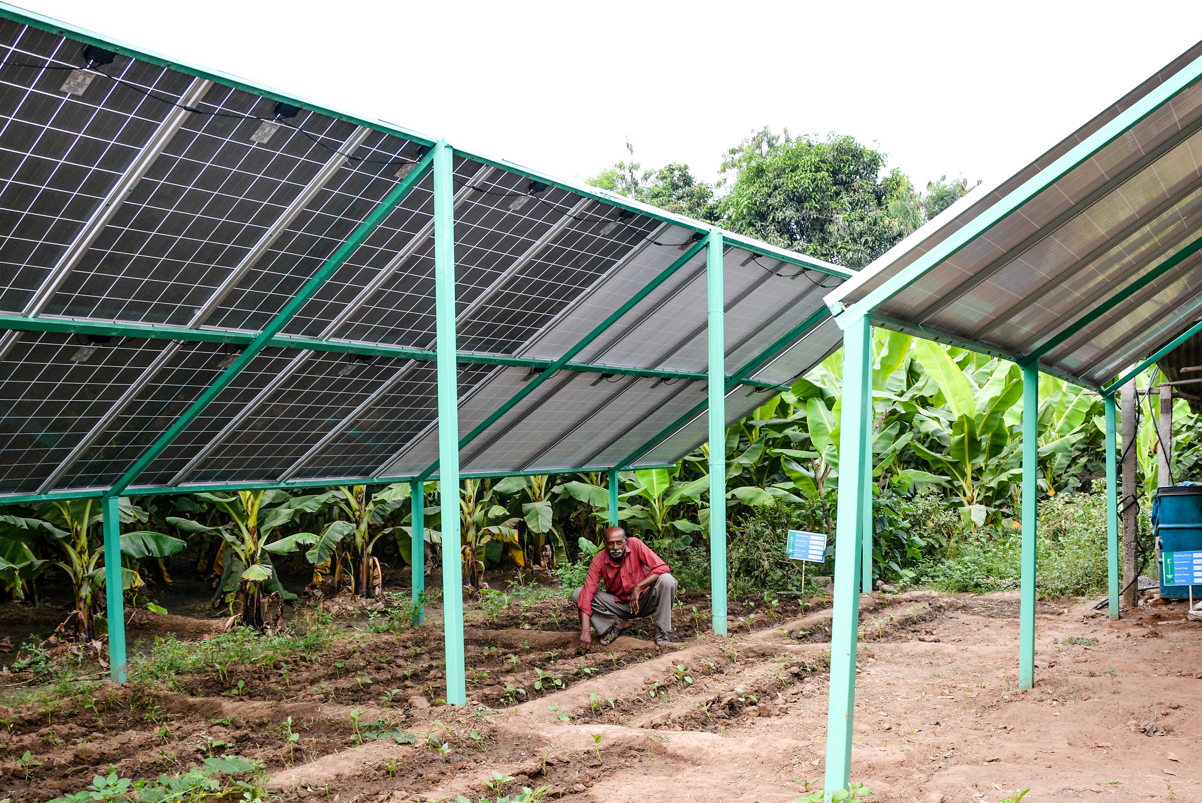
IWMI-WLE SPaRC Pilot in Anand
RamanBhai Parmar, Village Thamna, Anand

Slide 30
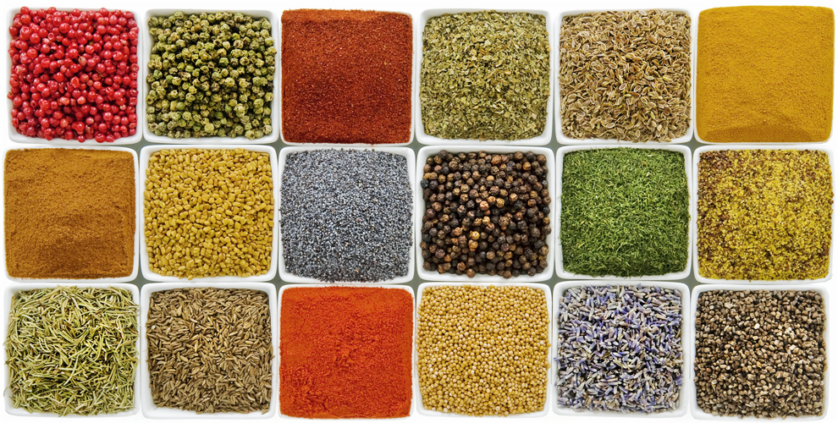
From SPaRC to SPICE
MGVCL – IWMI-Tata – CCAFS – GERMI

Slide 31
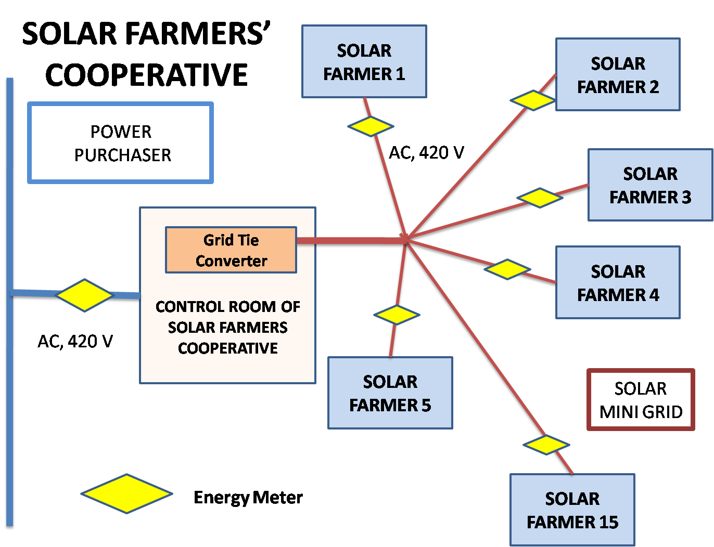
SPICE: Solar Pump Irrigators’ Cooperative Enterprise
Services offered:
Absorb transaction costs of pooling surplus power
Assist member farmers in maximizing power sales
Add solar capacity over time

Slide 32
Solar ISPs
Equitable Solar Irrigation Service Markets for Eastern India

Slide 33
Solar Irrigation Service Providers…
Current
  90% capital subsidy
  Individual SIPs, 2/3 kWp
Solar ISP Model
  6-8 Solar ISPs per village
  Each with 8 kWp SIPs + Buried pipeline
  SIPs on Annual Lease; paid through sale of irrigation service

Slide 34

Thank You…
shilpv@gmail.com | +91 9725503615
IWMI-Tata Water Policy Program
Anand, Gujarat

Slide 35
