Slide 1
Triggering Cooperation
Haileselassie Medhin
University of Gothenburg and Ethiopian Development Research Institute
(Joint work with Martin Dufwenberg, Gunnar Köhlin & Peter Martinsson )
CECFEE, 2015-06-06

Slide 2
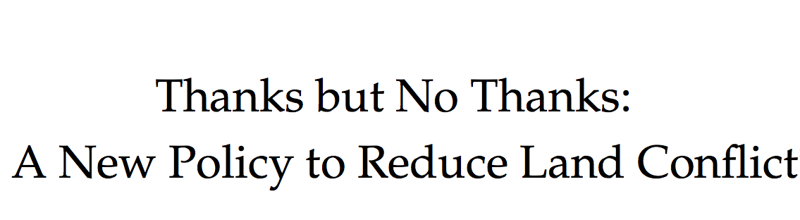
Relevant Policy problem
Behavioral insight
Policy proposal
Theoretical argument
Experimental test

Slide 3
_______________________Motivation and Context
Cooperation of users is fundamental in the management of common pool resources
Hardin: we are headed to the tragedy of the commons
Ostrom: situation not to so hopeless – many examples of cooperative local institutions across the world
This inspired large scale forest devolution policy reforms in many developing countries – but success has been limited
Gap in knowledge on how cooperation is triggered, especially after a rapid change on management rights?

Slide 4
__________________________________ Contribution
HOW should state forests be handed to community members so that the cooperate in management?
We propose a specific approach, based on a theory, and test it: lab-in-the-field experiment!

Slide 5
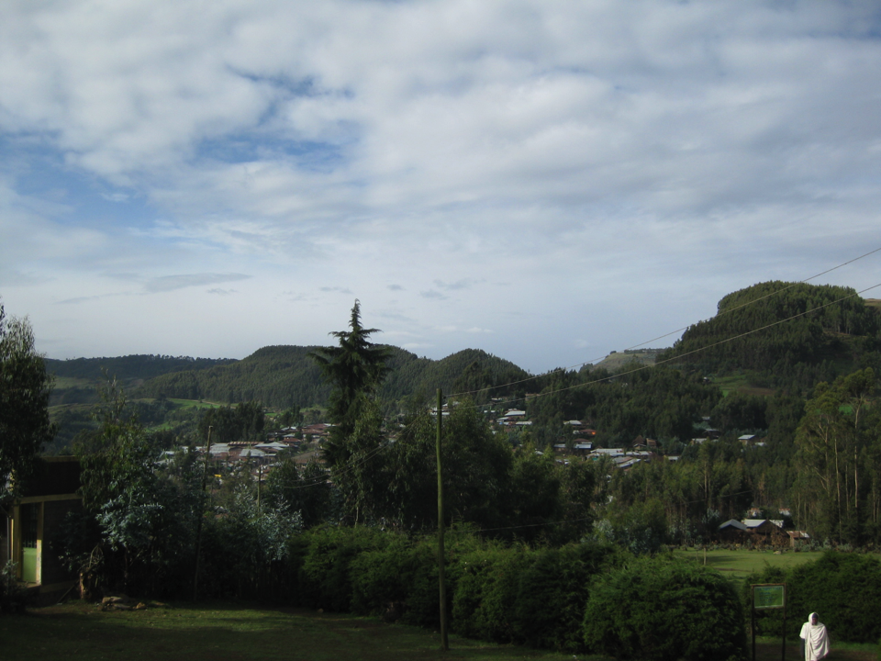

Slide 6
Common way of carrying our forest devolution :
To C or D?
To C or D?
To C or D?
To C or D?
2
4
6
8
10
12
14
16
‘Tragedy of the commons’ if people are selfish…
A coordination game if people harbor social preferences…
1
3
5
7
9
11
13
15

Slide 7
__________________________Framing the game
Consider a large number of people in a village
Forest user groups that consist 4 members
Forest user group plays a 4-player prisoners’ dilemma (MPD) game with endowment of 50 Birr
Players simultaneously decide whether to contribute their 50 Birr (C) to a public pool, or defect and keep it (D).
Contributions are doubled and shared among all 4 members equally.

Slide 8
____________________________the MPD game
 | Others’ decision
Own decision |  | CCC | CCD | CDD | DDD
 | C | 100 | 75 | 50 | 25
 | D | 125 | 100 | 75 | 50
D is dominant choice
(D,D,D,D) unique E

Slide 9
____________ MPD becomes coordination game with social preferences
e.g., maximin preferences:
 | Others’ decision
Own decision |  | CCC | CCD | CDD | DDD
 | C | 100 | 75 | 50 | 25
 | D | 125 | 100 | 75 | 50
75
50
25
The minimum is 75
(C,C,C,C) and (D,D,D,D) are both strict equilibria
Many other models of social preferences give similar results (e.g., Fehr & Schmidt, 1999)

Slide 10
_____________________Our proposed approach
Make participation voluntary!
 | Others’ decision
Own decision |  | CCC | CCD | CDD | DDD
 | C
 | D
Outside option
….where (C,C,C,C) pref to OO pref to (D,D,D,D)

Slide 11
_____________________ Forward induction
The player would only reject 60 if he was aiming for (C,C,C,C), suggesting a FI requirement selects that equilibrium.
60
 | Others’ decision
Own decision |  | CCC | CCD | CDD | DDD
 | C | 100 | 75 | 50 | 25
 | D | 75 | 50 | 25 | 50

Slide 12
_____________________ Note: changing utility
Game with changing utilities…
(C,C,C,C) 100
(D,D,D,D) 50
regardless, however…
60
 | Others’ decision
Own decision |  | CCC | CCD | CDD | DDD
 | C | 100 | 75 | 50 | 25
 | D | 75 | 50 | 25 | 50
125
100
75
50

Slide 13
Providing the OO may be costly for policy makers. However since OO is rejected intervention is counterfactual and thus free.
Our FI + equilibrium selection argument works if OO-payoff > 50
With R + CSBR we get comparable conclusions…
      if players have point-beliefs
      if beliefs reflect independence and OO-payoff > 65.4
      and more generally if OO-payoff > 87.5

Slide 14
___________ Lab-in-Field experiment in Ethiopia
We tested our proposal in lab-in-field experiment in the Ethiopian highlands
All subjects were household heads whose main form of livelihood was agriculture.
Households also depend on local forests for fuel wood and timber needs, and most forests were state owned
Neutrally framed MPD games with and without outside option
Instructions read orally with support of demonstrations and posters

Slide 15
__________________________ Three treatments
1) No opt-out option (benchmark treatment): experiment participants are randomly matched in groups of 4 players and play the MPD game
2) Low-value opt-out treatment: experiment participants first choose whether to take an opt-out option, with value of 60 Birr; those who reject it are randomly matched into groups of 4 and play the MPD game.
3) High-value opt-out treatment: experiment participants first choose whether to take an opt-out option, with value of 80 Birr; those who reject it are randomly matched into groups of 4 and play the MPD game.

Slide 16
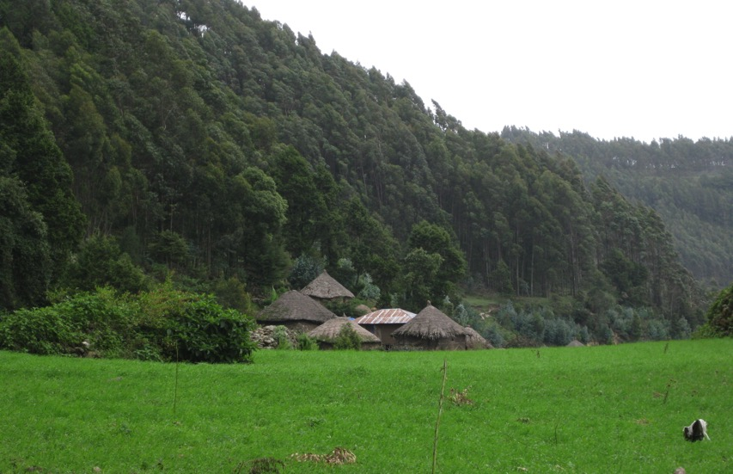

Slide 17
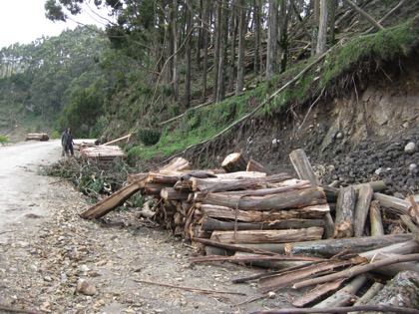
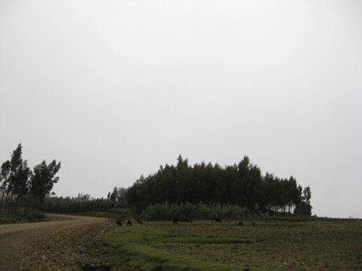
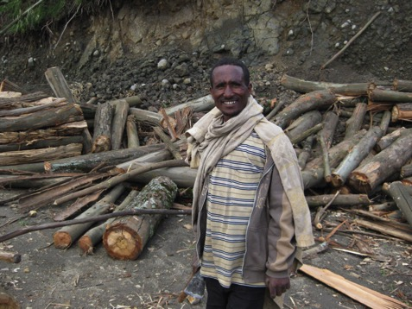
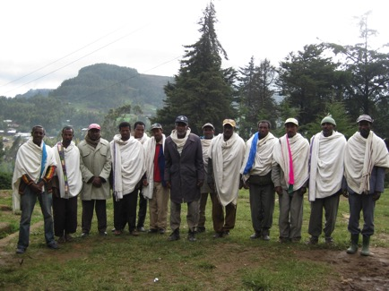

Slide 18
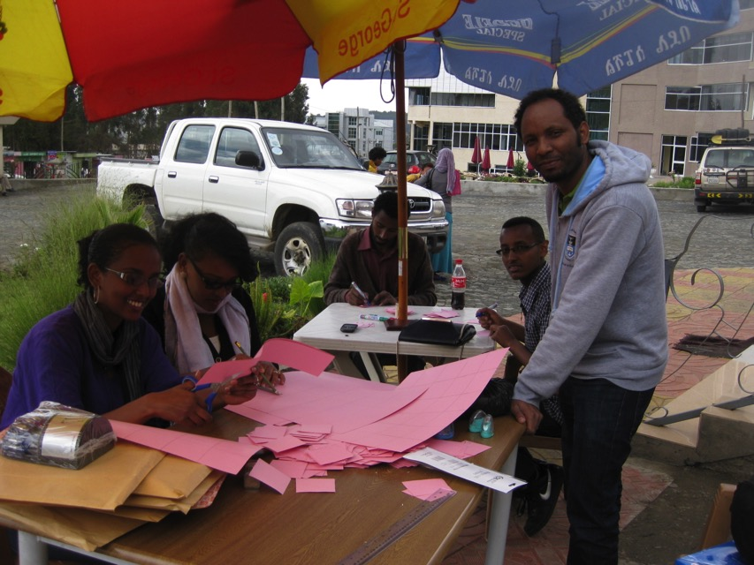

Slide 19
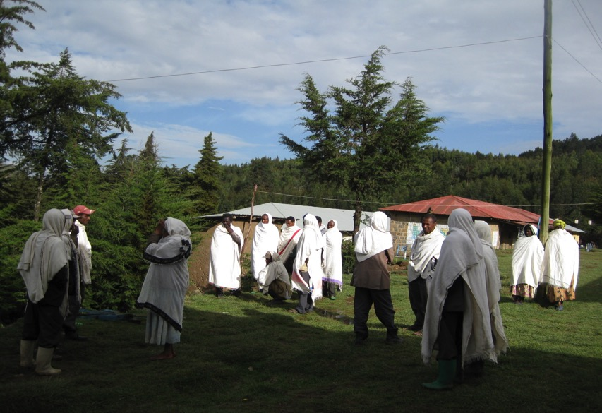

Slide 20
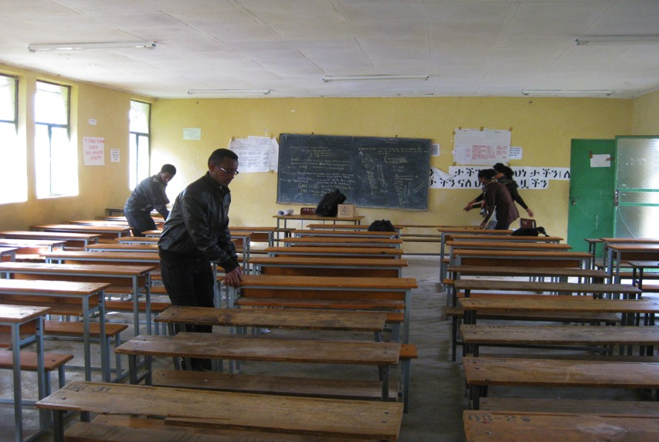

Slide 21
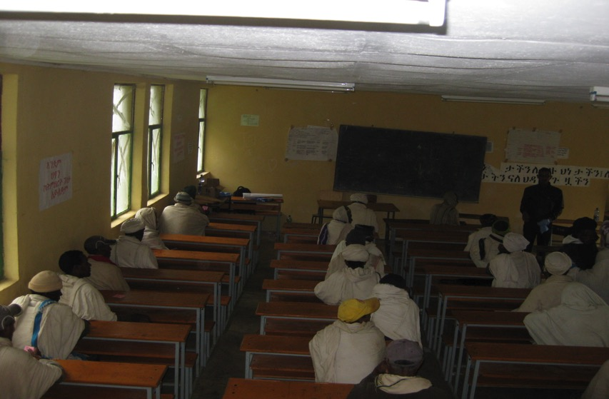

Slide 22
__________________________ Results
No OO
LV OO
HV OO
10.4%
89.6 %
24%
76 %
OO
OO

