Slide 1
Out of Africa: Human Capital Consequences
of In Utero Conditions
Victor Lavy
University of Warwick and Hebrew University
Analia Schlosser
Tel Aviv University
Adi Shany
Hebrew University
November 2014

Slide 2
Some Salient Facts About Micronutrient Deficiencies
During Pregnancy in Developing Countries

Slide 3
Iron Deficiency
Half of pregnant women in developing countries are anemic (WHO 2014).
More than half of this anemia burden is due to Iron deficiency, the rest partly due to deficiency of folic acid, vitamin B12, vitamin A, and due to parasitic infections.
Health consequences include poor pregnancy outcome, in particular impaired physical, brain and cognitive development.
If iron supplementation starts after the first trimester of pregnancy it will not help prevent these poor birth outcomes.

Slide 4
Folic Acid Deficiency
Recent review by WHO suggest that deficiencies of folic acid is a public health problem that affect many millions of people throughout the developing world.
Folic acid deficiency in early pregnancy increases dramatically the chance of a spinal cord problem (Neural Tube Defect) or brain development problems. A NTD is an opening in the spinal cord or brain that occurs very early in gestation.
Therefore FEolic acid supplement (folate) is advised for at least the first 12 weeks of pregnancy for all women - even if they are healthy and have a good diet. If Folic acid supplementation starts after the first trimester of pregnancy it will not help prevent these poor birth outcomes.

Slide 5
Iodine Deficiency (IDD)
IDD during pregnancy is world’s most prevalent cause of brain damage (WHO 2014). Thought to Matter most at time of fetal brain development.
It is estimated that 1 billion people are at risk of brain damage from IDD worldwide.
Comprehensive Handbook of Iodine (2009):
  “Iodine deficiency is now recognized by WHO as the most common preventable cause of brain damage in the world today, with excess of 2 billion at risk from 130 counties.”
Iodine deficiency reduces intellectual capacity and cognitive development, with larger effect on girls.
  “Humans require iodine for biosynthesis of thyroid hormone. In utero development of the central nervous system required for intellectual functioning depends critically on adequate supply of thyroid hormone, which influences the density of neural networks established in the developing of the brain” (Bror-Axel Lamberg 1991)..

Slide 6
Micronutrient Deficiencies in India
The prevalence of micronutrient deficiencies amongst pregnant women of New Delhi slum communities is high (Umesh et al, Indian Pediatrics 1999; 36: 991-998). Prevalence of anemia and Iodine deficiency was 78.8% and 22.9%, respectively.
A 2000-2001 survey in a sample of rural villages in Haryana State show that 73.4, 26.3, and 6.4 percent of pregnant women were deficient in iron, folic acid and iodine, respectively (Pathak et al, Indian J Pediatrics. 2004 Nov).
Padam Singh (2007): over all anemia among pregnant women in India is 85%.

Slide 7
Rresearch Question
What will be the human capital and economic consequences of eliminating these Micronutrient Deficiencies among pregnant women, for example, bringing them to the level in developed countries?
More general question, how would improvement of in utero environmental conditions affect later life cognitive and human capital outcomes?
The challenge: Identify the casual effect of in utero conditions where children’s family background correlate with in utero conditions.

Slide 8
Literature
Medical
  The fetal origin hypothesis (Braker 1992): certain chronic conditions later in life can be traced to the course of fetal development.
  Evidence on the effect of malnutrition during pregnancy:
    Dutch famine - Neugebauer et al. (1999), Rooij et al. (2010) - severe maternal nutritional deficiency early in gestation is associated with inferior brain and cognitive development of off-springs.
  Evidence on effect of radiation exposure:
    Relatively short pulse of exposure to radioactive fallout between 8 and 25 weeks of gestation has long term impact on cognitive abilities of off-springs later in life. This is plausible given the nature of the developmental events occurring in the brain during this period of gestation (Nowakowski and Hayes (2008)).

Slide 9
Literature
Economic
  Studies that use changes in local environment caused by negative in utero shocks and look at effect on health and education outcomes (review by Almond and Currie, 2011)
    Radiation shock (Almond et al. 2009 Chernobyl), Nutrition shocks (Almond et al. 2007 china famine),
  Economic shocks (Banerjee et al. 2010 19th century blight in French vineyards, Baten et al. food prices in Britain 18th century). Variation in infectious disease (Almond 2006 Influenza, Barreca 2009 malaria)
  Positive and policy driven events in early childhood:
    Food stamps program in USA that increasing family resources ((Hoynes et al. 2012) leads to reduction in incidence of obesity, high blood pressure, heart disease, diabetes, as well as an increase in reporting to be in good health.
    Migration to Sweden (Van Den Berg et al. 2012) at early childhood leads to improved outcomes at adulthood.

Slide 10
Literature
Economic
  Field et al "Iodine Deficiency and Schooling Attainment in Tanzania." AEJ Applied (2009).
  “Our findings suggest a large effect of in utero iodine on cognition and human capital: treated children attain an estimated 0.35-0.56 years of additional schooling relative to siblings and older and younger peers. Furthermore, the effect appears to be substantially larger for girls, consistent with laboratory evidence indicating greater cognitive sensitivity of female fetuses to maternal thyroid deprivation.”

Slide 11
In This Research Project
We use the immigration from a poor African country (Ethiopia) to a developed economy (Israel) in May 1991:
Quasi-experimental variation
  Immigration was unexpected, in a short time and not self selected
  Random variation in the timing of pregnancy and birth
  Different environmental conditions during pregnancy
    Pregnant women experienced different environmental conditions because of immigration, especially in terms of micronutrient deficiencies.
Natural Regression discontinuity Design
  Comparing cognitive and high school achievements of children who faced dramatic differences in prenatal conditions in utero based on their gestational age upon arrival to Israel in May 1991.

Slide 12
Unique in this Study
  Using unique identification based on a positive event of environmental differences caused by immigration.
  Investigating the effects of environmental conditions in utero in different stages of pregnancy on cognitive outcomes.
  Policy implications for developed and developing countries.
  Understanding of intergenerational effects of immigration

Slide 13
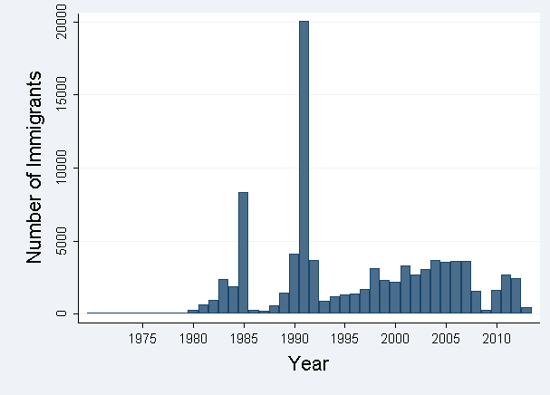
The immigration from Ethiopia to Israel
  In 1975 the Ethiopian Jews were recognized as Jewish by the state of Israel and allowed to immigrate to Israel under the Law of Return.

Slide 14
The immigration from Ethiopia to Israel
  “Operation Moses” - 6,000 immigrant airlifted from Sudan secretly between end of 1984 and 1985.

Slide 15
The immigration from Ethiopia to Israel
"Operation Solomon" - On May 24th 1991 the Israeli government brought to Israel more than 14,000 Ethiopians Jews within 36 hours.

Slide 16


“Operation Solomon” – May 24th 1991

Slide 17
Why is it Natural Experiment?
  Unexpected
    Organized by the Israeli government as a rescue operation following unstable political situation in Ethiopia
  Completed in short time
    Airlift by Israeli aircrafts within 36 hours
  Not self selected
    Included almost all the Jews living in Ethiopia
The quasi-experimental variation properties:
The timing of immigration uncorrelated with the timing of the pregnancy and birth
The decision to immigrate uncorrelated with unobserved factors like family background

Slide 18
Analysis Sample
Students born in Israel between June 1991 and February 1992 to mothers who immigrated to Israel in "Operation Solomon“:
  Their pregnancy incepted in Ethiopia but they were born in Israel
  Experienced the same conditions at birth and at later life
  Faced dramatic differences in prenatal conditions in utero based on their gestational age upon arrival to Israel in May 1991

Slide 19
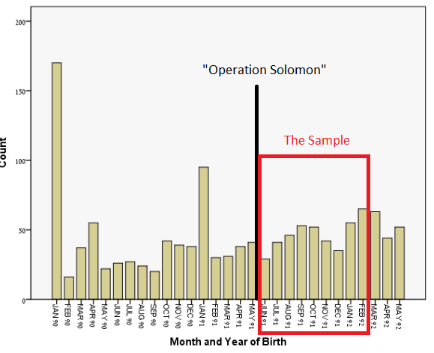
Analysis Sample
The birth distribution of all the "Operation Solomon" offspring:

Slide 20
Large environmental differences between Ethiopia and Israel that may have affected pregnant mothers
    Micro Nutrient Supplements:
      Ethiopia: No vitamins consumption (less then 1% of pregnant women age 15-49 took iron supplements for 90+ days – DHS 2011).
      Israel: use of vitamins during pregnancy, mainly iron and Folid Acid (Granot et al. (1996)).
      Iodine: Ethiopia remains severely iodine deficient. Children in Northern Ethiopia are Iodine Deficient (Girma et al. 2014). Iodine level in Israel is adequate.
    Health Care and Pregnancy Monitoring:
      Ethiopia: Little or no medical care during pregnancy. In Israel: modern health care and medicine, regular monitoring.
  Leaving Conditions and Nutrition
    Income per capita in Israel 60 times higher, nutritional level and quality in Israel better than in Ethiopia. Probably not much difference in short term.

Slide 21
Environmental Differences
Source | Ethiopia | Israel | Indicator
Israel (CBS 1993) Ethiopia (IFPRI 1993) | 1,516 | 3,089 | Calorie Supply Per Capita
The world bank (1990/1) | 120 | 10 | Mortality rate, infant (per 1,000 live births)
The world bank (1990/1) | 202 | 12 | Mortality rate, under-5 (per 1,000 live births)
The world bank (2000/1) | 15 | 8 | Low birth-weight babies (% of births)
The world bank (2000) | 27 | 100 | Pregnant women receiving prenatal care (%)

Slide 22
Data
Israeli Ministry of Education Database 2007-2011:
Students administrative records
  Birth date, Own and parental country of origin, Immigration date.
  Family characteristics – parents schooling, number of siblings.
  High School data
    Completion of 12th grade.
    Obtaining matriculation certificate by age 18.
      matriculation certificate is required for admission for academic post secondary schooling and for some jobs.
    Credit units of matriculation exams.
      Measure the quality of the matriculation program.
      Units in English and math, measures of inetability

Slide 23
Background Characteristics by Treatmetment

Slide 24
Definition of Treatment
The key variable:
The gestational age of the student at immigration (measured by weeks)
Treatment Definition by Trimester
    First trimester constitute the most critical time for negative effects of deficiencies in micro nutrients and iodine. Evidence from effect of famine on cognitive abilities later in life (Von Hinke Kessler Scholder et al. (2014), Neugebauer et al. (1999), Rooij et al. (2010)).
Treatment Definition by the critical period for fetus brain Development:
    Week 8 to week 25 is viewed as the critical period of pregnancy for fetus brain and cognitive development (Nowakowski and Hayes (2008), Loganovskaja and Loganovsky (1999). E.X. damage caused by radiation to human fetus in this period can result in cognitive deficits that still manifest 16-18 years after birth it is the major neuron genetic period of the developing human neocortex.

Slide 25
Balancing Tests
Testing the correlation between observable characteristics and timing of pregnancy based treatment definition by Trimesters:

Slide 26
Mean Outcomes by Treatment

Slide 27
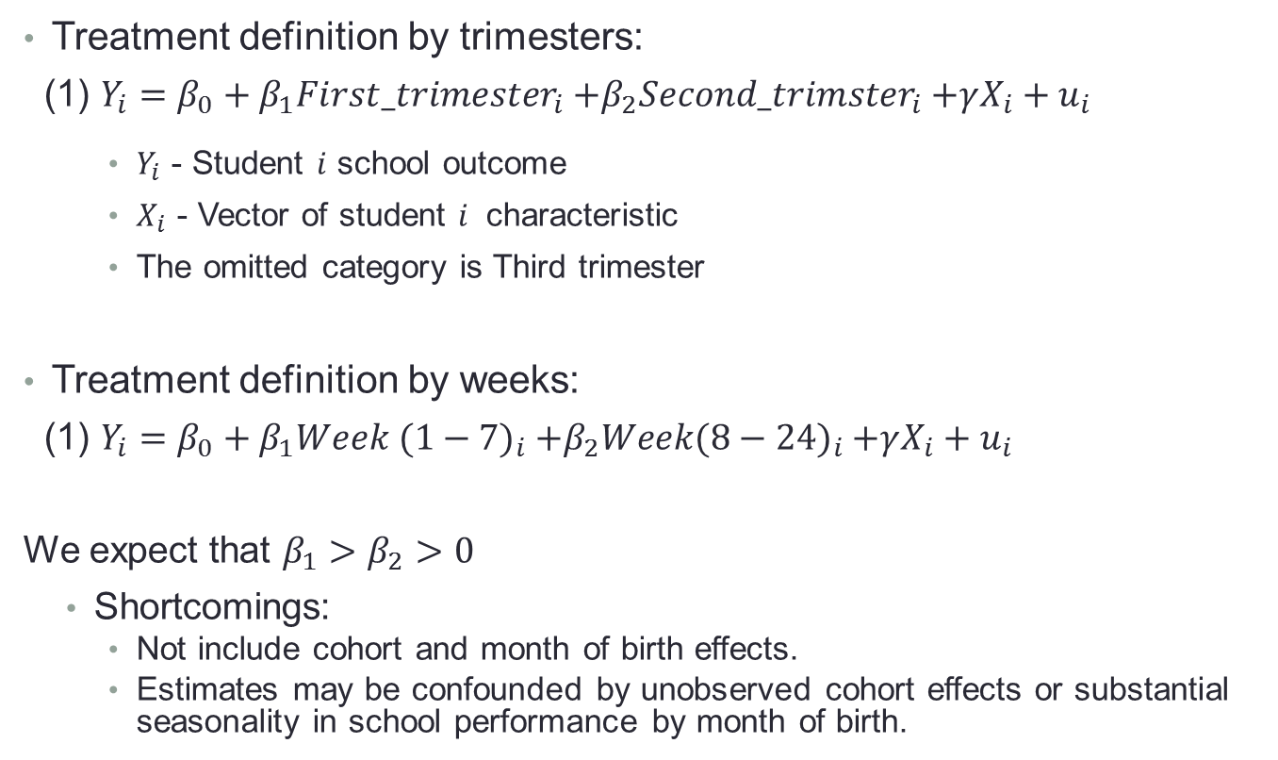
The Baseline Model
Treatment definition by trimesters:
(1) $Y_{i}={β_{0}+β_{1}First_trimester}_{i}{+β_{2}Second_trimster}_{i}+γX_{i}+u_{i}$
    $Y_{i}$ - Student $i$ school outcome
    $X_{i}$ - Vector of student $i$ characteristic
    The omitted category is Third trimester
Treatment definition by weeks:
(1) $Y_{i}={β_{0}+β_{1}Week (1−7)}_{i}{+β_{2}Week(8−24)}_{i}+γX_{i}+u_{i}$
We expect that $β_{1}>β_{2}>0$
  Shortcomings:
    Not include cohort and month of birth effects.
    Estimates may be confounded by unobserved cohort effects or substantial seasonality in school performance by month of birth.

Slide 28
Controlling for Cohort and Month of Birth Effects
(1) Adding a respective older cohort:
(2) Adding two comparison groups for the two cohorts:
Students born in Ethiopia between June 1990 and February 1991 and
immigrated to Israel on "Operation Solomon":
“Before Treatment” – Pre cohort | “Post Treatment” – Primary sample
June 1990 to February 1991 cohort | June 1991 to February 1992 cohort
Control for cohort effects and seasonality in the timing of birth in Israel. | Conception and birth In Israel | Second-generation immigrants from "Operation Moses“(parents immigrated before 1989) | Group A
Control for cohort effects and seasonality in the timing of conception in Ethiopia. | Conception and birth In Ethiopia | Ethiopian born students who immigrated between 1992 and 2000 | Group B

Slide 29
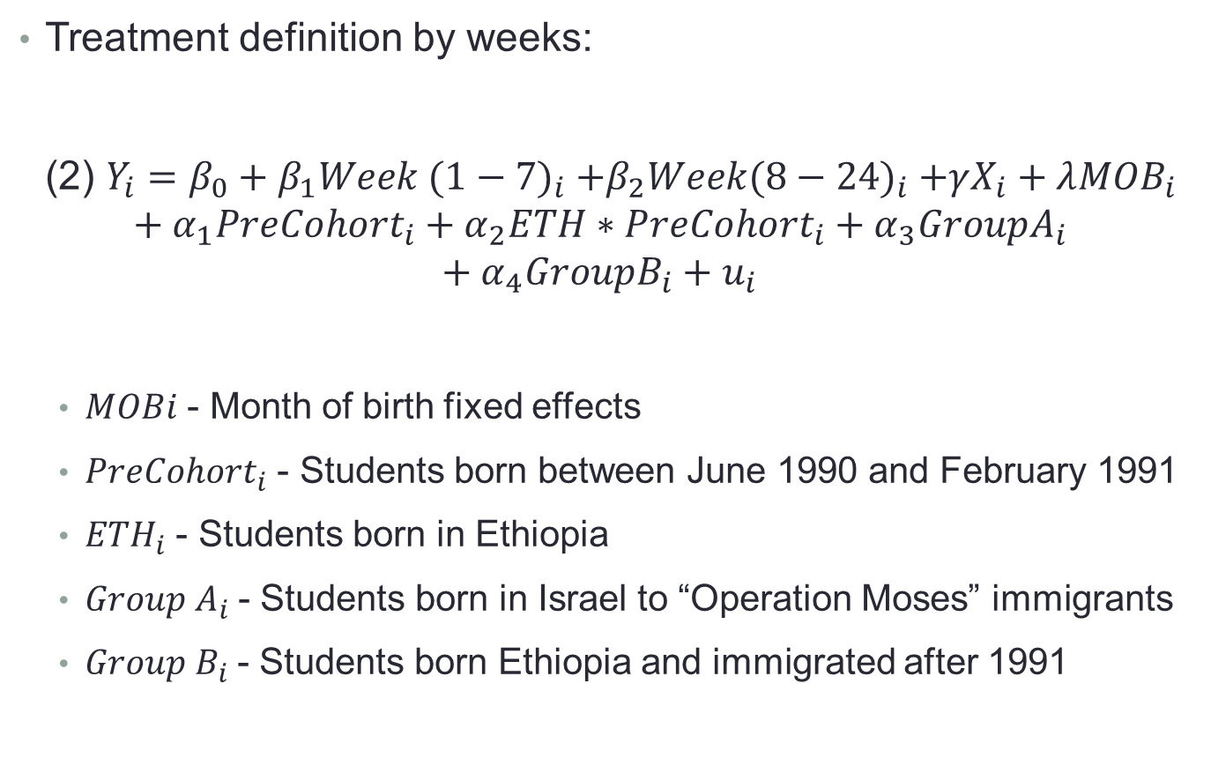
Controlling for Cohort and Month of Birth Effects
Treatment definition by weeks:
(2) $Y_{i}={β_{0}+β_{1}Week (1−7)}_{i}{+β_{2}Week(8−24)}_{i}+γX_{i}+λ{MOB}_{i}+α_{1}{PreCohort}_{i}+α_{2}ETH∗{PreCohort}_{i}+α_{3}{GroupA}_{i}+α_{4}{GroupB}_{i}+u_{i}$
  $MOBi$ - Month of birth fixed effects
  ${PreCohort}_{i}$ - Students born between June 1990 and February 1991
  ${ETH}_{i}$ - Students born in Ethiopia
  ${Group A}_{i}$- Students born in Israel to “Operation Moses” immigrants
  ${Group B}_{i}$- Students born Ethiopia and immigrated after 1991

Slide 30
Effect on Schooling Attainment

Slide 31
Effect on Repetition and Matriculation OLS Baseline

Slide 32
Effect on Repetition and Matriculation Two Years Cohorts Sample

Slide 33
Effect on Quality of the Matriculation Program
OLS Baseline

Slide 34
Effect on Quality of the Matriculation Program
Two Years Cohorts Sample

Slide 35
Effect Size
Effect on Matriculation diploma is about twice the effect of attending a high quality primary school versus a low quality primary school
Gould, Lavy and Paserman, QJE May 2004:
“Immigrating tp Opportunity: Estimating the Effect of School quality Using A Natural Experiment on Ethiopians In Israel”

Slide 36
Additional Results
Heterogeneity Effect by Gender:
  Large and significant effect for girls.
  Small and insignificant effect for boys.
Heterogeneity Effect by Family Education:
  Much larger and significant effect among the "high education" group.
  Negligible effect for the low education group.
Robustness Checks:
  Results are similar when dropping from the sample students who born in the last two weeks of February.
  Placebo test: Estimating equation (2) for the comparison groups only.

Slide 37
Effect By Gender

Slide 38
Effect on Repetition and Matriculation Two Years Cohorts Sample, GIRLS

Slide 39
Effect on Repetition and Matriculation Two Years Cohorts Sample, BOYS

Slide 40
Effect on Quality of the Matriculation Program
Two Years Cohorts Sample, GIRLS

Slide 41
Effect on Quality of the Matriculation Program
Two Years Cohorts Sample, BOYS

Slide 42
Why larger effect on girls?
Evidence of larger impact for girls is consistent with related literature.
1. Baird et al (2011) find that in DC girls infant mortality is significantly more sensitive to aggregate economic shocks during pregnancy.
2. Field et al. (2009) find that delays in resupply of iodine for pregnant women in Tanzania has larger educational improvements for girls.
3. Oreopoulos et al. (2008) show that effects of infant health on reaching grade 12 by age 17 appear to be stronger for females than males.
4. Hoynes et al. (2012) find that increasing family resources during early childhood improve health at adulthood for both men and women but have positive significant effect on economic self-sufficiency only for women.
5. Gould et al. (2011) find that early childhood living conditions affected only girls short and long term outcomes (until age sixty).

Slide 43
Why larger effect on girls?
Other studies, suggest that from conception and during pregnancy, males are more vulnerable than females.
1. Ravelli et al. (1999) show that in the Dutch famine during the Second World War the number of boys born fell in relation to the number of girls.
2. Eriksson et al. (2010) suggests that in the womb boys have a more dangerous growth strategy than girls. They grow more rapidly and invest less in placental
growth, which puts them at greater risk of becoming undernourished.
3. Kraemer (2000) discusses how the human male is, on most measures, more vulnerable than the female, a vulnerability that is attributed in part to the biological fragility of the male fetus and argues that girls are more likely to survive adverse in utero health conditions.

Slide 44
Why larger effect on girls?
If there are more spontaneous abortions of boys in utero during adverse conditions, as suggested in the literature, one possible explanation for our findings could then be that better environmental conditions early in utero enabled marginal boys to be born.
This could explain the absence of an effect of early exposure to better environmental conditions among boys since we compare between relatively stronger boys born to mothers who immigrated during weeks 25+ and marginal boys born to mothers who immigrated during weeks 1-7.

Slide 45
Effect by Parental Education

Slide 46
Effect on Repetition and Matriculation Two Years Cohorts Sample, By Education

Slide 47
Effect on Quality of the Matriculation Program
Two Years Cohorts Sample, By Education

Slide 48
Why larger effect in educated families?
These results are consistent with previews findings in the literature.
Studies found that the negative impact of poor fetal health [Currie and Hyson (1999)] or exposure to negative shocks in utero [Almond, Edlund and Palme (2009)] on human capital accumulation is greater in low-education or low-income families.
The explanation given for this finding is that higher educated families tend to compensate for negative shocks to fetal health or to poor birth health outcomes.
Moreover, negative shocks have usually smaller effects on children in high income families because they are less vulnerable.
In our analysis we evaluate the effect of positive shock so obtain the opposite result. The explanation can be that mothers with some formal education are able to take more advantage of a positive environmental shock by accessing more better medical technologies and nutrition.

Slide 49
Effect on Birth Weight

Slide 50
Effect on Birth Weight

Slide 51
Effect on Low Birth Weight (< 2500 gr)

Slide 52
Effect on Very Low Birth Weight (< 1500 gr)

Slide 53
Potential Longer Term Returns

Slide 54
Potential Longer Term Benefit

Slide 55
Conclusions
Exposure to better environmental conditions in utero during the first trimester of gestation (before week 13 at the latest or week 8 at the earliest) is associated with substantially better high stakes cognitive achievements by end of high school.
  Large expected earnings gain at adulthood.
Expected large effect on productivity and standard of living (ignoring general equilibrium effects).
Policy implications for developing countries: importance of pre-natal nutritional supplement programs, gains outweigh cost
Policy implications for developed countries with immigration from poor African countries (ex., Israel, Italy, France, Spain): target prenatal nutritional supplements

Slide 56
Definition of Treatment
  By Weeks (by the critical period for fetus brain development):
  By Trimester:

Slide 58
Linear regression: searching for the critical period
Estimated Effect of In-Utero Environment on Schooling Outcomes by Age 18 -Linear effect
 | Dropped out of high school before completing 12th grade |  |  |  | Obtained a matriculation diploma after 12 years of schooling |  |  | Total matriculation units |  |  | Math matriculation units |  |  | English matriculation units
Dependent variable
 | (1) | (2) |  |  | (3) | (4) |  | (5) | (6) |  | (7) | (8) |  | (9) | (10)
Week | 0.001 | -0.003 |  |  | -0.005** | -0.021*** |  | -0.175*** | -0.323** |  | -0.022*** | -0.054** |  | -0.029*** | -0.073**
 | (0.002) | (0.005) |  |  | (0.002) | (0.006) |  | (0.046) | (0.164) |  | (0.006) | (0.022) |  | (0.007) | (0.027)
Week^2 |  | 0.000 |  |  |  | 0.000 |  |  | 0.005 |  |  | 0.001 |  |  | 0.001*
 |  | (0.000) |  |  |  | (0.000) |  |  | (0.005) |  |  | (0.001) |  |  | (0.001)
Number of students | 418

Slide 59
Effect on Attending a Regular School, Repetition and Matriculation Two Years Cohorts Sample, By Education and Gender

Slide 60
Effect on Quality of the Matriculation Program
Two Years Cohorts Sample, By Education and Gender

Slide 61
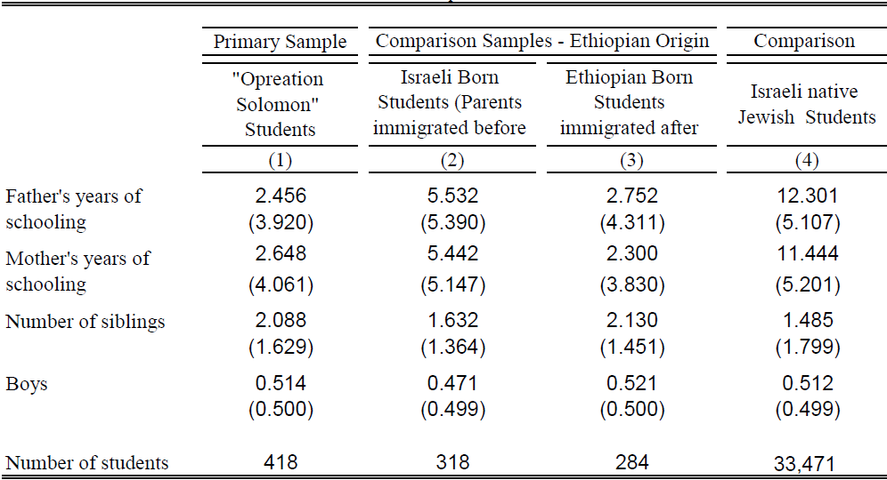
Summary Statistics
Background characteristics:
  Comparing our primary sample to other students (Ethiopian origin and Israeli natives) in the same cohort.

Slide 62
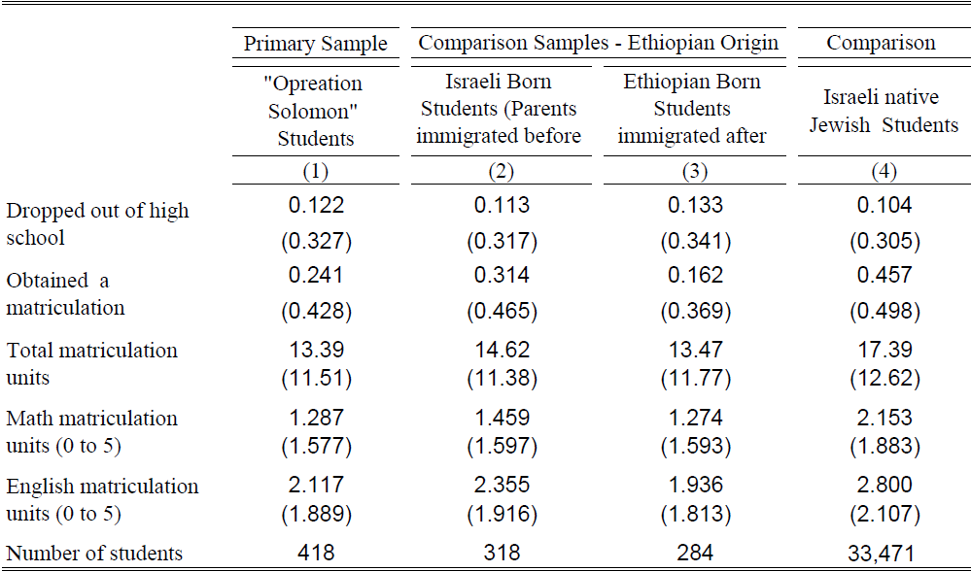
Summary Statistics
Outcome variables:
  Comparing our primary sample to other students (Ethiopian origin and Israeli natives) in the same cohort.

Slide 63
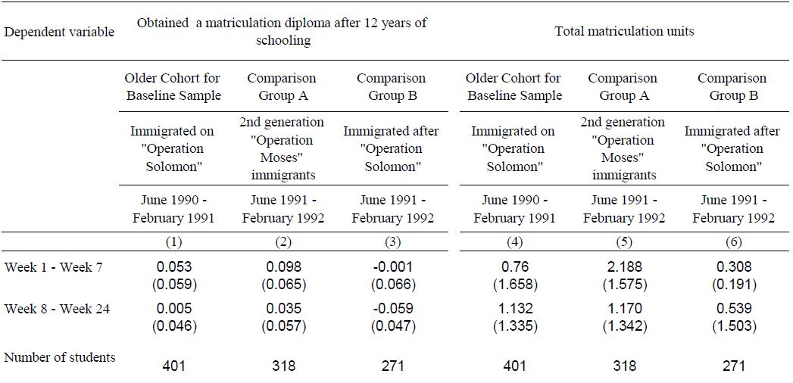
Placebo Test
Estimating equation (2) for the comparison groups only:

