Slide 1
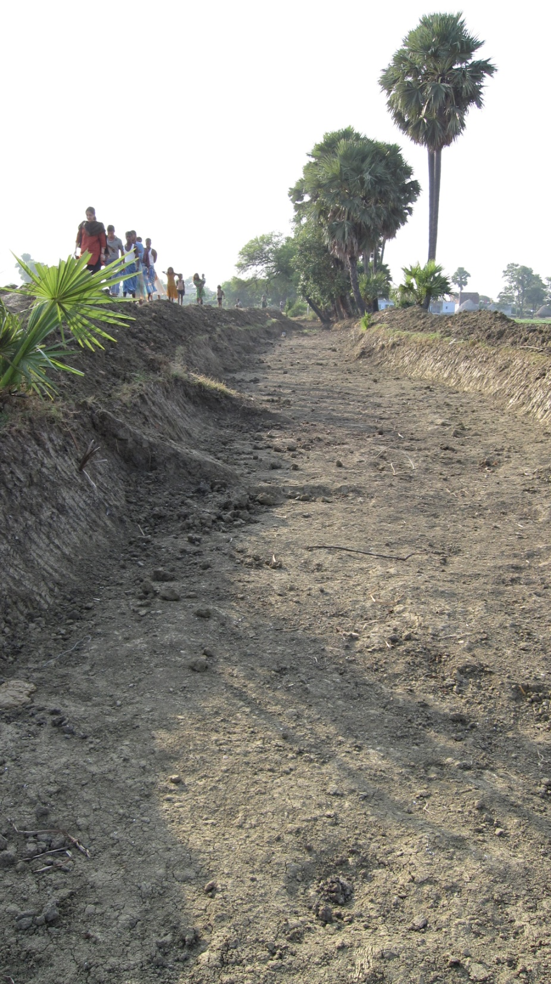
Presentation at the Indian Statistical Institute Conference, New Delhi, December 2011
The impact on poverty in Bihar of the National Rural Employment Guarantee Scheme
Puja Dutta, Rinku Murgai, Martin Ravallion and Dominique van de Walle
World Bank

Slide 2
India’s National Rural Employment Guarantee Scheme (NREGS)
NREGS is the most ambitious effort India has ever made to directly address absolute poverty.
Introduced in May 2006, the scheme:
  guarantees 100 days/ h’hold/year of unskilled work on public works projects in rural areas
  provides work on demand after h’holds obtain a job card;
  pays a piece-rate such that a normal worker can earn the state-specific minimum wage rate set for the scheme
  entitles women to equal wages

Slide 3
NREGS should be important for Bihar
Bihar has the highest rural poverty rate of any Indian state; 50+% in 2009/10. Also high % of rural landless.
Yet it has a relatively low participation rate in NREGS. Why?
Bihar: highest rural poverty rate (56%) based on 2009/10 NSS and PC poverty lines but one of lowest participation rates (0.22) significantly below the regression line (t=-3.16).

Slide 4
How close does NREGS in Bihar come to achieving its potential impact on poverty?
Does NREGS really guarantee employment to anyone who wants it in rural Bihar? Rationing of employment opportunities may be common.
forgone employment and income is unlikely to be zero in reality; poor people cannot afford to be entirely idle, but will find something to help make ends meet. But how much forgone income?
Leakage? Anecdotes that wages not paid in full; “ghost workers;” contractors use machines and pocket the difference. But how common in practice?
How much impact on poverty in rural Bihar?

Slide 5
Outline of presentation
Demand for work and rationing
Wages
forgone income
Impacts on poverty
Comparisons with other states
Why so much rationing in poor states?
Main messages

Slide 6
Demand for work and the rationing of the available work

Slide 7
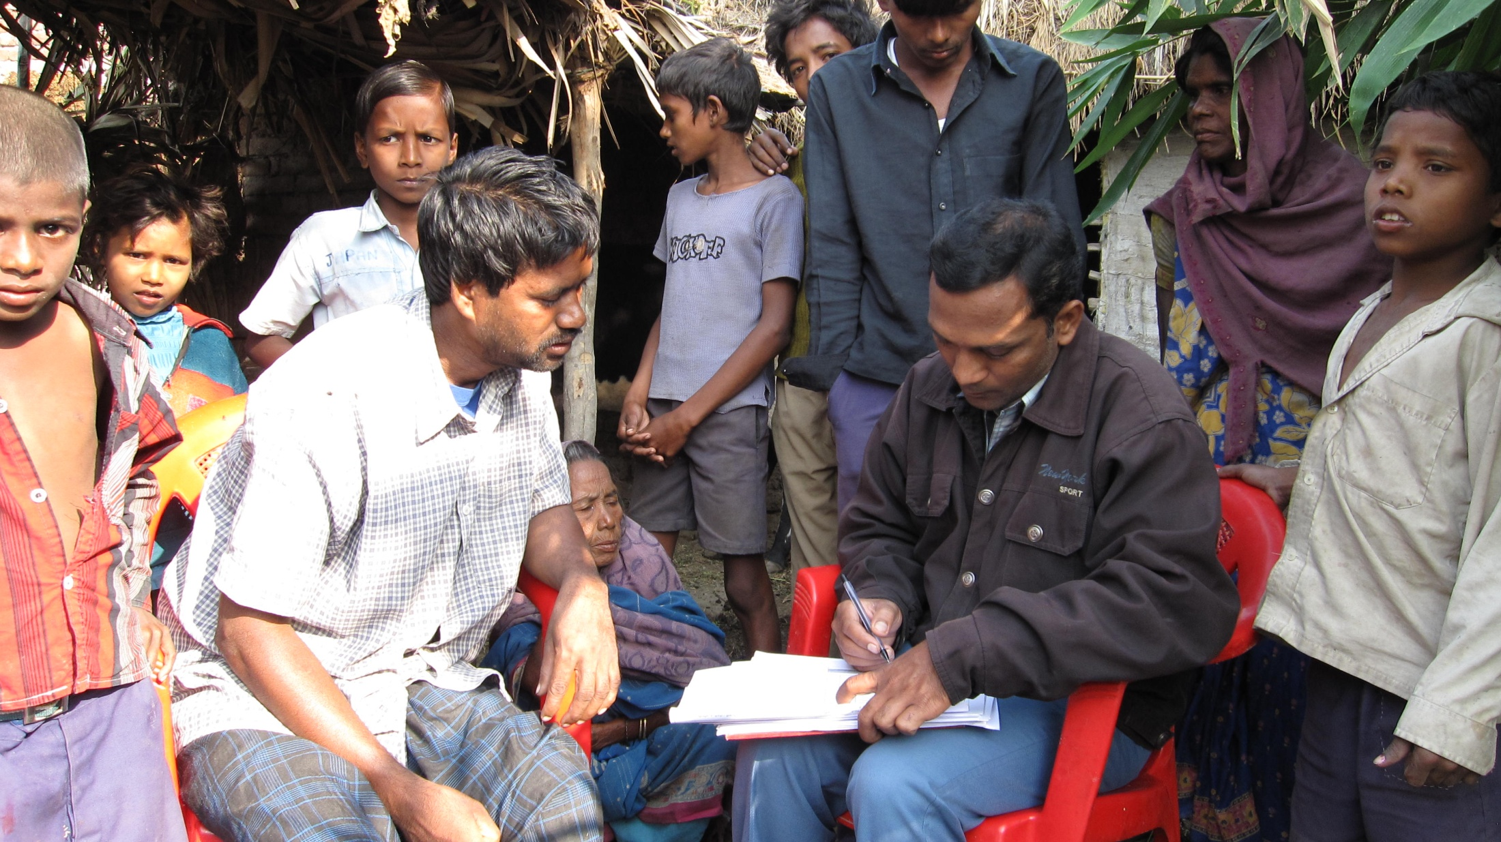
A closer look at NREGS in Bihar using our surveys

Slide 8
Survey data for the study
2009 Baseline survey (Round 1; “R1”)
3,000 randomly sampled households in 150 villages of rural Bihar surveyed in April-July 2009
5,200 adult individuals, one male and one female from each household
(“BREGS: The Movie:” A randomized control trial to test if information can improve performance=> another paper)
2010 Follow-up survey (Round 2; “R2”)
same villages/households in April-July 2010

Slide 9
Three groups
Participants in NREGS
“Excess demanders”: those who say they would like to work on NREGS but did not obtain work
The rest

Slide 10
Does NREGS guarantee employment? No
Huge excess demand by men and women; 66% of those households who wanted work on NREGS did not get it in R1; rising to 73% in R2.
Women are more likely to be excess demanders than to be participants; 81% of women versus 62% of men could not get NREGS work when they desired it in R1; 79% and 70% in R2.

Slide 11
Clear signs of pro-poor targeting
Over the bulk of the data (85%) participation declines as wealth rises
Poorest 15% are an exception; amongst this group, higher wealth implies higher participation
But not just “self-targeting” (whereby non-poor don’t want the work)
Note: Wealth measured by an “assets index” as a
function of housing and other assets and durables

Slide 12
The rationing process is also pro-poor
The probability of being rationed (wanting NREGS work but not getting it) is lower for the poor.
It is the relatively well-off groups who are rationed most in access to desired work on NREGS.

Slide 13
Findings from modeling participation and demand for work on NREGS 1
Demographics and gender matter
  Less likely to participate and more likely to be rationed in family with
    more adult females
    female head
Education matters
  Less well educated are more likely to want work on NREGS and to get it
Caste and religion matter
  Mahadalits more likely to both want NREGS work and to get it; other SC more likely to be rationed out
  Hindus more likely to want work and to participate

Slide 14
Findings from modeling participation and demand for work on NREGS 2
Existing registration as “poor” and political connections matter
  BPL card is a significant predictor of both demand for work and participation
  Connections to Mukhiya, Sarpanch or block officer influence whether work is obtained, but not demand for NREGS
Village characteristics matter
  Mukhiya’s power influences participation in the scheme
  Better infrastructure (pucca road) decreases desired participation but increases actual participation
  Higher inequality within village decrease demand for work on NREGS and participation

Slide 15
In summary:
Substantial and systematic rationing
Roughly two-thirds of those that want work don’t get it.
Relatively well-off groups are more likely to be excluded from access when they want it.
There is a clear gender dimension to the rationing, in that it is more likely for households with a large share of adult women and female headed.
Predominantly Muslim villages are more likely to be rationed,
Rationing more likely for those who do not have BPL card and lack political connections.
Those who are poor but lack the typical profile of the poor appear to be more likely to be excluded from access to the scheme when they want it.

Slide 16
Wages

Slide 17
NREGS is paying more than other casual work
In R1, PW wage 13% higher
than other casual work; 9% R2
Wages of excess demanders
similar to the non-PW wages
of NREGS participants
Those who get the jobs
on PW are essentially drawn
from the same wage
distribution as those who
do not get that work, but
want it.
This is again suggestive
of rationing in the
assignment of jobs.

Slide 18
Yet persistent gap between stipulated wage and reported wage
Mean of actual wage
received on NREGS
is about 10% lower
than the stipulated
wage rate
Half the workers
earned less than
90% of the stipulated
wage rate
Marked seasonality
In NREGS employ-
ment.

Slide 19
A wage floor?
In R1, only 14% of PW workers earned less than 75% of the minimum wage rate, as compared to 46% of non-PW workers. (21% and 45% in R2).
It appears that NREGS is able to provide a higher (though still variable) “wage floor” to participants than in other casual work.

Slide 20
Less of a wage floor for women
The proportion of women earning considerably less than the minimum wage rate is markedly higher than for men in both rounds.
In R1, 25% of women were earning less than 75% of the minimum wage rate, as compared to 16% of men. The gap only narrowed slightly in R2.
It is clear that NREGS is even less effective in providing
a wage floor for women than men.

Slide 21
But women get better wages under NREG than casual market

Slide 22
Leakage: Some comparisons with administrative data

Slide 23
Forgone income

Slide 24
Participation often comes at a cost
There is bound to be some loss of income from other sources for at least some of those who take up public works employment.
Given that the wage rate is so much higher than that for other work, some will naturally be attracted to NREGS for the wage gain over alternative work.
Others will no doubt be unable to find other work, and for them the wage gain is also the net income gain from NREGS.
The literature on the impacts on poverty of public works schemes has emphasized the importance of assessing the forgone income.

Slide 25
Estimating forgone employment and income
Various approaches in the literature (time allocation model; matching estimators).
Here we use individual self-assessments.
  Individual knows a lot more than we do!
  However, counterfactual questions are not easy to answer
  Alternative interpretations of the question (=>)
The survey asked counterfactual questions of actual participants, to obtain their assessment of how many days they expect to have worked and what they would have earned in the absence on the program.

Slide 26
Alternative interpretations of self-assessed forgone income
Interpretation 1: “Absence of the program for me only” => partial equilibrium forgone income
Interpretation 2: “Absence of the program for everyone” => general equilibrium forgone income
If respondents tended to use interpretation 1 then we will probably overestimate forgone income to the extent that counterfactual options overlap across respondents.
Since this is a relatively new program we expect interpretation 2 to apply to most people.
Sensitivity tests to alternative interpretations.

Slide 27
Gross vs. net gain in employment
Round 1
79 million person days of employment.
43% mean forgone employment in R1.
Round 2
98 million person days of employment provided,
but 42% days had to be given up.
Gender: Slightly higher forgone employment for men than women

Slide 28
Two alternatives to NREGS work
In R1, 39% of those who worked on PW had zero forgone income (42% in R2).
The rest reported that they felt they would have been working otherwise.
Mean ratio of forgone income to PW wages is 0.37 in R1, rising to 0.39 in R2. The corresponding medians are 0.36 and 0.31.
Lower mode at zero
Middle mode
at around 0.4
There is forgone income, but it varies considerably
between workers, which is not surprising.

Slide 29
Impacts on poverty
Bringing these elements together

Slide 30
Impact relative to “No-BREGS”
The post-BREGS distribution of consumption is that observed in the data
The pre-BREGS distribution is derived from this by subtracting the net gains from BREGS earnings, as given by gross wages less the imputed forgone income.
  Ignoring assets and savings

Slide 31
More formally
Actual (observed) post-BREGS poverty measure:
P(y₁,….,y_{n}; z)=P(y; z)
Counterfactual poverty measure in the absence of BREGS:
P(y – w + f; z)
where w = n-vector of actual wage earnings from BREGS
f = n-vector of forgone incomes due to taking up BREGS work
Impact on poverty =
P(y; z) – P(y – w + f; z)

Slide 32
About 1% point reduction in poverty due to the scheme
A 1% point reduction in the poverty rate at a poverty line of slightly more than 5,000 Rupees per person per year.
Amongst PW participants alone, the impact is higher, with a peak reduction in the poverty rate of 3% points, also at a poverty line of 5,000 Rupees.

Slide 33
An idealized counterfactual
What is the potential impact under ideal conditions?
  100 days of work per household who wants that work
  At the stipulated minimum wage rate for the scheme
  Only fully unemployed people join, i.e., no forgone income
  Again ignoring assets and savings
Impact on poverty =
    P(y – w + f; z) – P(y – w + f + 100w*d; z)
  where d=(d₁,…, d_{n}) is desired participation (self-reported) in NREG at stipulated minimum wage daily rate of w*

Slide 34
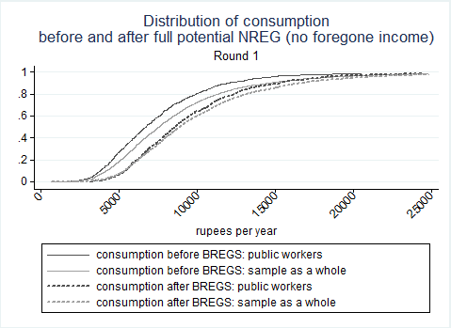
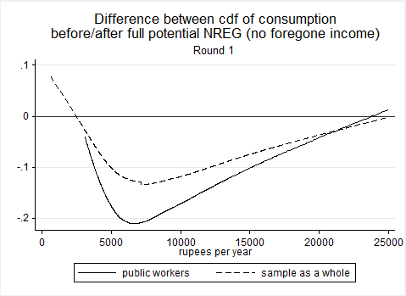
NREGS has a much larger potential impact on poverty in Bihar
12% point reduction
in poverty rate

Slide 35
Rationing accounts for large share of performance gap
To estimate impact in the absence of rationing we:
  Scale up days of work to those desired, up to 100 days per h’hold with extra days valued at their mean net wage.
  Give the median net earnings to those who wanted work but did not get any.
Then we get a poverty impact of 4-5% points.

Slide 36
An alternative counterfactual
Suppose the same gross expenditure on NREGS was used to finance a uniform lump-sum transfer to all rural households, whether poor or not.
This would have a larger impact on poverty than NREGS as it is currently performing.
Also true of an alternative using BPL card targeting.

Slide 37
Comparisons with other states
Using 2009/10 NSS

Slide 38
A puzzle about NREGS in India as a whole
Participation rates on NREGS across states of India are only weakly correlated with poverty rates across states.
Why?

Slide 39
Yet poorer states of India have higher demand for work on NREGS
Poorer states have a higher % of h’holds who want work on NREGS (actual employment + those who say they want work but could not get it).
Though here too Bihar is an outlier, with demand for NREGS 0.14 below the regression line (t=-2.58).

Slide 40
Rationing in poorer states is the reason
Greater rationing—un-met demand for work on the scheme—in some of the poorest states.
Highest rationing in Bihar, but also high in Jharkhand and Orissa.
Low levels in TN, HP, Rajasthan and Kerala
But low levels of rationing elsewhere, suggesting that the scheme is working better

Slide 41
Why so much rationing in poor states, including Bihar?
Here we can only offer some conjectures, informed by the evidence and our field observations

Slide 42
1. Lack of awareness on the part of workers
Our survey suggests that awareness of the right to work is low, esp., women.
  95% of men and 73% of women had heard about the program
  But most were unaware of their rights and entitlements under NREGA. Low level of understanding about how to get work.
Yes they still say they want work, but they don’t realize they can demand work, and should get unemployment benefit if it is not provided.
But why are they so unaware? History of subjugation/disempowerment, premised on illiteracy?
Awareness is endogenous, but it can be influenced externally: our RCT for the BREGS movie.

Slide 43
2. Low administrative capacity in poorest states
Supply side is slow to respond.
  Low levels of participation; few gram sabhas.
  Lags in execution; intermittant closures
  Poor flow of funds accounting
  Wages paid in cash not through POs
  Poor supervision
  Lack of transparency
A scheme such as NREGS is likely to be harder to implement in poor states.

Slide 44
3. Corruption?
Surely corrupt local officials will have an incentive to eliminate the rationing by starting more projects?
Not if their own personal gain from doing so is constrained by the design of the scheme.
Corruption requires cooperation between a set of stakeholders (officials and workers).
Marginal cost of corruption may rise steeply at higher levels of disbursement given checks and balances built into the design.
Very high MC when local officials would need to extend their network of collusion beyond the “comfort zone” of those they trust.

Slide 45
A simple model of rationing on NREGS
Local officials maximize:
R(E)-C(E) s.t. E<D(w)
  R(E)=officials’ own revenue at employment E; C(E) =cost of corruption; D(w)=supply of labor
  to NREGS at wage w
  Assume R”(E)<C”(E)
There will be rationing in equilibrium if E*<D(w), where R’(E*)=C’(E*) .
MC
MB
E*
D(w)
D(w)-E*=Rationing
in equilibrium

Slide 46
Main messages

Slide 47
NREGS in Bihar is falling well short of its potential impact on poverty
Potential 12% point reduction in poverty in Bihar vs, actual impact of 1% point.
Some of this gap is hard to avoid, esp., forgone income
But also many discrepancies between “theoretical ideal” and practice
  Rationing is common; 2/3 of those who want work do not get it
  While the rationing process is “pro-poor” overall some socially/politically excluded groups have poor access
  Received wages lower than stipulated wages
  Worksites often lack facilities
  Processes weak

Slide 48
Performance issues are limiting the potential benefits in Bihar
Rationing makes it unlikely that there will be large insurance and empowerment benefits.
Shocks do not predict participation.
Lack of awareness of rights under NREGS also makes it unlikely that there would be large impacts on empowerment.
No sign of impacts on participation in village decisions or that respect in the community improved.

Slide 49
Bihar is not typical of NREGS in India
There is a collection of some of the poorest states (Bihar, Orissa and Jharkhand) where rationing is substantial.
But also a number of states where this is not a problem, suggesting that the scheme is likely to be working better in reducing poverty and attaining its insurance and empowerment potential.
Harder to reduce poverty in poorer states.

