Slide 1
Cycling to School:
Increasing Secondary School Enrollment for Girls in India
Karthik Muralidharan
(UC San Diego, NBER, J-PAL, BREAD)
Nishith Prakash
(University of Connecticut, IZA, CReAM)
IGC Growth Week 2012
Session on Bihar
25 Sept. 2012

Slide 2
Background/Motivation
Increasing female school attainment is one of the MDG’s
Improving female education directly contributes to the ‘inclusive growth’ agenda of the Government
  Growth – by increasing human capital of the labor force
  Inclusive – by allowing more people to participate in the growth process
Large gender gaps in India (and especially in Bihar) in school attendance (grows with age)
Primary schools now exist within 1km of most villages
But distance is still an important barrier to secondary school attendance (again, more so for girls)

Slide 3
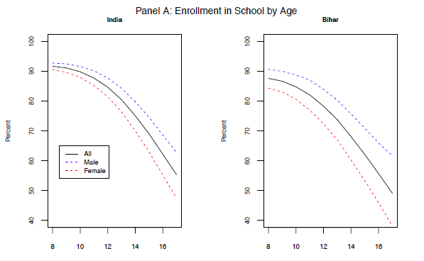
School Enrollment by Age & Gender

Slide 4
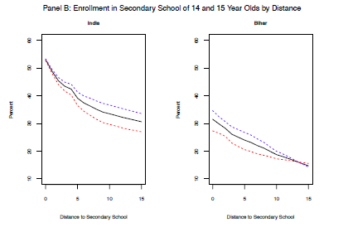
Enrollment of 14-15 year olds in Secondary School by Distance & Gender

Slide 5
Policy Intervention
In 2006, GoB initiated a program to provide bicycles to all girls studying in classes 9 and 10
  Personal initiative of the Chief Minister
  Program was called the “Mukhyamantri Balika Cycle Yojana (MBCY)”
An allocation of Rs. 2000/student was made (now Rs. 2500)
No direct provision of bicycles – cash was made available to eligible students through the schools, and receipts for purchase of cycles were collected
This was effectively a CCT (or CKT) program and was India’s first scaled up CT program for girl’s secondary education
  High-profile program, politically very visible (and also copied)
  Concerns include fake enrolments, and leakage of funds
  What was the impact of the program?

Slide 6
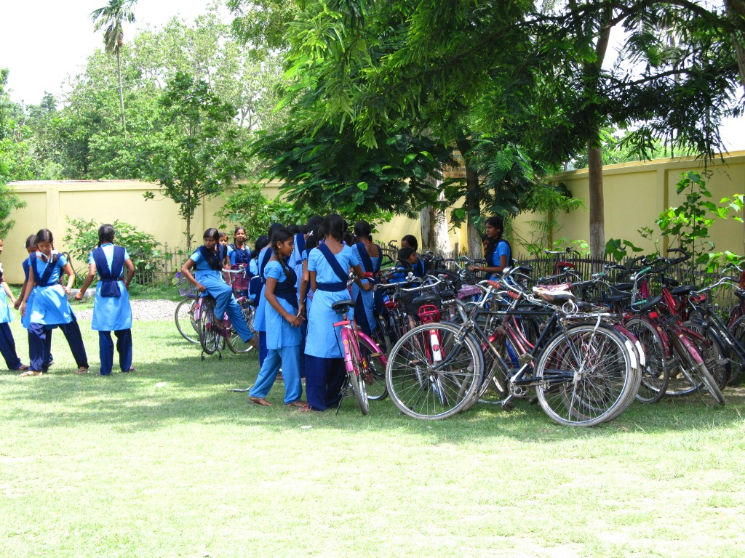
Picture Credits: Abhinav Nayar

Slide 7
This Paper
Aims to:
  Evaluate impact on secondary school enrolment for girls
  Examine the mechanism of impact (conditionality vs. cycle)
Main challenge for the empirical analysis is that the program was implemented state-wide and so it is difficult to find a control group
  Boys (double difference)
  Jharkhand (triple difference)
If the impact was because of the cycle itself, we should see differential impacts by distance to school
  Quadruple difference (by distance)
  Plot triple-difference by distance (non-parametric)

Slide 8
Data & Estimation Strategy
We use the 2008 District-Level Health survey (DLHS)
  Representative sample of ~1,000 HH/district (total sample of close to 50,000 HH across Bihar/Jharkhand)
  Family roster with education histories
  Village data includes distance to nearest secondary school
Survey conducted ~1.5 years after MBCY launched
  So we treat 14-15 year olds as ‘treated’ cohorts and 16-17 year olds as ‘control’ cohorts
  Dependent Variable: Enrolled in or completed class 9
  14-15 vs.16-17 year old girls (first difference)
  Compare with corresponding difference for boys (second difference)
  Compare double difference across Bihar & Jharkhand (triple difference)
But mechanism could be the ‘conditionality’ or the ‘cycle’ or other factors as well (other programs; changes in returns to education for girls in BH)
  If the channel of impact is that the cycle reduces the ‘distance cost’ of attending school, then we should see a larger impact in villages where the nearest secondary school is further away (data lets us test this)

Slide 9
Results (Double Difference)

Slide 10
Results (Triple Difference)

Slide 11
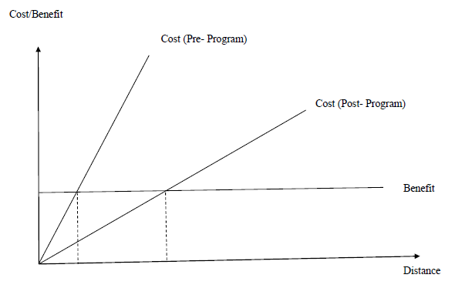
Sketch of Mechanism of Impact

Slide 12
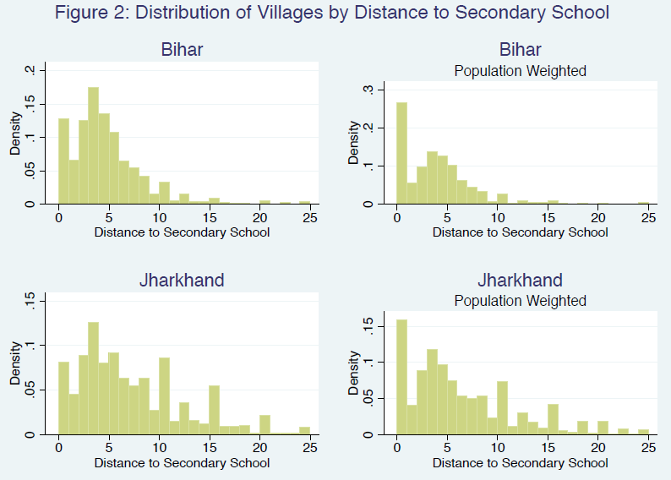

Slide 13
Quadruple Difference

Slide 14
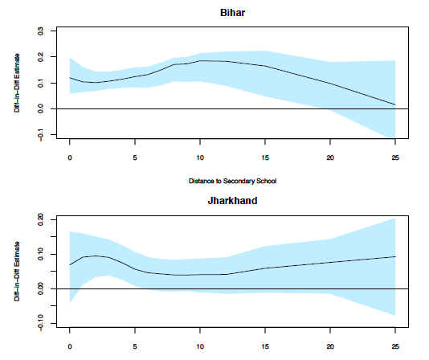
Double Difference by Distance

Slide 15
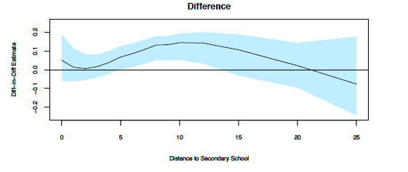
Triple Difference by Distance

Slide 16
Cycle Ownership
In looking at mechanisms, we may care about whether the ‘treated’ HH actually received the bicycle!
Asset questions in DLHS include bicycle ownership
  But it does not have ‘number’ of cycles (hence low-powered)
  So the triple difference is positive but not significant
But we compare bike ownership between HH with 14-15 year old girls in school and those with 14-15 year old girls who are not in school and see that the former HH are 20 percentage points more likely to own a bicycle
Notes:
KM

Slide 17
Learning Outcomes
No measured impact, but the data is under-powered (both in terms of sample size and range of test questions)
Notes:
KM

Slide 18
Conclusions and Policy Implications
Estimates of the impact of the MBCY suggest that it increased girls enrollment in secondary schools by 5 percentage points
  On a base of ~25%, this is a 20% increase in enrollment
  The policy also reduced the gender gap in enrollment by ~25%
We find that the program had a greater impact for girls who lived further away from a secondary school, suggesting that a key mechanism for program impact was the reduction in the ‘distance cost’ of school attendance for girls due to the cycle
Program was at least as cost effective as other comparable ones
Implications for cash vs. kind transfers – kind may work well when:
  There is a direct reduction in the marginal cost of schooling
  The in-kind item is NOT infra-marginal to household spending
Notes:
KM

