Slide 1
Sharecropping and the Interlinking of Agrarian Markets
Avishay Braverman
Joseph E. Stiglitz

Slide 2
One of the prominent features of less developed agrarian economies is the existence of interlinkages among the land, labor, credit and product markets.
The landlord often supplies credit, purchases and markets the output of the tenant, sells raw materials (like fertilizers) to his tenant.

Slide 3
The authors’ analysis is based on two features commonly found in less developed agrarian economies –
Workers are not paid on the basis of effort, since this is unobservable (in general), and they conventionally do not pay fixed rent since that imposes too much risk on them => some form of sharecropping =>workers do not obtain the full marginal product of their efforts
The worker has considerable discretion regarding the level of effort and its allocation, and the choice of production technique. Some of these decisions may be easily monitored by the landlord, but there are some for which the cost of monitoring is very high.

Slide 4
The landlord, thus, has an incentive to induce workers to behave in the way that he would like them to.
The behavior of the worker is affected by -
The amount he borrows
The terms at which he obtains credit
The goods he can purchase
The prices he pays
The landlord, by altering the terms at which he makes any of the above available to his tenants, can induce desirable behavior.
e.g. if the landlord makes credit less expensive, the tenant may be induced to borrow more.

Slide 5
Interlinked Credit and Tenancy Contracts
The tenant has some discretion over his effort and choices, and his behaviour can thus, affect the returns to the landlord. [MORAL HAZARD]
e.g. tenants may choose techniques which are less risky (lower variance) but also have lower expected return (lower mean).
A. The General Model
A pure sharecropping agreement - the tenant receives a share α, and the landlord receives a share 1 – α, of the gross output Y.
Y is a function of tenant effort (e), environmental factors (θ), and the choice of technique (Ω). An increase in Ω represents an increase in risk.
Y = Y(e, θ, Ω) (1)
The authors simplify and write Y = gf(e)
g is a positive random variable with a density function h = h(g, Ω) [Eg ≡ ]

Slide 6
The tenant’s utility u = u(y, e, Ω, z, q) (2)
y = αY
z = other variables under the tenant’s control
q = variables under the landlord’s control
The tenant chooses e, z, and Ω to maximize his expected utility, given the production function (1)
Max E u(y, e, Ω, z, q) = V(α, q)
From the first order conditions for this maximization problem, we can solve for effort level, choice of technique, level of z as a function of the landlord’s control variables
e = e(α,q) z = z(α,q) Ω = Ω(α,q)
For simplicity, the authors assume a risk-neutral landlord. His expected income = receipts from sharecroppers + return from interlinked activities
(3)

Slide 7
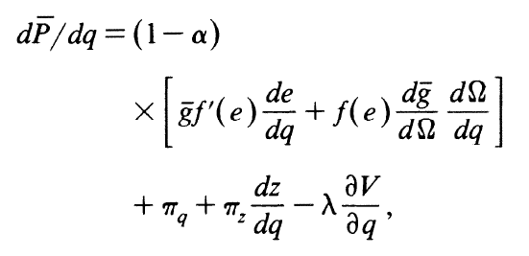
The landlord chooses q and α (if α is a control variable) to maximize his expected income, subject to the constraint of obtaining workers
(4)
First Order Conditions
(5)
λ is the multiplier associated with the constraint of obtaining workers.
Note that the landlord realizes that changing q has a direct effect on his return + an indirect effect through its effect on e or Ω.

Slide 8
B. Impact of Tenant Borrowing on Tenant Effort
The choice of technique Ω is taken as given, to focus only on effort e.
= the fixed amount the tenant must pay to the landlord
= tenant’s consumption
The tenant maximizes expected utility
U is a concave function of e and c.
FOC :

Slide 9
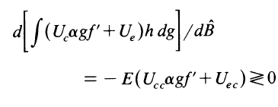
Total differentiation of the FOC yields
as
as
Since (U is concave), we have the following proposition
Proposition 1 : Increased borrowing will increase e, and hence the return to landlords, provided that
[a reasonable assumption - it states that increased consumption cannot negatively impact marginal disutility associated with effort].

Slide 10
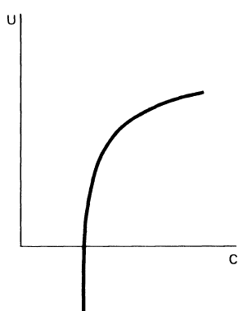
C. Effort and Default
Suppose the consequence of default is bonded labor – the tenant must provide labor services to the moneylender if he is unable to repay the loan. This is assumed to be undesirable for the tenant, so he will try to prevent output from falling below a certain level such that he would be unable to repay his debt.
Thus, the impact of adding a bonded labor clause to the loan agreement would be to increase tenant effort.
This can be modeled by assuming marginal utility
of consumption is very high for low values of c.
In the extreme case, the tenant will choose the
Minimum level of effort required to avoid bondage
Thus

Slide 11
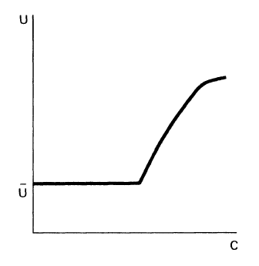
Now suppose the borrower is allowed to default whenever his income is sufficiently low (bankruptcy clause), and when he defaults, he is guaranteed a level of consumption , in excess of starvation level.
The impact of this clause would be to
decrease the tenant’s effort, since he does not
have to bear full the consequences of ‘bad’
events. If the tenant utility function is not ‘too
strictly’ concave, U becomes convex for certain
regions – the tenant’s attitude towards risk
changes from risk averter to risk lover.
Let the critical value below which bankruptcy occurs be
Then the tenant’s problem becomes

Slide 12
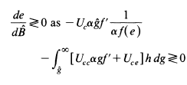
FOC:
which leads to
An increase in borrowing makes bankruptcy more likely. This reduces marginal return to effort (first term – always negative). If the second term dominates, the total effect of borrowing may still be positive on tenant effort.
Proposition 2: If the tenant’s loan agreement includes a bonded labor clause, increased borrowing will increase e, and hence, return to the landlord.

Slide 13
E. Equilibrium Terms of Loans from Landlords to Tenants
This section analyses the landlord’s optimal contract.
Tenant’s Utility Function : U*(c₀,c₁,e)
c₀ = consumption in the 0th period
= W_{o} + B = initial wealth + amount borrowed
c₁ = consumption in the 1st period
= αf(e)g – B(1 + r)
r is the interest rate charged to the tenant, and in general, will be a function of B. The landlord specifies r(B), and the tenant chooses B.
But we assume all tenants are identical => they all choose the same {r, B}. Furthermore, any {r, B} which makes the tenant better off than B = 0 can be generated by some loan function.
So, the authors analyze the behavior of the landlord assuming he controls B and r directly.

Slide 14
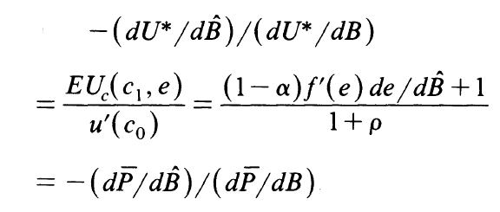
ρ = cost of capital to landlords
The landlord’s problem is now
[where without loss of generality, the authors assume Eg = 1]
subject to
We assume U* is separable in c₀ and c₁
Using the envelope theorem, and the fact that

Slide 15
In contrast, in a competitive loan market, if the tenant and landlord had equal access to the capital market
Proposition 4: the optimal contract offered by the landlord will entail the farmers borrowing more (less) than they would in an unlinked market with equal access to capital, if increased borrowing induces more (less) effort, that is if
Note that the tenant could have chosen to save some of his wealth, or borrowed less to ensure adequate consumption in period 1; yet, the landlord manages to induce him to borrow B even though the tenant is fully aware of the consequences.

Slide 16
D. Impact of Tenant’s Borrowing on Production Technique
Assumptions
An increase in Ω represents an increase in risk
Only set of decisions available to the tenant is the choice of technique Ω
Effort is assumed to be fixed (e.g. to obtain any output, a given level of effort is required. Increased effort beyond that point bears little fruit)
We first consider a set of projects all of which have the same mean

Slide 17
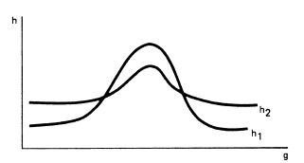
Therefore, riskier projects represent mean preserving spreads (MPS) of less-risky projects, that is , letting H represents the distribution function
Problem-our objective is to maximize expected utility by choosing choice of technique

Slide 18
Taking a separable utility function as in the previous section, the FOC is given by
and assuming , it follows that
Integrating twice by parts, and using
We obtain

Slide 19
Using
it is apparent that
Thus, an increase in borrowing will leave risk taking unaffected iff U is quadratic, so that Otherwise, risk taking can increase/decrease.
Special Cases
1. A Bonded Labor Clause : for very low values of c approaches infinity. Then, it is apparent that an increase in borrowing reduces risk taking: individuals are only concerned with the lower tail of the distribution where is very high, and , the shift in density, is positive. Hence, an increase in borrowing induces tenants to be more conservative.
In the limiting case, Ω* is the largest value of Ω such that

Slide 20
Thus,
since is negative; increasing Ω increases risk, which means the smallest value of g for given Ω declines.
2. Decreasing Absolute Risk aversion
Let A = Coefficient of Absolute Risk Aversion
Since DARA =>
Therefore, from
we see that risk taking is reduced by an increase in borrowing.

Slide 21
3. Bankruptcy Clause
Provided that the tenant is not “too” risk averse, this clause makes him a risk lover. Thus, increased borrowing may induce more risk taking.
In many cases, riskier techniques also have higher means (e.g. HYV seeds of the green revolution – more vulnerable to rainfall). If mean output is not increased too much, and tenants have decreasing absolute risk aversion, an increase in borrowing will reduce risk taking. But now this reduction will reduce the landlord’s expected income (since mean is lower for lower risk).
Formally,
with λ’ > 0 [an increase in Ω represents an increase in risk]
FOC (for the modified objective function)

Slide 22
Thus, the earlier results are unaffected, provided is sufficiently small
Proposition 3:
With a bonded labor clause/decreasing absolute risk aversion, an increase in tenant borrowing will reduce his risk taking. He will, therefore, not select some techniques which allow for higher mean output as well as higher risk. This reduces the returns of the risk neutral landlord.
Remark-
With a bankruptcy clause, the tenant may increase his risk taking with increased borrowing and, thus, may select riskier and higher mean output techniques which would increase a risk-neutral landlord’s returns.
So return to the landlord will depends critically on whether tenant has borrowed, and if so, how much?

Slide 23
Formally, the landlord could effect the same behavior by charging rent at the end of the production period = , in addition to the share.
What is important is that the individual’s behavior is affected by the sum of rent and loan repayments, and it is important for the landlord to control the total. This is what provides the motivation for interlinking. (rent paid at the end of the production period can be viewed as rent paid at the beginning + a loan from the beginning of the period to its end)

Slide 24
F. Default clauses
Previously discussed –bonded labor clause increases the tenant’s effort but reduces risk taking.
Bankruptcy clause produces opposite result; it reduces effort and increases risk taking.
Thus two effect go in opposite directions in their impact on the return to the risk-neutral landlord
Hence the landlord’s preference for one clause over another depends on the extent of the significance of the moral hazard problem regarding effort supply compared with the tenant’s choice of technique.

Slide 25
For example, if effort can be easily monitored and enforced, and the moral hazard problem mainly involves the tenant’s choice of technique, then a risk neutral landlord will tend to prefer a bankruptcy clause over bonded labor clause.
On the other hand if moral hazard problem is more significant in the tenant’s effort supply than in his choice of technique, then a bonded labor will be preferred by the landlord.

Slide 26
G. Production loans
Until now the analysis has assumed that used for consumption purposes but now in this section we are going to relax this criteria and consider interaction between the amount lent in previous period and output in the current period.
So we let output be a function not only of effort but of the amount borrowed
Then the FOC for the (appropriately modified version) maximization problem discussed in section E can be written as

Slide 27
Thus landlord takes into account that
He appropriates a fraction of the return from the increased input
The increased inputs alter the level of effort
An increase in the amount lent increases the expected utility of the tenant
If effort and other inputs are compliments ( >0 ) as we might expect, the increased inputs increase the marginal return to effort.
But the increased output has an additional income effect which normally decreases the level of effort
In the absence of subsidization, the tenant would have set

Slide 28
Thus , whether the landlord prefers to subsidize or to restrict borrowing depends on whether

Slide 29
H. Externalities from the landlord to the lender in the absence of linkage
Since landlord who lends funds to his own tenants can internalize this externality , he can obtain a higher return from lending to his own tenants than he can obtain lending elsewhere
This provides motivation for interlinking the two markets

Slide 30
I. General v/s Partial equilibrium
The preceding analysis shows that, for any fixed level of expected utility of workers, the landlord can increase his expected income by simultaneously controlling the credit market
It establishes that in a competitive equilibrium such linkage will in fact exist
However it does not necessarily imply that landlords are the only beneficiaries, or indeed, in general equilibrium, the landlords will be better off at all

Slide 31
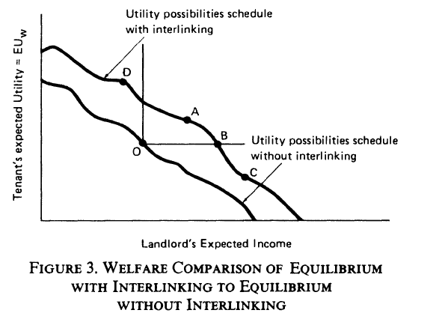

Slide 32
We can derive a pseudo demand curve for labor.
There is a now not a simple price of labor (the wage); but we can, instead, summarize the contract in terms of the expected utility that it generates to the tenant
If demand schedule enough, landlords will compete for tenants so fiercely that landlords will be worse off

Slide 33
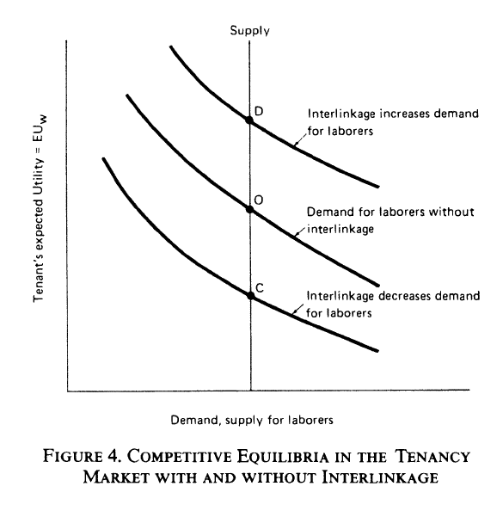

Slide 34
Rohitash Kumar
Ashna Arora

Slide 35
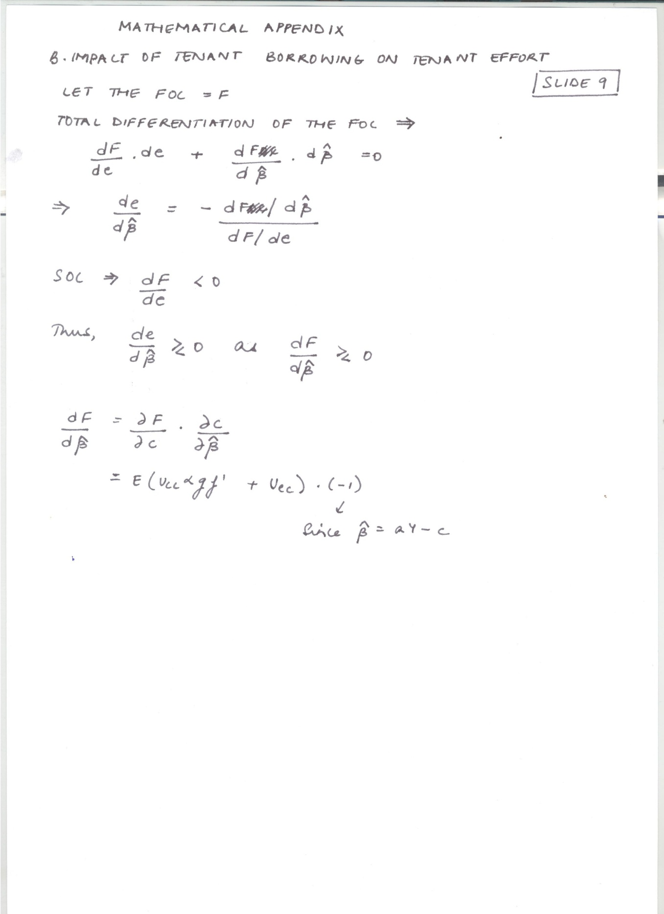

Slide 36
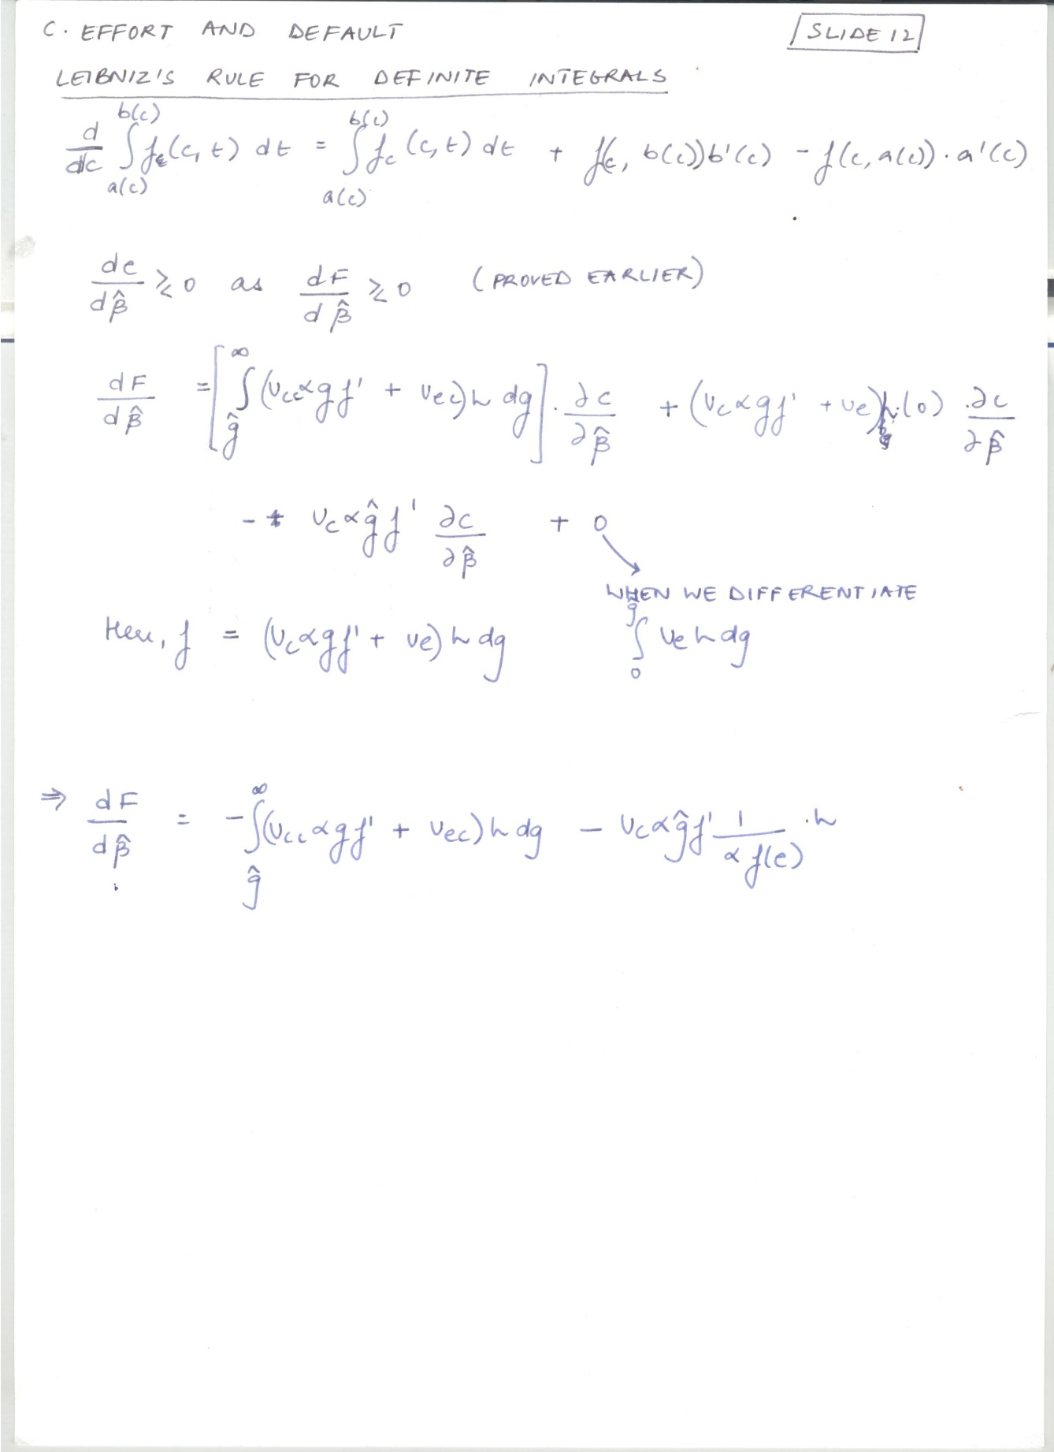

Slide 37
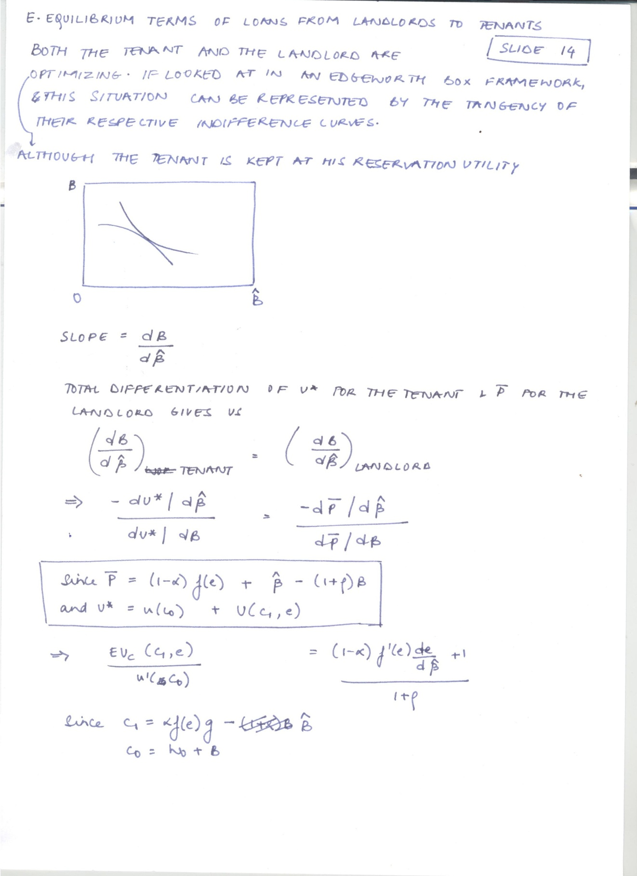

Slide 38
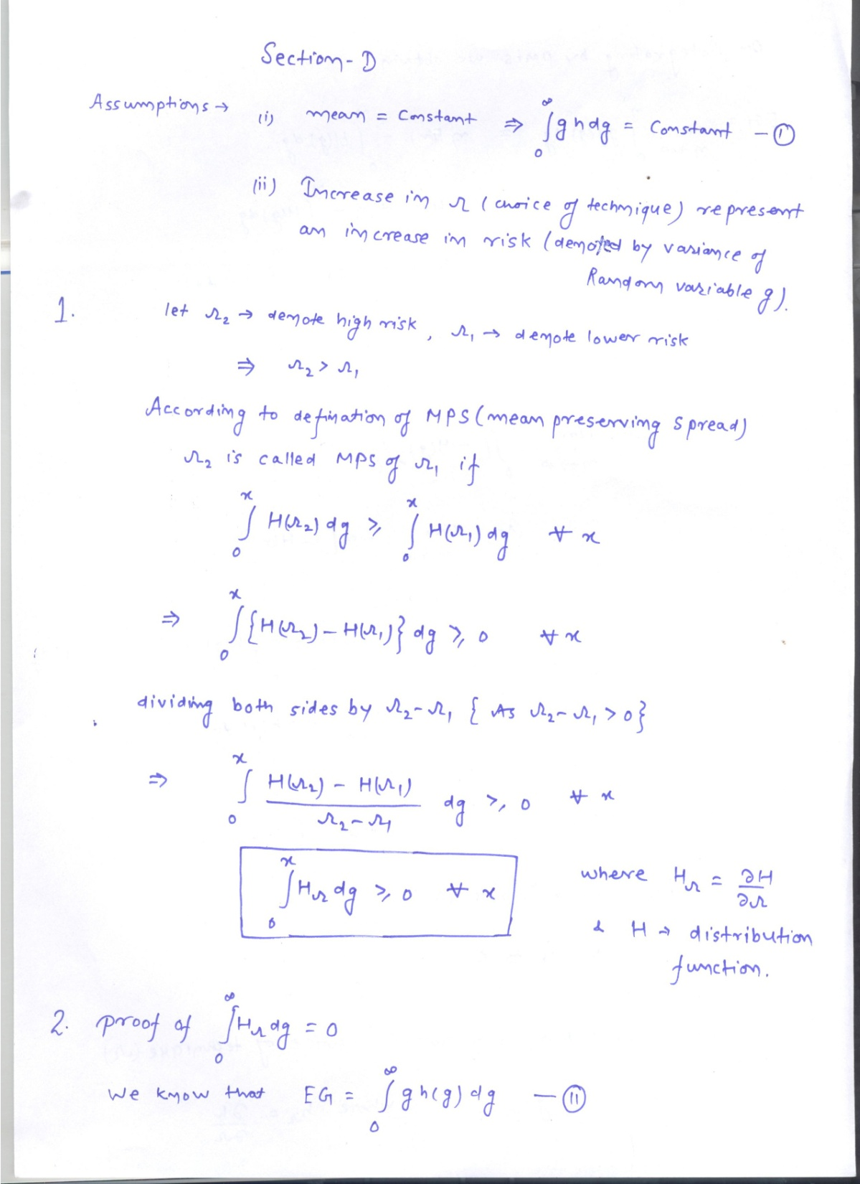

Slide 39
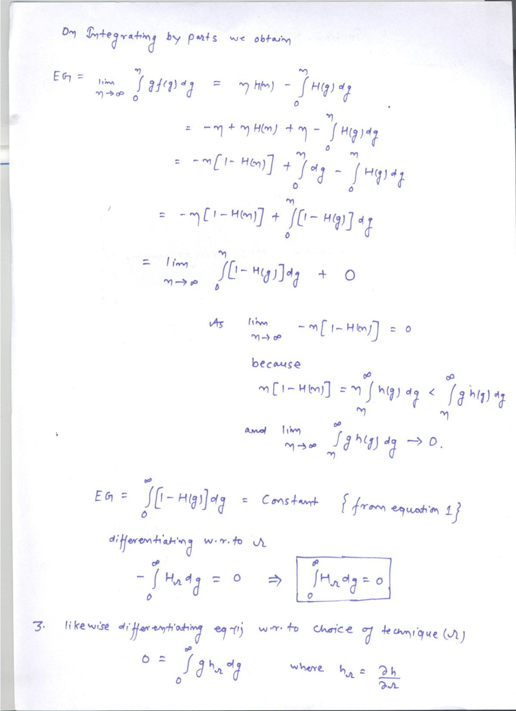

Slide 40
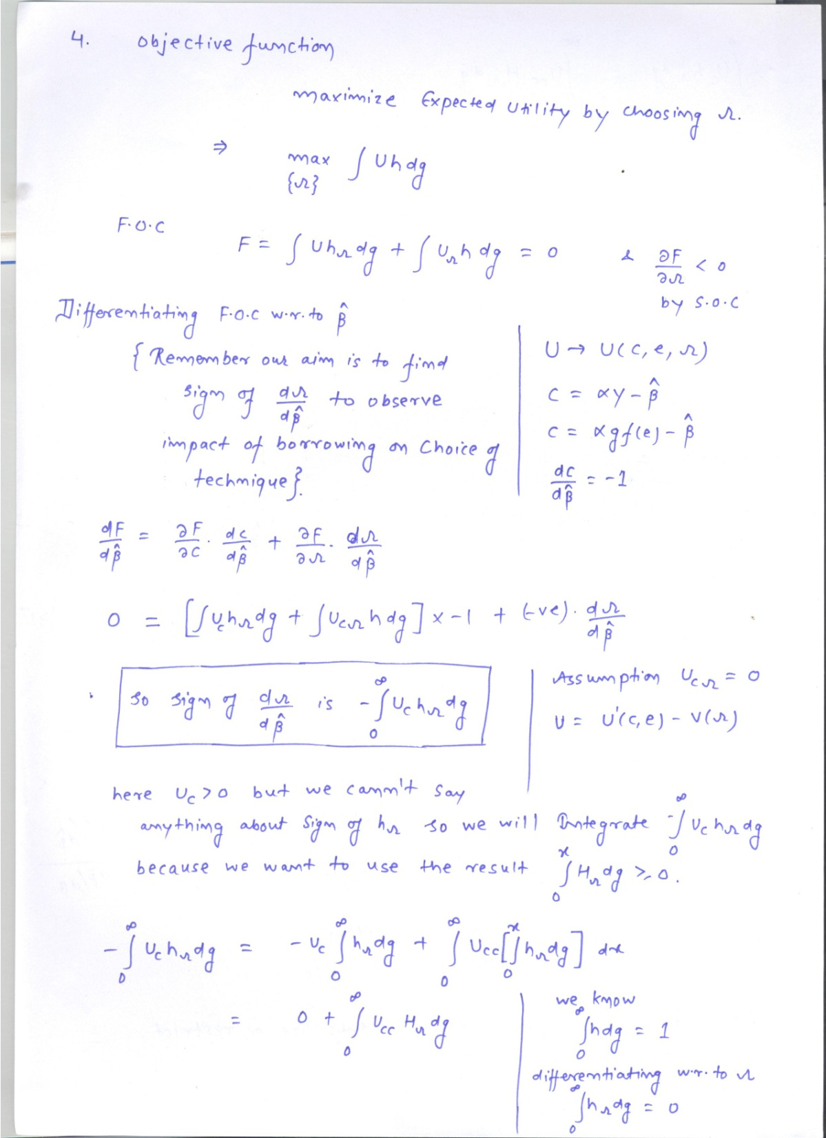

Slide 41
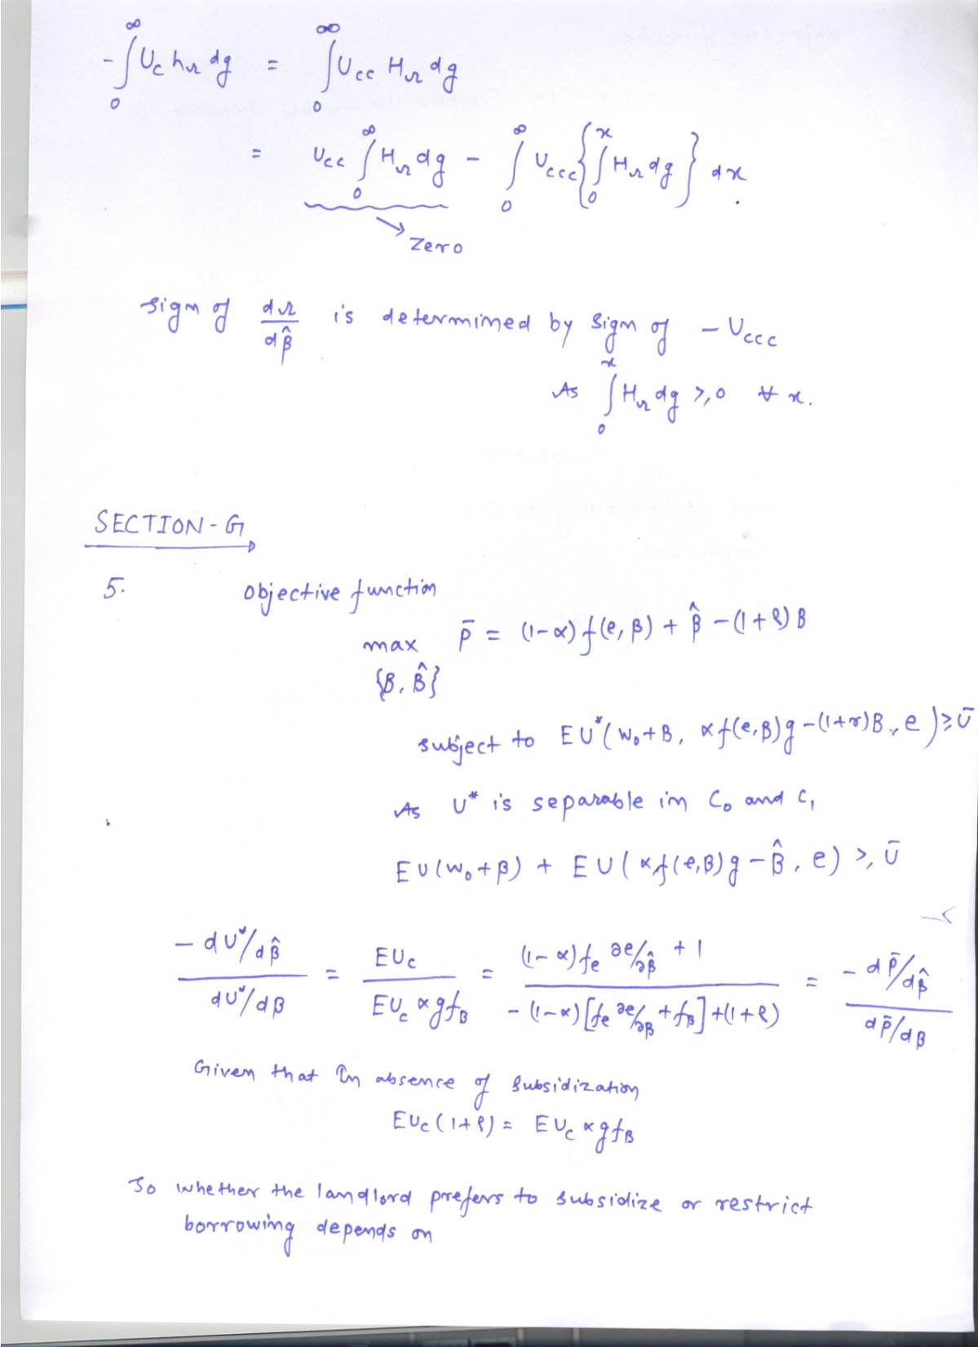

Slide 42
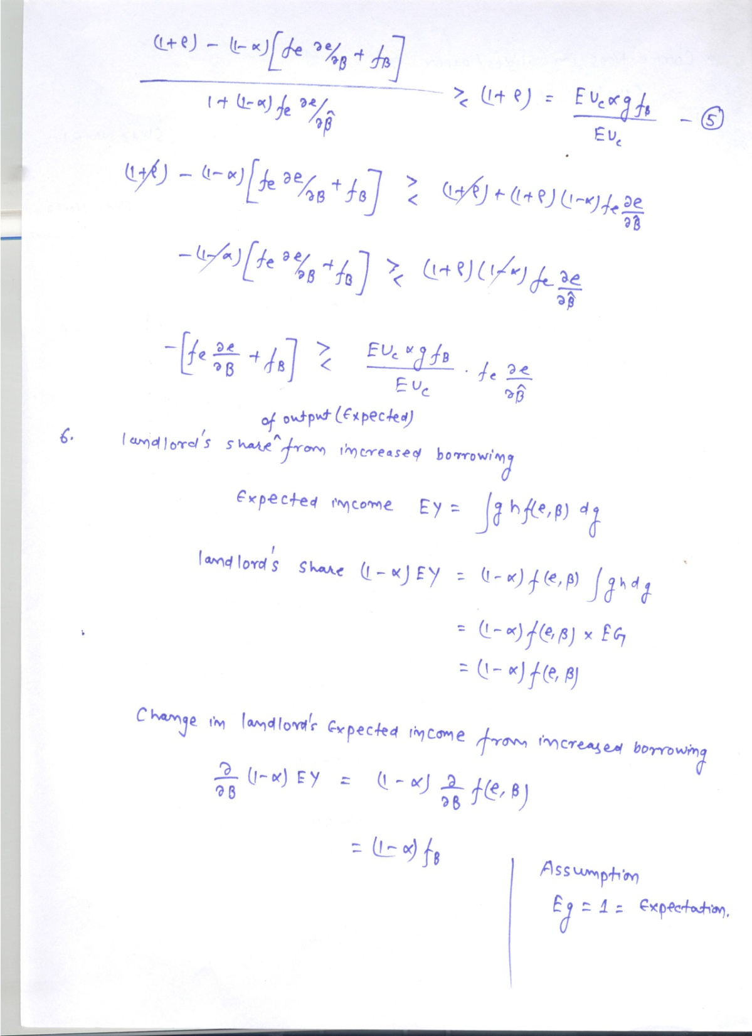

Slide 43
