Slide 1
The Economics of Rotating Savings and Credit Association
Timothy Besley
Stephen Coate
Glenn Loury

Slide 2
Introduction
Rotating savings and credit associations (Roscas) :- It is a type of informal financial institution which helps individuals to save and borrow together by meeting for a defined period of time.
This paper analyses the role and performance of Roscas.
These institutions are primarily used to save up for the purchase of indivisible durable goods.
They seem more appropriate for dealing with significant, idiosyncratic events, rather than hump savings for old age.

Slide 3
Types of Roscas
Random Roscas:-
members commit to put money into a “pot” for each period of life of rosca.
lots are drawn and, the pot is randomly allocated to one of the members.
in the nest period process repeats itself, except that previous winner is excluded from the draw of the pot.
the process continues, with every past winner excluded, until each member of the rosca has received the pot once.
In the end, the rosca is either disbanded or begins over again.

Slide 4
Bidding Rosca:-
The pot is allocated using a bidding procedure.
One individual receives the pot in an earlier period than another by bidding more, in the form of a pledge of higher contributions to the Rosca, or one-time side payments to the other rosca members.
Individuals will still receive the pot only once.
The bidding process merely establishes priority.

Slide 5
We use two good model with indivisibilities to show how group of individuals without access to credit markets improve their welfare by forming a random or bidding Rosca.
For Rosca to operate successfully it is necessary that individuals keep their commitment to pay into Rosca after they have won the pot.
Roscas circumvent these problems by exploiting individuals’ social connectedness.

Slide 6
The Model
Group of n individuals.
Prefer having an indivisible durable consumption good.
No access to credit markets.
Each individual lives for T years.
Exogenous flow of income over his lifetime of y>0.
Individuals have identical, intertemporally additive preferences.
Individuals instantaneous utility depends on non durable consumption, c, and on whether or not he enjoys the service of the durable.
Cost of durable is B and durable does not depreciate.

Slide 7
Durables yield constant flow of services for the remainder of an individual’s lifetime.
Durable’s services are not fungible across individuals.
There is no discounting so only motive to save is to buy durable.
An individuals’ instantaneous utility with nondurable consumption c is
ט(1, c) if he owns the durable.
ט(0, c) otherwise.
Assume ט(1, c) and ט(0, c) are increasing, strictly concave and three times continuously differentiable in their second argument.

Slide 8
Instantaneous gain in utility from owning the durable,
Δט(c) = ט(1, c) - ט(0, c) .
Expected instantaneous utility,
ט(α, c) = α ט(1, c) + (1- α) ט(0, c) , 0< α<1
when α is the probability of owning the durable.
Individuals like the durables,
Δט(c) > 0 for all c ≥ 0
Marginal utility of nondurable consumption is not decreased by owning the durable,
Δט'(c) ≥ 0.
➔ durable services and non durable consumption are complements.

Slide 9
Autarky
Individuals save up on their own.
Optimal for each individual to save B at a constant rate, y – c, over an interval [0, t].
Only save if T.Δט(y)/B is sufficiently large.
Lifetime utility maximization involves each individual choosing c and t to:
subject to
Let (t_{a},c_{a}) be solution to (1) and let W_{a} be the maximal value of lifetime utility.

Slide 10
Substituting for t using the constraint in (1), the maximand can be written as
Next, define
Expected fraction of time that an individual will enjoy the services of the durable during the accumulation period is zero. Therefore autarky is represented by α = 0.

Slide 11
Setting α = 0 in (2), lifetime utility under autarky can be written as,
➔ The first term represents lifetime utility if the durable was free, while the second term is the minimal utility cost of saving up for the durable.
Let c*(α) be the consumption level that solves (2), the optimal autarkic consumption rate, c_{a}, is c*(0).
Autarky is inefficient:
each person saves y – c_{a} = B / t_{a} and after an interval of t_{a} / n, there are enough savings to buy the durable which could be given to one of the members.

Slide 12
LEMMA
Under the assumption on preferences set out above, the minimized cost μ(.) in (2) is a decreasing function of α, and the cost-minimizing consumption rate c*(.) is an increasing function of α. Both are twice continuously differentiable on [0,1], where they satisfy the identity μ(α) ≡ ט'(α,c*(α)).Moreover, if ט’’’(i,c)> 0 for i=0 and 1, and if Δט’’(c)≥0, then c*(.) is strictly convex.

Slide 13
PROOF
First order condition for (2)
Since ט(α,c) is increasing in α, μ(.) must be decreasing from (2).
Elementary duality theory implies that μ(.) is a concave function of α.
By the envelope theorem,

Slide 14
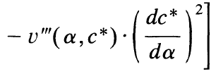
Differentiate ט‘(α,c*) ≡ μ(α) with respect to α, and use the envelope result to get,
Differentiating the same identity twice with respect to α:
> 0
using the assumptions that ט’’’(i,c)> 0 for i=0 and 1, and if Δט’’(c)≥0

Slide 15
Random Roscas
n-person group forms a random Roscas which meets at equally spaced dates up to t_{a} (i.e.{t_{a}/n,2t_{a}/n,….t_{a}}, with contributions of B/n at each meeting.
Individual is randomly selected to receive the pot of B at every meeting.
Each individual continues to save at rate B/t_{a} over the interval [0,t_{a}].
Now an individual can expect to receive the durable t_{a}(n-1)/2n sooner.
Given the uniform spacing of meeting dates and the constant contribution rate, the duration of the Rosca will be inversely proportional to the rate at which individual saves.

Slide 16
Consider a “general” random Rosca of length t, meeting at the dates (t/n, 2t/n,……,t), with members contributing B/n at each meeting date.
A representative member of the Rosca views his receipt date for the pot as a random variable, τ, distributed uniformly on the set (t/n, 2t/n,……,t).
Each member saves at the rate B/t over the life of the Rosca.
Nondurable consumption is thus c = y – B/t during this period.
Each members’ lifetime utility is the random variable:
τ . ט(0,c) + (t – τ) . ט(1,c) + (T - t) . ט(1,y)
where t = B/(y-c).

Slide 17
Each member’s ex ante welfare is
since E(τ) = [(n+1)/2n]t.
t_{r} denotes the optimal length, c_{r} is the consumption rate and W_{r} the maximal value.
(4) can be rearranged as,
where ,

Slide 18
We obtain,
➔ Welfare is the difference between what lifetime utility would be were the durables were free good and the minimal(expected) utility cost of saving up for its purchases.
This cost is lower under the random Rosca than under autarky because now he expects to enjoy the durable good for a fraction of time in which he is saving up for durable.

Slide 19
PROPOSITION 1
By forming a random Rosca, group members raise their expected lifetime utilities. The optimal random Rosca involves members saving at a lower rate over a longer interval than under autarky. Nevertheless, if ט’’’ (i,c) > 0 for i = 0 and 1, and if Δט’’(c) ≥ 0, then individuals expect to receive the durable good sooner in the optimal random Rosca than under autarky (i.e. t_{r} >t_{a} > (n+1)t_{r}/2n).

Slide 20
PROOF
Equation (5) and (3) implies:
Positive since μ(.) is a decreasing function.
➔ Group member’s expected utility is higher in random Rosca than under autarky because some financial intermediation reduces everyone’s utility cost of saving up.
Consumption is greater as well since c*(.) is an increasing function.
The optimal random Rosca involves members saving at a lower rate over a longer interval than under autarky i.e. .
(As constraint t(y-c) = B applies under both cases.)

Slide 21
The expected receipt date under the optimal random Rosca is sooner than under autarky. Need to show,
or,
(Since )
Since ט(1,.) is concave, from (2) we get, y = c*(1).
Therefore, need to show that,
➔This follows from convexity of c*(.)

Slide 22
The ranking of random Roscas and autarky does not hold ex post since, though individuals have the same properties ex ante, their circumstances differ once the order of receipt has been determined.
Using the index i to denote the person who wins the pot at the ith meeting, at date t_{r}(i/n), ex post utilities under the random Rosca are given by,
The individual receiving the pot at the final meeting date (i = n) has been made worse off ( ex post) by joining the random Rosca as his consumption/receipt date pair is feasible but not optimal, under autarky.

Slide 23
Bidding Roscas
Individuals now bid to receive the pot at a certain date.
Assume that the order of receipt is determined at time period zero (through bidding). This is not unreasonable since there is no uncertainty.
We require that :
All such auction protocols result in individuals being indifferent between bid/receipt date combinations, since individuals are identical in preferences and we assume complete information.

Slide 24
Additionally, we require an efficient auction procedure so that the money collected through the Rosca is just enough to finance the purchase of the durable good for all its members.
These 2 requirements completely determine the outcome of the bidding procedure.
Thus, it is unnecessary to commit to a particular protocol.

Slide 25
Bidding- A formal model
A series of n -1 oral, ascending-bid auctions are held at date zero among n group members, determining in sequence who receives the pot at each meeting date except the last, with each winner excluded from participation in subsequent auctions.
The last remaining individual has his contribution set so that the sum of all commitments just equals the durable's cost, B

Slide 26
Using a backward induction argument we have that every sub-game perfect equilibrium of this bidding mechanism leaves all individuals with the same level of lifetime utility.
Now, we characterize these bids.
Let b_{i} denote the promised contribution of individual i, defined to be the one who wins the pot at time (i/n)t.

Slide 27
A set of bids {b_{i}}, i={1,…,n }, constitutes an equilibrium if
(i) no individual could do better by outbidding another for his place in the queue
(ii) contributions are sufficient to allow each participant to acquire the durable upon receiving the pot
Given b_{i}, i’s nondurable consumption will be, c_{i} = y - (n / t)b_{i} , at each moment during the Rosca's life => We can characterize the Rosca in terms of consumption rates {c_{i}}_{i=1 to n}

Slide 28
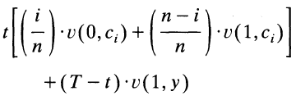
Condition (ii) requires that I’s equilibrium utility level in a bidding Rosca of length t is :
Letting α_{i} = (n-i)/n, from condition (i) we have, for all i and some number x,

Slide 29
The number x represents the members’ average utility during the lifetime of the bidding Rosca of length t, in a bidding equilibrium.
Define : average non-durable consumption over t. Then condition (ii) is equivalent to
Given t, (7) and (8) uniquely determine {c_{i}}_{i=1 to n} and x.

Slide 30
Equivalently using (7) and (8), given ‘x’, we can determine {c_{i}}_{i=1 to} _{n} and ‘t’.
As in the random Rosca, it is natural to assume that the length of the bidding Rosca is chosen to maximize the common utility level of its members.
(6), (7) and (8) imply that this common welfare is:

Slide 31
Now, let be the function satisfying
And define,
Now, when the equilibrium average utility during a bidding Rosca is x, then represents i’s non-durable consumption rate during the Rosca and is the length of the Rosca.

Slide 32
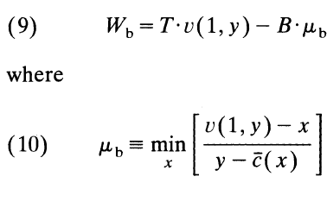
Denote by t_{b} and W_{b}, respectively, the duration and common utility level of the optimal bidding Rosca.
Then we may write,
Letting x* give the minimum in (10), then t_{b} = B/[y - c(x*)] is the length of the optimal bidding Rosca.

Slide 33
Lifetime utility expressed in (9) admits the same interpretation noted for autarky and the random Rosca; it is the difference between lifetime utility if the durable were free and the minimal cost of saving up.
The latter, determined in (10), again trades off higher welfare during the Rosca versus faster acquisition of the durable.

Slide 34
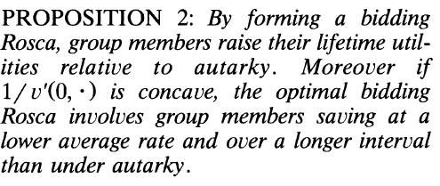

Slide 35
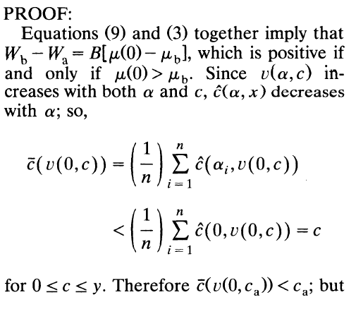
Cont. in appendix 1.

Slide 36
To conclude this section we note that early acquirers of the good bid a higher contribution to the Rosca and consume less of the non-durable.
Proposition 2 also reveals that the last individual to acquire the good must have greater non-durable consumption than under autarky.
These higher contributions of earlier recipients resemble interest payments.

Slide 37
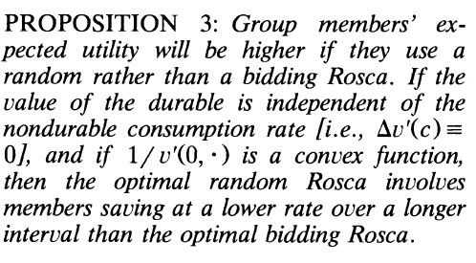
Bidding versus Random Roscas

Slide 38
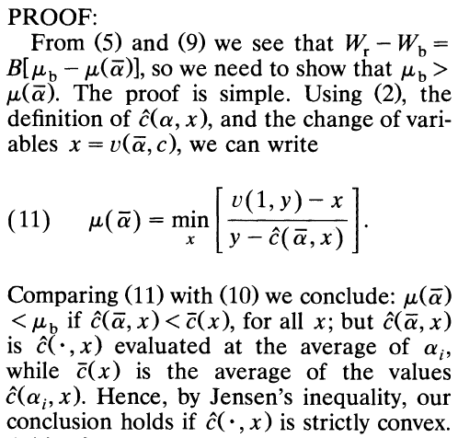
The rest continued in appendix 2.

Slide 39
Appendix 1

Slide 40
Appendix 2

