Slide 1
Empowerment and Efficiency: Tenancy Reform in West Bengal
Abhijit V. Banerjee, Paul J. Gertler, Maitreesh Ghatak (April 2002)

Slide 2
Recalling dual impact of reforms on productivity
Bargaining power effect of the reform
The legal contract becomes the tenant’s “outside option,” which increases his bargaining power vis-a`-vis the landlord and forces the landlord to offer him a higher crop share, which translates into stronger incentives
An increase in the tenant’s bargaining power, with everything else held constant, leads to an increase in his share and productivity
Security of tenure effect of the reform
The landlord may use the threat of eviction when output is low to induce the tenant to work harder and disallowing eviction restricts the use of such incentives and therefore reduces efficiency
But greater security of tenure encourages the tenant to invest more since it gives him the confidence that he will stay on the land long enough to enjoy the fruits of his investment

Slide 3
Net effect of Operation Barga – negative or positive?
From the theoretical analysis we know that tenancy laws that lead to improved crop shares and higher security of tenure for tenants can have a positive effect on productivity
Since Operation Barga both eliminated evictions and increased (m), its net effect could be positive or negative
The model says that the tenant’s share of the crop should go up, or at least not go down, when (m) goes up
There is evidence based on Operation Barga that explains around 28 % of the subsequent growth of agricultural productivity
NOTE: We know from the aggregate data that the tenants responded positively to the reform: By 1993, about 65% of all
sharecroppers were registered, compared to 15% before Operation Barga

Slide 4
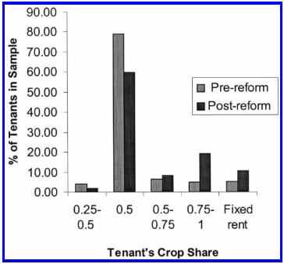
Evidence from author’s sample
The proportion of tenants getting more than 50% of output increased from 17 % to 39% post reform
The increase in share was greater for registered tenants than unregistered

Slide 5
Evidence on the effect of Operation Barga on productivity
Quasi-experimental approach* that uses Bangladesh as a control (similar to West Bengal in most productivity trends and agriculture related criterion such as agro climatic conditions, main crops grown, prevalence of tenancy, and agricultural technology (HYV) )
The fact that Operation Barga was implemented in West Bengal but not in Bangladesh can be largely attributed to an exogenous shock**.
Program intensity approach that uses the number of registered sharecroppers in a district as a measure of program intensity and compares the growth in productivity in districts in which Operation Barga was implemented intensely to districts in which the program was implemented less intensely
*A quasi-experiment is an empirical study used to estimate the causal impact of an intervention on its target population but it specifically lacks the element of random assignment to treatment or control. This is more of a natural experiment as assignment discretion doesn’t lie with the researcher. ** National political upheaval (Not factors affecting only West Bengal) caused the Left to come into control.

Slide 6
COMPARISON TO BANGLADESH

Slide 7
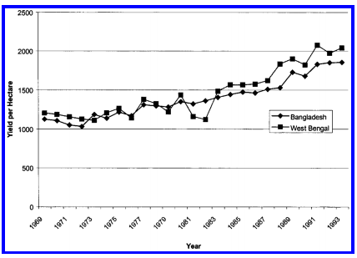
Rice yield trend comparison
Between 1969 and 1978, rice yields increased by 9.3% in West Bengal and by 11% in Bangladesh (similar trend line: comparable baseline characteristics)
In the period after Operation Barga was introduced (1979–93), rice yields in West Bengal increased by 69% compared to 44% in Bangladesh
Agricultural productivity increased in part due to Green Revolution’s HYV seeds, fall in fertilizer price, increase in small scale pvt irrigation

Slide 8
Empirical methodology
The authors measure the impact of Operation Barga on agricultural rice yields using a difference-in-difference estimator with district-level panel data.
The difference-in-difference speciﬁcation compares the change (before and after Operation Barga) in yields in treatment districts (West Bengal) with the corresponding change in control districts (Bangladesh)
The difference-in-difference model makes the counterfactual assumption that the treatment districts would grow at the same rate as the control districts if there were no intervention
The authors control for public irrigation and adoption of HYV grains of rice, since these are interventions that were contemporaneous with Operation Barga and were differentially implemented in West Bengal and Bangladesh

Slide 9
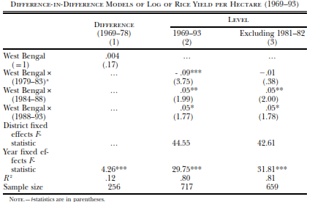
Simple Difference-in-Difference (Growth in yield)
ss intensely
NOTE: The data are district-level data from 14 West Bengal and 15 Bangladesh districts collected from various ofﬁcial government sources, and we expect the last time period to have the full effect of the reform, and * (LOS 10%), ** (LOS 5%), *** (LOS 1%)

Slide 10
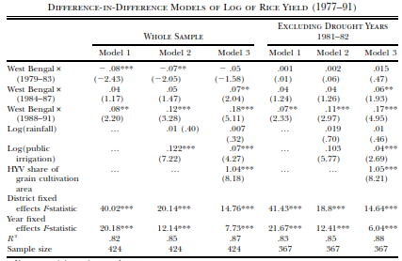
Adjusted Difference-in-Difference: Time varying controls
Model1: simple unadjusted difference-in-difference model
Model 2: controlling for public irrigation and rainfall
Model 3: additionally controlled for HYV share
Period: 1977-91 (due to data availability), thus sample size is different

Slide 11
Possible problem with the methodology
There may be unobserved differences in government programs between the two countries and if these unobserved programs behaved like the observed programs (Operation Barga) and also expanded faster in Bangladesh in the post–Operation Barga period, our difference-in-difference estimates of the impact of Operation Barga on agricultural productivity would give us a lower-bound estimate.
The authors cannot completely rule out the possibility that there were unobservable policies that confound the estimated effect
The drought could have affected effort on part of the West Bengal government.

Slide 12
PROGRAM INTENSITY APPROACH

Slide 13
The basic approach
The approach taken uses the district sharecropper registration rate as a measure of program intensity and then examines whether productivity rises faster in areas with greater program intensity
In 1978 (program launch), the average level of registration for West Bengal was 15% and in 1993 stood at 65% of the total number of sharecroppers (Increase in take-up rate: (0.65-0.15)/0.15 = 58%
The authors add data on the length of roads constructed and maintained by the public works department to the set of time-varying controls for West Bengal used in the previous analysis

Slide 14
Empirical methodology
Identification issues: Since the registration rate may be correlated with unobserved
productivity shocks
Due to a combination of the supply and demand of registration opportunities, as well as non random selection of villages to offer registration (registration opportunity at their doorstep was extremely important for tenants in rural areas)
DEMAND SIDE: A tenant’s decision to register is likely to be affected by his ability,
wealth, relations with the landlord, and other characteristics that are associated
empowerment and efﬁciency with his dependence on the landlord (e.g., for loans) or his
bargaining power
The wealthier, more able, and more enterprising tenants are likely to be more productive and adopt productivity-enhancing technology, and more likely to register
A district with a higher proportion of more productive tenants is likely to have high output as well as high registration
=> However, as long as individual characteristics are constant over time, they should not be a problem as long as we allow for district ﬁxed effects

Slide 15
Identification issues
SUPPLY SIDE: The geographic distribution of sharecroppers within a district
varied across districts, and as a result, the marginal cost of making registration
opportunities available to tenants varied across districts
If the government introduced registration opportunities in districts of high (or low) productivity ﬁrst, then the registration rate would be correlated with unobserved productivity characteristics
If allocations were based on initial productivity, which is a time-invariant factor, the district ﬁxed effects control for this source of bias
If the government dynamically allocated registration opportunities on the basis of current productivity in the district, then the ﬁxed-effects estimate will be biased
A similar problem could occur if the order of villages selected within a district was based on productivity

Slide 16
Identification issues
Identification issues: Since the registration rate may be correlated with
unobserved productivity shocks:
Due to correlation with the progression of other (omitted) programs:
Expansion of infrastructure in West Bengal: Controlling for availability of public irrigation and roads within districts
HYV seeds spread during this period: Controlling by including the share of gross cropped area planted with HYV seeds
Bias in Left front districts: A Left Front majority district (in 1977) dummy variable interacted with time
Proximity to Calcutta (admin. Centre): The interaction of a southern district dummy variable with time
Registration targeted at high sharecroppers regions: The initial extent of sharecropping interacted with time dummies as additional explanatory variables

Slide 17
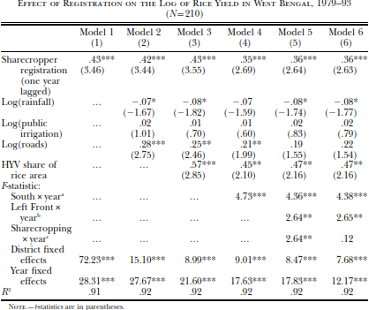
> Productivity rise of ~20% (owing to registration:
0.36*0.58)
> A weighted average used to evaluate full impact ~ 28%
(total increase in rice yield: 69%)

Slide 18
Conclusion
We concluded from the theoretical analysis that tenancy laws that lead to improved crop shares and higher security of tenure for tenants can have a positive effect on productivity
Evidence from West Bengal suggests that the tenancy reform program called Operation Barga explains around 28% of the subsequent growth of agricultural productivity there
However, given data limitations, we cannot separate the direct and indirect effects of Operation Barga (like empowerment of the poor, change in society’s mindset of collective action)

Slide 19
Land Reform, Poverty Reduction, and Growth: Evidence from India
Timothy Besley and Robin Burgess (May, 2000)

Slide 20
Introduction (1/2)
Land reforms in developing countries are often aimed at improving the poor's access to land, although their effectiveness has often been hindered by political constraints on implementation
India is an important case study of land reform: It is home to a significant fraction of the poor in the developing world and in the post independence period we have been subjected to the largest body of land reform legislation ever to have been passed in so short a time period in any country
This paper studies land reform as a redistributive policy as improvement in the asset base of the poor has been viewed as a central strategy to relieve endemic poverty
The authors attempt to study the growth-inequality interaction in this context

Slide 21
Introduction (2/2)
This paper takes advantage of the state level panel data available for the 16 main Indian states from 1958-1992 to assess the real impact on the conditions of the poor of the land reform legislation, and on overall growth
Most existing empirical evidence on the links between redistribution and growth comes from cross-country data wherein there are insurmountable problems of comparability of data across countries and concerns about endogeneity
The fact that this data comes from one country with similar data collection strategies in each state, and the relatively long time period helps to deal with above mentioned endogeneity issues
Principal finding: Land reforms do appear to have led to reductions in
poverty in India. (This finding is robust to a number of methods of
estimation, and the inclusion/exclusion of many different controls)

Slide 22
Background and Data
Under the 1949 Indian Constitution, states were granted the powers to enact land reforms and this autonomy ensures that there has been significant variation across states and time in terms of the number and types of land reforms that have been enacted
Land reform acts are categorized as per their main purpose:
Tenancy reforms : Attempts to regulate tenancy contracts both via registration and stipulation of contractual terms (shares)
Abolishing intermediaries: Intermediaries who worked under feudal lords (Zamandari) to collect rent
Ceilings on landholdings: Redistributing surplus land to the landless people
Consolidation of disparate landholdings: Aimed at achieving efficiency gains

Slide 23
Background and Data
Poverty measures : The headcount index and the poverty gap have been employed. Given that NSS surveys are not annual, weighted interpolation has been used to obtain values between surveys. The all-India rural headcount measure has fallen from around 55 % to 40 %, and the rural poverty gap from 19 % to around 10 %
Agricultural wage : Data were also collected to enable us to examine whether land reforms had general equilibrium effects and were thus capable of reaching groups of the poor (e.g., landless laborers) who did not directly benefit from the reforms
Output: Real values of per capita agricultural, nonagricultural, and combined state domestic product are also available to examine the determinants of growth
Measure of agricultural yields: Defined as real agricultural state domestic product divided by the net sown area. This crudely captures technological changes in agriculture
Public finance data: Taken at the state level, collected chiefly as a means to control for other government interventions besides land reform
Poverty measures are based on consumption distributions from 22 rounds of the (NSS). The poverty line is based on a nutritional norm of 2400
calories per day and is defined as the level of average per capita total expenditure

Slide 24
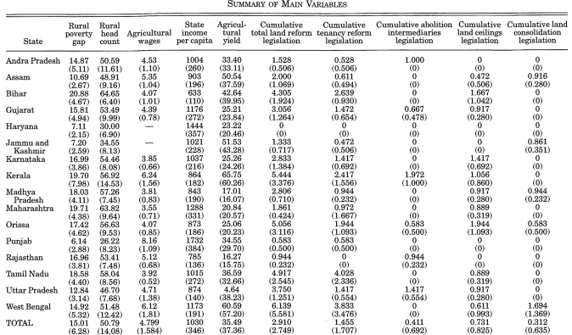

Slide 25
Empirical approach: Panel data regression
The empirical approach is to run panel data regressions of the form:
(1)
  x(st) is some measure of poverty in state s at time t
  Alpha (s) is a state fixed effect
  Beta (t) is a year dummy variable
  y(st) is a vector of variables that we treat as exogenous
  l(st-4) is the stock of past land reforms four periods previously
E (st) is an error term which we model as AR(1) process where the degree of autocorrelation is state-specific:
NOTE: The approach is also reduced form because land reform legislation is used as regressor-we are unable to measure
whether land reforms are actually implemented

Slide 26
Empirical approach: Panel data regression
Estimation via GLS will also allow for heteroskedasticity in the error structure with each state having its own error variance. Equation (1) is a reduced-form model of the impact of land reform
Effect of land reform on poverty is picked up by that variable along with other effects that change the claims that tenants have to land
Land reform is represented only by the cumulative land reform variable where all types of land reforms are aggregated
NOTE: The approach is also reduced form because land reform legislation is used as regressor-we are unable to measure
whether land reforms are actually implemented

Slide 27
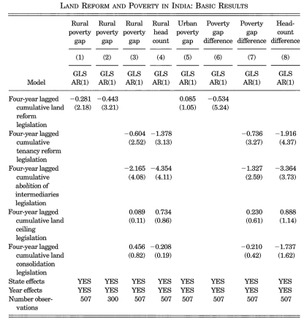
CHANGES IN (1) – (8):
(1) Only state and year effects
(2) Using interpolated years when NSS n.a.
(3) Disaggregation into various reforms
(4) Using head count index (alternative)
(5) Urban poverty gap checked for (no significant negative association)
(6) Capturing closing rural urban poverty gap (given non response of urban poverty gap)
(7) Disaggregated impact of land reforms
(8) Checking with head count rural-urban difference

Slide 28
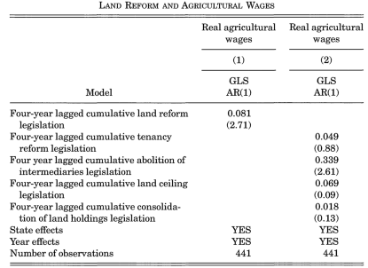
If land reform pushes up agricultural wages, this represents an additional mechanism through which these reforms can reduce rural poverty
The results illustrate an indirect route through which land reform may positively affect the welfare of landless laborers even if they do not benefit directly from the reform

Slide 29
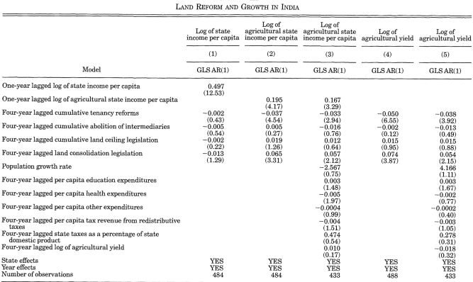
Disaggregated land reform variables lagged four periods have no significant impact on total state income per capita
Suggests that tenancy reform has a negative effect on agricultural output with land consolidation having the opposite effect (no other effects observed)
Shows that both the tenancy reform and land consolidation effects are robust to including our other policy variables lagged four years
Effects remain when agricultural yields rather than income per capita is the left-hand-side variable
Effect of tenancy reform is robust to including other policy variables

Slide 30
Interpreting the results
Results hint at an equity-efficiency trade- off for tenancy reforms- both poverty and output per capita are lower after such reforms are enacted
No such trade-off emerges for abolition of intermediaries
Ceilings on landholdings do not seem to have an effect on either output measures or poverty, while land consolidation promotes output increases in agriculture without affecting poverty
>> Overall, these results suggest that the impact on poverty comes mainly through reforms that affect production relations, rather than by altering the distribution of land

Slide 31
Conclusion
Robust evidence of a link between poverty reduction and two kinds of land reform legislation - tenancy reform and abolition of intermediaries
Land reform can benefit the landless by raising agricultural wages
Even partial, second-best reforms which mainly affect production relations in agriculture can play a significant role in reducing rural poverty
The analysis suggests that a reduction of the all-India poverty gap of 1% can be explained by land reform (one-tenth of the actual reduction in poverty over the period) (This remains true even after factoring in the possibility that output per capita is reduced by some kinds of land reform)
This comparison suggests that implementing a land reform has a similar effect on poverty reduction to a 10% rise in per capita income, or around 4-5 years growth at the all-India average growth rate over this period

Slide 32
THANK YOU!

