Slide 1
Missing Women and Price of Tea in china
NANCY QUIAN
Presented in Development Microeconomics
Subhrodip Sengupta

Slide 2
Many Asian populations are characterized by severe male biased sex imbalances.
According to 2005 WDI, whereas 50.1% of the current populations in western European countries are female, only 48.4% are female in India and China.
Amartya Sen (1990, 1992) referred to this observed deﬁcit as “missing women.”
At birth, boys outnumber girls everywhere in the world, by much the same proportion—there are around 105 or 106 male children for every 100 female children.

Slide 3
Missing Women
Ingrid Waldron's “The Role of Genetic and Biological Factors in Sex Differences in Mortality”, shows if men and women receive similar nutritional and medical attention and general health care, women tend to live noticeably longer than men. Women seem to be, on the whole, more resistant to disease and in general hardier than men, an advantage they enjoy not only after they are forty years old but also at the beginning of life, especially during the months immediately following birth, and even in the womb. When given the same care as males, females tend to have better survival rates than males.
Women outnumber men substantially in Europe, the US, and Japan, where, despite the persistence of various types of bias against women (men having distinct advantages in higher education, job specialization, and promotion to senior executive positions, for example), women suffer little discrimination in basic nutrition and health care. The greater number of women in these countries is partly the result of social and environmental differences that increase mortality among men, such as a higher likelihood that men will die from violence, for example, and from diseases related to smoking.

Slide 4
Missing Women(…contd)
Ranking the proportion of women in so-called gainful employment relative to the proportion of men in such employment, in descending order:
Sub-Saharan Africa
Southeast and Eastern Asia
Western Asia
Southern Asia
Northern Africa
Ranking the ratios of life expectancy of females to those of males produces a remarkably similar ordering:
Sub-Saharan Africa
Southeast and Eastern Asia
Western Asia
Northern Africa
Southern Asia.
That the two rankings are much the same, except for a switch between the two lowest-ranking regions (lowest in terms of both indicators), suggests a CORRELATION between employment and survival prospects. Contrasts between sub-Saharan Africa and North Africa, and that between Southern (and Western) Asia and Southeast (and Eastern) Asia are suggestive distinctions within Africa and Asia respectively, linking women's gainful employment and survival prospects.

Slide 5
Conceptual Challenges
This paper explores whether changes in relative female income (as a share of total household income) affect the relative outcomes for boys and girls.
Conceptual framework:
The Unitary Model:
Increase in Income should have the same effect on Household consumption, and investment decisions, regardless of ‘who’ brings in the Income.
Alternatives would be the ‘pooling’ model and bargaining models, where income is shared according to a given Rule(say female income, or female assets) which would give us the reasons why EMPOWERING females, improving their wages, etc could alter Household decisions. If change in female income had different effects on education of girl and boy child then we would support evidence for such models.
The authors also test for this important question: Is Education merely an investment decision. If it were so, we would find the same change in education on girl and daughter. The Authors also test for joint hypotheses.

Slide 6
Empirical Strategy
The authors objective is to compare the effect of change in sex-specific income on for boys and girl child.
There are 2 problems in such a approach:
1 If Greater Female Income is due to the fact that Women’s status is higher due to other reasons, pre-reforms then we have a omitted Variable Bias.
2 At time of the reforms, there is a change in the attitudes that drive sex preference in tea-planting counties, then the estimate of the effect of planting tea will capture both the relative female income effect and the effect of the attitude change.

Slide 7
The Background
Tea is Afult Female Labour intensive, and Orchard, adult male, primarily because of the physical attributes advantageous to each type of job. Thus increase in Prices, would effect the Demand for Adult female(male) labour, as the plantation area, roughly remained same, amount of tea(Orchard) sown.
Pre 1978,Central planning divided crops into three categories.
Category 1 included crops necessary for national welfare: grains, all oil crops, and cotton.
In Category 2 were cash crops, including orchard products and tea .
Category 3 included all other agricultural items (mostly minor local items). This last group was not under quota or procurement price egulation.
The Central government set procurement quotas for crops in Categories 1 and 2 that filtered down to the farm or collective levels. Quota production was purchased by the state at very low prices. These quotas were set so that farmers could retain enough food to meet their own needs but leave very little in surplus . Nongrain producers produced grain and other foodstuffs they needed for their own consumption.
Post Mao:
The ﬁrst set gradually reduced planning targets and represented a return to earlier policies that used procurement price as an instrument for controlling production.
The Second, Household Production Responsbility System (HPRS , devolved all production decisions and quota responsibilities to individual households instead of production being a collective responsibility, and eﬀectively allowed household to take full advantage of the increase in procurement prices by expanding production to cash crops when proﬁtable
Income from Tea and Orchards increased much greater extent than the Income from Staple Crops. The reformincreased the value of adult female labor in tea-producing region

Slide 8
What is DID(distinguish from DDD)
To counter the problem of Omitted Variable Bias the authors use DID(Difference in Difference) strategy.
Since the work by Ashenfelter and Card (1985), the use of difference-in-differences method has become very widespread. The simplest set up is one where outcomes are observedfor two groups for two time periods. One of the groups is exposed to a treatment in the second period but not in the first period. The second group is not exposed to the treatment during either period. In the case where the same units within a group are observed in each time period, the average gain in the second (control) group is substracted from the average gain in the first (treatment) group. This removes biases in second period comparisons between the treatmentand control group that could be the result from permanent differences between those groups, as well as biases from comparisons over time in the treatment group that could be the result of trends. Higher order differencing is also interesting, but hasn’t been done here.

Slide 9
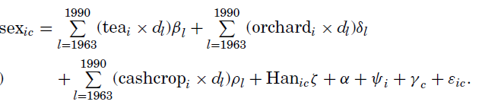
Note that there are c equations summarised in a single equation, one for every cohort. This is available due to the rich datasets that the authors have obtained.
The fraction of Males in County i, cohort c, is a function of the amount of tea planted in each county i, and the cohort’s birth year, d_{l} ; the amount of Orchard Plantation, and d_{l} , Han stands for ethnically Han, ϒ stands for county Fixed Effects, and Ψ_{c} the cohort-fixed effect. Post Reforms, we should expect the value of β to be –ve. If an increase in Value of Orchards worsened Female Survival, we would expect δ to be positive.

Slide 10
Before applying the method, however authors test for the Control Group:
The Average Demographic Characteristics are quite similar in counties which grew no tea to counties which grew tea, controlled for Ethinic Composition. (See next slide)
Also, the Control Group is not valid if there is a change in reason of Women to pick tea. However, the Authors introduce hilliness(slope variable) as a valid instrument for this(as well as the Orchards Sown)

Slide 11
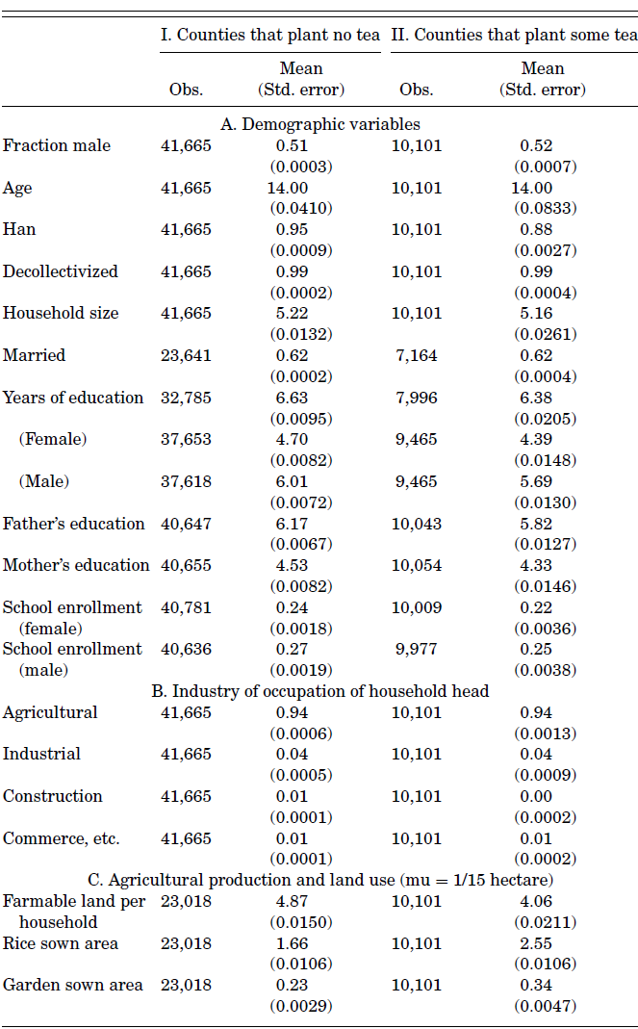

Slide 12
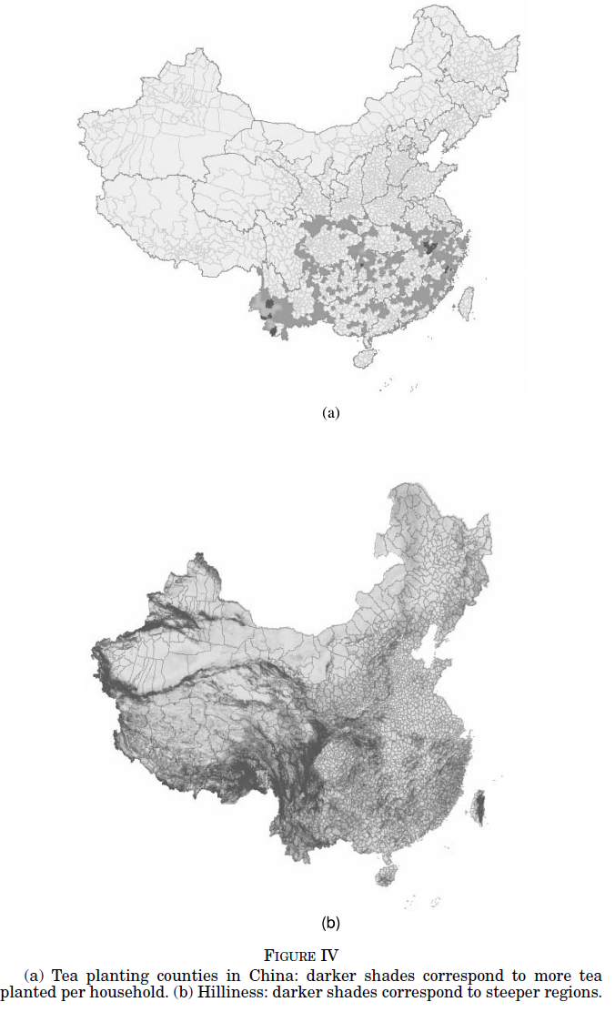

Slide 13
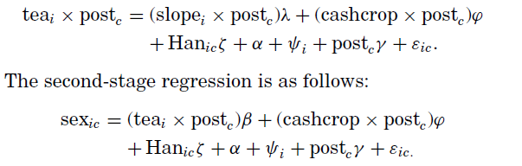
The two stage least square equation to estimate post reform, effect of tea plantation on sex-ratio
Instruments out the endogeniety that income might be higher due to other reasons. If there is non-linearity(higher orders) in Actual relationship, we get a lower bound.

Slide 14
Results

Slide 15
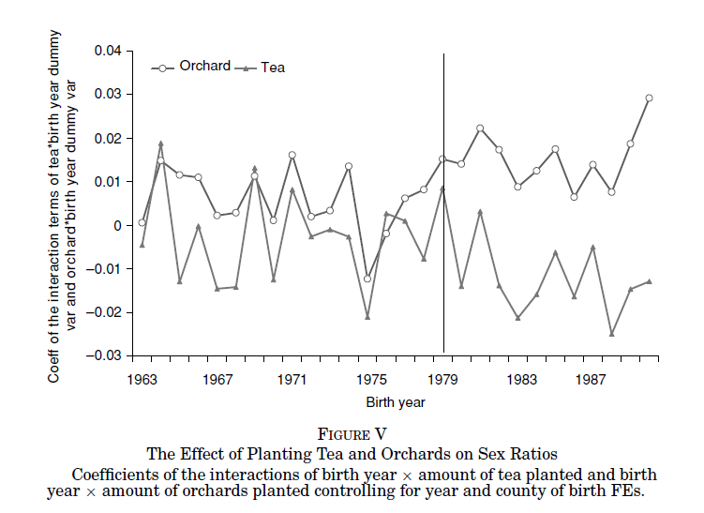
The DID

Slide 16
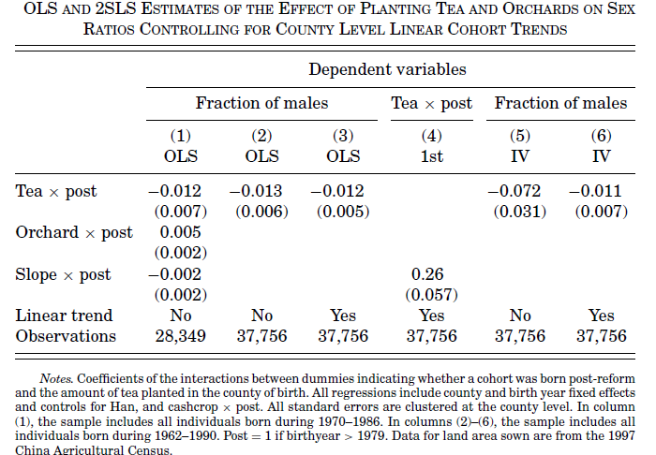

Slide 17
How to Interpret Results
In the First Result, we may summarise the DID change in multiplier post reform. consistent with predictions(remember, dependant is male to female ratio.
Subsequently, labeling all post as equal to 1 (discrete), we summarise results in a table. We are interested in the sign-of(consistent estimates) the betas(or as I mentioned earlier lower bound in absolute terms, of true betas) , tea* post. Simple OLS in case of unobserved variables which could be co-rrelated would give consistency as would IV. Trend Observations, would reduce SE’s but are in themselves of little policy value, as are the consistent multipliers. That IV gives lower lower bounds than OLS, suggests higher dergree of the functional form(geometric with just more than linear)---- Resort to Taylor’s expansion to see my claim. Thus a significant negative relation is Found.(In dev empirics, what we look for).
In the following slide, we’ll reject Uninary Model of household decision making.
Father favour Sons’ education, while mother daughters’.
To present results drastically, left hand side represents a regression where Regions growing some tea *post takes one if some tea is planted and so on(discrete variables), and the right hand represent continuous variable in qty of tea or orchard sown . These again suggest the increasing effect of ‘sowing tea’. High standard errors are due to time-fluctuation of trends. Authors have checked for robustness of results to migration, by biasing results away from the hypothesis. Again Family Control norms have been checked, Sex is taken at four yrs. Remember the Hahn ethnicity dummy which I’ve not mentioned so far?

Slide 18
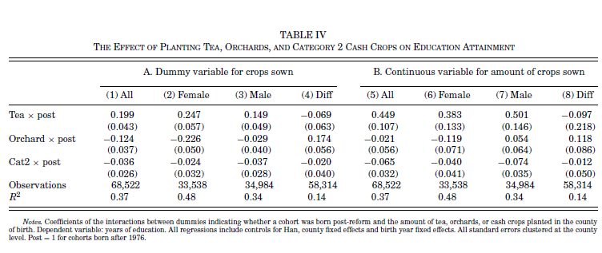

Slide 19
Conclusion
The findings for both survival and education reject the joint hypotheses that households are unitary (under the assumption that unitary households are income-pooling) and parents view girls as luxury goods relative to boys. An alternative explanation for the results within the unitary framework is that parents view children as a form of investment. This is consistent with the results for survival. However, if parents view returns from having children in the same way as returns from children’s education, then this hypothesis cannot easily explain the results for educational attainment.
The empirical findings provide a clear affirmative answer: both sex imbalance and educational attainment respond quickly to changes in sex-specific incomes. In addition, increasing total household income without changing the relative shares of female and male income has no effect on either survival rates or education investment.

Slide 20
Policy implications
One way to reduce excess female mortality and to increase overall education investment in children is to increase the relative earnings of adult women.

