Slide 1

Credit rationing in developing countries: an overview of the theory
Parikshit ghosh
Dilip mookherjee
Debraj ray

Slide 2
introduction
Credit is essential in poor rural economies to finance working capital, investment in fixed capital etc. particularly among farmers who are too poor to accumulate much saving.
A significant portion of the credit transactions in underdeveloped countries still take place in the informal credit market. This is mainly because poor farmers are incapable of providing the required collateral asked for by commercial banks, since they lack the sufficient assets.
The world of informal credit is one of asymmetric information and incentive problems.
There are a number of broad strands in literature focusing on adverse selection, moral hazard and contract enforcement issues. This paper focuses on the latter two.

Slide 3
The first part deals with the case of involuntary default under limited liability.
The model illustrates the trade-off between extraction of rents and provision of incentives to induce good harvest.
It also shows how the amount of collateral affects the effort and borrower returns
We will see that asset inequalities within the borrowing class are possibly magnified through the operation of the credit market, a phenomenon that may cause the persistence of poverty.
The second part introduces the possibility of voluntary default and analyses the problem of contract enforcement. The author discusses a model of repeated borrowing, where compliance (no default) is ensured by the threat of reduction/elimination of access to credit in the future.
We will see that credit rationing arises unless the borrower has sufficient bargaining power.
One common conclusion we can draw is that the distribution of bargaining power affects degree of rationing, effort levels and efficiency. Greater bargaining power to lender reduces available credit and efficiency.

Slide 4
The moral hazard problem

Slide 5
Consider an indivisible project which requires funds of amount L to be viable.
Output is binary taking the value of Q (good harvest) or 0 (crop failure).
The probability of good harvest is where “e” is the effort level of the agent. We assume that .
Cost of effort is given by “e”.
All agents are risk neutral.
Problem of self financed farmer
If investment takes place, then effort level is chosen to:
The optimal choice (efficient/first best) is given by:

Slide 6

Problem of debt financed farmer:
Let be the total debt, where “i” is the borrowing interest rate.
To introduce moral hazard we assume that “e” is not observable and hence not contractible.
Further, there is limited liability (i.e. the borrower has no repayment obligations in case of crop failure)
Let denote the value of the borrower’s transferrable wealth that can be put up as collateral. Assume that w<L (or else he will not borrow)
Then the problem facing a borrower having total debt R is:
The optimal effort level is given by:
BORROWER’S INCENTIVE CURVE

Slide 7



is decreasing in R: A higher debt burden reduces the borrower’s pay-off in the good state but not in the bad state, thus reducing the incentive to provide effort.
is increasing in w: A bigger collateral on the other hand imposes a stiffer penalty in the event of crop failure. Thus borrowers will want to prevent that by giving more effort.
Lender’s profit is given by:
LENDER’S ISOPROFIT CURVE
Since lender’s always have the option of not lending, we may assume that

Slide 8

Proposition 1: As long as the borrower does not have enough wealth to guarantee the full value of the loan (w<L), his effort choice will be less than the first best.
This is known as the debt overhang problem: i.e. the indebted borrower will always work less hard than one who is self financed.
The equilibrium values of “e” and “R” are determined simultaneously from the borrower’s incentive curve and the lender’s isoprofit curve.
So, we hold the lender’s profit constant at some level, and then find the values of “R” and “e” that satisfy the incentive constraint of the borrower.
Isoprofit curve is negatively sloped: If effort by borrower is higher, then default risk is lower and hence R must be lowered to keep lender’s profit at the same level.
Incentive curve is downward sloping: is decreasing in “R”

Slide 9
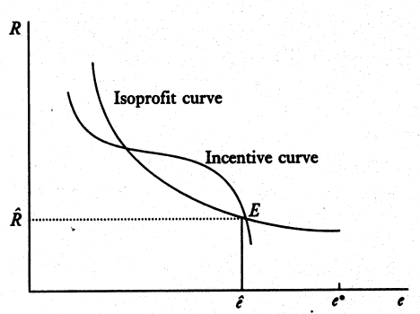
Notice also that borrower’s utility increases as we move down the incentive curve.
So, equilibrium is defined by an intersection of the incentive curve and the isoprofit curves.
However, if there are multiple intersections then the lowest one is consistent with the notion of Pareto efficiency. Also, the incentive curve must be steeper than the isoprofit curve at the equilibrium, for it to be efficient.

Slide 10
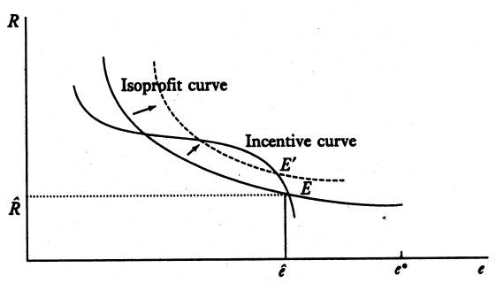
Note that the incentive curve must be steeper for efficiency because otherwise any slight movement to the right along the incentive curve increases both borrower utility and lender profit.
Comparative statics
Higher lender profit: As increases, the isoprofit curve of the lender shifts out. Thus we get a new Pareto efficient equilibrium corresponding to this level of .

Slide 11


The new equilibrium point is higher on the incentive curve. The debt burden (R) increases and so does the borrowing rate “i” (because loan size is fixed) while the effort level falls.
Even though each equilibrium point is Pareto efficient, the higher it is on the incentive curve, the lower is the social surplus associated.

Slide 12
There are two effects of the rise in :
Rise in interest rate: this just implies a transfer of wealth from the borrowers to the lenders and hence there is no impact on social surplus.
Reduced incentive to give effort: the higher debt burden reduces the borrower’s incentive to provide effort. This increases chances of crop failure and thus creates a deadweight loss. Thus social surplus decreases as the lender’s profit increases.
Proposition 2 (Pareto efficient) equilibria in which lenders obtain higher profits involve higher debt and interest rates, but lower levels of effort. Hence the equilibria produce lower social surplus.

Slide 13
Consider two extreme cases:
Perfect Competition: = 0 corresponds to this case. Notice that it generates the highest possible level of effort, under the case where the farmer is debt financed. However since the debt burden “R” is still greater than “w”, the effort level is less than the first best.
Thus the source of inefficiency is not so much the monopolistic distortion created by the lender’s market power(although that certainly exacerbates the problem) but the distortion in incentives caused by limited liability. While the borrower shares the capital gains he shares no part of the capital losses (beyond the collateral posted)

Slide 14
Monopoly: This would correspond to the highest amount of lender’s profit that meets the incentive constraint of the borrower. So, this is given by the tangency of the incentive curve and the isoprofit line. This provides a ceiling on the level of debt or interest rate.
Credit rationing in a Macro level: Note that if at this level of interest rate, there is excess demand for funds, there will be no further rise in interest rate to clear the market (as expected in competitive credit markets).
There are some borrowers who wish to borrow but do not get credit. Thus there can be a situation of credit rationing if lenders have too much market power.
Hence, as mentioned in the beginning, the distribution of bargaining power affects the effort levels and productivity. Policies which improve the bargaining power of the borrowers will enhance the social surplus.

Slide 15

Can there also be a situation of micro-credit rationing?
Can we have a situation where even those who succeed in getting credit still get too little?
In other words, can there be underinvestment in debt-financed projects along with undersupply of effort (i.e. the debt overhang problem)?
We cannot address this issue in this simple model because the project has been assumed to be indivisible.
However, if we allow for variable size of investment then we can model micro-rationing.
Suppose output in good state is where “L” is the amount of investment; Q is an increasing concave function.
Output in the bad state is zero.

Slide 16






In any efficient contract, the amount of investment “L” is selected to :
The first order condition becomes:
Now given that the effort choice is suboptimal; i.e. e< e*
Hence we get sub-optimality on both fronts.

Slide 17
Non-linear interest rates:
Even in competitive credit markets, higher loan sizes may be accompanied by higher interest rates.
An expansion in the loan size will increase debt burden. This decreases borrower incentive to provide effort and hence increases default risk.
This may outweigh the effect of larger scale of borrowing, thus making the lenders worse off. In order to remain commercially viable, the larger loan must be accompanied by a higher interest rate and/or the level of collateral to reduce lender risk.
However, increase in interest rate can make matters worse by increasing debt burdens even more. Thus there is a trade-off.
While some loan increases can be sustained by charging higher interest rates, the lenders may be unwilling to lend beyond some level of loan size
Thus we may have credit ceilings which may imply rationing .

Slide 18
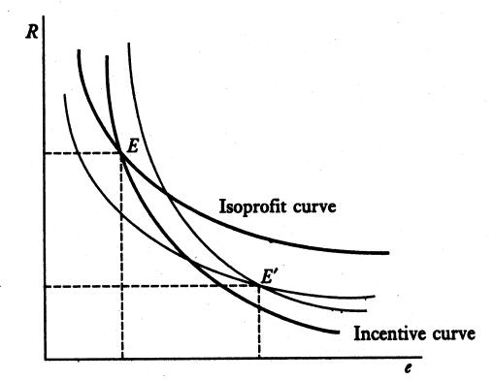
Higher Collateral : If “w” increases then
Incentive curve shifts to the right: since failure is more costly so at any R there is more effort.
Isoprofit curve shifts down: for any effort level, since the return in the bad state is higher, the return in the good state, given by the interest charged, must be lower to keep the profit of the lender unchanged.

Slide 19
Proposition 3: An increase in the size of the collateral “w”, leads to a fall in the equilibrium debt and interest rates, and an increase in the effort level. For a fixed the borrower’s expected income increases
Intuition: Bigger collateral induces higher effort from borrower. On the other hand if lender’s profit has to be kept unchanged then interest rate must fall because there is lower default risk.
Thus there is less debt overhang, further reinforcing the effect on incentives
Higher effort increases the social surplus, but since lender’s profit is constant, borrowers must be getting more in net terms.

Slide 20
Explains interest rate dispersion: Interest rate is closely tied to borrower characteristics like wealth, ability to post collateral etc. Wealthier borrowers pose less risk for 2 reasons:
they are capable of providing higher collateral and thus have better guarantees in case of default.
higher collateral means they have higher incentive to give effort. Thus default risk is low.
Thus wealthier borrowers have access to cheaper credit
Also, the functioning of the credit market may aggravate already existing inequalities. Those with lower wealth are doubly cursed:
they face lower consumption potential from asset liquidation
they also face lower income earning potential due to costlier access to credit.

Slide 21
Repeated borrowing and enforcement

Slide 22
In this section we basically consider the problem of voluntary default. i.e. how do lenders prevent willful default by borrowers who do in fact possess the means to repay the loan
Contracts have to be self-enforcing, where repayment of loans rely on the self interest of borrowers, given the future consequences of a default.
Defaults are deterred solely by the threat of cutting the borrower off from future access to credit.
In the absence of any usual enforcement mechanism (collateral, courts etc.) such dynamic incentives should be used for contract enforcement.
Since bankruptcy and involuntary default are not the focus of this section, the author does not include production uncertainty in this part of the paper.

Slide 23
In each period the borrower has access to production technology which produces output F(L), where L is the volume of inputs purchased and invested.
Suppose production takes the length of one period and let “r” be the bank rate of interest (opportunity cost of funds)
Consider a self financed farmer. His optimal investment level L* will be given by the solution to:
Thus the optimal L* is given by:

Slide 24


Debt Financed Farmer:
Assumptions: Borrowers live for an infinite number of periods and borrowers discount the future by a discount factor .
Partial Equilibrium:Single Lender
Suppose there is a single borrower and a single lender.
We are looking for a stationary sub-game perfect equilibrium where the lender offers a contract every period.
Lender follows a trigger strategy of never offering a loan in case of default.
Defaulting borrower has an outside option with payoff v. (v is taken to be exogenous)
We characterize the Pareto frontier of all stationary equilibria in which the same loan contract is offered at all states.
All such must satisfy the borrowers incentive constraint:
……….. (8)

Slide 25
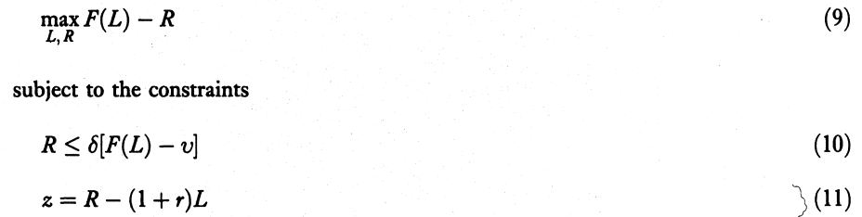
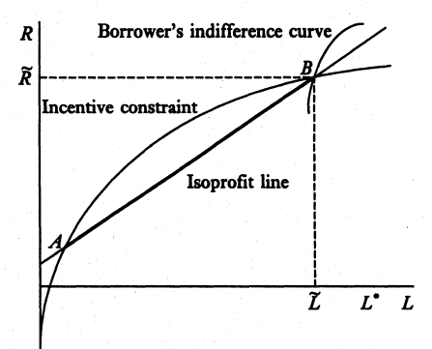
To generate the Pareto frontier we maximize borrower’s per period income satisfying the incentive constraint and holding the lender’s profit at some level z:
Diagrammatically:

Slide 26

The boundary of the incentive constraint is concave and positively sloped with slope equal to .
The lender’s profit constraint is given by a straight line with slope equal to (1+r).
Notice that A and B are the points where both the constraints bind.
Line segment AB represent the feasible set.
Borrower’s indifference curve are rising,concave curves with slope and
lower indifference curves gives higher utility to borrower.
Solution to the Problem:
If the borrower’s indifference curve is tangent to the isoprofit line on some point in AB then and .
If not,then the solution is given by the point B.Let L= at B.
Combining the above information we can write:
……….(12)

Slide 27
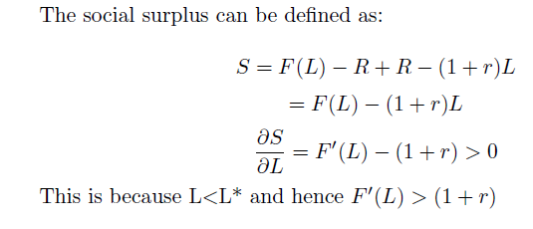
Observations:
The line joining the origin to any point on the incentive curve gives us nothing but the interest rate “i”. This is because:
R= (1+i)L
Thus R/L= (1+i)
Thus, as the loan size decreases, the social surplus also decreases.

Slide 28
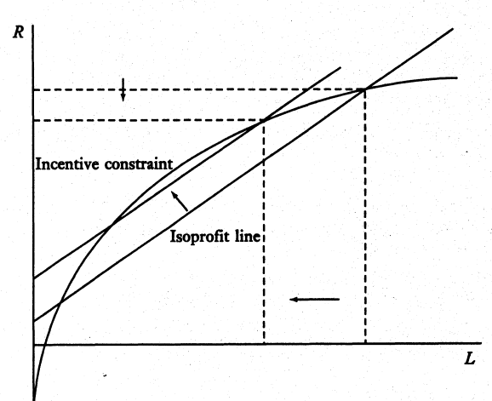
EFFECT OF PARAMETRIC SHIFT IN Z(lender’s profit) or V(option value of default).
Increase in z:the isoprofit line shifts up implying is lower.
Therefore if ,then increase in z results in lower L and higher i.
If then a small increase in z results in increasing R but L remaining the same and i increases.

Slide 29
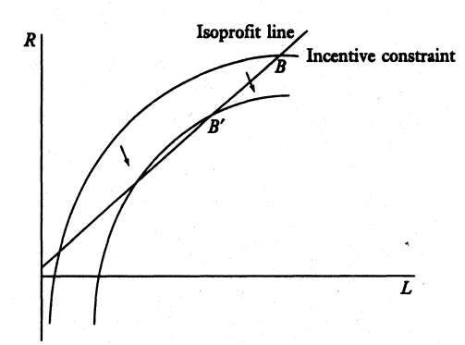
Increase in outside option v:the incentive constraint shifts inwards.The effect on loan sizes and interest rates in nearly similar to the previous case.

Slide 30
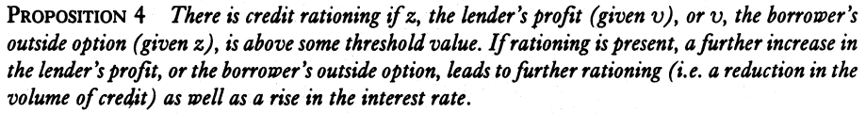
CREDIT RATIONING:
Notice that if the value of z (given v) or v (given z) is very high,the problem does not have a solution.
The borderline case is where the incentive curve and the isoprofit line is tangent-the feasible set reduces to a singleton and so this is the equilibrium.
Tangency of eq. (10) and eq. (11) implies .Therefore .
There is credit rationing if z or v is sufficiently high.
Since the solution is continuous in z or v ,therefore there will be credit rationing if either z or v is above some critical value.

Slide 31
Notice that:
Equilibria which give more profit to the lender involve lesser overall efficiency because credit rationing is more severe.

Slide 32
General equilibrium: multiple lenders

Slide 33
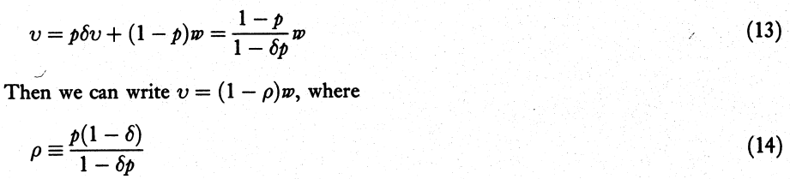
ASSUMPTIONS:
Suppose that following a default,the existing credit relationship is terminated.
The borrower can approach a new lender,who checks the borrower’s past and discovers the borrowers past with probability p(i.i.d. across periods).
If the past is discovered,the lender refuses to give loan.Then in the next period,the borrower approaches another lender.
If at any period the lender fails to discover the past default, then the borrower enters into a new credit relationship.
We are looking for a symmetric and stationary equilibrium,so the borrower receives the same contract (L,R) as with previous lenders.
Denote ,by w, the payoff of a borrower when he is in a contract (L,R).
Denote ,by v, the expected value of the outside option:

Slide 34

Here can be viewed as the scarring factor.
When p goes to 1, goes to 1.( when default is almost surely discovered,then value of outside option goes to 0)
When 0<p<1 and goes to 1 then goes to 0.(when the borrower values his future highly,then he doesnot default so easily which implies a good history and therefore outside valuation tends to w)
When p goes to 0 ,then goes to 0.(if the borrower defaults but chances of his past getting revealed is very low,then the value of outside option is w)
SOLUTION TO THE PROBLEM:
We have seen that if v or z changes,then the equilibrium changes.Therefore w is a function of v and z.
We are looking for a stationary equilibrium,therefore given z,we need to find that v such given this period’s v,the v obtained for the next period remains same.
Define a function = ……..(15)
The solution of the problem will be given by the fixed point of this function.

Slide 35

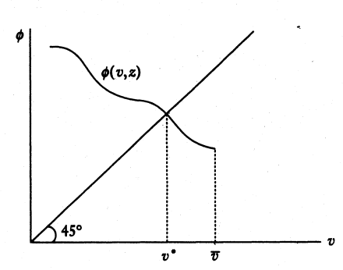
Note that the borrower’s per period payoff (on the equilibrium path) in partial equilibrium is(assume the incentive constraint to bind):
Observe that the function is decreasing in v.

Slide 36


This happens because an exogenous rise in v leads to a smaller loan size and higher interest rates,which adversely affects borrower payoffs.
Observe that if v is greater than some threshold then the problem has no solution and can be taken to be 0.
Therefore the function is downward sloping with a downward jump at
There is an unique fixed point if there is an intersection before the point of discontinuity,otherwise no symmetric equilibrium exists.
TO SHOW:If the scarring factor is sufficiently high then equilibrium exists.
Proof:
Notice that as z increases ,v decreases.Lower bound of v is 0.Therefore there exists such that equilibrium v =0.
Suppose .
As increases,the function undergoes a downward shift.
Therefore there exists a threshold value such that an equilibrium exists if and only if .

Slide 37

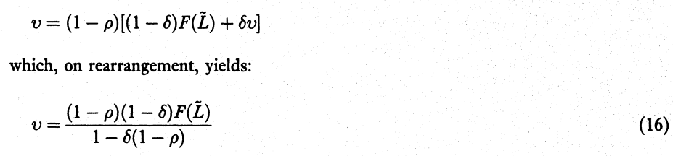
Observe that a rise in z shifts the function downwards( keeping v the same a rise in z reduces w and hence lower value of ).
Combining eq.(15) and borrower per period payoff in partial equilibrium we have:

Slide 38
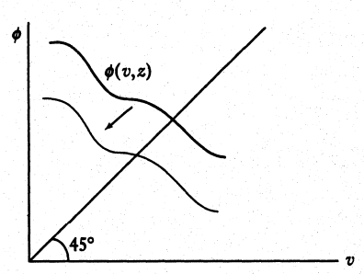
Therefore from eq.(16) we see that there exists a positive relation between v and .
Therefore a rise in z implies a reduction in v and .
This means that a higher profit to lender results in more credit rationing and lesser efficiency.

Slide 39
conclusion

Slide 40
In the case of involuntary default we saw that there will be the debt overhang problem; i.e. effort is always less than the first best. Moreover, this problem is not solely due to market power but also because of incentive issues.
We saw that as lender’s bargaining power improved, there was a rise in interest rates but fall in effort and this reduced social surplus on the whole. So distribution of bargaining power is important from the efficiency aspect. Borrowers should be given more bargaining power to improve efficiency.
Also, as collateral increased, effort levels increased, reducing the debt overhang problem.
thus the model could explain:
interest rate dispersion
how the credit markets can magnify existing inequalities
how the distribution of bargaining power affects efficiency

Slide 41
In the case of voluntary default:
Credit rationing was present if either z or v was above some threshold level.
Moreover if credit rationing is present,then a further increase in v or z leads to further rationing.
With multiple lenders there is a unique rationing in the credit market
( ) provided is above some threshold value i.e. the scarring factor is sufficiently high which reduces incentive for default.

