Slide 1
The Economics of Rotating Savings and Credit Associations
By: Timothy Besley, Stephen Coate, Glenn Loury

Slide 2
Rotating savings and credit associations (ROSCAS) are informal financial institutions, primarily used to save up for the purchase of indivisible durable good, found all over the world but majorly in developing countries. Using a model in which individual saves for an indivisible durable consumption good, the paper analyze economic role of Roscas which distribute funds using random allocation and bidding. They seem more appropriate for dealing with significant, idiosyncratic events, rather than hump savings for old age.

Slide 3
TYPE OF ROSCAS
A . RANDOM ROSCA
In a random Rosca, members commit to putting a fixed sum of money into a pot for each period of life of the rosca.
Lots are drawn and pot is randomly allocated to one of the members.
In the next period the process repeats itself, except the previous winner is excluded from the draw for the pot.
The process continues, with every past winner excluded, until each member of the
Rosca has received the pot once. At this point, the Rosca is either disbanded or begins over again.

Slide 4
B. BIDDING ROSCAS
One individual receives the pot in an earlier period than another by bidding more, in the form of a pledge of higher contributions to the Rosca, or one-time side payments to the other Rosca members.
Under a bidding Rosca, individuals may still receive the pot only once.
The bidding process merely establishes priority.

Slide 5
ISSUES WITH ROSCAS
1. For Roscas to operate successfully it is necessary that individuals keep their commitment to pay into the Rosca after they have won the pot. This may appear problematic since Rosca members are often not able to borrow in conventional credit markets precisely because they cannot be presumed to repay loans. Roscas somewhat circumvent such default problems by exploiting individuals‘ social connectedness. Incentive to defect from a Rosca is curbed by social constraints. Roscas are thus typically formed among individuals whose circumstance and characteristics are well known to each other. Defaulters are sanctioned socially as well as being prevented from any further Rosca participation. Nonetheless, default does sometimes occur.
2. Random Roscas are not particularly effective as institutions for buffering against risk, since the probability of obtaining the pot need not be related to one's immediate circumstances.
3. Even bidding Roscas, which may allow a member to obtain the pot immediately,only permit individuals to deal. with situations that cannot recur, since the pot may be obtained no more than once. Furthermore, since many kinds of risks in LDC's are covariant, individuals will have
high valuations at the same instant.

Slide 6
THE MODEL
ASSUMPTIONS
A group of ‘n’ individuals with no access to credit markets would each like to own an indivisible durable consumption good.
Each individual lives for T years, receiving an exogenous flow of income, over his lifetime y > 0.
Individuals have identical, intertemporally additive preferences. Each individual's instantaneous utility depends on nondurable- consumption, c, and on whether or not he
enjoys the services of the durable.
The durable does not depreciate and can be purchased at a given cost of B. Once purchased, it yields a constant flow of services for the remainder of an individual's lifetime. We also assume that one must own the durable to benefit from its services i.e. the durable good services are undivisible. It can’t be shared.
There is no discounting, which precludes any motive for saving or borrowing apart from the desire to acquire the durable.

Slide 7
An individual’s instantaneous utility with nondurable consumption c is v(1, c) if he owns the durable, and v(0, c) otherwise. We assume that v(0, ∙) and v(1, ∙) are increasing, strictly concave, and three times continuously differentiable in their second argument, using v'(i, c), v"(i, c), and so forth to denote differentiation of v(i, ∙) with respect to c, for i = 0 or 1.
Given c, we define
v(c) = v(1, c) - v(0, c)
to be the instantaneous gain in utility from owning the durable, and
as the expected instantaneous utility when is the probability of owning the durable
v (c) > 0 for all c ≥ 0 i.e. the individuals likes the durable and v’(c) ≥ 0 i.e. the marginal utility of non-durable consumption is not decreased by owning the durable. This is analogous to saying durable and non-durable goods are compliments.

Slide 8


Under AUTARKY , individuals save up on their own. Given the assumptions of the model, it is optimal for each individual to save B at a constant rate y - c, over an interval [0, t]. Thus, lifetime utility maximization involves each individual choosing c and t to:
( 1 )
Let be the solution to the above equation and let be the maximal value of lifetime utility.
Now, we substitute for t using the constraint in the maximization problem. This yields a one-variable maximization problem involving c, and the maximand can be written as :

Slide 9


Next, we define
(2)
Setting in the above equation, lifetime utility under autarky is :
(3)
The first term represents lifetime utility if the durable were free, while the second term is the minimal utility cost of saving up for the durable. This minimization trades off the benefit of a shorter accumulation period against the benefit of higher consumption during this period. Letting , be the consumption level which solves (2), the optimal autarkic consumption rate is c*(O). Under autarky, no individual has the durable good before date at which time all n individuals receive it. Thus the expected fraction of time that an individual will enjoy the services of the durable during the accumulation period is zero. This explains why autarky is represented by in (2). Autarky is inefficient; each person saves at rate

Slide 10
and after an interval of there are enough savings to buy a durable which could be given to one of the group members. Roscas remedy this inefficiency, with the cost function ,u( ∙ ) measuring the extent of welfare improvement.

Slide 11

LEMMA: Under the assumptions on preferences set out above, the minimized cost , u ( ∙ ) in (2) is a decreasing, concave function of , and the cost-minimizing consumption rate c*( ∙ ) is an increasing function of . Both are twice continuously differentiable on [0,1], where they satisfy the identity , . Moreover, if v"'(i, c) > 0 for i= 0 and 1, and if v"(c) ≥ 0, then c*( ∙ ) is strictly convex.
PROOF OF LEMMA : As long as acquiring the durable good is desirable under autarky,
a unique interior solution to (2) exists. The first-order condition for this problem implies:
This is the identity claimed in the lemma. Since is increasing in u( ∙ ) must be decreasing. Moreover, since u( ∙ ) is the value of a minimand linear in the parameter a, elementary duality theory implies that u( ∙) is a concave function of By the envelope theorem,

Slide 12

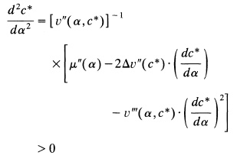
These relations, the assumed three-times continuous differentiability of the utility function, and the implicit-function theorem establish the extent of differentiability of u( ∙ ) and c*( ∙ ) asserted in the lemma. Now differentiate with respect to and use the envelope result to get
Given concavity of the utility functions v(i, ∙), and the assumption that
Differentiate the identity twice with respect to to get
Since and for i = 0 and 1.

Slide 13
RANDOM ROSCAS
Imagine that n-person group forms a random Rosca which meets at equally spaced dates up to with contributions of B/n at each meeting).
Each time the Rosca meets, an individual is randomly selected to receive the pot of B, allowing him to buy the durable. Each individual continues to save at rate over the interval as under autarky, but can now expect to receive the durable
sooner.
Risk aversion is not an issue here, since from each individual's ex ante viewpoint, the random Rosca does as well as autarky in every state of the world, and strictly better in all but one.
Given the uniform spacing of meeting dates and the constant contribution rate, the duration of the Rosca will be inversely proportional to the rate at which the group saves and accumulates the durable.

Slide 14
Group will choose length of Rosca in order to maximize the ex-ante expected utility of representative group member.
Consider, a "general" random Rosca of length t, meeting at the dates {t / n, 2 t / n, ..., t), with members contributing B/n at each meeting date. A representative member of the Rosca views his receipt date for the pot (and hence the durable) as a random variable,
distributed uniformly on the set {t/n, 2t/n,...,t). Each member saves at rate B / t over the life of the Rosca, and nondurable consumption is thus c = y - B/ t during this period. Given c, each member's lifetime utility is the random variable:
where t = B/(y - c). Lifetime expected utility in this random Rosca is the expected value of the expression above.

Slide 15
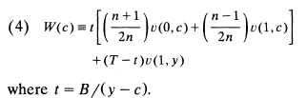

Each member's ex-ante welfare is :
choose t (or equivalently c), to maximize (4). Let denote the optimal length , the associated consumption rate, and the maximal value of expected utility.
Defining (4) may be rearranged as follows:

Slide 16

This can be written as:
In words, welfare is the difference between what lifetime utility would be were the durable a free good and the minimal (expected) utility cost of saving up for its purchase. This cost is lower under the random Rosca than under autarky because each member expects to enjoy the durable's services for a fraction of the time in which he is saving up for the durable.

Slide 17
PROPOSITION 1: By forming a random Rosca, group members raise their expected lifetime utilities. The optimal random Rosca involves members saving at a lower rate over a longer interval than under autarky. Nevertheless, if v "'(i, c) > 0 for i = 0 and 1, and if v"(c) > 0, then individuals expect to receive the durable good sooner in the optimal random Rosca than under autarky (i.e.,
Proof :
Equation (3) and (5) implies,
The above expression is positive,u( ∙ ) is a decreasing function; so group members' expected utility is higher in the random Rosca than under autarky.
Lemma also established that c*( ∙ ) is increasing. Therefore consumption is greater as well, since

Slide 18
However, the constraint , t(y - c) = B applies under both autarky and the random Rosca. Hence, and the optimal random Rosca involves members saving at a lower rate over a longer interval than under autarky.
To prove that the expected receipt date under the optimal random Rosca is sooner than that under autarky we have to show that :
Since, and its sufficient to show that,
By assumption of concavity of v(1, ∙), inspection of (2) reveals that y = c*(1). Therefore, we need to show that :
This follows from Jensen's inequality and the convexity of c*(∙) established under
these hypotheses in the lemma.

Slide 19

Hence, Welfare is raised by forming a Rosca because some financial intermediation reduces everyone's utility cost of saving up.
The ranking of random Roscas and autarky does not hold ex post since, though individuals have the same prospects ex ante, their circumstances differ once the order of receipt has been determined. Using the index i to denote the person who wins the pot at the ith meeting, at date ex post utilities under the random Rosca are given by :
Since his consumption/receipt-date pair is feasible, but not optimal, under
autarky, the individual receiving the pot at the final meeting date (i = n) has been made
strictly worse off (ex post) by joining the random Rosca.

Slide 20
RECAP
What are Roscas?
Why are Roscas formed?
What are random roscas?
Welfare in random rosca

Slide 21
BIDDING ROSCA
Individuals bid for the right to receive the pot at a certain date.
Assume that Rosca members determine the order of receipt for the pot at time zero.
“Bid" : a pledge to contribute a certain amount to the Rosca at a constant rate over its life, in exchange for the right to receive the pot at a certain meeting date.
A higher bid would naturally entitle an individual to an earlier receipt date.
Since there is no uncertainty about the date of receipt, this does not seem unreasonable.

Slide 22
Any auction protocol must satisfy the following conditions:
All must result in individuals being indifferent among bid/receipt- date pairs, since individuals have identical preferences and complete information
Any efficient auction procedure must be structured so that total contributions committed through bids are just adequate to finance acquisition of the durable by the recipient of the pot at each meeting date. This precludes both redundant savings within the Rosca and the necessity to save outside of the Rosca.
These 2 conditions determine the outcome of the bidding procedure. Thus it is unnecessary to commit to a particular auction protocol.

Slide 23
THE MODEL
t : time duration of the Rosca
n : number of group members = number of times the Rosca meets.
In the zero ^{th} period, the bidding takes place.
There are (n-1) ascending-bid auctions , determining who wins the pot at each meeting date except the last. Each winner is excluded from participation in subsequent auctions.
Contribution of the last remaining individual is set such that sum of all the commitments equals B.
Winning bids + last recipient's contribution = B

Slide 24
CHARACTERIZATION OF THE EQUILIBRIUM BIDS
Bidding Rosca lasts until time t.
Meeting dates are given by {t/n , 2t/n , . . . , t}.
i ^{th} individual : the one who receives the pot at (i t/ n )
b_{i} : promised contribution of individual i
A set of bids constitutes an equilibrium if
(i) no individual could do better by outbidding another for his place in the queue &
(ii) contributions are sufficient to allow each participant to acquire the durable upon receiving the pot.

Slide 25
If a member i bids b_{i} ,
then the nondurable consumption in each moment during the Rosca’s life is
Thus, we can characterize the Rosca in terms of the consumption rates:

Slide 26
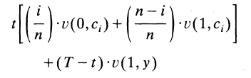

Condition (ii) , contributions are sufficient to allow each participant to acquire the durable upon receiving the pot, implies that individual's equilibrium utility
level is
Letting α_{i} equal (n - i)/n, condition (i) implies, for all individuals i and some number x, that
The number x represents the members’ common average utility during the life of a bidding Rosca of length t, in a bidding equilibrium.

Slide 27

Now define ¯ to be the average nondurable consumption rate of members during the life of the Rosca
Then condition (ii) is equivalent to
given the equilibrium average utility level for the duration of the Rosca, x. Then (7) gives individuals' equilibrium consumption levels, and these, via (8), can be used to find the Rosca's length, t.
c

Slide 28


Assume that the length of the bidding Rosca is chosen to maximize the common utility level of its members. The foregoing discussion and (7) imply that this common welfare is
Now let ĉ (α ,x) be the function satisfying v(α, ĉ) =x, and define
Then, when the equilibrium average utility during a bidding Rosca is x,
ĉ (α ,x ) is individual i's nondurable consumption rate during the Rosca, and B/[ y - c(x)] is the Rosca's length.
¯

Slide 29
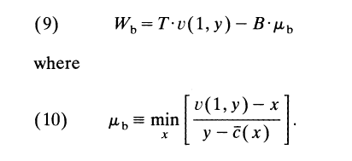
Denote by t_{b} : the duration
W_{b}: common utility level of the optimal bidding Rosca.
Letting x* give the minimum in (10), then t_{b} = B/[y - c(x*)] is the length of the optimal bidding Rosca.
¯

Slide 30
Lifetime utility expressed in (9) admits the same interpretation noted for autarky and the random Rosca; it is the difference
between lifetime utility if the durable were free and the minimal cost of saving up.
The latter, determined in (10), again trades off higher welfare during the Rosca versus faster acquisition of the durable.

Slide 31

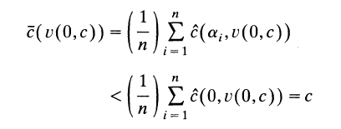

COMPARING AUTARKY AND BIDDING ROSCA!
From (3) and (9),
Since v(α, c) increases with both α and c, ĉ (α ,x) decreases with α; so,

Slide 32
Therefore ¯(v(0, c_{a})) < c_{a}; but then, setting x = v(0, c_{a}) in (10) and comparing the value of the right-hand side with the minimized value in (2), we see that µ(0)> µ(b). Thus, by forming a bidding Rosca, group members raise their lifetime utilities.
PROPOSITION 2 :
By forming a bidding Rosca, group members raise their lifetime utilities relative to autarky. Moreover if 1/ v'(0, . ) is concave, the optimal bidding Rosca involves group members saving at a lower average rate and over a longer interval than under autarky.
c

Slide 33
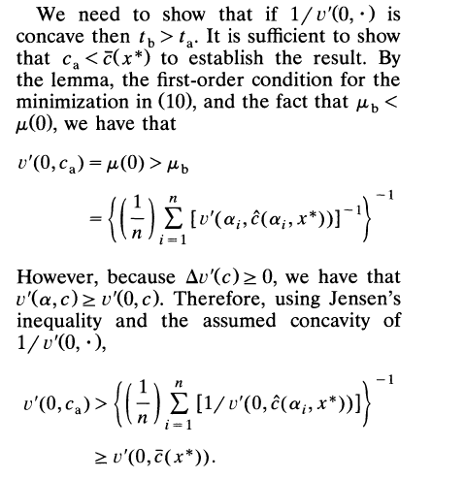

Slide 34
The bidding Rosca leaves each individual with a different rate of nondurable consumption during the accumulation period.
Earlier acquirers of the durable bid a higher contribution to the Rosca and consume less of the nondurable; (c₁ < ...< c_{n}).
Proposition 2 also reveals that the last individual to acquire the durable in a bidding Rosca must have greater nondurable consumption during
accumulation than under autarky (c_{n} > c_{a}). These higher contributions of earlier recipients resemble interest payments, and in this sense the bidding Rosca can be likened to a market.

Slide 35
Bidding versus Random Roscas
Either type of Rosca allows a group to use its savings more effectively than under autarky.
They do not yield identical outcomes.
Bidding results in recipients of early pots forgoing consumption. The optimal savings rate may also differ between the two institutions. Comparison of these savings rates and welfare levels is the object of this section.

Slide 36
PROPOSITION 3:
Group members' expected utility will be higher if they use a random rather than a bidding Rosca. If the value of the durable is independent of the nondurable consumption rate [i.e., Δv'(c)= 0], and if 1/ v'(O, .) is a convex function, then the optimal random Rosca involves members saving at a lower rate over a longer interval than the optimal bidding Rosca.

Slide 37
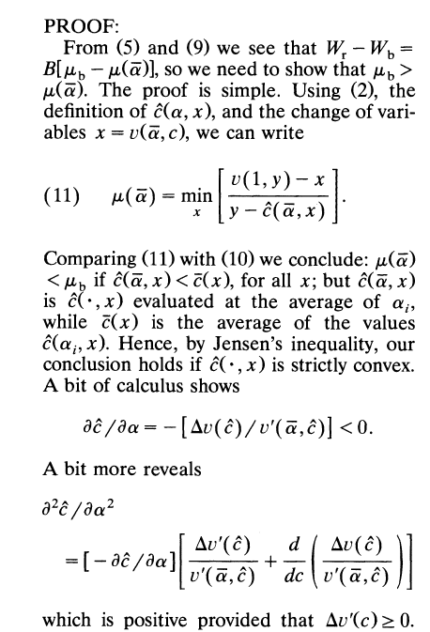

Slide 38
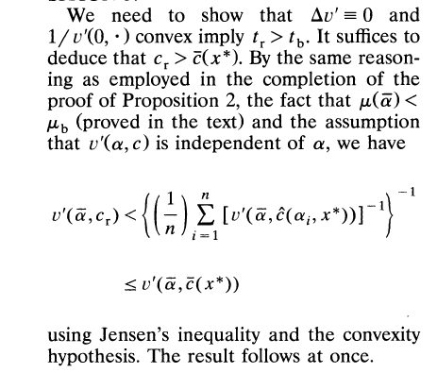
TYPO:
c_{r} < c(x*)
¯

Slide 39
The assumption that the durable and nondurable goods are complements is key to proving that random allocation dominates bidding from an ex ante viewpoint.
WHY??
Consider two Roscas of the same duration.
Bidding Rosca : same average utility over the life of the Rosca;
Random Rosca: same nondurable consumption rates.
These are the constraints on the general scheme which randomly assigns members an order of receipt i, 1 < i < n, and a consumption rate c_{i}, 0 < c_{i} < y, but which requires neither equal consumption rates nor equal ex post utilities.
Were such a scheme designed to maximize ex ante expected welfare, it would equate individuals' marginal utilities: v'(α_{i} , c_{i}) = v'(α_{i} , c_{j}), 1 < i < n.

Slide 40
Which type of Rosca approximates this condition more closely?
In a biddinge quilibrium,earlier recipients of the pot contribute more to the Rosca (lower c_{i}) in exchange for greater access to the durable during the Rosca (higher α_{i} ). However, with Δ v'(c) ≥ 0, they also have higher marginal utilities than those receiving the pot later.
In the random Rosca, c_{i} = c_{j}, for all i. The divergence is mitigated.
Thus, when the two goods are complements, the equal-consumption-rate constraint of random allocation is less inhibiting than is the
equal-average-utility constraint of bidding, and the random Rosca performs better than the bidding Rosca in this case.
When Δ v'(c) ≥ 0, random assignment with equal nondurable consumption more closely approximates this condition than does bidding.

Slide 41
This is particularly clear when Δ v'(c) = 0.
Equality of consumption rates during the Rosca implies equality of marginal utilities.
Equality of lifetime utilities constrains consumption so that the marginal utility is higher among those who receive the pot earlier.
To see this graphically, consider a 2-person group.
T = 3 years : time horizon for the 2 people
t = 2 years : life of the Rosca
Value of the durable’s services = ζ

Slide 42
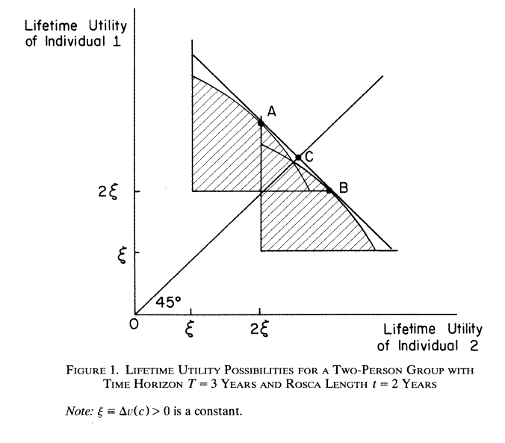

Slide 43
Since total annual contributions to the Rosca must equal the durable's cost, total annual consumption for the individuals equals 2y - B during the life of the Rosca.
By considering alternative nondurable consumption levels for the two
individuals satisfying this constraint, we trace out two utility possibility frontiers. Which is relevant depends upon who gets
the durable first.
If individual 1 gets the good first : northwest of the graph
If individual 2 gets the good first : southeast of the graph

Slide 44
Random Rosca yields equal nondurable consumptions.
Therefore, its utility allocation is either at point A (if individual 1 wins the first pot) or at point B (if individual 2 does).
Because Δv'= 0, the slope of the relevant utility possibility frontier is -1 at points A and B; the line containing A and B is tangent to the two frontiers at
those points. Since these utility allocations have equal probability, each individual's ex ante expected utility is at point C.
The sum of expected utilities at point C is maximal among all feasible expected utility allocations.
A bidding Rosca, by making utilities equal, produces a utility allocation at the intersection of the two frontiers. The dominance of the random Rosca is now obvious.

