Slide 1
Credit Markets in Northern Nigeria:
Credit as Insurance in a Rural Economy
Christopher Udry

Slide 2
Introduction
The article addresses issues of incomplete markets and imperfect information in the context of credit markets in rural northern Nigeria.
It is found that in the four villages surveyed, credit transactions take advantage of the free flow of information within rural communities.
Information asymmetries between borrower and lender are unimportant, and their institutional consequences-the use of collateral and interlinked contracts-are absent.
Credit transactions play a direct role in pooling risk between households through the use of contracts.
In these contracts the repayment owed by the borrower depends on the realization of random production shocks by both the borrower and the lender.

Slide 3
Literature on rural credit markets
Complete insurance markets are absent.
So credit transactions take a special role in allowing individuals to smooth income shocks over time.
Because moral hazard and adverse selection are especially prevalent in credit transactions, credit markets are likely to incorporate organizational features that serve to mitigate them.
Two organizational features have received particular attention in the literature on credit markets.
The first is the pledging of collateral.
The second institution is contractual interlinkage between markets.
Notes:
An interlinkage exists if two parties engage in transactions in more than one market and the terms of each transaction are set in a single contract.
An interlinked transaction may be a disguised form of collateral. For example, the forward sale of standing crops (a product-credit market interlinkage) is often most easily interpreted as the pledging of those crops as collateral

Slide 4
What is this article about ?
This article extends contemporary research on credit markets to rural credit in Africa by reporting findings from a detailed survey of 198 households in northern Nigeria.
The survey yields two major findings
First, nearly all loans are transacted within a village or kinship group.
The paper presents evidence that information asymmetries within such groups are unimportant.
Second the author shows that credit contracts play a direct role in pooling risk among households in the survey area:
The repayment owed by a borrower depends upon the realization of production and consumption shocks by both borrower and lender.

Slide 5
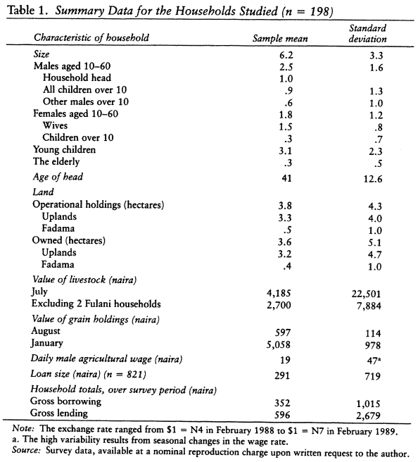
The Geographical setting
2 staged random sampling .
4 randomly selected villages near the city of Zaria in northern Nigeria.
The questionnaires were designed to yield a complete picture of each household's asset and debt position;
An account of its credit, labor, product, asset, and asset-rental transactions over the previous month; and a range of demographic and background data.

Slide 6
Occupations
The area has a diverse population, with agricultural systems ranging from farmers who keep no cattle to semisettled herders.
Every household in the research villages operates a farm, which is usually composed of multiple plots(an average of five plots per household) interspersed with those of other village residents.
A large variety of nonagricultural occupations also exists. These include trading, the provision of transport services (via vans, motorcycles, bicycles, or donkeys), and small-scale industries such as carpentry, house building and tailoring.

Slide 7
Moslem laws
A large majority of the population of the area is Moslem, as are all but one of the 198 sample households.
This fact has particular importance for a study of rural credit because Islamic law prohibits the use of fixed interest charges on loans.
Investment income is prohibited if the investor does not share in the risks of the enterprise.
Hence an equity investment is legal, whereas lending with a fixed interest rate is not.
Fixed repayment periods are also prohibited.
Almost no loans between individuals are made with positive explicit fixed interest rates.
Yet individuals display no reluctance to accept loans from banks at low (but positive) fixed nominal interest rates.

Slide 8
CREDIT TRANSACTIONS
Only 7.5 percent of all loans (by value) come from banks, companies, or projects.
There is widespread participation, in both borrowing and lending in the informal credit market, as can be seen in table 2.
On average, loans are held for just under three months (see figure 1).
The peak borrowing period occurs near the start of the main growing season, and many loans are repaid after the first crops are harvested.
The average amount of credit transacted per household over the survey year 1989-90 was approximately N1,000.
The loans, therefore, are of a scale and timing associated with short-term consumption and working capital needs.
Both borrowing and lending tend to increase with wealth, as can be seen in figure 2.

Slide 9
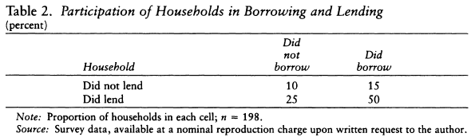
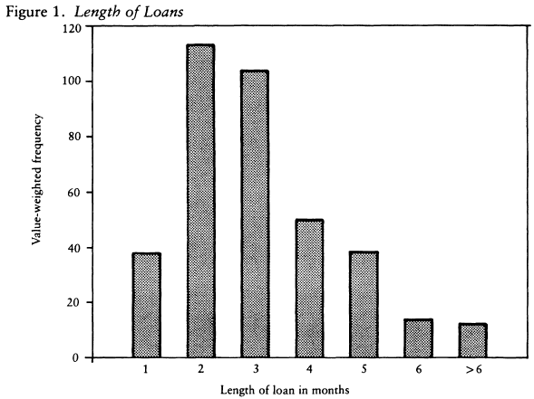
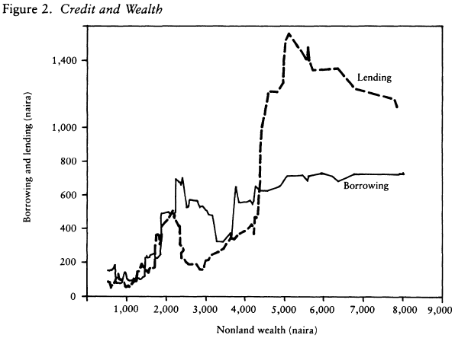

Slide 10
Loans with no interest and no fixed term
These loan transactions appear to be extreme in their informality.
They generally occur in private, with no witnesses and no written record.
Although the borrower and lender negotiate over the size of the loan, most (84 percent of transactions) are made without setting an explicit (nominal) interest rate or repayment date.
The borrower and lender, therefore, only implicitly agree on the terms of the loan.
The simplest and most direct penalty for a default is the exclusion of the defaulter from future opportunities to borrow from the lender.

Slide 11
There is more than one lender available to most borrowers, however, so this particular penalty may have little force.
Alternative mechanisms for enforcing credit obligations are available through appeal to community authorities.
The response to a default must consist of at least two stages:
First, the lender must convince the authority that the borrower has not met his obligations;
Second, the authority must impose a penalty.
The authority's decision looks at
if misunderstandings over the terms of the contract.
reputations of both parties for honesty in previous activities.
all types of social activity.

Slide 12
The penalties invoked by the authority also depend on his position as a respected figure in the community.
There is a strong incentive for the borrower to not default.
The possibility that he might make his finding public, either to other authority figures or to the community at large (through gossip), is a stronger incentive to meet obligations.
If his honesty is impugned, the defaulter may be excluded from future credit transactions, and his ability to transact in other markets may be damaged as well.

Slide 13
Information asymmetry
Since formal sector lenders are almost completely absent from the study area, the information flows of concern are between individuals who lend to each other.
These parties are, with very few exceptions, well known to each other: 97 percent of informal sector loans by value are between residents of the same village or between relatives (see table 3).
A total of 65 percent of the remaining informal sector loans occur between individuals who share a long history of exchanging gifts or a long history of previous credit transactions.
However, collateral (usually land) is used in only 3 percent of the loans observed.
The distinguishing feature of the few loans for which collateral is used is their size; the average size of a loan involving collateral is N634, as opposed to an average size of N276 for unsecured loans

Slide 14
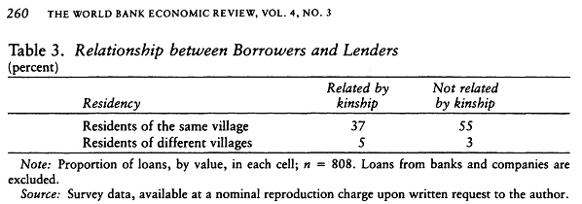
The information asymmetries that may drive market interlinkage and collateral use in other contexts do not seem to be present in this set of loans.
Information flows freely between borrowers and lenders within an extremely small geographic or social space.
The fact that almost no loans are observed to cross the boundaries of this space is an indication of the advantages held by family members and village co-residents in the availability of either information or enforcement mechanisms

Slide 15
RISK POOLING
Wherever insurance markets are incomplete, credit markets are known to play an important role by allowing risks to be pooled over time; households borrow more when they suffer an adverse shock, and they lend more when favored with a positive shock.
The free flow of information within the village and among relatives may permit credit contracts to play a more direct role in insuring against risk.
A striking finding is that repayments owed on a loan appear to depend upon the random production and consumption shocks received by both the borrower and the lender

Slide 16
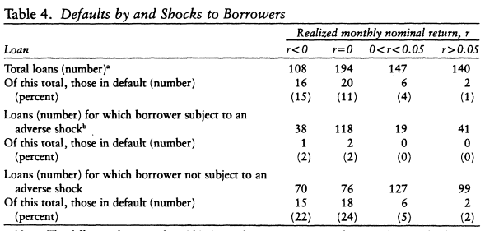
As shown in table 4, for a given realized interest rate, a borrower is less likely to be considered in default if he was subject to an adverse production or consumption shock.

Slide 17
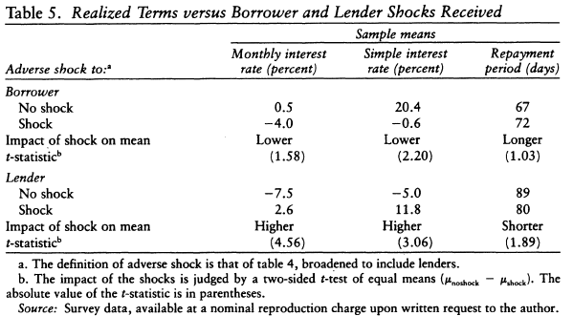
The survey data show that realized interest rates are lower and repayment periods are longer for debtor households who have experienced adverse shocks (table 5).
The evidence that repayments respond not only to the entire circumstances of the debtor household, but also to those of the creditor household (table 5).

Slide 18
Contrast to conventional loans
Loans involving relatives, overall, are just as likely to be considered in default as are other loans, and the terms of loans between relatives seem to be just as responsive to realizations of random shocks.(Tab 6,7)
Access to conventional loans permits a household to consume its permanent income; the consumption effects of an unexpected shock to income (and therefore to wealth) can be spread over a period of time.
In contrast, state-contingent contracting offers a mechanism through which both borrowers and lenders can neutralize the unexpected shock itself so that it has no effect on wealth.
Only certain shocks, however, can be insured against, through this market.
In general, the loans described in this article are concentrated within single villages, and thus can serve to pool only the idiosyncratic shocks faced by households within the village.
They can contribute almost nothing to a household's efforts to respond to a shock that affects the village as a whole.

Slide 19
Puzzling absence of outside lenders
Variation in farm yields across sample households can be explained 42 percent from idiosyncratic shocks, and 58 percent from a combination of shocks that affects the entire village.
More puzzling is the almost complete absence of credit transactions which cross community boundaries.
This is an environment characterized by seasonal demands for finance that are highly positively correlated over small areas, and the analysis above indicates that there is a large component of yield risk that cannot be insured against within the village.
It would seem that there could be high returns available to financial intermediaries able to move finance over wide areas.
The absence of direct lending from outside the community can be explained by the high information costs of such transactions and by the existence of village-based traders who provide financial intermediation.
The outside lender cannot observe production shocks, cannot monitor the borrower, cannot impose a strong penalty on borrowers who default.

Slide 20
How to allow for outsider lending ?
These costs could be reduced by a contravention of the requirements imposed by Islam or by the development of alternative institutions (such as interlinkages with other markets) within which fixed interest charges can be hidden.
A fixed term contract would reduce the monitoring difficulties faced by outside lenders, and the availability of assets that could serve as collateral could alleviate the problem of contract enforcement.
Land is available to serve as collateral for borrowing from outside lenders. ( shown in the paper)

Slide 21
Pipeline traders
In northern Nigeria, the Hausa tradition of long distance trading has led to a class of merchants, dispersed through many villages, who have long-term relations with other merchants throughout Nigeria and beyond.
These merchants provide market intelligence, advance short term trading credit, and act as agents for each other.
This intensive contact enables them to enter into information-intensive state-contingent credit contracts of the sort described above.
Therefore, these village-based traders with wide connections can act as pipelines for outside credit to enter the village, increasing the volume of locally available credit and keeping the cost of credit below the threshold which would induce the entrance of outside lenders.

Slide 22
Evidence of pipeline traders
Of the 198 household heads in the sample, three are traders who have active relationships with traders in other locations.
Each of the three made far more loans than average, accounting for 37, 25, and 17 percent of the total value of loans made by the fifty sample households in their villages.
One of the three also had large loans from outside traders, accounting for 11% of all of the borrowing by sample households in that village.

Slide 23
SUMMARY AND IMPLICATIONS
There is only minimal use of collateral and no evidence of contractual interlinkage with other markets.
Contractual mechanisms to alleviate the difficulties posed by information asymmetries are not necessary because credit flows through paths that take advantage of the extremely free flow of information within a rural community.
In this information environment, credit transactions can be viewed as state-contingent contracts that allow direct risk pooling between creditor and debtor and that conform to the prohibition on fixed interest charges by Shari'a law.
There is some evidence in one village that these information-intensive contracts are spread over a wide geographical area by a network of village-based long distance traders.

Slide 24
The flexibility of the state-contingent credit contracts presents an exceptional challenge to potential formal sector lenders.
They have neither the access to information nor (generally speaking) the administrative flexibility necessary to make state-contingent loans.
Therefore, they cannot compete directly with lenders from within the community.
The existence of assets that could serve as collateral for fixed-interest loans may provide an opportunity for institutional change that could be exploited by formal sector lenders.
In addition, the conditions which permit state-contingent loan contracting within rural communities, namely the free flow of information within the village and the availability of mechanisms to enforce agreements between village residents, may also allow the design of peer monitoring systems to support lending by formal sector institutions to groups of rural households.

Slide 25
Peer monitoring
What is peer monitoring?” We found two types of peer monitoring.
Direct peer monitoring occurs when workers notice their peers' behavior or results and respond in a forthright way, such as correcting coworkers who make mistakes.
Indirect peer monitoring occurs when workers gossip about or avoid poorly performing peers.
Peer monitoring, which occurs when individuals notice and respond to their peers' behavior or performance results, is an informal organizational control that has not been extensively studied.

Slide 26
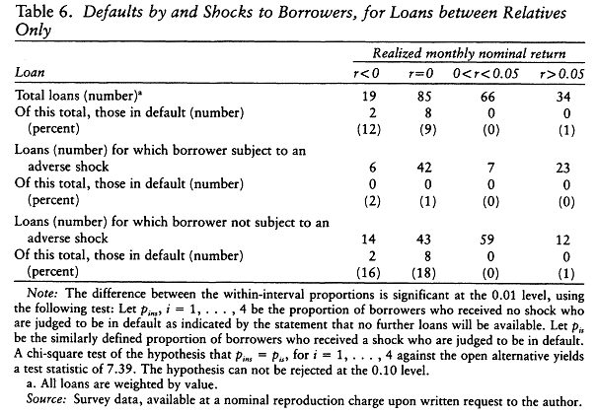

Slide 27
