Slide 1
Agricultural Volatility and Investments in Children
Robert Jensen

Slide 2
Agricultural Volatility
In many low-income countries, a large proportion of the population depends on agriculture for its primary means of support, whether through subsistence agriculture, the production of cash crops, or as hired farm labor.
However, agricultural yields and the demand for agricultural labor can be extremely volatile, especially due to weather conditions.
Furthermore, while the optimal consumption stream for households entails some appropriate smoothing over states of nature and across time, it has long been recognized that many of the usual mechanisms for doing so (credit and insurance markets) are often quite limited in such economies.
While there may exist nonmarket mechanisms, many shocks to agriculture such as weather or pests cannot be insured against locally through these channels, since they affect most people in a given region

Slide 3
Literature
Several studies have tested the hypothesis of perfect insurance in developing countries, for example, Robert Townsend (1994) for India, and Angus Deaton (1992) and Franque Grimard (1997) for Cote d'Ivoire. Most studies reject perfect insurance but find evidence of some consumption-smoothing.
However, considerably less attention has been devoted to the consequences for children of the limited ability of households to transfer resources across time or states of nature. Investments in children and the development of human capital are the cornerstones of enhancing well-being and breaking the cycle of intergenerational transmission of poverty, and they are also central to national growth and economic development. However, such investments may require substantial cash outlays.
The main interest is whether volatile income in an environment of incomplete insurance or capital markets leads to lost opportunities for such investments. If households cannot borrow or save, they must finance a given period's investment out of current-period income, and a large negative income shock could lead to a reduction in current-period investment in children. For example, Hanan Jacoby and Emmanuel Skoufias (1997) find that income fluctuations among households in India lead to variability in school attendance, and Andrew Foster (1995) concludes that credit-market imperfections influenced the impact of a flood on children's weight in Bangladesh.

Slide 4
Objective and Motivation
Author wants to test the hypothesis that “Negative income shocks lead to a reduction in current-period investment in children” for Cote d'Ivoire.
Over 70 percent of Ivorian households earn their primary source of income from agriculture, especially in the smallholder production of cash crops such as cocoa, coffee, and cotton, or as agricultural laborers.
Approximately 25 percent of Ivorians live below the official World Bank poverty line and spend a large fraction of their budget on food, leaving little room for schooling costs, doctor fees, or the purchase of medicine. Some of these costs can be considerable; for example, in 1986 the median household cash outlay for sending children to school (tuition, enrollment fees, books, school supplies, uniforms, and transportation) was almost CFAF 40,000 (about $90 U.S.) per year, which is about one-third the median household income per capita.

Slide 5
Data
Author uses data from the Cote d'Ivoire Living Standards Survey (CLSS), a household-level survey collected annually between 1985 and 1988 by the World Bank and the Cote d'Ivoire Ministry of Finance.
The survey gathered information on a range of topics, including farm production, income, expenditure, education and health (including measurements of weight and height).
Author examines whether children living in regions that experienced adverse weather shocks had lower investments in education and health. Author uses measures of investment flows (school enrollment, short-term nutritional status, and use of medical services), rather than health or human-capital stocks, since the goal is to determine whether there are changes in investment behavior in response to income shocks.

Slide 6
Agriculture and Income in Cote d'Ivoire
There are three distinct agro-climatic regions in Cote d'Ivoire; the coastal region in the south, dense forest in the middle, and savanna in the north. These three zones have very different rainfall, topography, and soils and thus feature different crops. In the forest region, tree crops such as coffee, cocoa, rubber, and palm oil are dominant, produced largely by numerous small-holders. Cereals, grains, and cotton are more prevalent in the savanna, and again much production takes place on small family farms.
The CLSS data reveal that, on average, households receive 50 percent of their income from the sale of crops; excluding Abidjan, the major city, it is almost 75 percent. Agricultural wages account for an additional 20 percent of income on average.
Rainfall represents both an important input into agriculture and an important source of un-certainty for farmers. Though total land size is small (322,463 kM²) there is considerable variation in levels of rainfall received throughout the country (see Jensen, 2000). Despite four major rivers running north to south, much agriculture is rain-fed rather than irrigated, and thus dependent on the amount of rainfall received.

Slide 7
Agriculture and Income in Cote d'Ivoire
In order to identify adverse weather shocks, Author merges the CLSS data with 14 years of monthly rainfall data collected from 41 weather stations throughout the country by the Agence Nationale des Aerodromes et de la Meteorologie.
Author defines an indicator for whether the rainfall data for a given station in the summer months most relevant to the 1986 harvest were more than one standard deviation (in absolute value) from their historical mean. Taking deviations from this mean is meant to capture the extent to which rainfall differs from what is typically received and the absolute value reflects that either too much or too little rainfall adversely affects output. This measure was also chosen to correspond to the methods of Grimard and Barton Hamilton (1999).
Using this definition, in 1986 approximately 20 percent of households were living in areas that experienced an adverse rainfall shock that would affect their income in 1987 (but not in 1986). The areas with the shocks are geographically dispersed and represented across all regions.
Table 1 presents mean characteristics for the pooled 1986 and 1987 cross-sectional surveys.

Slide 8
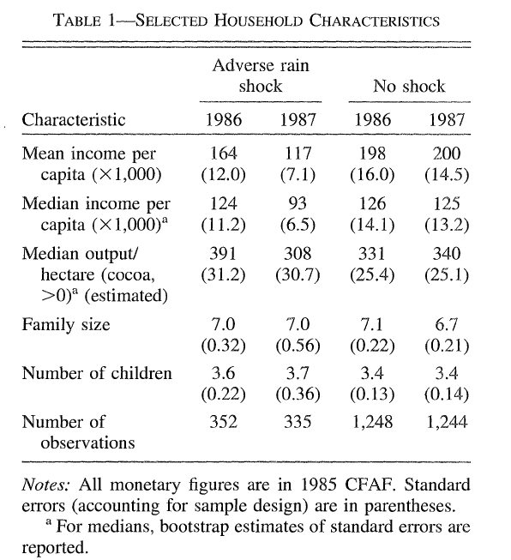

Slide 9
Pre-Post Analysis of Shock
Households living in areas with the adverse shock had lower average income per capita than other households in the pre-shock period. The differences in means are due to a few extremely wealthy households in the non-shock regions; in fact, there is no difference in the medians.
The two groups diverged between 1986 and 1987 as incomes declined by nearly 25 percent for households receiving the shock and were largely unchanged for other households.
An example of the cause of this decline is seen in row 3, where cocoa output per hectare dropped from 391 to 308 (21 percent), while output per hectare was unchanged for the non-shock group (hectares planted did not change differentially for the two groups, and prices were held constant by government marketing boards)..

Slide 10
Impact on Investments in Children: Approach
Approach:
  Compare the differences in the percentage of children enrolled in school, nutritional status, and the use of medical services (conditional on being ill) in 1986 and 1987 in regions that had the adverse shock, relative to the differences in regions that had normal rainfall.
  Use the child's weight-for-height (WFH)Z score (standard deviations from the NCHS reference median suggested by the World Health Organization), which is a summary measure of current nutritional status or health-investment flow (compared to height-for-age, which captures longer-term nutritional status or health stock; see Frank Falkner and J. M. Tanner [1986]). These investment variables represent flows over the past year, not stocks; they are additions to the existing stock.
  Focus on children aged 0-10 for health measures, and aged 7-15 for education. An advantage of these measures is that they represent individual allocations within households, in contrast to most studies of consumption-smoothing which assume equal allocation among household members.
  The identifying assumption is that, in the absence of the weather shock, the two groups would have followed similar paths of investment in children.
Table 2 shows the essence of the empirical strategy.

Slide 11
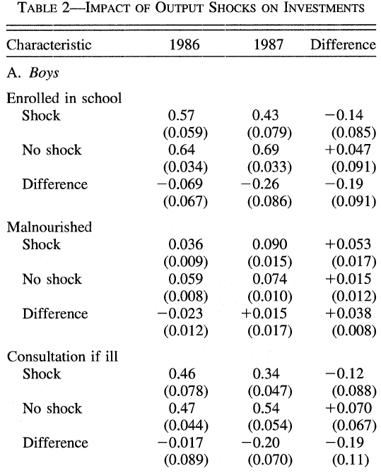

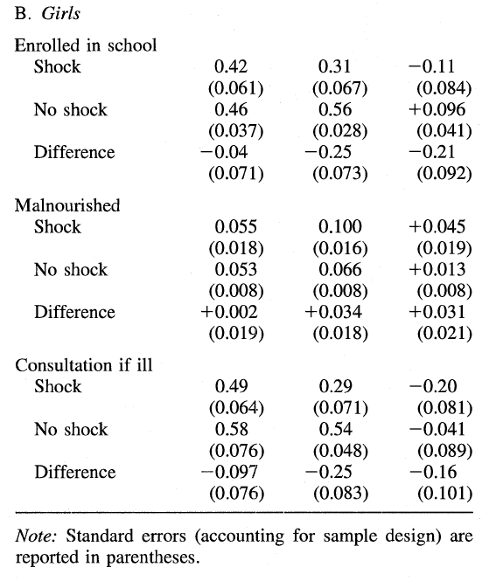

Slide 12
Impact on Investments in Children: Enrollment
In the period prior to the shock, there were only small differences in enrollment rates in the shock and non-shock regions, both for boys and for girls.
However, school enrollment rates declined by 14 and 11 percentage points among boys and girls (respectively) living in areas that experienced the adverse shock and actually increased in all other areas.
Overall, enrollment rates declined by about 20 percentage points (more than one-third of the original rate) for boys and girls in the shock regions relative to children in the non-shock regions.
Despite boy-girl differences in enrollment rates, the impacts of the shock on boys and girls are nearly identical. Unlike what is often suggested for South Asia, there is no evidence here that girls suffer more than boys in the face of economic shocks.

Slide 13
Impact on Investments in Children: Health and Malnutrition
The table also shows whether a health practitioner was consulted for children who were ill in the four weeks prior to the survey. Again, the percentages are similar prior to the shock, at about 50 percent, but the percentage of sick children taken for consultation declined dramatically to around one-third for those who received the negative shock and increased slightly (for boys) in areas with normal rainfall (rates of illness did not differ significantly between the two groups before the shock, nor did they change differentially).
Table 2 also reveals a change in the percent-ages of boys and girls who are acutely malnourished, defined as having a Z score more than two standard deviations below the reference median.
For boys, malnutrition was lower in the shock regions before the shock. While malnutrition increased for all groups, there was again a larger increase for those in the shock areas. An additional 3-4 percent of boys and girls were moved into malnutrition in regions receiving the rainfall shock (though the effect is not statistically significant for girls), for example, nearly doubling the original percentages for boys.

Slide 14
Impact on Investments in Children: Health and Malnutrition
Examining malnutrition alone hides a great deal of detail about the distribution of nutritional status.
Panels A and C in Figure 1 presents kernel estimates of the densities of VVFH for boys (results for girls are similar). There was a dramatic left-shifting of the entire density between 1986 and 1987 in areas with the shock, with only very small changes for the non-shock group. The densities give a more vivid depiction of the overall worsening of the distribution of nutritional status.
Panels B and D in Figure 1 show the differences in the estimated densities. A much greater percentage of children fall below the reference median following the rainfall shock, though much of the worsening of the distribution is concentrated above the malnutrition cutoff and thus would not be observed by simply looking at the percentage malnourished.

Slide 15
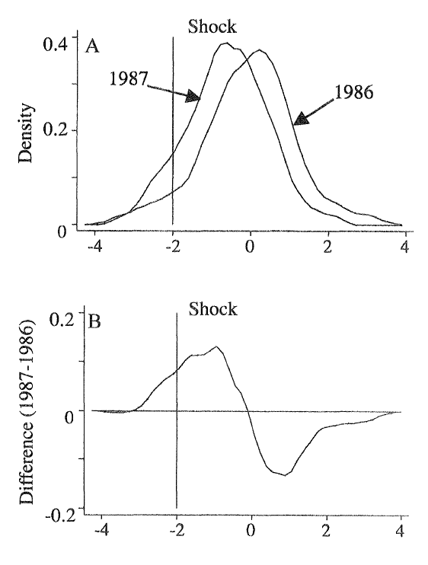
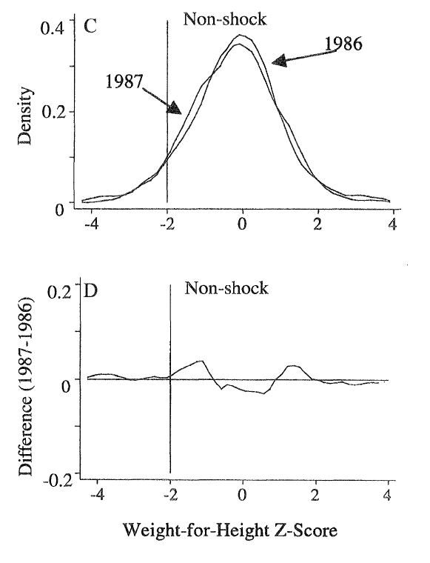

Slide 16
Additional Remarks
While Table 1 reveals that there was no difference in median incomes or demographic structure prior to the shock, the main concern is whether the two groups were changing differentially.
Though we cannot estimate the counterfactual of what the investment flows in children would have been if the rainfall shock had not occurred, the 1985 CLSS can be used to examine whether there were differential changes between the two groups prior to 1986.
Also no region that had an adverse rainfall shock in 1986 also had a shock in 1985; Author omits households in the 1986-1987 non-shock group that had shocks in the earlier period. In 1985, school enrollment rates were 0.44 for girls in the shock regions, and 0.48 for girls in the non-shock regions; for boys, the rates are 0.58 and 0.64. Comparing these numbers to those for 1986 in Table 2, it is clear that there is no indication of a differential trend prior to 1987, certainly not of the magnitude observed by 1987.
Thus, all of the results are compromised only if there was some unobservable difference between the two groups or there was some other change (unrelated to rainfall) that affected the groups differently which also occurred between 1986 and 1987. Since the rainfall-shock areas are spread throughout the country, it seems unlikely that there was some independently occurring common decline in those dispersed areas.

Slide 17
Conclusion
In this paper, Author finds that critical investments in children suffer dramatically in the presence of adverse agricultural conditions, with school enrollment rates declining by between one-third and one-half, and malnutrition doubling.
However, whether these period investment shortfalls can be made up for or whether they have permanent effects cannot be addressed without further assumptions (see Jensen, 2000).
To the extent that even temporary schooling interruptions or shortfalls in medical care or nutrition have lasting impacts, and given the importance of such investments for human development, the results suggest that aid and public insurance programs should be used to help households overcome adverse economic shocks. There may be a role for weather indicators for the targeting of such social programs.

Slide 18
Conclusion
These indicators are easy to measure and observe (thus administrative costs of targeting are low), and they avoid some moral hazard problems since they are beyond the control of individuals (there is little migration by households).
In cases where the government controls the purchase of commodities from farmers, such insurance schemes are also easy to implement and make compulsory.
However, such schemes have a troubled history in low-income countries, and in the absence of cross-national insurance they would be ineffective against widespread weather shocks.

Slide 19
Extension
Jensen (2000) extends the results in several ways.
The paper shows that the results are similar when he estimates treatment-effects regression controlling for other characteristics which affect education and health, including household demographic composition, parental education, and survey month (for seasonal effects).
It also addresses child fostering in detail. Many children in West Africa live apart from their biological parents (see Martha Ainsworth, 1996). He finds that households are slightly more likely to send children to live elsewhere if the household receives an adverse weather shock. The survey asks about the education of children living away from home, so one can track investments in these children.
In general, there is no evidence that children who are fostered out of households receive different investments, and including or excluding these children does not affect the present results significantly

