Slide 1
Consumption Smoothing, Migration, and
Marriage: Evidence from Rural India
Mark R. Rosenzweig (University of Minnesota)
Oded Stark (Harvard University and Bar-Ilan University)

Slide 2
Introduction
A significant proportion of migration in low-income countries, particularly in rural areas, is composed of moves by women for the purpose of marriage.
We seek to explain these mobility patterns by examining marital arrangements among Indian households.
In particular, we hypothesize that the marriage of daughters to locationally distant, dispersed yet kinship-related households is a manifestation of implicit inter-household contractual arrangements aimed at mitigating income risks and facilitating consumption smoothing in an environment characterized by information costs and spatially covariant risks.
Analysis of longitudinal South Indian village data lends support to the hypothesis.
Marriage cum migration contributes significantly to a reduction in the variability of household food consumption.
Farm households afflicted with more variable profits tend to engage in longer-distance marriage cum migration.
Notes:
Pg 904

Slide 3
Studies of migration in low-income countries have been principally concerned with the flows of individuals and families from rural to urban areas.
Such studies for the most part have been based on theories of migration in which agents seek income gains (or expected income gains), and migration is viewed as a wage (or expected wage) equilibrating mechanism.
However, rural to urban migration propelled by earnings incentives is only one component of spatial mobility.
Indeed, in one major low-income country, India, rural to urban migration plays a relatively small role in total migration.
Overall geographical mobility and hence rural to rural migration in India, however, are not low.
The 5 percent sample from the 1981 Population Census also reveals that almost 30 percent of the Indian population in 1981 (196.3 million people) was composed of individuals who resided in a place other than their place of birth.
Most important, approximately 80 percent of these "lifetime migrants" were women who gave marriage as the principal reason for their move.
Migration in India is thus predominantly a marital phenomenon, for which conventional employment-based explanations of migration, motivated by the incentives of spatial income differentials, would appear ill suited.
Notes:
A little of page 905

Slide 4
On the basis of unique longitudinal data from India, we develop and test in this paper a framework capable of explaining marriage cum migration patterns.
Our central hypothesis is that marital arrangements among households, in particular, the "exchange" of individuals among households, characterized by the distance between households and assortative mating patterns, are manifestations of implicit contractual arrangements serving to mitigate income risk and facilitate consumption smoothing under conditions in which there are informational costs and spatially covariant risks.

Slide 5
I. Spatial Risk Patterns and the Gains from Marriage Migration
A distinguishing feature of the agricultural sector is that income risk has a strong spatial dimension.
As a consequence, the pooling of risks entails the transfer of funds or resources across space.
The spatial separation (distance) of agents who might benefit from a risk-pooling arrangement, however, makes such arrangements difficult, given the need to monitor performance as a consequence of moral hazard.
Thus while the distance between contracting agents provides a risk pooling benefit, it also increases costs of enforcement.
Protection against risks, however, is an important need of households engaged in agricultural production.
Notes:
Pg 908,909

Slide 6
One means by which a household may spatially diversify its sources of income, using the bonds of' kinship to mitigate the consequences of’ enforcement costs, is to locate its members in areas characterized by low covariance in income.
The transfer of a family member to another established household confers diversification benefits to both households with minimal setup costs.
The presence in household i of a member of' household j not only supplies household j with an incentive to contribute to consumption smoothing in i (altruism) but also introduces a verification and monitoring capacity.
Notes:
Pg 909

Slide 7
Marriage across villages, whereby one of the marital partners "migrates” to the household of the other partner, thus in part fulfills the role of an institution providing income insurance benefits for households in the presence of spatially covariant risks.
Note that this form of migration is welfare-improving even in the absence of' any (expected) inter-village wage differentials and even if village-specific risk distributions are identical, as long as the timing of states of nature is not perfectly synchronized.
If' households connected by marriage are also related because of some past marriages, an additional layer of enforcement is enjoyed.
Notes:
Pg 909

Slide 8
Risk considerations suggest that marriages will take place between partners in different rather than the same villages, but not in order to avoid marriages between close kin.
Rather, marriages are likely to be among kin groups because they take place across spatially separated locations.
Considerations of the returns to risk via cross-household sharing arrangements and problems of incentives imply a particular assortative mating pattern: the origin and destination households‘ "permanent" characteristics or endowments influencing the level and variability in incomes will be similar (positive assortative mating with respect to the persistent attributes of agricultural incomes), but the correlation between income outcomes will be as low as possible.
Notes:
Pg 909,910

Slide 9
Close matching by endowments is desirable because a difference in endowments that determines susceptibility to risk (such as the size of irrigated landholdings) leaves the better-endowed household poorly insured.
While multiple transactions (marriages in same family) with the same household do minimize transaction costs, gains from diversification are not fully exploited.
The insurance conscientious village household will best subdivide its risk by sharing it among different villages.
Notes:
Pg 910

Slide 10
The risk-theoretic approach to marriage migration thus implies that
households engaged in a marriage exchange will be closely matched by the permanent traits of the members;
gains in income levels associated with marriage migration moves will be small or nonexistent;
households with more wealth, and thus better able to self-insure, will invest less in marriage migration; the distance between households linked by marriage will be less for the wealthier, to the extent that distance confers a diversification benefit; and
households facing greater income risk, for given wealth levels, will be more willing to finance moves of longer distance
Notes:
Pg 910

Slide 11
Divergence b/w Standard Migration and Marriage Models
Risk-theoretic considerations provide predictions about marital arrangement and migration that diverge in some important respects from those of standard migration and marriage models.
Economic models of marriage (Becker 1973, 1974; Keeley 1977) and of migration incorporate income gain and search cost considerations, with marriage models, unlike those of migration, concerned as well with the matching of individuals' traits, although this is implicit in migration models in which individuals seek locations most complementary to their skills.
Positive assortative mating is predicted by income gain marriage models on the basis of the notion that individuals' traits are for the most part complementary.
Notes:
Pg 910,911

Slide 12
The wealth-distance relationship provides a strong test of the two approaches to marriage in the Indian setting.
In a spatial context, therefore, using the income gain framework, we would expect that the wealthier would tend to search over a greater area for a marital match and to be engaged, on average, in longer-distance marital arrangements.
In contrast, the risk model implies that the primary payoff to distance is the reduction in risk covariances, which is less valued by the wealthy who are better able to self-insure.
Notes:
Pg 911

Slide 13
A well-known finding of migration studies is the high serial correlation in migration flows between specific origins and destinations.
  As noted, such search-theoretic considerations thus suggest that the correlation between the destinations of individuals from the same origin (household) will be positive, while risk diversification suggests the desirability of diversity among destinations.
  The sign of the correlation between the destinations of marital migrants thus discriminates between the risk and income gain approaches to migration.
  Risk-diversifying behavior is indicated if households distribute their migrant members across destinations with differing mean incomes rather than concentrating them at the higher mean income destination.
Finally, in contrast to the income gain models applied to marriage migration, the risk framework suggests that (origin) income riskiness will increase the distances of marriage migration linkages.
Notes:
Pg 911

Slide 14
II. Mobility, Marital Arrangements, and Spatial Risk Diversification among Indian Farm Households
The Sample and Spatial Covariances in Rainfall, Income, and Wages
To examine marriage and migration patterns in the context of household arrangements facilitating the minimization of consumption risk requires information not only on the characteristics of household members and on household asset portfolios, but on income flows, their spatial correlations, and consumption behavior over time.
We use a unique longitudinal data set from southern India that provides most of the necessary information.
Notes:
Pg 911, 912

Slide 15
In three villages, information on family membership, incomes, expenditures, and production resources was collected continuously over a 10-year period for 40 households in each village.
The availability of a 10-year time series on daily rainfall, agricultural profits, and wages for six villages affords an opportunity to test directly whether increasing the distance between households can potentially reduce their inter-temporal covariance in weather conditions and in incomes.
As the number of locations provides N bivariate correlations for each variable, we can construct a cross-sectional sample of 15 correlation-distance pairings from the six ICRISAT villages.
The direct regression of the N estimated pair-wise correlations on inter-village distances would yield biased coefficient’s standard errors because the variance of the distribution of each estimated correlation r depends both on the number of time-series observations, which in this case is the same for each village (10 years), and on the magnitudes of the true bivariate correlation, which clearly varies across the N village pairs.
Notes:
Pg 912

Slide 16

However, the variance of the monotonic transform z of r, where
z depends solely on the size of the sample from which the correlation is computed.
Regressions of the transform z on distance yield homoscedastic errors, so that valid hypothesis tests are possible, and, from (1), enable computations of the effects of distance on the correlations.
The results indicate that distance decreases significantly the correlations in all three variables:
Notes:
Pg 912

Slide 17
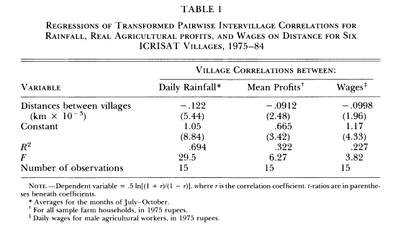
Notes:
Pg 913

Slide 18
B. Mobility and Marriage
In the analysis of marriage and migration we used data of farm households in the three villages (Aurepalle, Shirapur, and Kanzara) for which there is both continuous information over the 10 years on farm profits and food expenditures and the supplemental marital information.
Each village represents a distinct agroclimatic area.
Table 2 provides descriptive statistics on the farm (cultivating) households in the sample.
Agricultural incomes are quite variable: the 10-year standard deviation in farm profits net of the value of family labor is 25 percent greater than mean profits for the average farm household
Notes:
Pg 913, 914

Slide 19
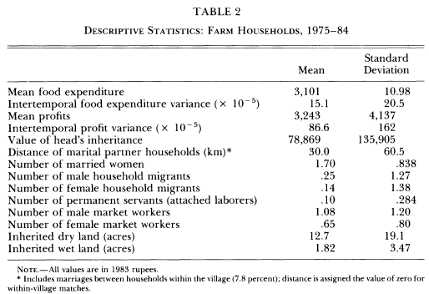
Notes:
Pg 914

Slide 20
The three villages appear to conform to the general Indian mobility pattern.
Almost 94 percent of married women were not residents of the village prior to marriage. "
"Temporary" migration is more prevalent than male "permanent" migration but less pervasive than marital migration in the sample.
Only 28 percent of the sample farm households reported having at least one migrant member, a person 18 years of age or over not resident in the village household nor residing in an independent household.
With respect to spatial diversification via marriage, the mean distance from a sample household to the origin villages of the daughters in-law is 30 kilometers.
Most important, within all but two of the 49 percent of households with two or more married women, each married woman came from a different village.
Notes:
Pg 914, 915

Slide 21
The observed within-household diversification of marriage partners by origin location appears to be inconsistent with pure search-theoretic income gain theories of migration or marriage.
To assess the degree to which there is positive assortative mating with respect to the mean income-generating characteristics of the parents of the marital partners, we performed a confirmatory factor analysis (Joreskog 1969) based on the survey information describing the family backgrounds of the heads and their wives in the 10 ICRISAT villages.
Notes:
Pg 915

Slide 22
We assumed that the permanent income potential or "quality" of each partner's origin household, a latent variable, is measured by the dry and irrigated landholdings (in tenths of acres) in each partner's household when each was 15 years of age and the educational level (in five categories) of the fathers.
Table 3 presents the correlations between the three individual background variables of the marital partners, the correlation between the latent indices estimated from the two-factor latent variable model, and the associated t statistics.
Notes:
Pg 915, 916

Slide 23
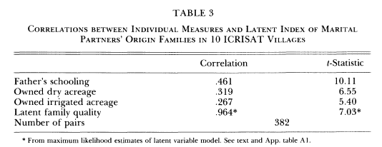
The results indicates a significant degree of positive association between the origin households of the heads and those of their wives, which is, however, underestimated by the individual correlations between any one of their background characteristics.
Notes:
Pg 916

Slide 24
III. Household Characteristics and Consumption Smoothing
The close matching of marital partners with respect to origin house-hold variables and the diversity and distance characterizing the ICRISAT households' marriage portfolios are consistent with the hy-pothesis that marital arrangements influence a household's ability to smooth its consumption when confronted with highly variable income streams.
In this section we exploit the longitudinal feature of the ICRISAT data to estimate directly the contribution of marriage mi-gration, as well as of endowed wealth, to consumption smoothing.

Slide 25



More-over, if capital markets are imperfect, the sensitivity of other income to the household's current realization of will depend on its owned stock of assets.
Borrowed/ Transfer Income received

Slide 26
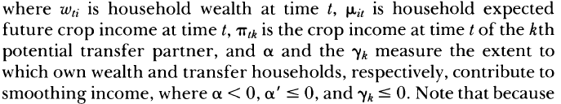

If households have an infinite horizon and the stochastic income process is characterized by stationarity, assumptions not unreasonable for the environment we are studying, we can treat as a constant for a given household I, that is, any current realization of crop income will not affect income expectations.
Changes in consumption for a household i ,

Slide 27
Two extreme views:
If there are perfect credit markets or all households are able to self-insure perfectly, then for each household, consumption will be constant (given stationarity and an infinite horizon), independent of stochastic realizations of income.
If, on the other hand, no household can "store" income and there are no risk-pooling arrangements via credit markets or via implicit familial contracts, then current consumption is then dependent solely on current crop income.
We believe that neither of these ex-treme cases well characterizes the Indian setting; instead we expect that

Slide 28


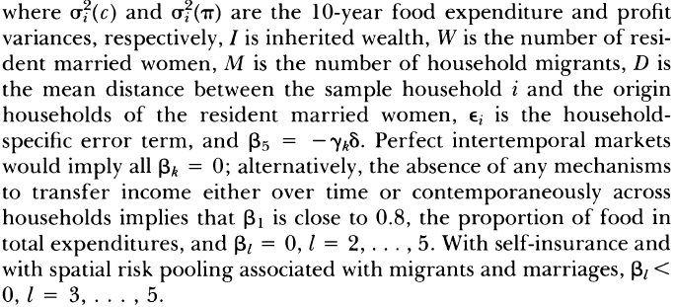

Slide 29
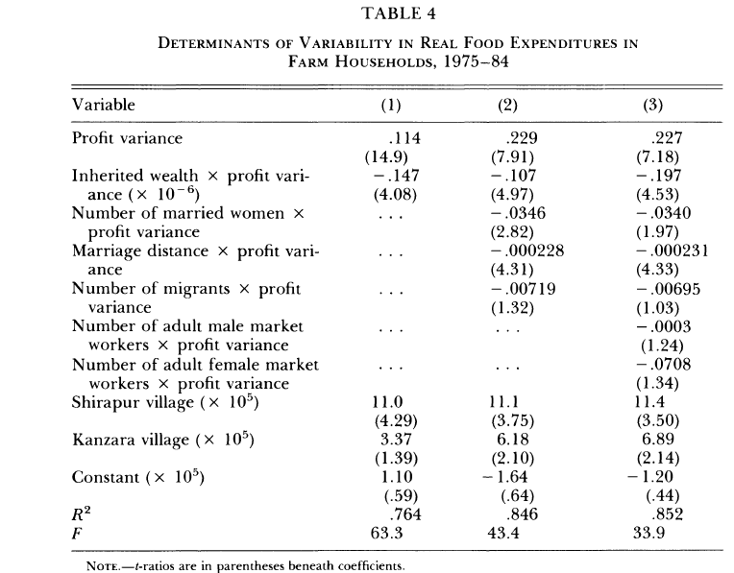

Slide 30
In the first column, we exclude the possibility of spatial in-come pooling.
  The results reject the hypotheses that households, independent of their endowed wealth, can perfectly smooth consumption or that households cannot smooth consumption at all via asset transactions.
  A one-standard-deviation increase in wealth, at the sample means, reduces the impact of profit variance in food consumption by 14 percent.
In the second column of table 4 we add the migration and marriage profit variance interaction variables
  The point estimates indicate that at the sample means the (positive) effect of profit variability on the variability in food expenditures is reduced by 15 percent when the number of resident married women increases by 1 and
  by 6 percent for each one-standard-deviation (60 kilometers) increase in the mean distance between the farm household and the origin households of the resident married women.
  The addition of a household migrant has a weaker effect, reducing the effect of profit variance by 3 percent.

Slide 31
In the last column of table 4, we assess the robustness of our results to the addition of variables representing the number of resident adult male and female market (off-farm) workers.
  the influence of marriage migration in reducing the impact of profit variability on consumption variability is essentially unchanged when the family worker variables are included.
  It is not the presence of adult women (or men) in the household willing or able to work but their marital status, with its associated inter-household bonds, that contributes to income risk mitigation.

Slide 32
IV. The Determinants of Spatial Income Diversification
In this section we test the hypothesis that farm households facing exogenously riskier incomes associated with spatially covariant risks will be more likely to invest in spatial risk diversification. We also examine the influence of endowed wealth on such arrangements.
We used as instruments the weather variables interacted with each household's inherited dry and wet landholdings to predict each household's mean and variance in profits for the 10 years.
Under the assumption that village rainfall and inheritances do not reflect household risk preferences, these predicted measures of household income risk should be orthogonal to preferences.

Slide 33
Table 5 reports estimates of the effects of profit variability and endowed wealth on the number of migrants, on the presence or absence in the household of a worker with a regular salaried job (assured yearly income), and on the mean distance between the origin village of the resident daughters-in-law and the sample household, on the basis of two-stage tobit, two-stage probit, and two-stage leasts quares procedures, respectively.'

Slide 34
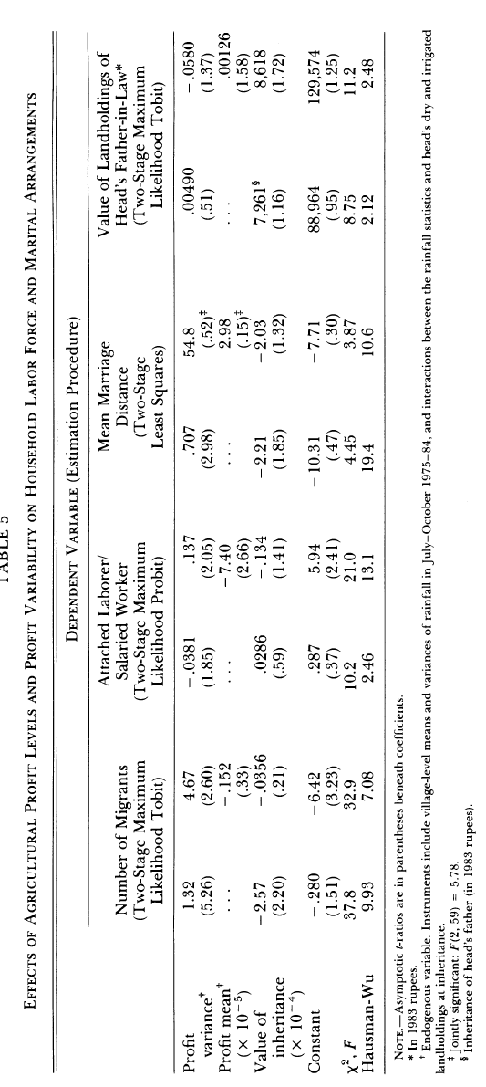

Slide 35
V. Conclusion
In this paper we have examined from a risk-theoretic perspective a major component of migration in low-income rural areas, that associated with the movement of women for the purpose of marriage.
In particular, we have hypothesized that the spatial distribution and characteristics of matches associated with the marriage of daughters are in part manifestations of implicit interhousehold contractual arrangements facilitating consumption smoothing in an environment characterized by information costs and spatially covariant risks.
Analysis of longitudinal data from villages in South India provided support for the hypothesis, indicating that marriage cum migration contributes to a reduction in the variability in consumption, for given variability in income from crop production, and that households exposed to higher income risk are more likely to invest in longer distance migration-marriage arrangements.
Notes:
Pg 924

Slide 36
Conversely, improvements in formal institutional arrangements (e.g., credit markets) that facilitate consumption smoothing may reduce the role played by risk considerations in marital arrangements and rural migration, perhaps resulting in diminished rural mobility.
Finally, our results suggest that the value to parents of having a girl relative to having a boy in environments characterized by underdeveloped insurance markets and spatially covariant risks may be substantially understated by sex differentials in expected labor market returns.
Attention to the returns arising from the specialized role of daughters accruing from their dispersion, moreover, suggests that policies lowering ex ante income risks in such settings may result in diminished resources allocated to young girls if intra-household resource allocations are influenced by economic incentives.
Notes:
Pg 925

