Slide 1
Land Acquisition for Industrialization and Compensation of Displaced Farmers
Maitreesh Ghatak
Dilip Mookherjee

Slide 2
Introduction
Frictions in the leasing market (e.g., resulting from moral hazard and low wealth of tenants) can result in farmers earning surpluses which would be foregone in the event of eviction.
Landowners would have no private incentive to incorporate these losses in their decision to convert land.
Inadequate compensation can thereby create incentives for excessively rapid industrialization.
The anticipation of such conversions in the future breeds insecurity of tenure among those currently engaged in agriculture, with implications for their incentives to undertake investments that enhance farm productivity.
Analyzing the effects of varying the compensation paid to the tenant in the event of a sale.
Three channels of potential impact: the owner's decision to convert, and resulting implications for ex ante investments of the two parties respectively.

Slide 3
Introduction
Optimal resource allocation necessitates paying compensation to the tenant so that the landlord correctly internalizes the cost imposed on the latter as a result of the property sale.
Case 1: No Rental Market Distortions
Vesting the sole decision right over the sale to the landlord results in an efficient outcome.
The argument is further strengthened if the landlord makes ex ante investments in the construction and upkeep of the property.
Case 2: Rental Market Distortions
Vesting sole decision rights with the landlord concerning sale of the asset will generate socially excessive incentives to sell to third parties when the opportunity arises.
the landlord needs to pay a compensation to the tenant that equals the surplus lost by the latter in the event of conversion.

Slide 4
Model
There is a landlord L who owns n identical plots and leases each of them to a tenant.
The yield or quality of any given plot equals Ap(x; y) where A is
positive and p depends on non-negative investments x and y made by the landlord and the tenant.
All tenants have identical preferences and costs
We shall focus on symmetric outcomes.

Slide 5
Model
The function p is assumed to be strictly increasing, strictly concave, twice-differentiable, and exhibiting complementarity between x and y: p_{xy} ≥ 0. It is normalized so as to lie between 0 and 1, and can be interpreted as a probability of a successful harvest of value A.
We shall assume an interior probability of a successful harvest, irrespective of investments: 0 < p(x; y) < 1 for all non-negative x; y.
On any given plot the tenant incurs cost c_{T} (y) while the landlord's cost equals c_{L}(x), where c_{T} ; c_{L} are both strictly increasing, strictly convex, and twice-differentiable functions.
Finite capacity limits x and y

Slide 6
Model
There is a random outside option available to the landlord to sell all the n plots together and earn v per plot, where v≥ 0 is drawn according to a density f and a corresponding distribution function F.
If the landlord does not sell, the farm yields are shared between landlord and tenant in fixed proportions 1-s and s stipulated by rental regulations. And if the landlord does sell, he is required by law to compensate each farmer by a lump sum amount c.
We suppose that there is a finite upper bound to the extent of compensation.
Our main focus will be on situations where the tenant is under-compensated, i.e., c < spA < sA, in which case c equals sA.

Slide 7
Model
A law which required the compensation to be some fraction of the price at which the land is sold would also have difficulty in getting enforced
The compensation is not a function of the quality of the plot (because this is not verifiable by third parties)
We assume the rate of change of the density f over the range
[(1 - s)p(0; 0)A, + (1 - s)A] is bounded, i.e.,

Slide 8
Model

Slide 9
The First-Best
Here a hypothetical planner selects investments x, y and makes the conversion decision in order to maximize the sum of expected payoffs of landlord and tenants.
In this setting the land will be converted, after the investments have been made by the tenants and the landlord, if and only if its value in industry exceeds its value in agriculture, i.e., if v > pA.
Let denote the probability of the land being
converted under the 1st-best. In this case, expected social
surplus per plot equals:

Slide 10
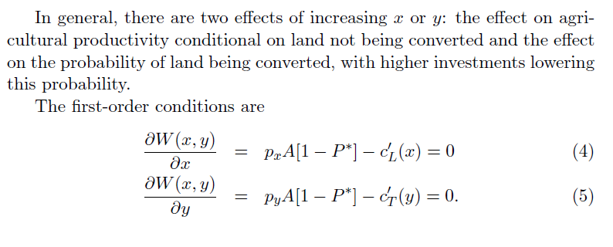
The First-Best

Slide 11
Time-line
Landlord(L) and Tenant(T) make investment
L observes the value of p, therefore x & y (not verifiable)
L can sell plots for v per plot
v is random variable with continuous density f
L
sale
nv-nc,c
No sale
(1-s)pA,spA

Slide 12
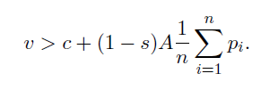
The second best
Tenants and landlord maximize their respective payoﬀs and select their investments independently
landlord decides whether to sell the plots after observing v
L will sell land if
We will focus on symmetric equilibria, as preference of tenants are same
We need to check whether it is an equilibrium → are unilateral deviations are unproﬁtable?

Slide 13
Tenant’s expected payoff
=
The ﬁrst-order condition for the tenant to optimally choose yi = y is then
The second order condition

Slide 14
The slope of the tenant’s reaction function:
spA−c > 0, with n large enough slope is positive
There are two effects:
- Rise in x → positive marginal return to the tenant’s investment
- Higher investment by Landlord → change in the tenant’s incentive to manipulate the probability of land conversion
Higher investment by Landlord → reduced likelihood of the land conversion → higher tenant’s incentive to invest

Slide 16
Landlord’s incentives
The landlord’s expected payoff
FOC
Leibniz rule for diffrentiation
d/dx[ ]= -(c+(1-s)pA-c)f(c+(1-s)pA) (1-s)pxA
= -(1-s)pAf(.) (1-s)pxA
SOC

Slide 18
Effect of varying compensation c
Diffrentiating the landlord’s optimal condition (11) w. r. t c
First term: direct eﬀect of higher compensation on the landlord’s investment incentive (this is +ve given SOC)
Second term: reaction to the tenant’s investment change
The landlord’s reaction function shifts ‘outward’

Slide 19
The eﬀect on the tenants incentives, can be obtained by diﬀerentiating (7) :
For n is large enough first term is positive
Intuitively, a rise in compensation lowers the probability of a sale, raising the tenant’s incentive to invest. For a given investment by the landlord
The tenant’s investment rises — the latter’s reaction function also moves outwards

Slide 20
Using (18), (17) can be written as following
Local stability implies y’(x)x’(y) < 1. By Lemma 1, y’(x) > 0. n large enough implies yc > 0.
Since x’(y)> 0 by Lemma 2, it also follows that xc > 0.
Proposition1:Starting with any locally stable Nash equilibrium, an increase in c induces both tenants’ and landlord’s investments to rise.

Slide 21
Welfare Implications of changing c
Three eﬀect of changing c:
- on the tenant’s investment
-on the landlord’s investment
-on the conversion decision
The former two eﬀects are positive, probability of conversion falls with increase in c
If we are in an equilibrium where the tenant is undercompensated. The resulting welfare eﬀects will be positive, provided both tenant and landlord are under-investing to start with.

Slide 22
Gross welfare

Slide 23
Expected (gross) payoff of tenant

Slide 24
Expected (gross) payoff of landlord

Slide 26
Proposition 2 Consider any local stable Nash equilibrium in which tenants are under or fully compensated (spA-c>=0). Then a small increase in the compensation will raise the welfare, as well as the expected utility of each tenant. Hence at welfare optimum tenants must be over-compensated

Slide 27
Diﬀerentiating the tenant’s payoﬀ with respect to c, and using the ﬁrst-order condition, we get
The ﬁrst term is the eﬀect of raising c, both directly and through induced eﬀects on investments by others (the landlord and other tenants), on the under-compensation eﬀect
The second eﬀect is the direct eﬀect of changes in investments of the landlord on the expected return to the tenant from agriculture
The third term is the direct eﬀect on expected compensation, which is proportional to the probability of sale.

Slide 28
Suppose the landlord can charge a fee t, ex ante
The corresponding eﬀect on the landlord’s per plot payoﬀ is
First term: changes in tenants investments on the landlord’s expected crop share
Second term: marginal ﬁnancial cost of the compensation/the probability of sale.
Combining previous equations, we get the welfare (per plot) impact :

Slide 29
Key factor → the tenant gets a surplus that landlord cannot extract
legal share is stipulated at s
If landlord charges a ﬁxed fee that reduces the tenant’s payoﬀ to reservation level → rents will disappear.
Such ﬁxed charges are not feasible for the poor
If ﬁxed charges could be collected, and the landlord committed ex ante to a compensation →no over-conversion

Slide 30
The landlord can set
The landlord’s net expected payoff is
Since UL +UT is expected social surplus, despite the incentive problems or the fact that s is legally stipulated, the landlord’s choice of c will be the same as the second-best surplus maximizing one.

Slide 31
The eﬀect of c on the landlord’s utility
The landlord gains owing to increased investment of the tenant
But loses on account of the higher compensation in the event of a sale.
The landlord is worse oﬀ as long as

Slide 32
Thanks ☺

