Slide 1
The Economics of Rotating Savings and Credit Associations
By Timothy Besley, Stephen Coate and Glenn Loury

Slide 2
What is a ROSCA?
Rotating Savings and Credit Associations (Roscas) are an informal financial institutions where a group of individuals come together to make regular contributions to a common fund, which is then lent out in whole to one member each cycle – giving that member access to a larger amount of capital than would otherwise be possible.
It is a poor man’s bank!

Slide 3
Where would you find it?
Roscas are found all over the world mainly in developing countries namely India (chit funds), Senegal (tontines), Cameroon (njangis), Sri Lanka (cheetu) etc
It is also used by immigrant groups in United States.
Many US savings and loan associations started life as Roscas

Slide 4
Motivation behind Roscas
In the absence of external funds they can be used to finance lumpy expenditures.
They play a role in transferring resources to meet life-cycle needs.
They provide a means of making joint savings work.
Roscas can be understood as a response by a socially connected group to credit market exclusion.

Slide 5
Types of Roscas
Random Roscas:
- members commit to putting a fixed amount into a pot for each period of life of the Rosca
- pot is allocated randomly to one of the members
- process continues next period with the winner of the period excluded until everyone has been covered
Bidding Roscas:
- similar to Random Roscas
- winner is determined by a bidding procedure
- Bids are in form of pledge of higher contributions

Slide 6
Problems with Roscas
Not useful for buffering against risk
- In Random Roscas probability of obtaining the pot is not related with ones immediate circumstances.
- In Bidding Roscas are not helpful - Deal with situations with cannot recur
- In LDCs risks are usually covariant
For Roscas to operate successfully individuals must commit to pay into the Rosca after they win the pot.

Slide 7
The Model
n individuals
One indivisible durable consumption good
No access to credit markets
Each individual has T years of lifetime
Exogenous flow of income – y > 0
Identical intertemporally additive preferences
Instantaneous utilities depend on non-durable consumption and whether or not the service of durable is enjoyed
Durable good doesn’t depreciate.
Cost of purchase of durable - B

Slide 8
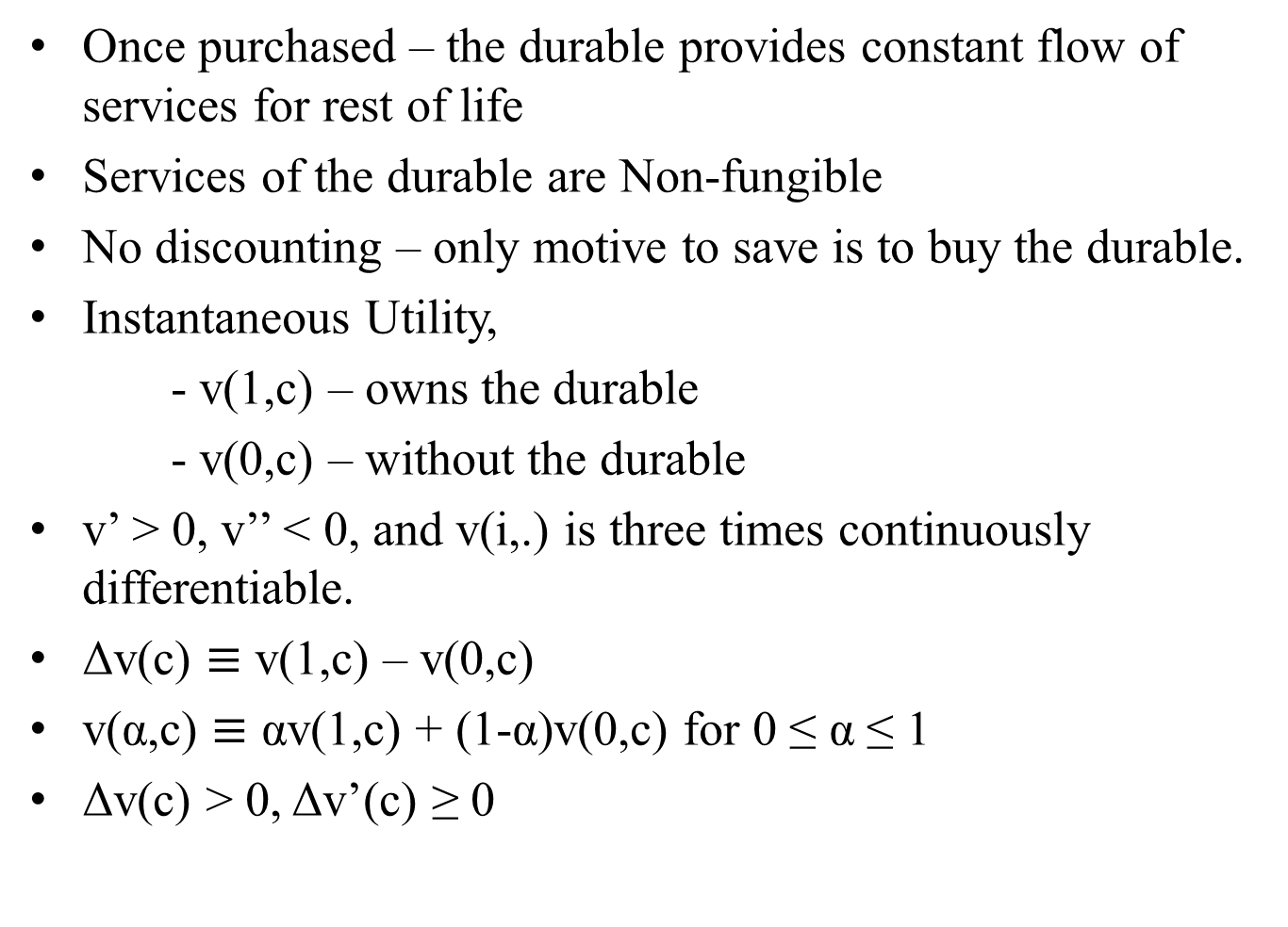
Once purchased – the durable provides constant flow of services for rest of life
Services of the durable are Non-fungible
No discounting – only motive to save is to buy the durable.
Instantaneous Utility,
- v(1,c) – owns the durable
- v(0,c) – without the durable
v’ > 0, v’’ < 0, and v(i,.) is three times continuously differentiable.
Δv(c) $≡$ v(1,c) – v(0,c)
v(α,c) $≡$ αv(1,c) + (1-α)v(0,c) for 0 ≤ α ≤ 1
Δv(c) > 0, Δv’(c) ≥ 0

Slide 9
Autarky
Individuals save up on their own.
It is optimal to save B at a constant rate y – c over an interval [0,t]
Lifetime Utility under Autarky,
U(c,t) = t.v(0,c) + (T – t).v(1,y)
The individual’s objective is choosing t and c to
Maximize{t.v(0,c) + (T – t).v(1,y)} (1)
Subject to t(y – c) = B
and 0 ≤ c ≤ y

Slide 10


Let (t_{a},c_{a}) be the solution to the maximization problem and W_{a} be the maximal value of lifetime utility.
To simplify the problem, substituting for t from (1), we get,
Let
(2)
where 0 ≤ α ≤ 1

Slide 11
Setting α = 0 in (2), lifetime utility under autarky is
The first term is lifetime utility if the durable were free.
The second term is the minimal utility cost of saving up for the durable.
c*(α) is the consumption level which solves (2), the optimal autarkic consumption rate, c_{a,} is c*(0).
No individual has the durable good before t_{a} after which all n individuals receive it.
Expected fraction of time that an individual will enjoy the services of the durable during accumulation period is 0. Hence, α is 0 in (2).
Autarky is inefficient.

Slide 12
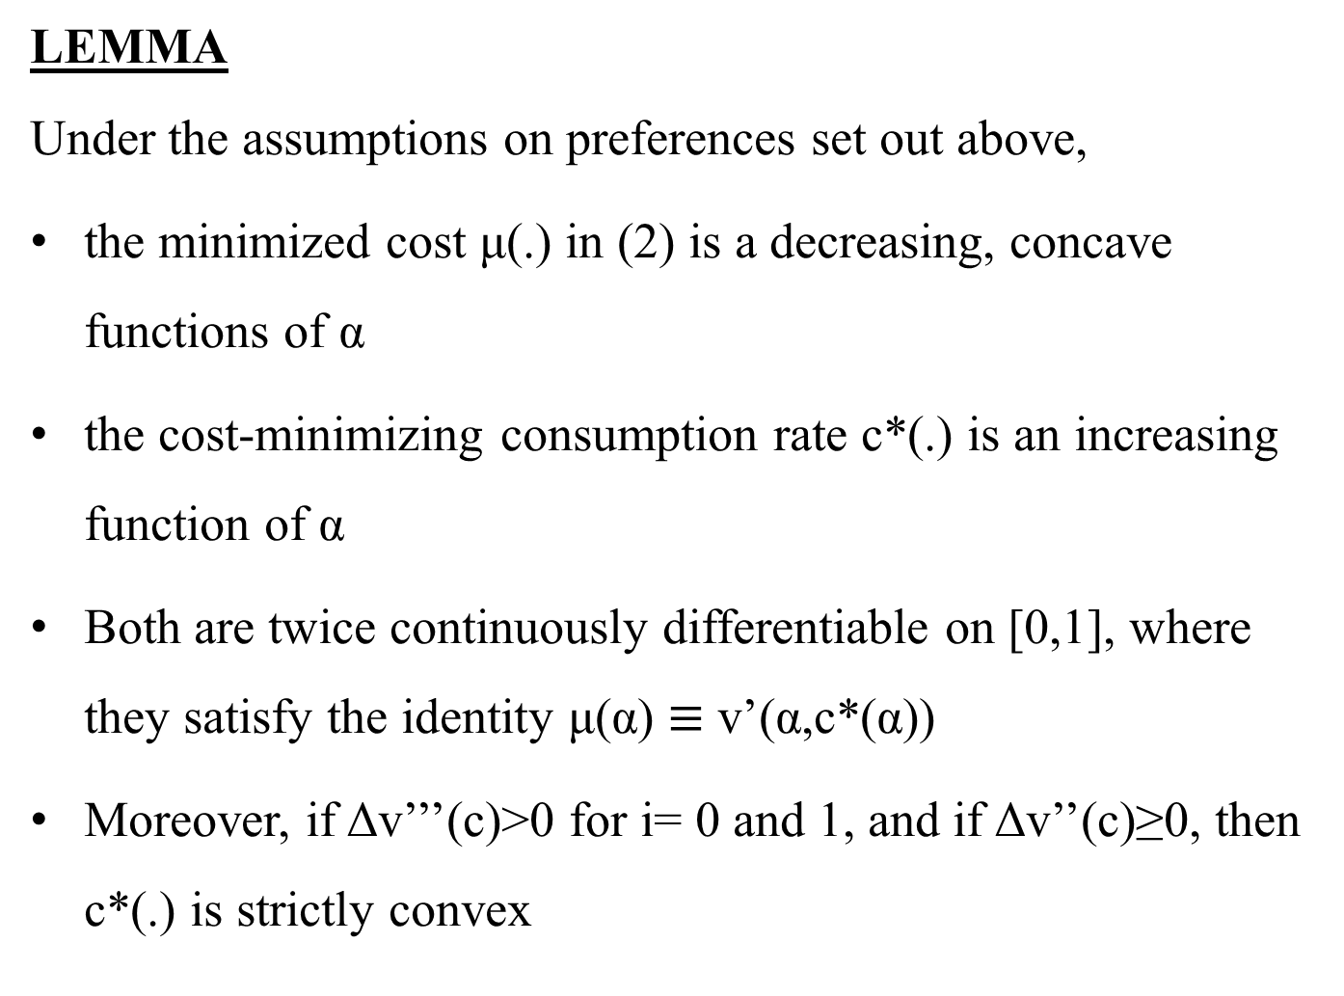
LEMMA
Under the assumptions on preferences set out above,
the minimized cost μ(.) in (2) is a decreasing, concave functions of α
the cost-minimizing consumption rate c*(.) is an increasing function of α
Both are twice continuously differentiable on [0,1], where they satisfy the identity μ(α) $≡$ v’(α,c*(α))
Moreover, if Δv’’’(c)>0 for i= 0 and 1, and if Δv’’(c)≥0, then c*(.) is strictly convex

Slide 13
Random Roscas
n-person group
Meet at equally spaced dates up to t_{a,} {t_{a} /n, 2 t_{a} /n,…, t_{a}}.
Each individual contributes B/n at each meeting
At every meeting an individual is randomly selected to receive the pot B, which allows him to buy the durable.
The individual continues to save at rate B/t_{a} over the interval [0,t_{a}]

Slide 14
Similar to autarky, but can now expect to receive the durable t_{a}(n+1)/2n
The group’s objective is to maximize the (ex ante) expected utility of the representative member.
The choice variable here would be the length of the Rosca, t.
Let the receipt date for the pot, τ̃ be a random variable distributed uniformly over the set {t/n, 2t/n,…,t}.
Each member saves at rate B/t over the life of the Rosca.
Non-durable consumption is thus c = y – B/t during this period.

Slide 15

The agent’s problem is to maximize the lifetime utility:
τ̃.v(0,c)+(t- τ̃).v(1,c)+(T-t).v(1,y)
where t=B/(y-c)
E(τ̃)=[(n+1)/2n]t. Substituting this in lifetime utility we get each members (ex ante) welfare is
(4)
where t=B/(y-c)
Group’s Problem: Choose t to maximize (4).

Slide 16

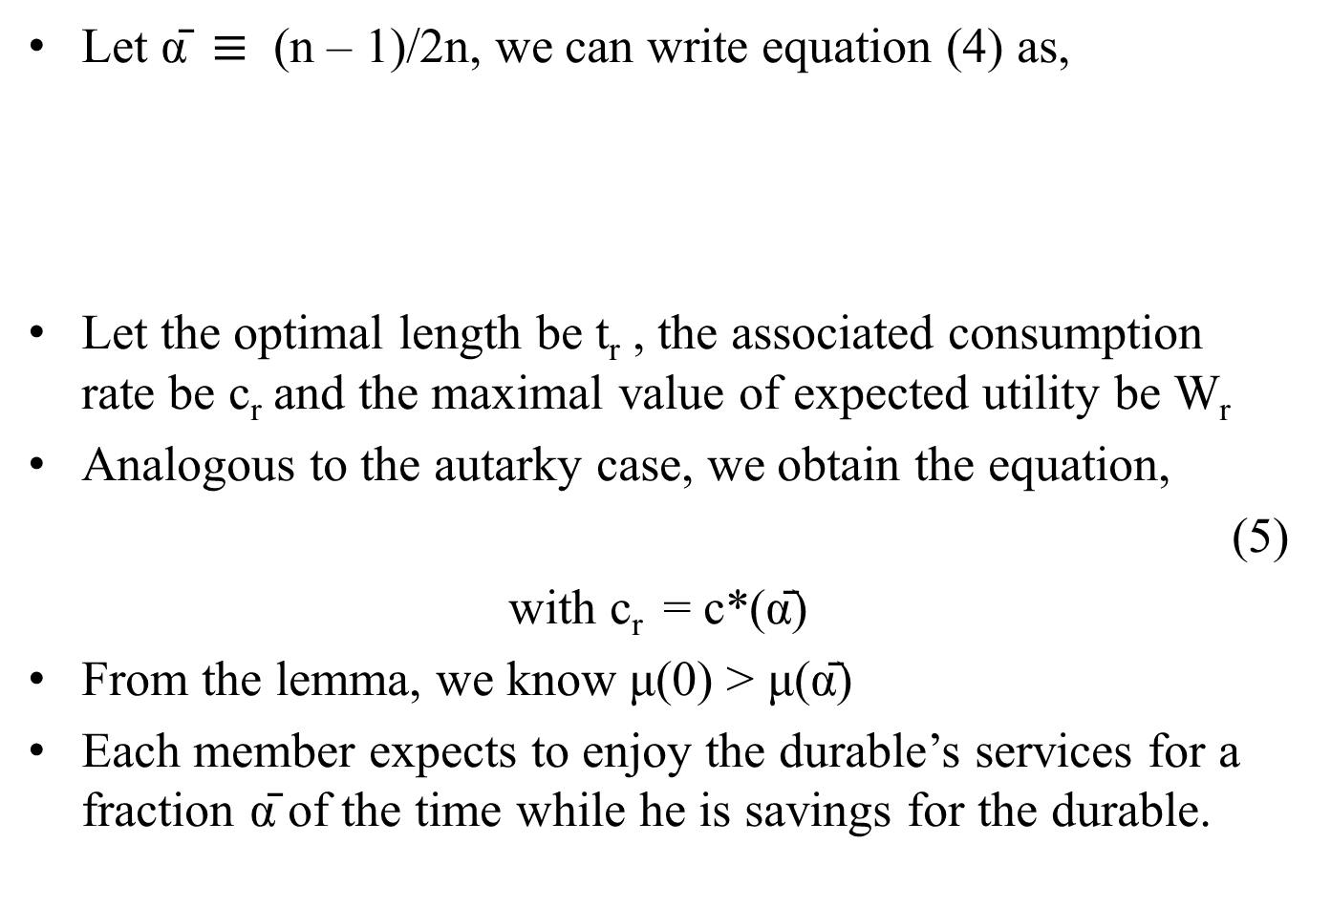
Let ᾱ $≡$ (n – 1)/2n, we can write equation (4) as,
Let the optimal length be t_{r} , the associated consumption rate be c_{r} and the maximal value of expected utility be W_{r}
Analogous to the autarky case, we obtain the equation,
(5)
with c_{r} = c*(ᾱ)
From the lemma, we know μ(0) > μ(ᾱ)
Each member expects to enjoy the durable’s services for a fraction ᾱ of the time while he is savings for the durable.

Slide 17
PROPOSITION 1
By forming a random Rosca, group members raise their expected lifetime utilities.
The optimal random Rosca involves members saving at a lower rate over a longer interval than under autarky.
Individuals expect to receive the durable good sooner in the optimal random Rosca than under autarky
i.e. t_{r} > t_{a} > (n+1)t_{r}/2n
under the restrictions v’’’(i,c) > 0 for i = 0,1 and Δv’’(c) ≥ 0

Slide 18
Effects of Random Roscas
Welfare is raised
Reduction in everyone’s utility cost of saving up
Non – durable consumption is higher
Accumulation period is longer
Individuals receive the good earlier on average

Slide 19


Effects of Random Roscas (Ex-post)
Individuals have same prospects ex-ante
Circumstances differ once order of receipt has been determined
Lets use index i to denote the person who wins the pot at the ith meeting at date t_{r}(i/n)
Ex-post utilities are,
for i = 1,…,n
For the final individual (c_{r} , t_{r}) is not optimal, he is strictly worse off

Slide 20
Bidding Roscas
Individuals bid for the right to receive the pot at a certain date
Order of receipt is determined at time 0
Individuals have identical preferences. So they must end up getting the same utility.
Any efficient auction procedure should have the total contributions in each period equal to B

Slide 21
Setup of the Rosca
Let the length of the Rosca be ‘t’
At period 0, a series of n-1 ascending bid auctions are conducted among n members to determine who receives the pot at each auction
The last individual has his contribution set such that the sum of all contributions must equal the durable’s cost B.

Slide 22
Since the length of the Rosca is t, and there are n individuals so the meeting times will be
{t/n, 2t/n,…, t}
Let b_{i} be the contribution of individual i, who wins the pot at time (i/n)t.
For a member bidding b_{i}, his non-durable consumption would be c_{i}= y-(n/t)b_{i} in each period

Slide 23


So the individual's utility is
Here α_{i} = (n-i)/n and since all individuals have the same utility, say x, we have
v(α_{i}, c_{i})= x, i=1,…,n
Let c̄ be the average non durable consumption rate of members during the life of rosca. Then we have
t(y- c̅) = B

Slide 24

Now given x we can, from the equations, find out c_{i}’s and Rosca length t
From the earlier discussions we can write the welfare functions as
T.v(1,y) - B {[ v ( 1 , y ) - x ] / [y -c̅]}
Let ĉ(α,x) be the function satisfying v(α,ĉ) = x and define

Slide 25

Let t_{b} and W_{b} be the optimal time and welfare level of the bidding rosca.
As before we can write
W_{b} = T. v(1,y) - B. μ_{b} (9)
Where (10)
Let x* be the minimum in (10) we get, the length of the optimal bidding rosca,
t_{b} = B/[y- c̅(x*)]

Slide 26
PROPOSITION 2
By forming a bidding Rosca, group members raise their lifetime utility relative to autarky.
Again if 1/v’(0,.) is concave, the optimal bidding Rosca involves group members saving at a lower average rate and over a longer interval than under autarky.

Slide 27
Effect of Bidding Roscas
Welfare is raised
Each individual has a different rate of non durable consumption in the accumulation period
Earlier acquirers of the durable bid a higher contribution to the rosca and consume lesser of the non durable (c₁<c₂<…<c_{n} )
Last individual to acquire the durable has greater non durable consumption than under autarky

Slide 28
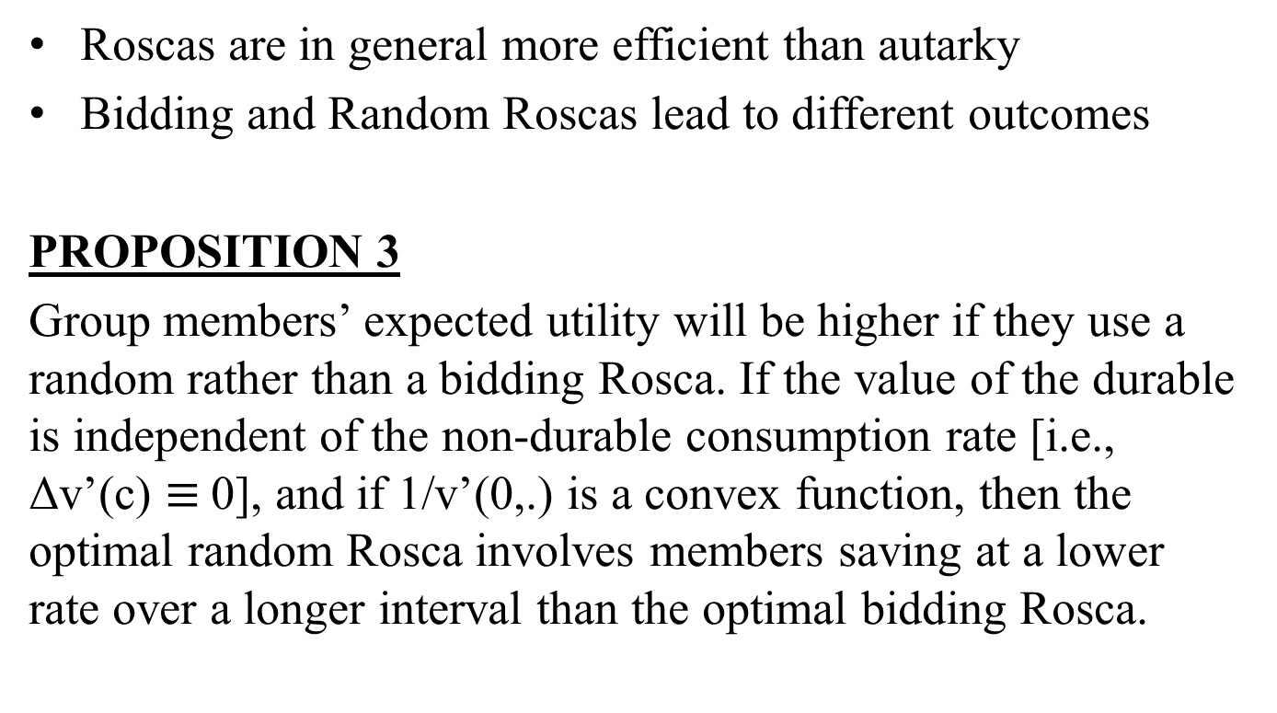
Bidding versus Random Roscas
Roscas are in general more efficient than autarky
Bidding and Random Roscas lead to different outcomes
PROPOSITION 3
Group members’ expected utility will be higher if they use a random rather than a bidding Rosca. If the value of the durable is independent of the non-durable consumption rate [i.e., Δv’(c) $≡$0], and if 1/v’(0,.) is a convex function, then the optimal random Rosca involves members saving at a lower rate over a longer interval than the optimal bidding Rosca.

Slide 29
Intuition Behind Proposition 3
Looking from an ex-ante view point, consider two Roscas of the same duration
Under Bidding – lifetime utilities are equal
Under Random Roscas – non-durable consumption rates are the same.
Consider a General Scheme
- Order of receipt of pot is randomly assigned
- a consumption rate c_{i}
- but the above constraints do not apply.
To maximize ex-ante expected welfare the scheme would equate the marginal utilities

Slide 30
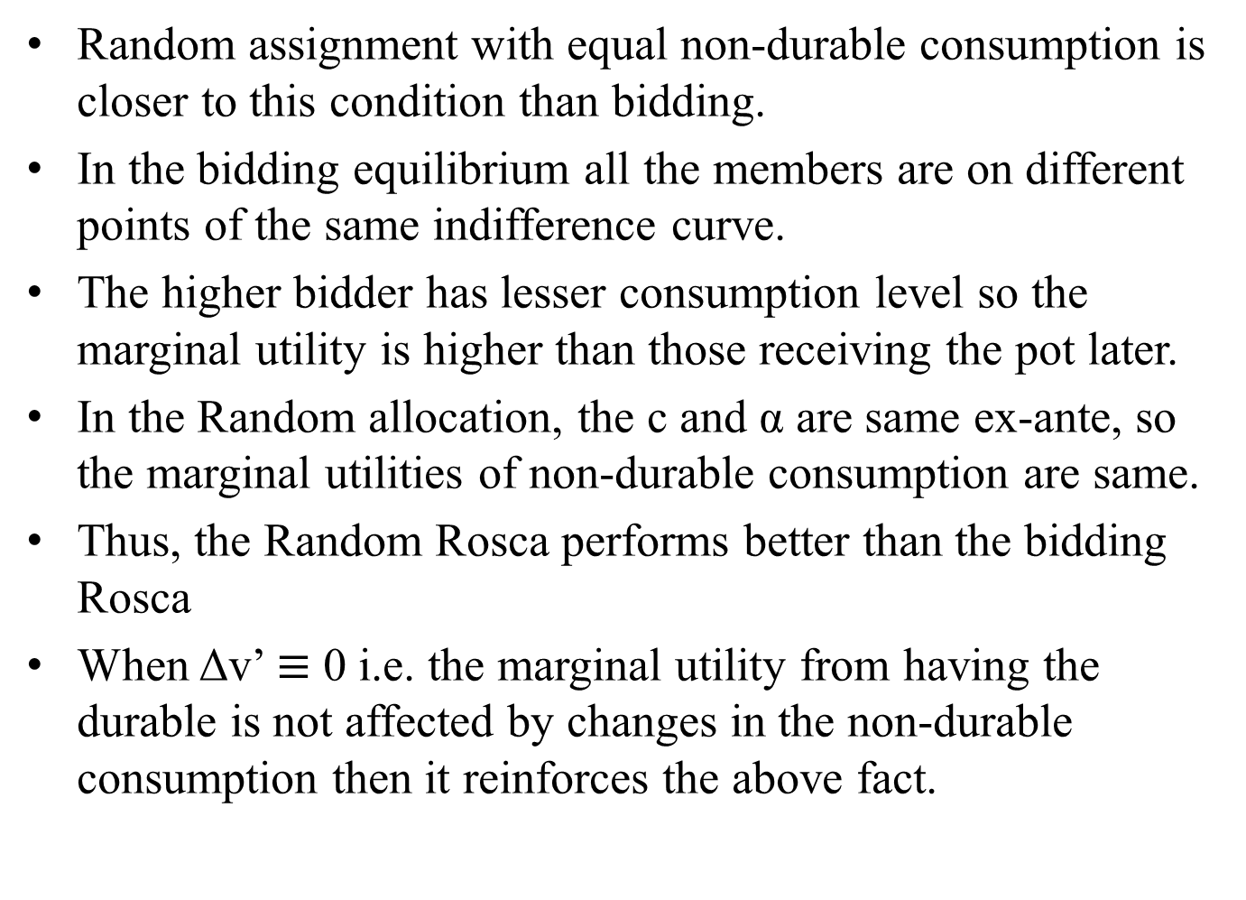
Random assignment with equal non-durable consumption is closer to this condition than bidding.
In the bidding equilibrium all the members are on different points of the same indifference curve.
The higher bidder has lesser consumption level so the marginal utility is higher than those receiving the pot later.
In the Random allocation, the c and α are same ex-ante, so the marginal utilities of non-durable consumption are same.
Thus, the Random Rosca performs better than the bidding Rosca
When Δv’ $≡$ 0 i.e. the marginal utility from having the durable is not affected by changes in the non-durable consumption then it reinforces the above fact.

Slide 31
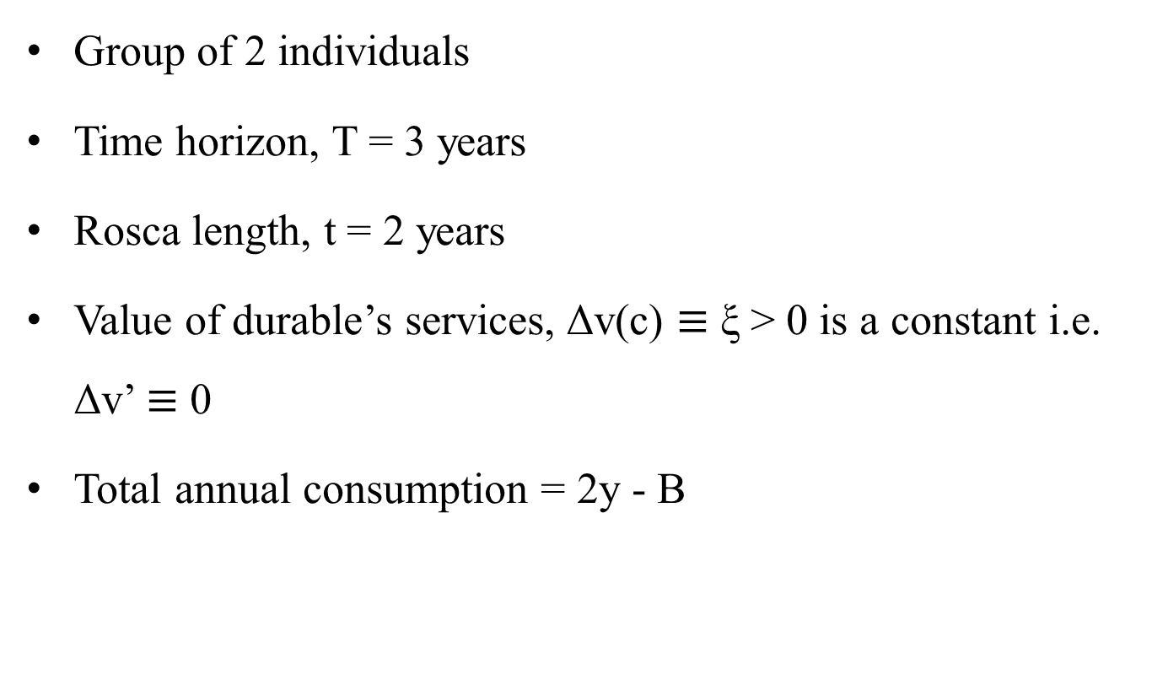
Proposition 3 Diagrammatically
Group of 2 individuals
Time horizon, T = 3 years
Rosca length, t = 2 years
Value of durable’s services, Δv(c) $≡$ ξ > 0 is a constant i.e. Δv’ $≡$ 0
Total annual consumption = 2y - B

Slide 32
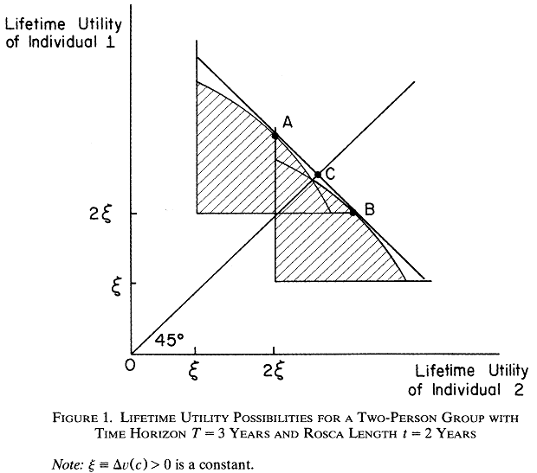

Slide 33
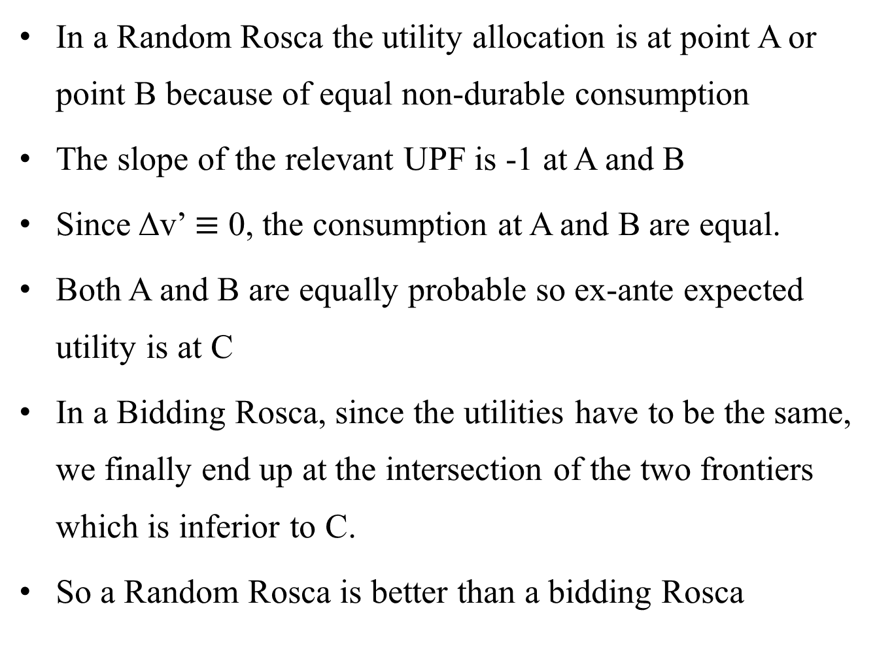
In a Random Rosca the utility allocation is at point A or point B because of equal non-durable consumption
The slope of the relevant UPF is -1 at A and B
Since Δv’ $≡$ 0, the consumption at A and B are equal.
Both A and B are equally probable so ex-ante expected utility is at C
In a Bidding Rosca, since the utilities have to be the same, we finally end up at the intersection of the two frontiers which is inferior to C.
So a Random Rosca is better than a bidding Rosca

Slide 34
Conclusion
We looked at an informal institution of Roscas
They help individuals without access to credit markets to pool in their resources and increase welfare.
We looked at Random Roscas and Bidding Roscas
In both cases individuals were better off participating in the Roscas
Comparing the two, with the assumption of identical preferences, Random Roscas were better than Bidding Roscas.

