Slide 1
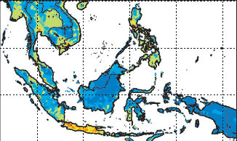
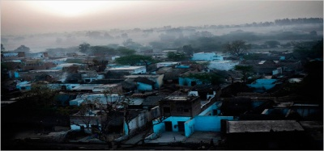
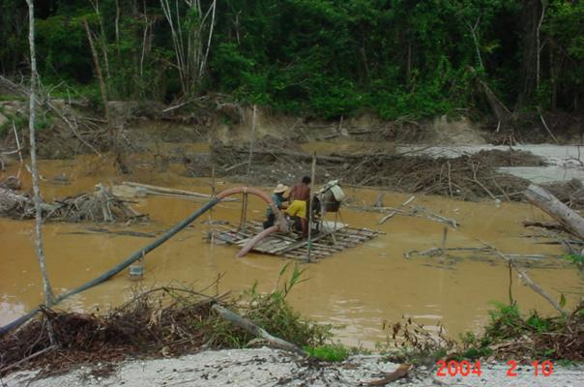
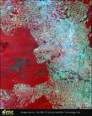
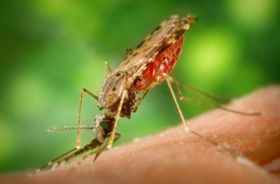
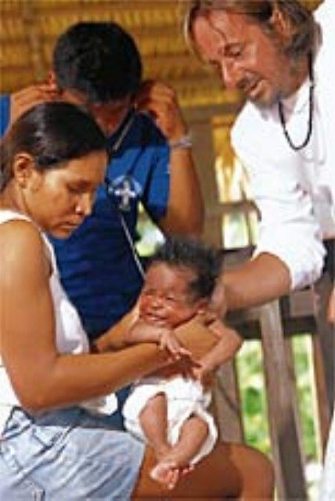
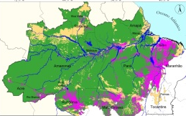
JieSheng Tan Soo & Subhrendu K. Pattanayak
Fetal attractions? Forest fires, air pollution, & health irreversibilities from early-life exposures in Indonesian children
CECFEE, ISI Delhi, Nov 2015

Slide 2
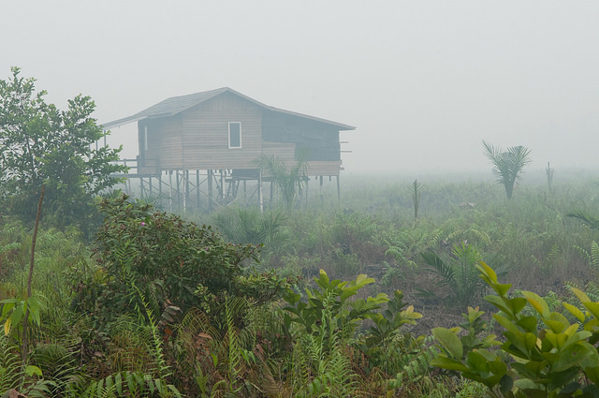
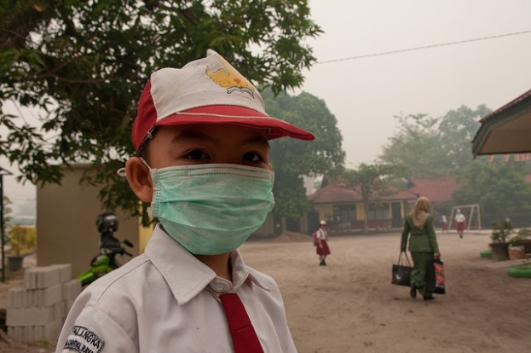
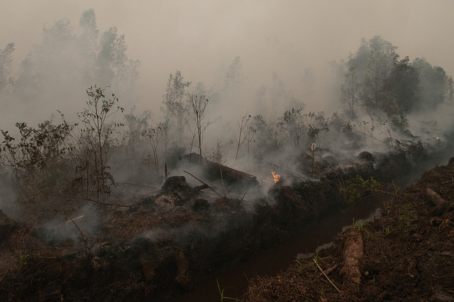
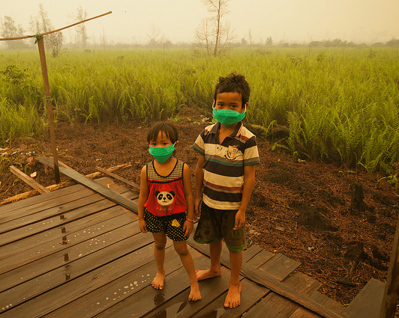
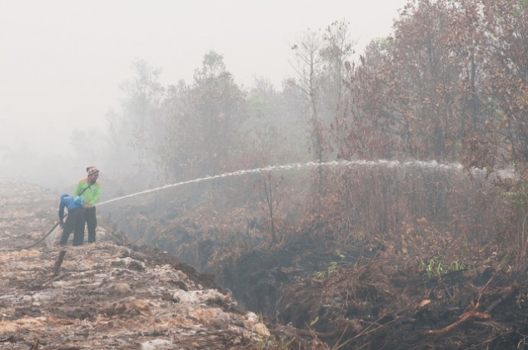
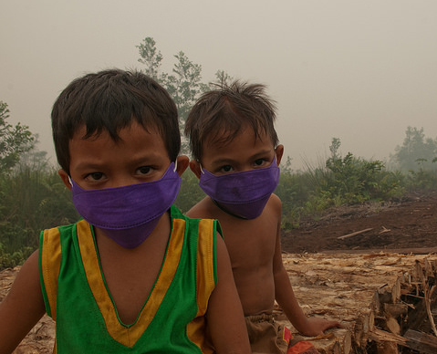
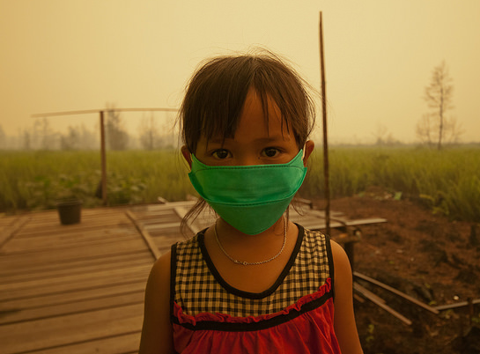
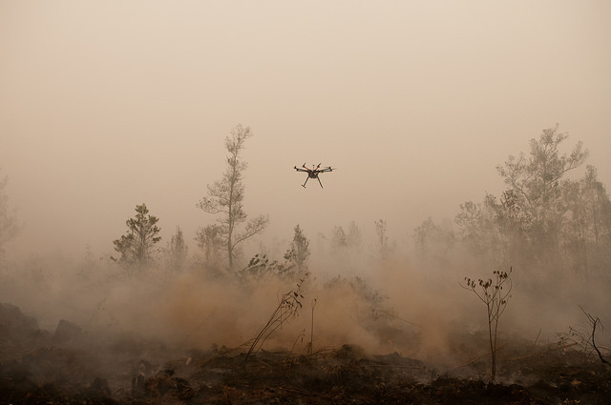
Photo credits: CIFOR

Slide 3
Preview & punch line(s)!
Planetary health
Health-related ecosystem services relatively under-studied
environmental policies that avoid irreversible (potentially epigenetic) penalties.
Painstakingly combine data from
IFLS on human capital, parental genetic endowment and SES
satellite-derived indicators of air quality, rainfall and temperature in 1997 in mother’s location for each trimester.
health in 2007 of children in their early-life (in-utero or first six months) during the peak of the 1997 fires.
regress various child outcomes in 2007 on air quality in 1997 and a rich set of covariates, including fixed effects for location and month.
Find that
Child height; lung capacity; and cognitive ability tests harmed.
Weight is unaffected
Set of robustness and placebo tests to check for bias from confounders

Slide 4
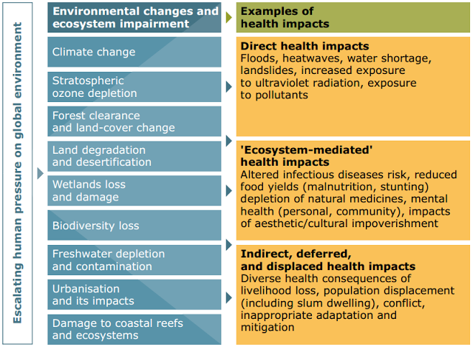
Ecosystems & Human Health
Source: Figure SDM1. Corvalan et al. (2005). Health Synthesis. MEA.

Slide 5
Env Health Burden (WHO 2006)
30% of GBD & 15M deaths year (ignoring malnutrition links)

Slide 6
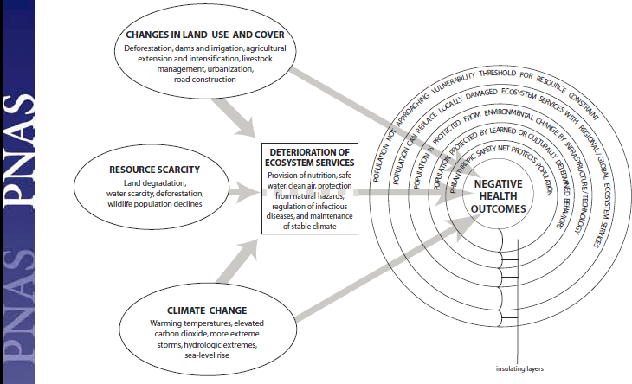
Ecosystems & Human Health
Source: Myers et al. 2013.

Slide 7
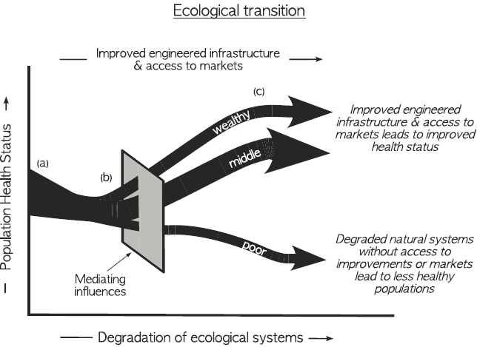
Myers et al.: Conclusion
narrow focus on single health outcome
complex interplay of multiple contemporaneous environmental changes
inadequate treatment of human adaptations
whose health? winners and losers?

Slide 8

Marlier-Myers – modeling from Lancet?
Johnston et al. 2012 EHP

Slide 9
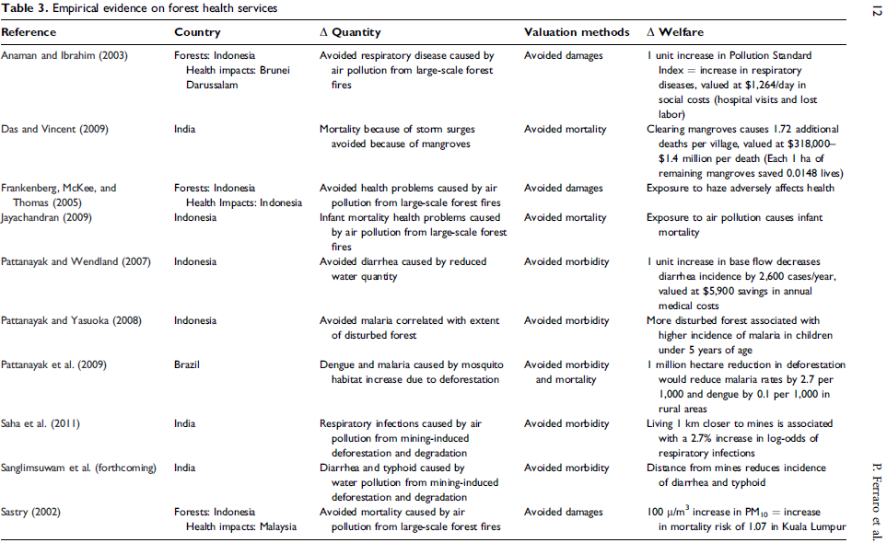
Forest ES & Health: Evidence
Ferraro, PJ, K Lawlor, KL Mullan, and SK Pattanayak. 2012. “Forest figures” Review of Environmental Economics and Policy. 6 (1): 20 – 44.

Slide 10
Questions
Do early-life shocks impact long-term outcomes
Some evidence from developed countries on exposure to famines, moderate malnutrition, diseases, pollution (?), & war
Why do adult outcomes depend on childhood health shocks?
Fetal programming / Development origins of health
Environmental epigenetics
Relative magnitudes & interactions of different health shocks
Critical and sensitive periods
Inter-generational effects of negative health shocks
Irreversibility & dynamic complementarity
Poverty traps & Inequality
Cognitive & non-cognitive skills
What are the joint impacts of indoor and outdoor air pollution on children’s health?
Notes:
State results here

Slide 11
Literature Review
Include both IAP & OAP in India (Ghosh & Mukherji, 2011); endogeneity ignored
Very little on impacts of air pollution on long-term outcomes (Currie and Vogl, 2012)
Exposure to CO impacts later life cognition (Bhardwat et al., 2015)
Use 1997 Indonesian forest fires as exogenous shock to OAP (Frankenberg et al., 2005 ; Jayachandran, 2008); IAP missing
Notes:
Organize the literature

Slide 12
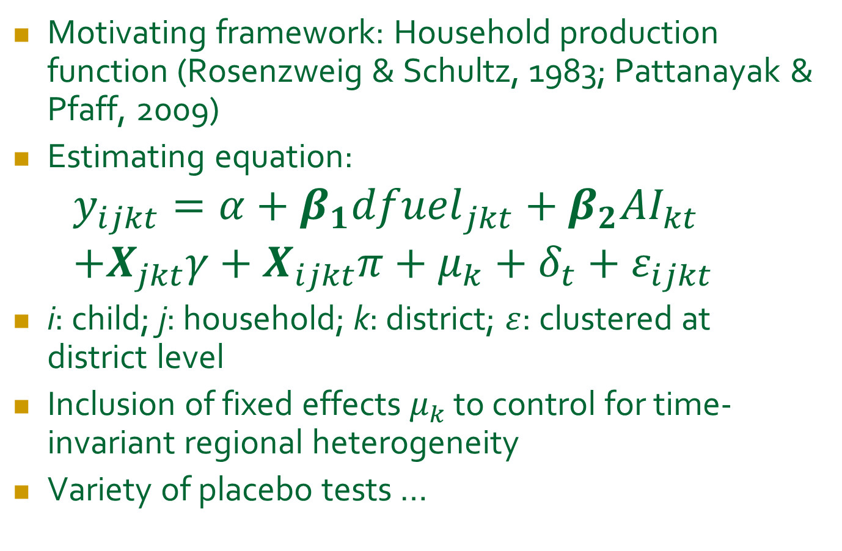
Empirical strategy
Motivating framework: Household production function (Rosenzweig & Schultz, 1983; Pattanayak & Pfaff, 2009)
Estimating equation:
$$y_{ijkt}=α+β_{1}{dfuel}_{jkt}+β_{2}{AI}_{kt} \\ +X_{jkt}γ+X_{ijkt}π+μ_{k}+δ_{t}+ε_{ijkt}$$
i: child; j: household; k: district; $ε$: clustered at district level
Inclusion of fixed effects $μ_{k}$ to control for time-invariant regional heterogeneity
Variety of placebo tests …
Notes:
Highlight coefficients of interest
Make equation larger

Slide 13
Data
Exogenous air quality shock: 1997 Indonesia forest fires
Affected: children in-utero or in 1st six months of their lives during August to October 1997; approx 700 children
Indonesia Family and Life Survey (1993, 1997, 2000, 2007)
height, weight, lung capacity and cognition
Parental characteristics
SES, including main type of fuel and sanitation
NASA Total Ozone Mapping Spectrometer
AI: cumulative aerosol index in 1997
From 1993 onwards
Satellite data at district level
Ongoing analysis correlates AI to PM, ozone, NOX, SO2
Climate variables: rainfall, temperature

Slide 14
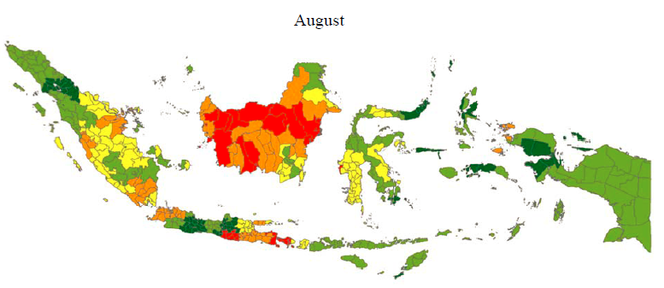
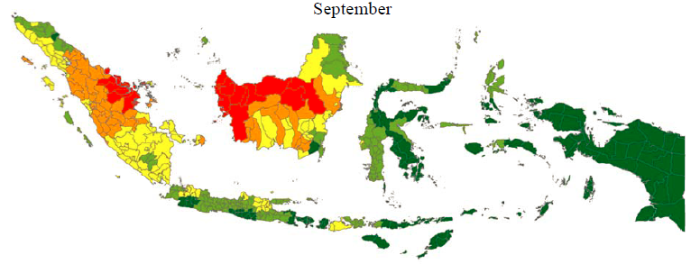
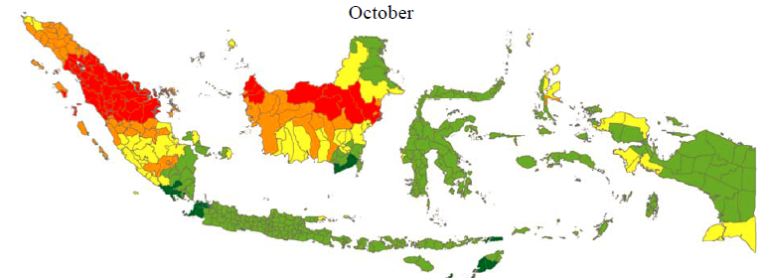
Exposure varies over sample and time

Slide 15
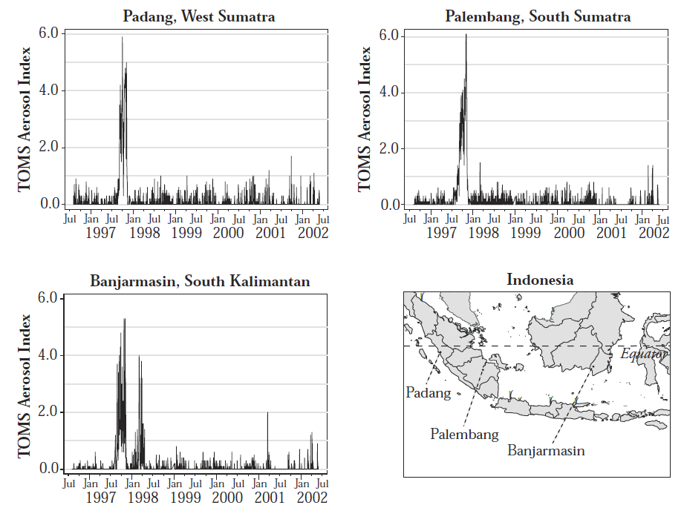
AI: peaks in the Aug-Oct period

Slide 16
Main result in a graph: AI & HaZ
HaZ is highly correlated with AI

Slide 17
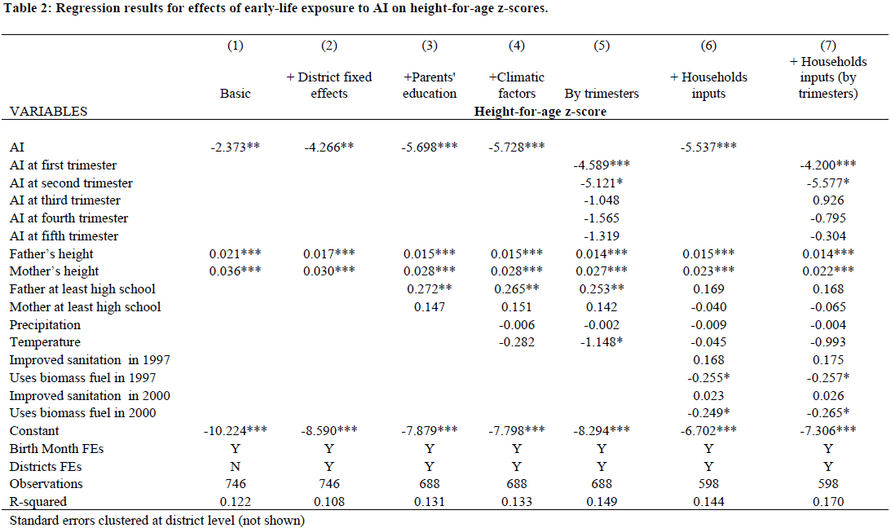
AI & Height (HaZ)
AI negatively correlated with HaZ, ten years after exposure
AI effect most prominent in 1st trimester

Slide 18
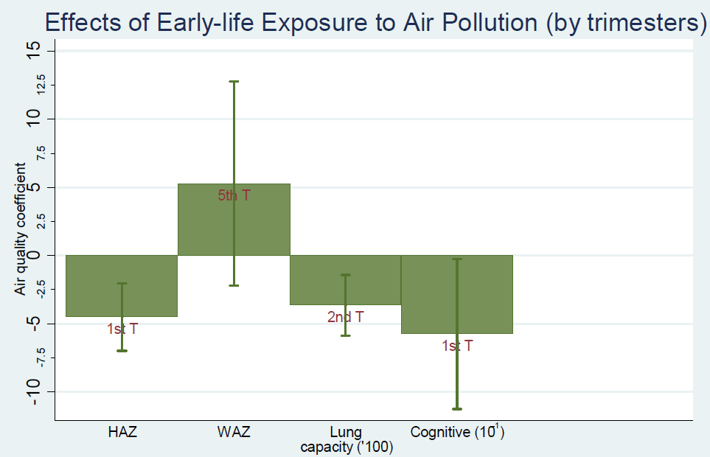
AI & HaZ, WaZ, Lung fn, Cognitive

Slide 19
Regressing health outcomes on AI
VARIABLES | Height | Weight | Lung Function | Cognitive Ability
AI at first trimester | -4.511*** | -1.460 | -78.166 | -0.575*
AI at second trimester | -5.229* | -0.814 | -364.321*** | -0.411
AI at third trimester | 0.292 | 2.425 | -144.817 | -0.287
AI at fourth trimester | -1.655 | 0.427 | 42.871 | -0.459
AI at fifth trimester | 0.064 | 5.292 | -206.498 | -0.267
HH inputs | Yes | Yes | Yes | yes
Uses biomass fuel in 1997 | -0.386*** | -0.100 | -7.315* | -0.042*
Precipitation | -0.004 | -0.002 | -0.199 | 0.001
Temperature | -1.016 | -0.124 | 8.829 | -0.115
Parental characteristics | Yes | Yes | Yes | yes
Individual characteristics | Yes | Yes | Yes | yes
Birth Month FEs | Yes | Yes | Yes | yes
Districts FEs | Yes | Yes | Yes | yes
Observations | 602 | 596 | 607 | 632
R-squared | 0.164 | 0.197 | 0.156 | 0.066
Also, impact cognitive function, lung capacity, but not weight

Slide 20
Placebo 1: The year after (1998)
VARIABLES | Height | Weight | Cognitive Ability
AI at first trimester | -1.295 | -0.695 | -0.147
AI at second trimester | 6.775*** | 5.015 | 0.479
AI at third trimester | 5.210* | 7.302 | 1.144
AI at fourth trimester | -1.752 | 1.005 | 0.023
AI at fifth trimester | 4.953 | 1.812 | 0.322
HH inputs | Y | Y | Y
Uses biomass fuel in 1997 | -0.290** | -0.202 | -0.040
Precipitation | 0.002 | -0.007 | -0.002
Temperature | 0.199 | -0.588 | 0.110
Parent’s characteristics | Y | Y | Y
Child’s characteristics | Y | Y | Y
Birth Month FEs | Y | Y | Y
Districts FEs | Y | Y | Y
Observations | 543 | 535 | 598
R-squared | 0.152 | 0.177 | 0.064

Slide 21
Placebo 2: …the year Before (1996)
VARIABLES | Height | Weight | Lung Function | Cognitive Ability
AI at first trimester | 1.028 | -0.014 | -40.934 | 0.188
AI at second trimester | 0.053 | 0.383 | -198.206* | 0.105
AI at third trimester | 1.637 | 2.455 | -160.988 | 0.487
AI at fourth trimester | 1.186 | 3.546 | 114.663 | 0.550
AI at fifth trimester | 1.804 | -0.028 | -62.651 | 0.040
HH inputs | Y | Y | Y | Y
Uses biomass fuel in 1997 | -0.219 | -0.043 | -5.096 | 0.000
Precipitation | 0.018 | 0.006 | 0.635 | -0.001
Temperature | 0.142 | -0.432 | -29.809 | 0.284*
Parent’s characteristics | Y | Y | Y | Y
Child characteristics | Y | Y | Y | Y
Birth Month FEs | Y | Y | Y | Y
Districts FEs | Y | Y | Y | Y
Observations | 617 | 620 | 624 | 645
R-squared | 0.084 | 0.138 | 0.171 | 0.047
If born a year before, AI has no impact

Slide 22
AI & Height: Catchup or Irreversible?
VARIABLES | Height-year 2000 | Height-year 2000 | Weight-year 2000 | Weight-year 2000
AI | -2.267 |  | -2.185
AI at first trimester |  | -2.079 |  | -4.617**
AI at second trimester |  | -8.841*** |  | -6.050**
AI at third trimester |  | -2.301 |  | -5.229*
AI at fourth trimester |  | -1.183 |  | -3.061
AI at fifth trimester |  | -3.765 |  | 2.019
Father’s height | 0.011*** | 0.011**
Mother’s height | 0.018** | 0.016*
Father at least high school | 0.114 | 0.148 | 0.231 | 0.227
Mother at least high school | 0.030 | -0.025 | 0.055 | 0.000
Improved sanitation in 1997 | 0.284* | 0.284* | 0.064 | 0.085
Uses biomass fuel in 1997 | -0.595*** | -0.605*** | -0.176 | -0.197
Precipitation | 0.005 | 0.007 | -0.007 | -0.001
Temperature | -0.031 | -0.946 | 0.900 | -0.442
Father’s weight |  |  | 0.010 | 0.010
Mother’s weight |  |  | 0.015** | 0.012*
Constant | -5.535*** | -5.533*** | -2.481*** | -2.490***
Observations | 490 | 490 | 482 | 482
R-squared | 0.124 | 0.145 | 0.103 | 0.136
Birth Month FEs | Y | Y | Y | Y
Districts FEs | Y | Y | Y | Y
Looking at outcomes 3 (not 10 years later): AI impact smaller. Therefore, the negative impact grows over time, and there is no catch up

Slide 23
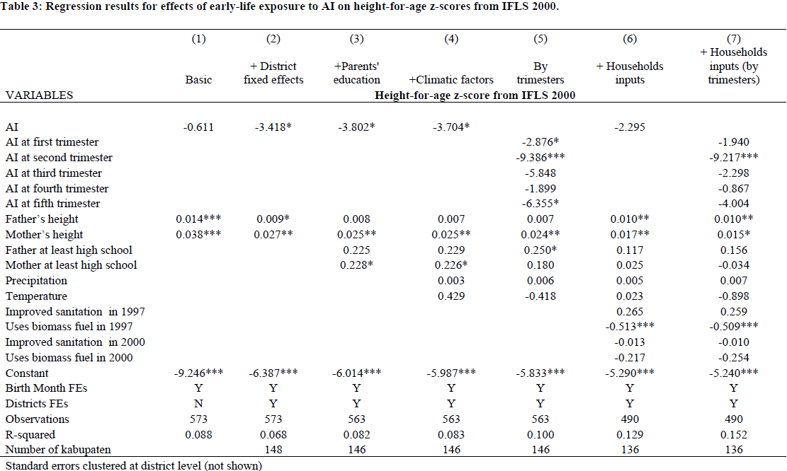
AI & Height: Catchup or Irreversible?
Looking at outcomes 3 (not 10 years later): AI impact smaller. Therefore, the negative impact grows over time, and there is no catch up

Slide 24
CIFOR – fires, causes, consequences
annual, normal event in Indonesia’s peatlands and forests, peaking around September or October, made worse by El Niño
deforestation and repeated burning have made the landscape considerably more fire-prone.
Legal restrictions on fire are seldom successful
Corporate self-regulation has met with mixed success
roots of Indonesia’s fires lie in poverty and weak governance; not environmental problems but human ones.
do not have a single cause: result of activities by a network of different actors from the community, government, non-government, and private sectors.
groups operate across several different types of land: corporate concessions, state land and private/communal lands. In many cases, it is not clear who has tenure rights to the land.

Slide 25
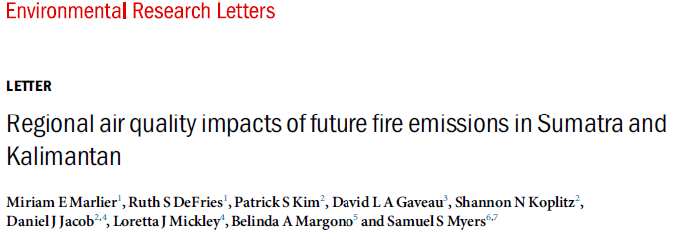
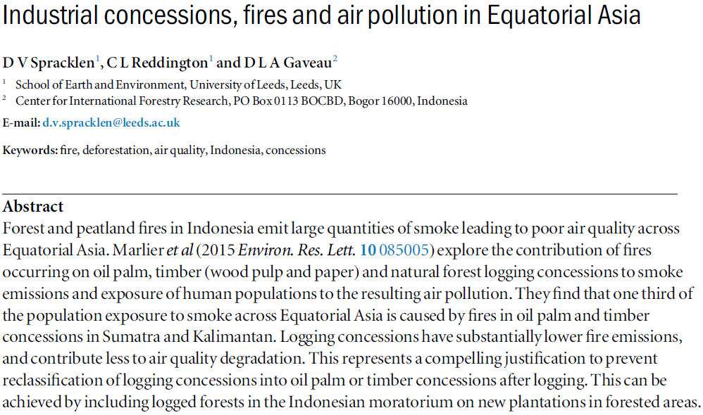
So what can we do?

Slide 26
Do PAs make a difference services?
Outcome | Treatment | Raw ATT | Bias Adj ATT | #T / #C | Unit
Defor 2000-2006 | >30% village area under PA | -1.29** (0.51) | -1.10*** (0.32) | 1,337/ 43,288 | village
Cumulative forest fires 2000-2006 | >30% village area under PA | 0.18 (1.08) | 0.06 (0.51) | 1,337/ 43,288 | village
Cumulative forest fires (60% village forest) 2000-2006 | >30% village area under PA | -0.25 (0.49) | -0.28 (0.31) | 499/ 4,403 | village
PM2.5 2001-2006 | >40% subdistrict Under PA | -9716.79 (5925.46) | -9540.33* (5258.67) | 91/ 2,403 | Sub- district
Miteva & Pattanayak, 2013
Notes:
Note:
the second row dependent variable is the #fires that fall on landcover rasters cells with at least 40% forest cover, regardless of the village forest area
The third row represents the #fires that fall on landcover raster cells with at least 40% forest cover and the village has at least 60% forest area.

Slide 27
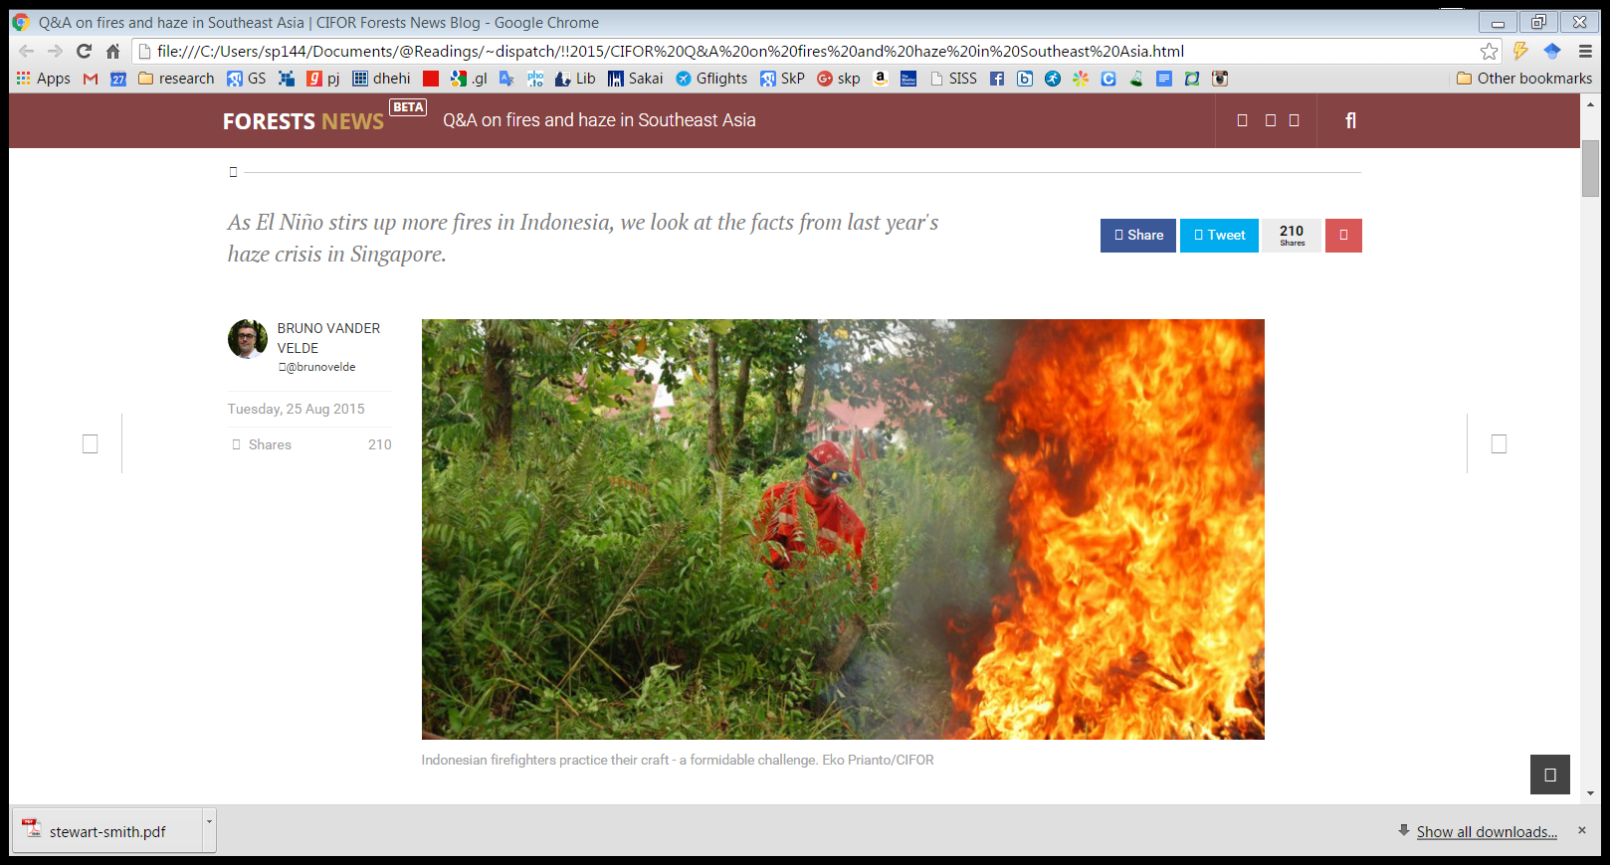
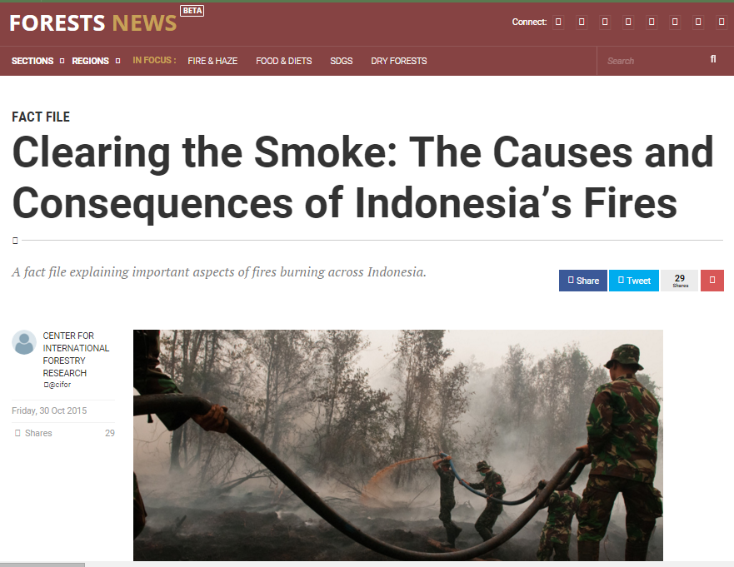


Slide 28
CIFOR: from suppression to prevention
Tens of thousands of personnel dispatched to the fires have been unable to bring them under control. Firefighters are often ill equipped and poorly coordinated.
Long-term solutions will take time to develop: avoiding forest conversion, reducing reliance on fire, and avoiding the cultivation of peatlands
Political economy of fire in Indonesia is key: many beneficiaries, including farmers, politicians, businesspeople, government officers, and even academics. Thus, large financial incentive to switch.
Fire suppression is important but itself may actually hamper long-term solutions; highly visible, creates local jobs, and attracts funds.
Not all fires cause damage and are unwanted; many smallholders rely on slash-and-burn agriculture for their livelihood.
The long-term focus should be on providing Indonesia’s rural poor with fiscal support and competitive alternatives to fire-based agriculture.

Slide 29
Preview & punch line(s)!
Planetary health
Health-related ecosystem services relatively under-studied
environmental policies that avoid irreversible (potentially epigenetic) penalties.
Painstakingly combine data from
IFLS on human capital, parental genetic endowment and SES
satellite-derived indicators of air quality, rainfall and temperature in 1997 in mother’s location for each trimester.
health in 2007 of children in their early-life (in-utero or first six months) during the peak of the 1997 fires.
regress various child outcomes in 2007 on air quality in 1997 and a rich set of covariates, including fixed effects for location and month.
Find that
Child height; lung capacity; and cognitive ability tests harmed.
Weight is unaffected
Set of robustness and placebo tests to check for bias from confounders

Slide 31
Preview & punch line(s)!
Ecosystem degradation in the tropics is more rapid than at any time in human history possibly because the services provided by well-functioning ecosystems (a.k.a. ‘ecosystem services’) are public goods primarily benefiting the poor and politically weak.
Diseases regulation by intact ecosystems are potentially substantial (allegedly 30-40% of the global disease burden), especially when considering emerging threats induced by climate change. Unfortunately, these services are poorly understood because of a complex causal chain (not biomedical, public health), reliance on conveniently collected patchy data, and inadequate methods
Look at the case of air pollution from forest fires (not a provisioning service per se). Unlike most focus on air pollution from factories and cars, look at landuses, and unlike evidence from rich countries, study an emerging market economy
Find that exposed children are shorter, perform worse in cognitive tests, and have lower lung capacity. Of these, the height outcome arguably matters most due to the strong evidence showing correlation between height and socioeconomic outcomes
Our findings are robust to placebo tests looking at outcomes that should not be impacted (e.g., weight), and in sub-samples that should not be impacted (those born right before and right after 1997 forest fires).
Find no evidence of catch-up growth, which is a grim prospect if it is in fact true. The impacts are irreversible and the penalties are generational.

Slide 32
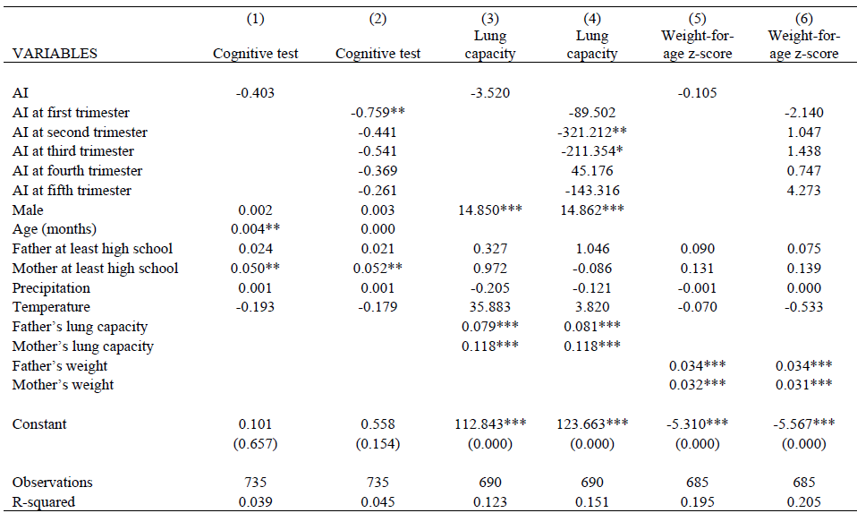
AI & other outcomes
Also, impact cognitive function, lung capacity, but not weight

Slide 33
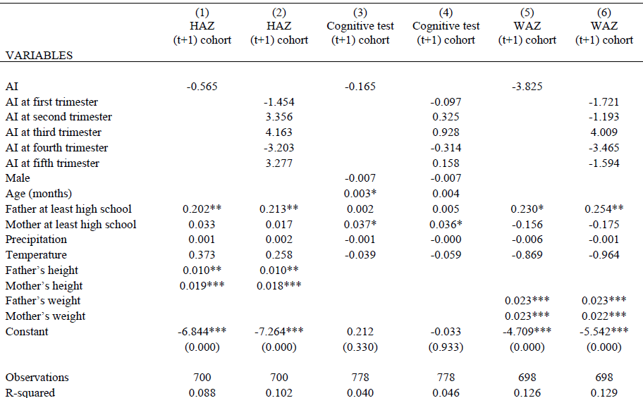
Placebo 1: The year after (1998)
Instruments for HT: assets index
If not yet born, AI should not and does not have an impact

Slide 34
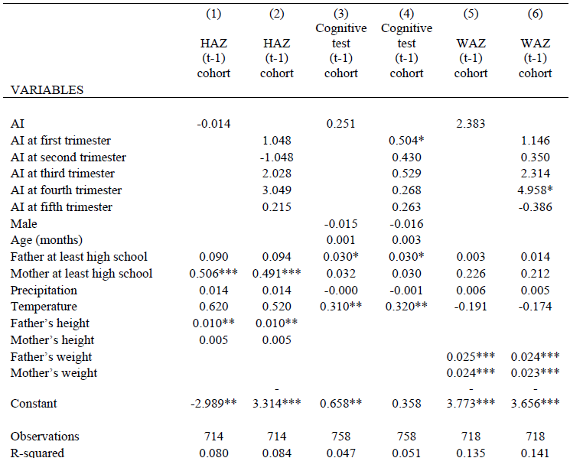
Placebo 2: …the year Before (1996)
If born a year before, AI has no impact

Slide 35
Indonesia. Early-life exposure to AI
2000 (3 years later)
2007 (10 years later)
The negative impact gets bigger, the gap widens, and there is no catch up

Slide 36
VARIABLES | Height-year 2000 | Height-year 2000 | Weight-year 2000 | Weight-year 2000
AI | -2.267 |  | -2.185
AI at first trimester |  | -2.079 |  | -4.617**
AI at second trimester |  | -8.841*** |  | -6.050**
AI at third trimester |  | -2.301 |  | -5.229*
AI at fourth trimester |  | -1.183 |  | -3.061
AI at fifth trimester |  | -3.765 |  | 2.019
HH inputs | Y | Y | Y | Y
Uses biomass fuel in 1997 | -0.595*** | -0.605*** | -0.176 | -0.197
Precipitation | 0.005 | 0.007 | -0.007 | -0.001
Temperature | -0.031 | -0.946 | 0.900 | -0.442
Parent characteristics | Y | Y | Y | Y
Child characteristics | Y | Y | Y | Y
Observations | 490 | 490 | 482 | 482
R-squared | 0.124 | 0.145 | 0.103 | 0.136
Birth Month FEs | Y | Y | Y | Y
Districts FEs | Y | Y | Y | Y

Slide 37
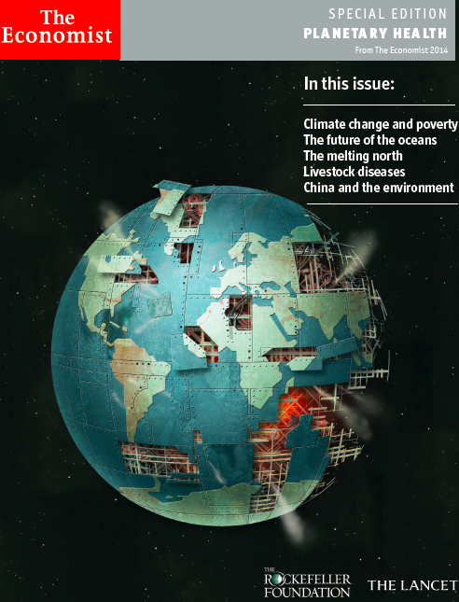

Coming Soon! Planetary Health by Lancet

