Slide 1
Public Expenditure for Tiger Conservation in India: Understanding the Trends and Linkages Bibhu Prasad Nayak The Energy and Resources Institute (TERI) New Delhi

Slide 2
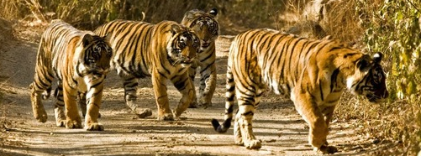

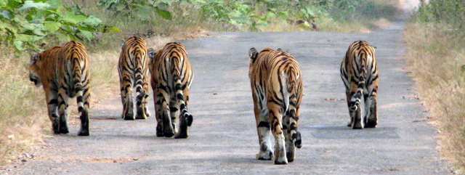
Study Objectives
The study aims at exploring
the trends and patterns of government expenditure (Project Tiger) based on approved APOs for tiger reserves
whether the outcomes in terms of change in tiger numbers in the reserves are linked to the expenditure pattern

Slide 3

Project Tiger
Project Tiger, launched in 1973 as a centrally sponsored scheme, with 9 tiger reserves in 9 different states with around 9000 sq km of core reserve area
Increased to 48 tiger reserves spread across 18 different states with 40000 sq km of core and 70000 sq km of buffer
The size of the reserve (core area) varies
from 200 (Nameri) to 2600 sq km (NSTR)
‘Core- Buffer’ PA management strategy
Sariska ‘tragedy’ in 2004 and aftermath

Slide 4
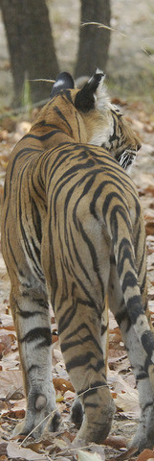
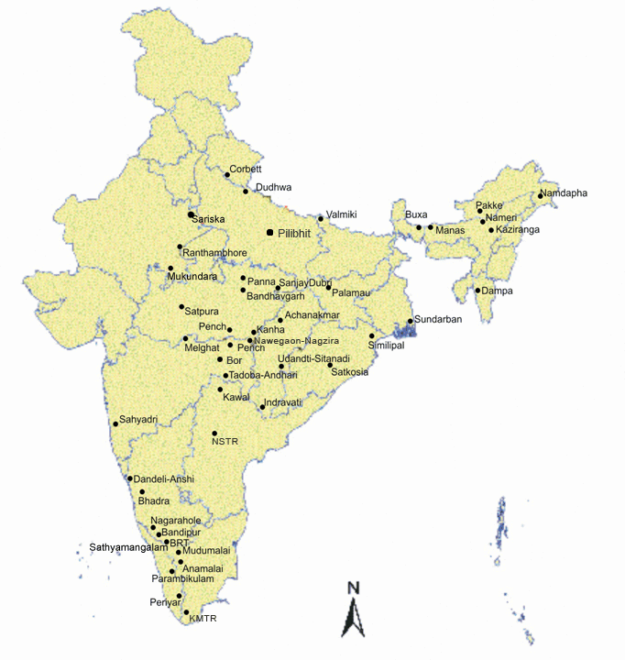
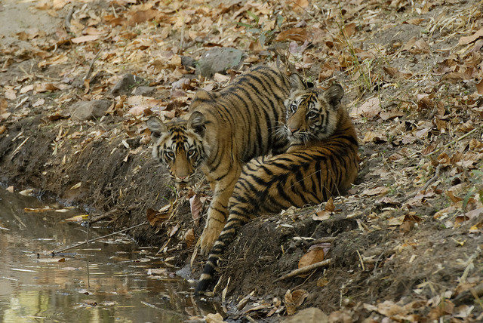

Slide 5
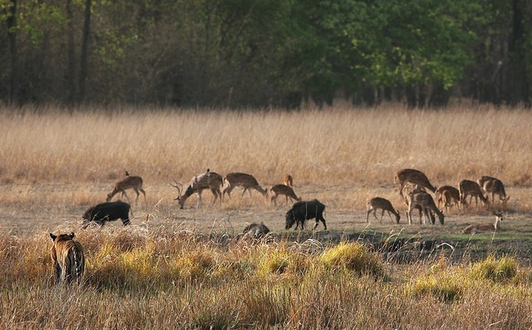
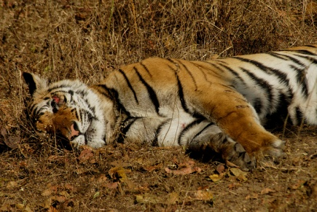
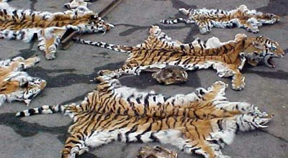
Tiger Challenges
Habitat Quality and Prey: Occupancy declined in from 2006 and 2010. Though overall prey population increased, it has declined in several parks too; corridor connectivity issues
Mortality
Poaching is still a threat in several reserves.
Of the 43 tiger death in 2013, 23 were poached;
diseases, infighting and natural death are

Slide 6
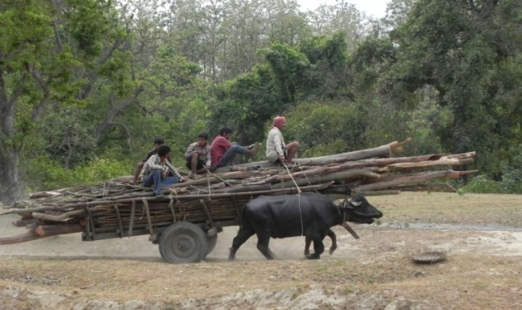


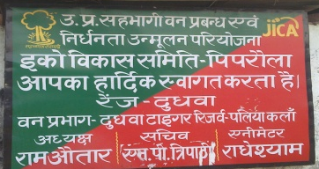
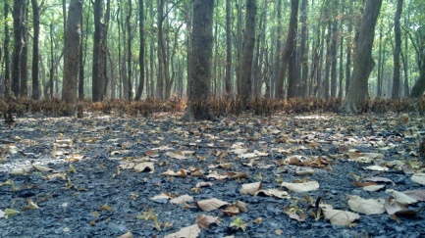

Tiger Challenges
Communities and Livelihood
-762 villages (over 48000 families) in
core, 3678 villages (223000 families)
in buffer
-800 to 1200 sq km of inviolate space?
-Coexistence ?
Management Approaches
- Tiger centric and top down
- Leadership

Slide 7



Effectiveness Concern
2005 Tiger Task Force: institutional inertia,
lack of innovative protection initiatives,
inadequate compensation, outcome measure
2006 CAG Review: gap between allocation and release; non-utilization of allocated funds; poor monitoring and documentation of expenditure; inadequate protection infrastructure and staff; no definite relocation plan
Management Effectiveness Evaluations:
2006, 2011 & 2015:45 qualitative criteria
covering planning, input, process and output

Slide 8



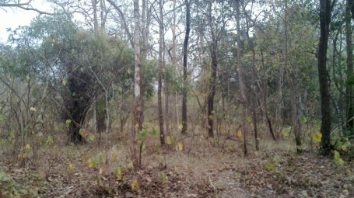

Methodology and Data Sources
Trends and patterns of expenditure under ‘project tiger’ in 28 tiger reserves
Panel regression examining the linkage between expenditure pattern and outcomes
Expenditure data: APOs (NTCA)
Outcomes-tiger population: Tiger Census (WII)
Field visits to 3 tiger reserves (Nagarjunasagar-Srisailam, Dudhwa and Corbett)

Slide 9
Expenditure: Project Tiger
Project Tiger is a centrally sponsored scheme and mostly funded by the central government with a little share of the state governments in which the tiger projects are located
Funds are allocated in five year plans and the annual allocations for each tiger reserve are made based on the demand for resources from respective tiger reserves
Three major heads of allocation i.e., non-recurring (center), recurring (state and center share equally) and eco-development (center)
Tiger reserves do to gets funds from sources other than project tiger

Slide 10
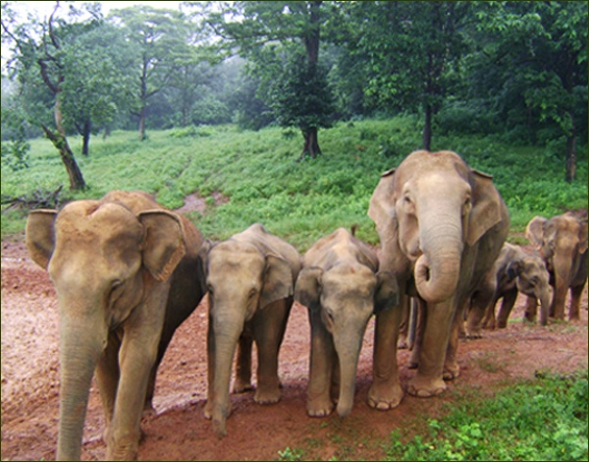



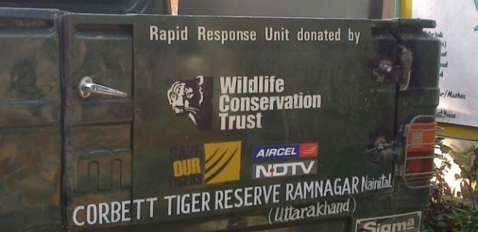
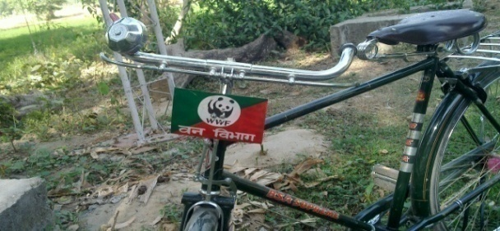
Expenditure: Others
Other central and state government
schemes
Tiger Conservation Foundations
Conservation and development NGOs
This study discusses only the
Expenditure under Project Tiger

Slide 11
Expenditure under Project Tiger in FYPs: 1973-74 to 2011-12 (Rs. Millions in 2004-05 Prices)

Slide 12
% Share of Project Tiger in MoEF’s Total Outlay

Slide 13
Tiger Reserve wise Allocations
Allocations are made based on Annual Plan of Operations (APOs); center and state share
Allocations vs expenditures
Allocation for 28 tiger reserves from 2004-05 to 2011-12: Rs. 5692 millions at 2004-05 prices
Grouping the Expenses
-Infrastructure
-Protection
-Habitat Improvement
-Relocation
-Human-Animal Conflict
-Other Activities
-Eco-Development

Slide 14
Allocation Pattern: 2004-05 to 2011-12

Slide 15
Allocation Pattern: 2004-05 to 2011-12

Slide 16
Allocation of Non-Recurring and Recurring Expenses

Slide 17
Allocation-Tiger Reserve wise (without Relocation) 2004-05 to 2011-12

Slide 18
Per Sq Km (Core Area) Allocation (Relocation Excluded) 2004-05 to 2011-12

Slide 19
All India Tiger Population

Slide 20
Tiger Census 2006 and 2010
Population (in Nos)
Four Phases
Phase I: Determining occupancy and mapping relative abundance
Phase II: Remotely Sensed spatial and attribute covariates
Phase III: Camera Trapping
Phase IV: Annual Monitoring of individual reserve and MSTRIPES for source population
Occupancy (in Sq. Km)

Slide 21
% Change in Tiger Population- 2006 to 2010 census

Slide 22
% Change in Occupancy- 2006 to 2010 census

Slide 23
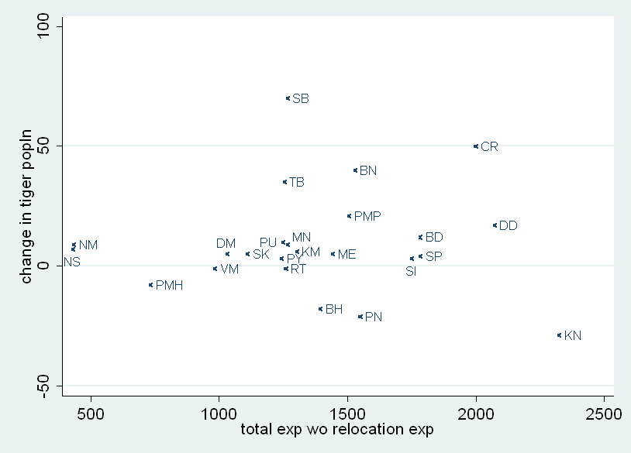
Expenditure and Change in Population

Slide 24
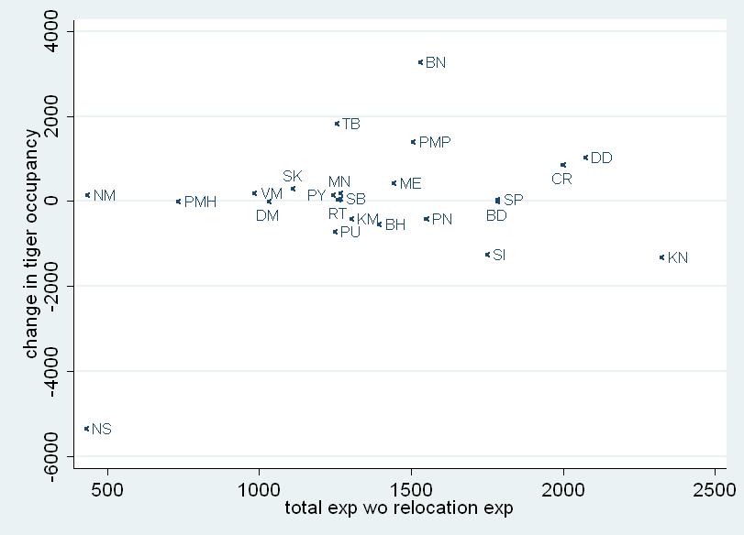
Expenditure and Change in Occupancy

Slide 25
Variables (Randomized Negative Binomial Model)
Dependent Variable | Explanatory Variables
Tiger Number | Expenditure Variables | Controls
 | Infrastructure | Reserve Area
 | Protection | Rainfall
 | Habitat improvement | Temperature
 | Human-animal conflict | Villages in core
 | Other activities | Villages in buffer
 |  | Families in core
 |  | Families in buffer

Slide 26
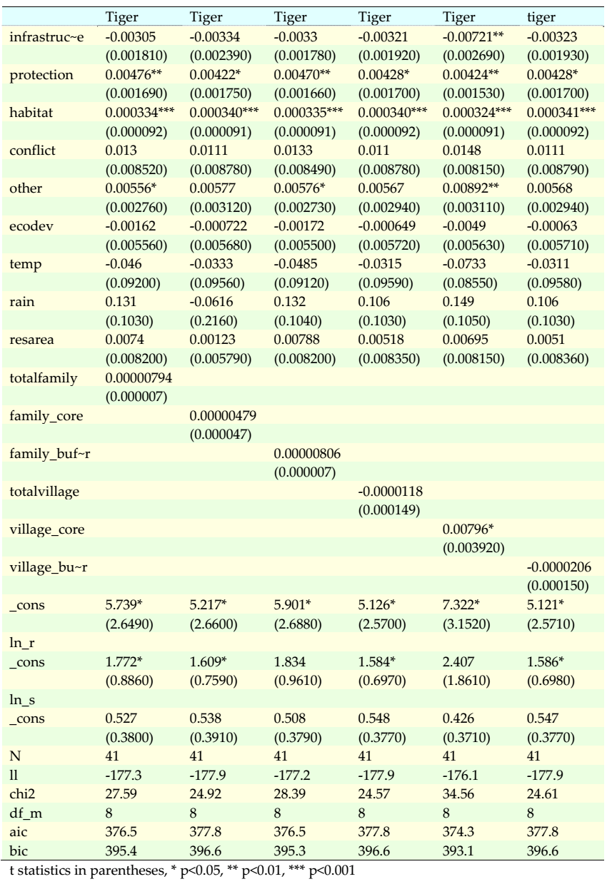

Slide 27
Discussion
Tiger number as dependent variable
Limitations of expenditure data
Expenditure as explanatory variable:
-Expenditure decision making
-Differential perceptions
-Administrative issues

Slide 28

Thank You
Tiger Pictures in the slides sourced from www.tigernation.org
(Madhuri-Tadoba Andheri, Krishna-Ranthambore, Vijaya-Bandhavgarh)

