Slide 1
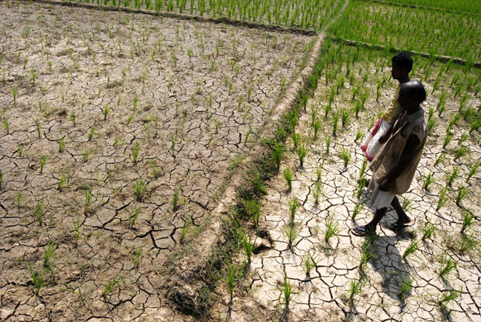
Is Indian agriculture becoming resilient to droughts? Evidence from rice production systems
Pratap S Birthal, Digvijay Negi, Md. Tajuddin Khan and Shaily Agarwal
National Institute of Agricultural Economics and Policy Research
New Delhi

Slide 2
Background
67% of India’s geographical area is vulnerable to droughts
The probability of occurrence of a drought is about 35%- - ranging from 20% in dry-humid regions to 40% or more in arid regions.
India experienced 13 major droughts since 1966; 4 of these occurred during 2001 to 2012.
A severe drought affect food production , deplete productive assets, exacerbate rural poverty, force outmigration, contract demand for non-agricultural goods and services and lead to over-exploitation of natural resources, including land and water.
  25-60% shortfall in household income and 12-33% increase in head-count poverty (Pandey et al. 2007)
  Farm households in spite of using a number of coping mechanisms to regain their previous levels of livelihoods, they rarely recover the loss of productive assets in the subsequent years.

Slide 3
Drought management policy
After 1987 drought that affected 60% of the geographical area, India’s strategy to cope with droughts has been undergone a paradigm shift, from crisis management to risk management.
  preparedness in terms of meteorological forecasts and development of location- specific contingency plans,
  mitigation and adaptation through improvements and innovations in irrigation management and crop breeding for drought-tolerance, and
  diversification of rural economy towards non-farm activities to reduce farm households’ excessive dependence on agriculture
  Government claims: The policy has been effective in mitigating harmful effects of droughts on crop production
  But, it could be due to decline in frequency and intensity of droughts

Slide 4
In this presentation
Examine the frequency, severity and spread of droughts in India
Assess the impact of droughts food production, focusing on rice
Assess the role of irrigation and other adaptations in mitigating the impact of droughts
District-level data for 200 rice growing districts (at 1970base) for 1969-2005

Slide 5
Drought?
No universal definition: meteorological, hydrological, and agricultural
In India, a drought is defined and measured in terms of extent of shortfall in rainfall from its normal.
  An area is affected by drought if the actual rainfall is 25% or more below its historical mean. If the rainfall-deficit is between 25% and 50% then the drought is of moderate intensity, otherwise it a severe one
This measure of drought is based solely on the degree of dryness.
Scientific evidence suggests that dry and hot weather is more harmful to crops rather just the dry conditions . Several studies on climate impacts show that climate impacts are largely driven by rise in temperature
Thus, a drought can be conceptualized as an outcome of the occurrence of two joint events, abnormally low moisture due to poor rainfall and abnormally hot temperature.

Slide 6
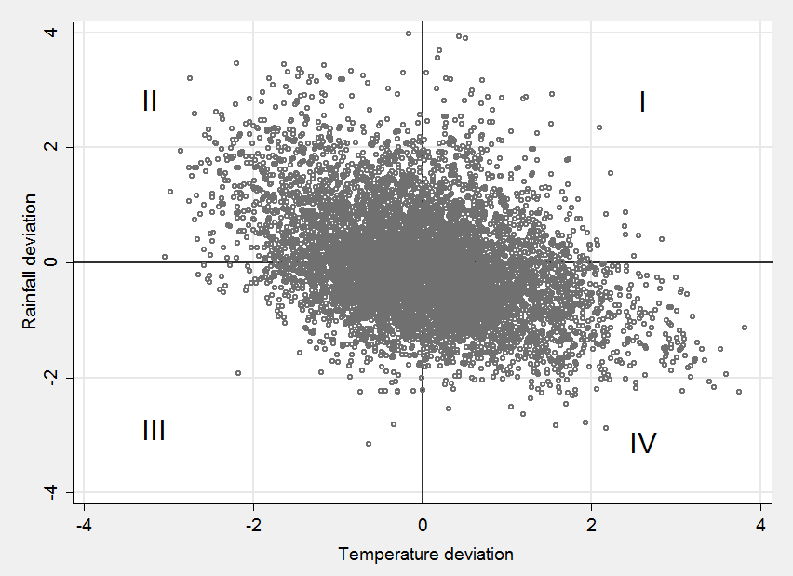
Relationship between deviations in rainfall
and temperature?

Slide 7
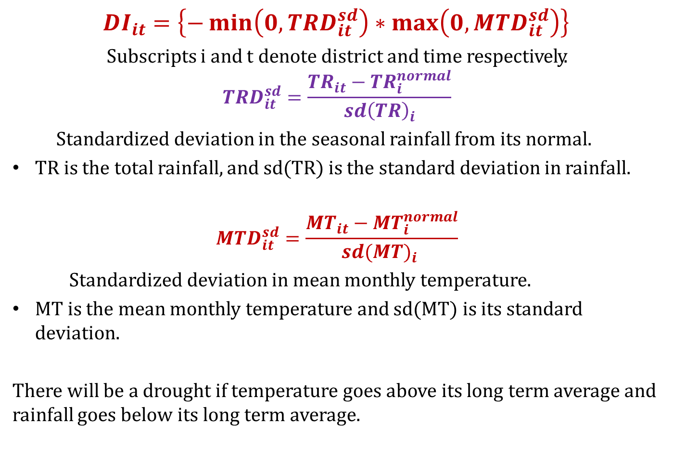
Drought Index
${DI}_{it}=\left\{−\min\left(0, {TRD}_{it}^{sd}\right)∗\max\left(0, {MTD}_{it}^{sd}\right)\right\}$
Subscripts i and t denote district and time respectively.
$${TRD}_{it}^{sd}=\frac{{TR}_{it}−{TR}_{i}^{normal}}{{sd\left(TR\right)}_{i}}$$
Standardized deviation in the seasonal rainfall from its normal.
TR is the total rainfall, and sd(TR) is the standard deviation in rainfall.
$${MTD}_{it}^{sd}=\frac{{MT}_{it}−{MT}_{i}^{normal}}{{sd(MT)}_{i} }$$
Standardized deviation in mean monthly temperature.
MT is the mean monthly temperature and sd(MT) is its standard deviation.
There will be a drought if temperature goes above its long term average and rainfall goes below its long term average.

Slide 8
Utility of Drought Index?
DI summarises both degree of hotness and degree of dryness;
It is the product of deviations; hence, lays relatively more emphasis on larger deviations
It utilizes district-level/local weather data; hence more relevant to the cropping activities there.
It comprises of two important causes of crop damage, viz. lack of moisture and excess heat; hence a single index rather multiple weather variables offers an easy means of assessing impacts of climate change on agriculture.
It provides level of severity of a drought, making it convenient to quantify crop loss at different severity levels, and to take adaptation measures accordingly.

Slide 9
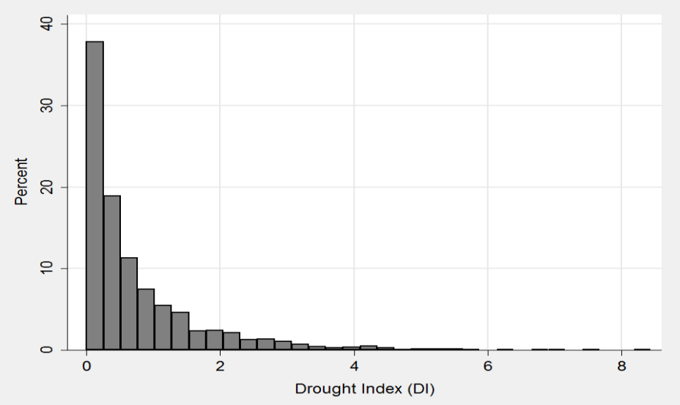
Frequency Distribution of Drought events
The index ranges from 0 to 8;
Zero implies rainfall being more than normal and temperature being less than normal.
Abnormally low values of DI can be considered to representt normal weather.
DI is skewed towards its lower bound, means most drought events were not severe.

Slide 10
Droughts: Severity, Distribution and Area Affected
Based on dispersion of DI, drought events are classified as low, moderate and severe droughts
 | Severity | Mean drought index | % of total events | % rice area affected
 | Low | 0.05 | 2.7 | 1.1
1969-2005 | Moderate | 0.47 | 82.7 | 25.7
 | Severe | 2.59 | 14.6 | 4.6
 | Mean | 0.77 | 100.0 | 31.4
 | Low | 0.04 | 2.3 | 0.7
1969-1987 | Moderate | 0.49 | 76.8 | 24.5
 | Severe | 2.84 | 20.9 | 6.5
 | Mean | 0.97 | 100.0 | 31.8
 | Low | 0.06 | 3.1 | 1.5
1988-2005 | Moderate | 0.45 | 88.4 | 26.8
 | Severe | 2.00 | 8.5 | 2.7
 | Mean | 0.57 | 100.0 | 31.0

Slide 11
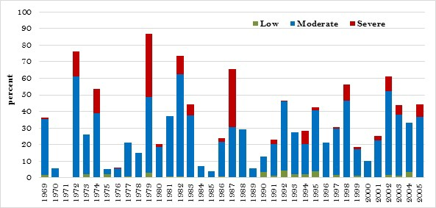
Year –wise rice area affected by droughts

Slide 12
Are the Trends in Drought Events Significant?
We regressed occurrence of drought (drought=1, zero otherwise) on time trend using probit model.
The coefficient on time trend is positive and statistically significant implying an increase in the probability of occurrence of droughts, especially the moderate intensity droughts.
The coefficient on severe droughts, however, is negative but not significant indicating a tendency of decline in their frequency.
 | (1) | (2) | (3) | (4)
Variable | Low intensity drought=1, zero otherwise | Moderate drought=1, zero otherwise | Severe drought=1, zero otherwise | Drought event=1, zero otherwise
 | 0.0038 | 0.0107*** | -0.0025 | 0.0094***
Time trend | (0.0041) | (0.0015) | (0.0026) | (0.0015)
Number of events | 56 | 1712 | 302 | 2070

Slide 13
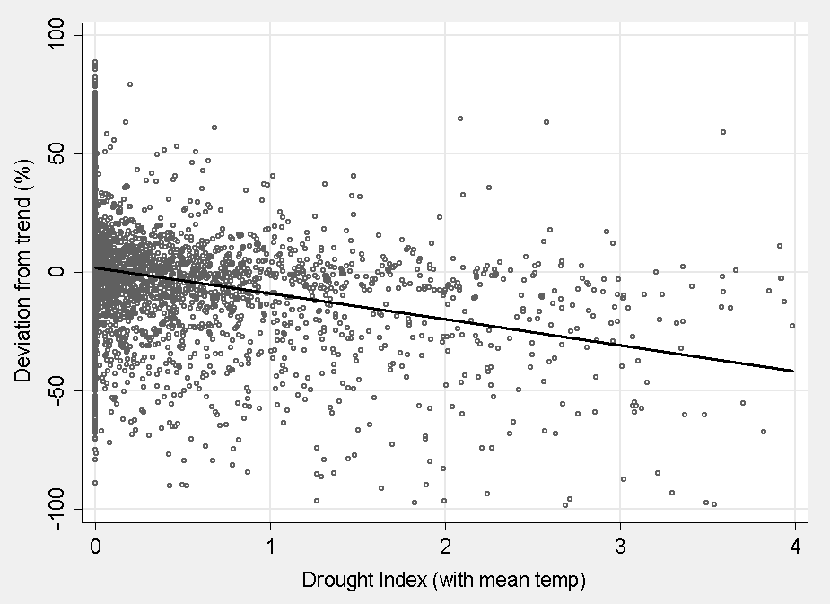
Impact on Rice Yield?
Deviation in rice yield from its trend against the drought index
The relationship is negative, and the estimated correlation coefficient is -0.27 and statistically significant at 1% level.

Slide 14
Deviation in rice yield from trend
 | Average | Low | Moderate | Severe | Average
 | Yield (Kg/ha) | 1246.2 | 1259.0 | 1139.7 | 1234.1
1969-1987 | Deviation from trend (Kg/ha) | +37.4 | -45.5 | -191.2 | -73.7
 | Deviation from trend (%) | +3.0 | -3.6 | -16.8 | -6.0
 | Yield (Kg/ha) | 1936.9 | 1900.3 | 1814.2 | 1894.6
1988-2005 | Deviation from trend (Kg/ha) | +4.6 | -25.2 | -147.0 | -34.3
 | Deviation from trend (%) | +0.2 | -1.3 | -8.1 | -1.8
 | Yield (Kg/ha) | 1705.8 | 1584.3 | 1328.3 | 1550.5
1969-2005 | Deviation from trend (Kg/ha) | +15.6 | -35.2 | -178.8 | -54.8
 | Deviation from trend (%) | +0.9 | -2.2 | -13.5 | -3.5

Slide 15
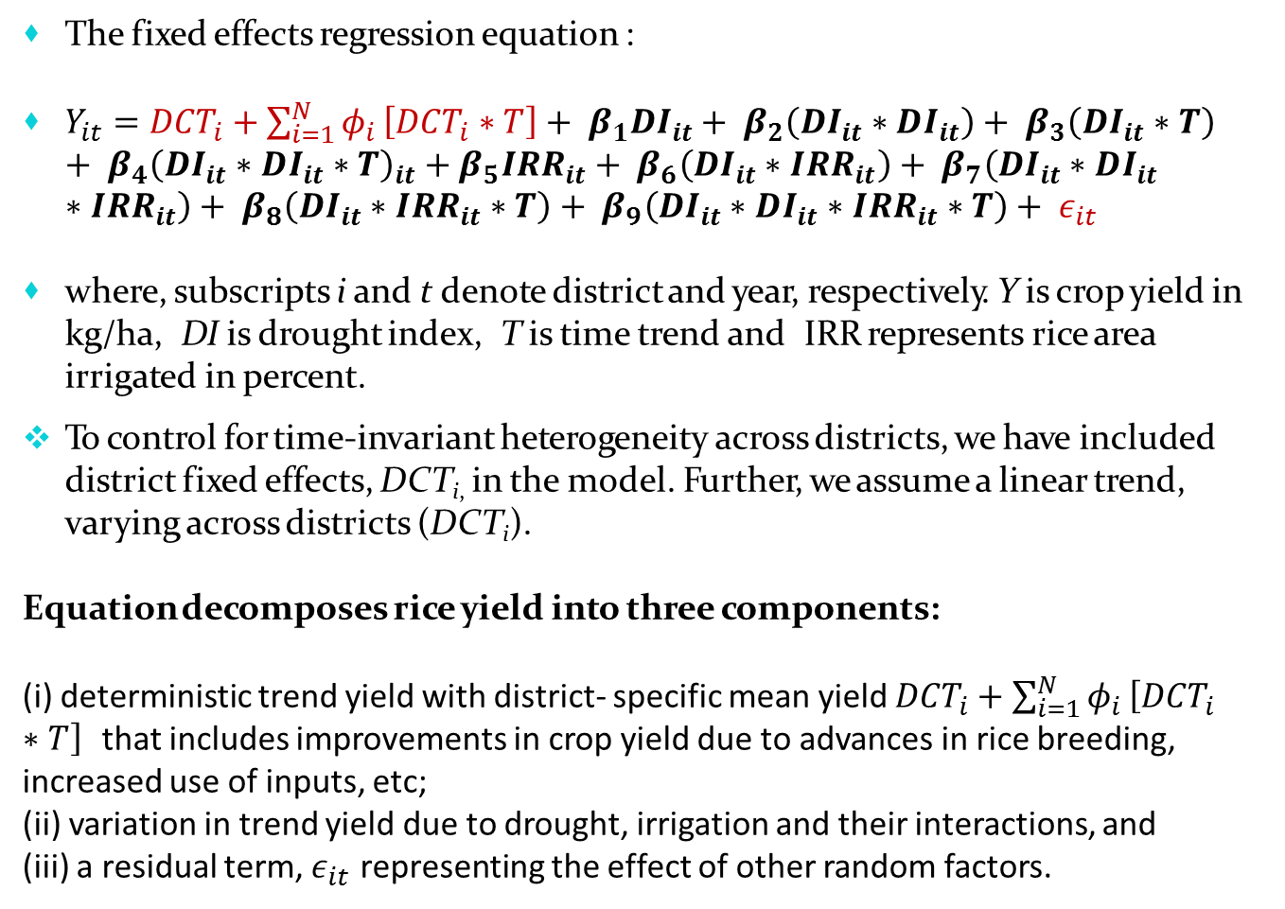
Econometric specification:
The fixed effects regression equation :
$Y_{it}={DCT}_{i}+\sum_{i=1}^{N}{φ_{i}}\left[{DCT}_{i}∗T\right]+ β_{1}{DI}_{it}+ β_{2}\left({DI}_{it}∗{DI}_{it}\right)+ β_{3}\left({DI}_{it}∗T\right)+ β_{4}{\left({DI}_{it}∗{DI}_{it}∗T\right)}_{it}+β_{5}{IRR}_{it}+ β_{6}\left({DI}_{it}∗{IRR}_{it}\right)+ β_{7}\left({DI}_{it}∗{DI}_{it}∗{IRR}_{it}\right)+ β_{8}\left({DI}_{it}∗{IRR}_{it}∗T\right)+ β_{9}\left({DI}_{it}∗{DI}_{it}∗{IRR}_{it}∗T\right)+ ε_{it}$
where, subscripts i and t denote district and year, respectively. Y is crop yield in kg/ha, DI is drought index, T is time trend and IRR represents rice area irrigated in percent.
To control for time-invariant heterogeneity across districts, we have included district fixed effects, DCT_{i,} in the model. Further, we assume a linear trend, varying across districts (DCT_{i}).
Equation decomposes rice yield into three components:
(i) deterministic trend yield with district- specific mean yield ${DCT}_{i}+\sum_{i=1}^{N}{φ_{i}}\left[{DCT}_{i}∗T\right]$ that includes improvements in crop yield due to advances in rice breeding, increased use of inputs, etc;
(ii) variation in trend yield due to drought, irrigation and their interactions, and
(iii) a residual term, $ε_{it}$ representing the effect of other random factors.

Slide 16
Regression results
The coefficient on DI and DI-squared is negative , drought reduces yield
Coefficient on DI*T is positive: suggests rice has become less vulnerable to droughts
A positive coefficient on DI*DI*T indicates that the rice has also become less susceptible to severe droughts
The coefficient associated with IRR is positive and significant
The interaction of IRR with DI-squared is positive, means that irrigation moderates harmful effects of severe droughts
The effectiveness of irrigation seems to have declined : negative and significant coefficient of DI*DI*T*IRR

Slide 17
Estimated coefficients
Explanatory variables | Linear model | Log linear model
DI (Drought index) | -551.5 | -13.5
 | (6944.1) | (10.9)
DI*DI | -2902.4 | -8.3
 | (2068.3) | (5.2)
DI*Trend | 0.161 | 0.007
 | (3.50) | (0.005)
DI*DI*Trend | 1.481 | 0.004
 | (1.043) | (0.003)
IRR (proportion of rice area irrigated) | 284.014*** | 0.132**
 | (107.431) | (0.063)
DI*IRR | -236.6 | 4.7
 | (10268.1) | (13.6)
DI*DI*IRR | 4534.1 | 12.2*
 | (2997.8) | (6.4)
DI*Trend*IRR | 0.142 | -0.002
 | (5.171) | (0.007)
DI*DI*Trend*IRR | -2.3 | -0.006*
 | (1.5) | (0.003)
Constant | -44838.7*** | -20.7***
 | (819.4) | (0.7)
No. of observations | 5929 | 5929
Figures in parentheses are district-clustered standard errors. ***, **, and * denote significance at the 1%, 5%, and 10% levels, respectively

Slide 18
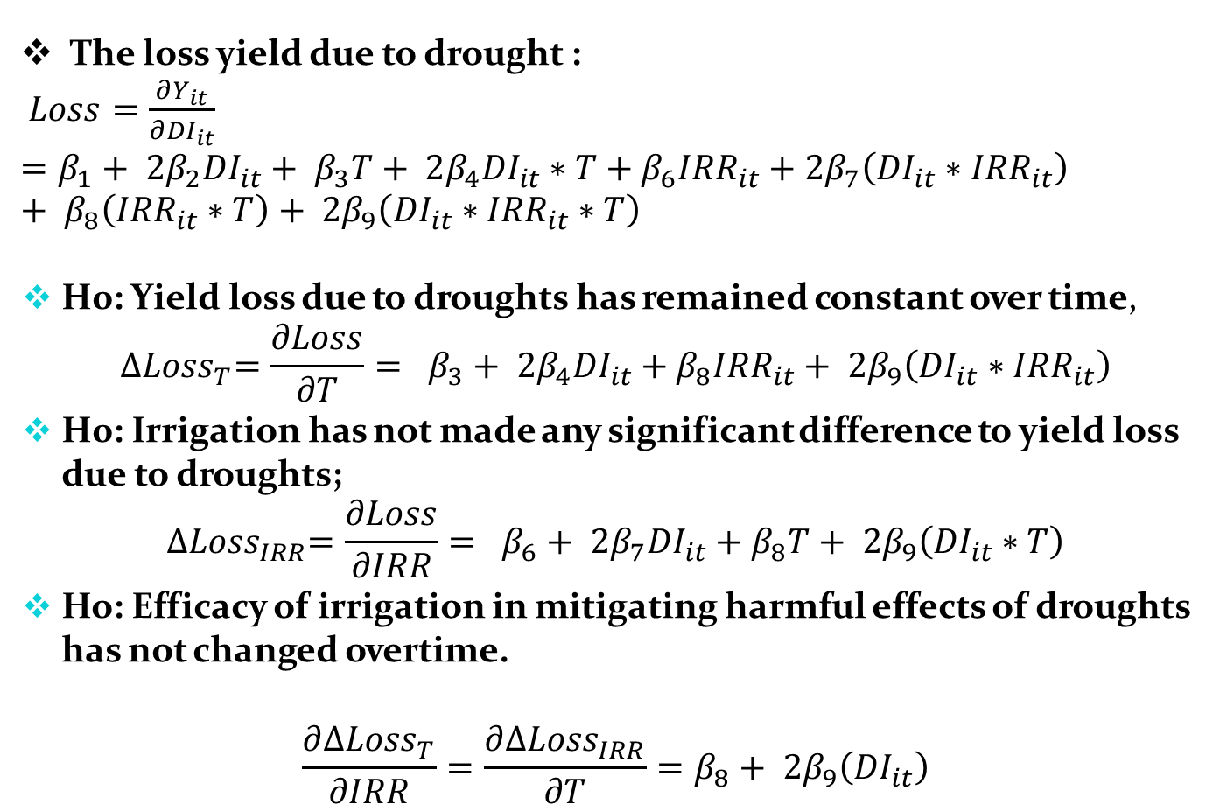
Estimation of yield loss; and Hypothesis:
The loss yield due to drought :
$Loss=\frac{∂Y_{it}}{∂{DI}_{it}}=β_{1}+ 2β_{2}{DI}_{it}+ β_{3}T+ 2β_{4}{DI}_{it}∗T+β_{6}{IRR}_{it}+2β_{7}\left({DI}_{it}∗{IRR}_{it}\right)+ β_{8}\left({IRR}_{it}∗T\right)+ 2β_{9}\left({DI}_{it}∗{IRR}_{it}∗T\right)$
H0: Yield loss due to droughts has remained constant over time,
$${∆Loss}_{T}=\frac{∂Loss}{∂T}= β_{3}+ 2β_{4}{DI}_{it}+β_{8}{IRR}_{it}+ 2β_{9}\left({DI}_{it}∗{IRR}_{it}\right)$$
H0: Irrigation has not made any significant difference to yield loss due to droughts;
$${∆Loss}_{IRR}=\frac{∂Loss}{∂IRR}= β_{6}+ 2β_{7}{DI}_{it}+β_{8}T+ 2β_{9}\left({DI}_{it}∗T\right)$$
Ho: Efficacy of irrigation in mitigating harmful effects of droughts has not changed overtime.
$$\frac{∂{∆Loss}_{T}}{∂IRR}=\frac{∂{∆Loss}_{IRR}}{∂T}=β_{8}+ 2β_{9}\left({DI}_{it}\right)$$

Slide 19
Marginal effects associated with time trend, drought and irrigation evaluated at their mean values.
The marginal effect of time indicates an increase in the rice yield at a rate of 1.6% or 23.4kg/ha per annum during the period 1969-2005, but the trend varies considerably across districts The effect of drought on yield is negative to the extent of 194 kg/ha or 25% of the normal yield. A positive marginal effect of irrigation reinforces its role in improving rice yield. Test of Hypothesis the yield loss due to droughts has remained constant overtime the expansion of irrigation has not affected drought-induced yield loss, the efficacy of irrigation in mitigating harmful effects of droughts has remained constant overtime i.e. |  | Linear | Log linear
 | Average marginal effects
 | Trend | 23.4*** | 0.016***
 |  | (0.42) | (0.0003)
 | DI | -194.0*** | -0.246***
 |  | (14.1) | (0.022)
 | IRR | 289.2*** | 0.181***
 |  | (106.8) | (0.063)
 | Test of hypotheses (at average DI = 0.77, IRR = 0.50)
 | H₀: ∆Loss_{(T)} = 0 | 0.75 | 0.0072***
 |  | (1.22) | (0.0014)
 | H₀: ∆Loss_{(IRR)} = 0 | 22.46 | 0.2102***
 |  | (30.92) | (0.0401)
 | H₀: ∆Loss_{(T,IRR)} = 0 | -3.38 | -0.0117***
 |  | (3.09) | (0.0035)

Slide 20
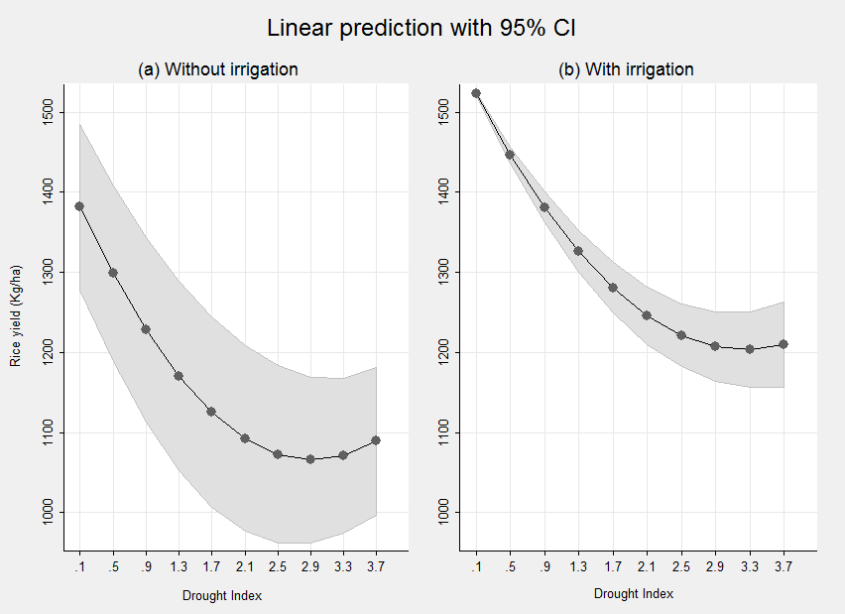
Predicted rice yield, with and without irrigation, at different levels of drought severity

Slide 21
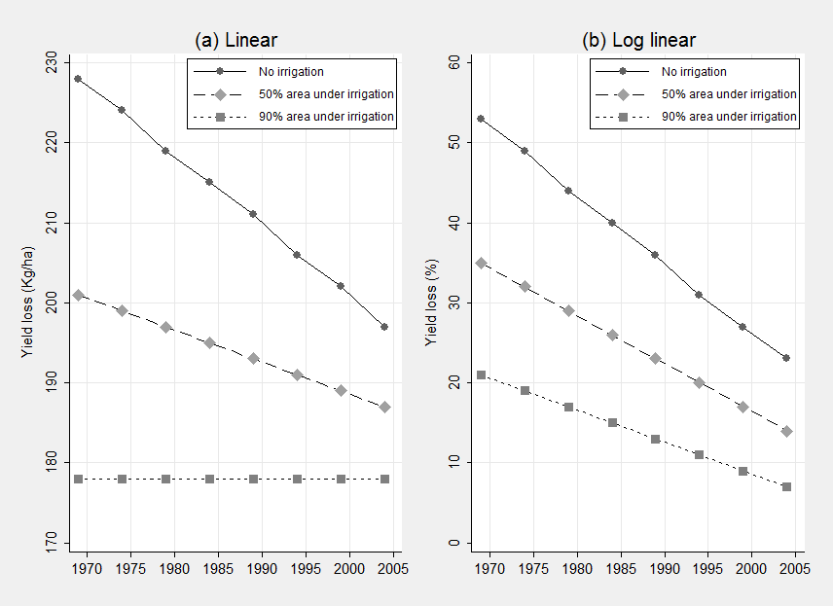
Trend in yield loss under varying levels of irrigation; DI=0.77
Slope of the curves is negative but moderates at a higher level of irrigation; irrigation is important to cope with droughts, its effectiveness diminishes when water is thinly distributed.
Loss curve associated with no irrigation lies above their irrigation counterfactuals indicating that drought has a bigger impact in rainfed farming systems, but its impact has weakened overtime.
It also indicates role of adaptation strategies other than irrigation in containing harmful effects of droughts.

Slide 22
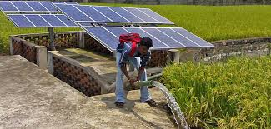
Irrigation
 | Source of irrigation |  |  |  | Rice area irrigated (%)
 | Canal | Groundwater | Others | All
1969-70 | 9.1 | 8.1 | 4.6 | 21.8 | 38.2
1986-87 | 11.8 | 14.9 | 3.8 | 30.5 | 43.6
2005-06 | 11.8 | 25.6 | 5 .7 | 43.1 | 56.0
2010-11 | 11.1 | 27.6 | 6.3 | 44.9 | 58.7

Slide 23
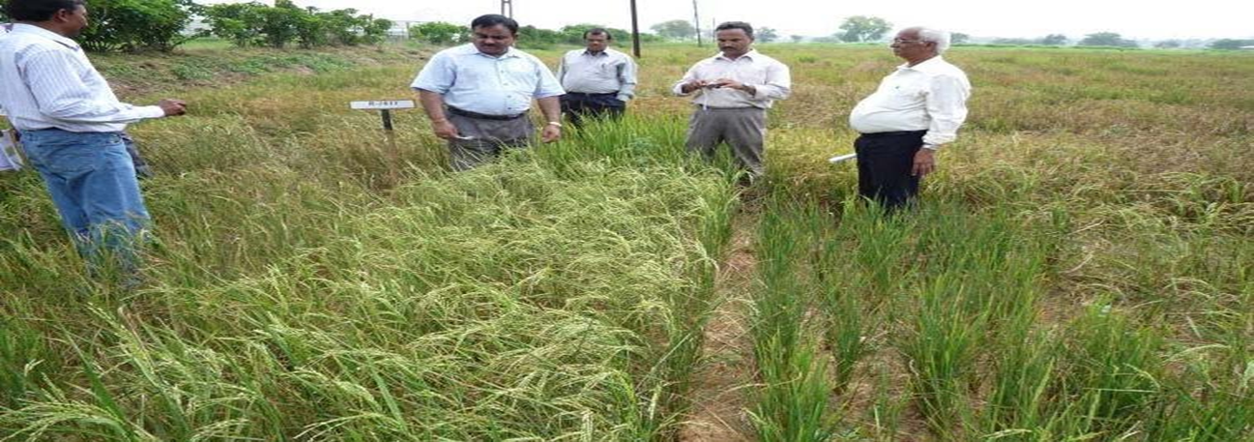
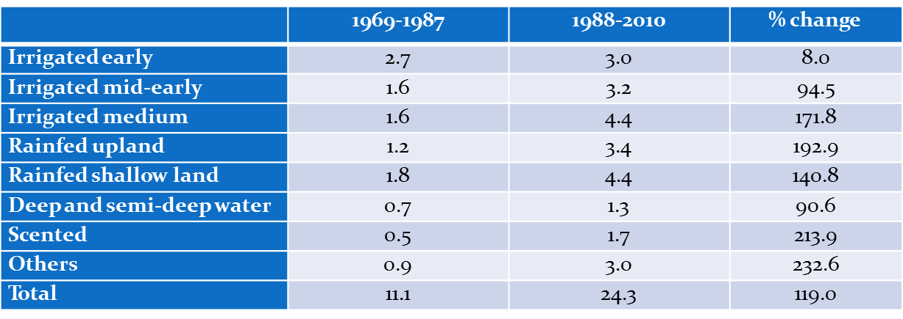
Rice varieties (No./annum)

Slide 24
Summing Up
Droughts have become more frequent but less intense
over time.
Drought adversely affects crop production; their impact has weakened over time.
Irrigation, drought-tolerant varieties and other adaptation strategies have played an important role in mitigating the harmful effects of droughts on rice yields.
Need for innovations in irrigation management and agronomic practice for improving irrigation efficiency
  Laser levelling
  DSR
  AWD
  Irrigation scheduling (tensiometer)
  Micro irrigation
  Conservation tillage

Slide 25
Thank YOU

